Slide 1

Temporary Pedestrian Process Facility at Calexico West Port of Entry in Calexico, California
Environmental Assessment
Osmahn Anthony Kadri
NEPA Program Manager
Virtual Public Scoping Meeting, July 13, 2021

Slide 2
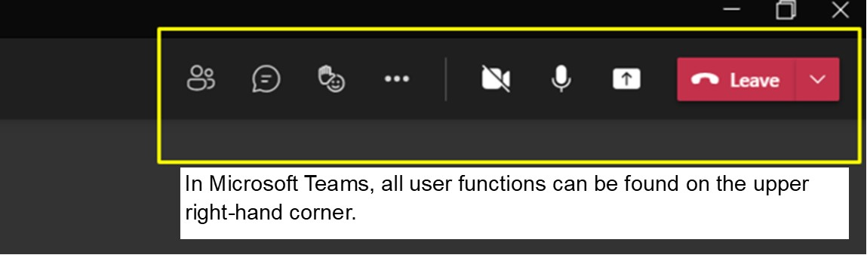
Accessing Teams “Raise Hand” and “Chat” functions for Q&A session

Slide 3
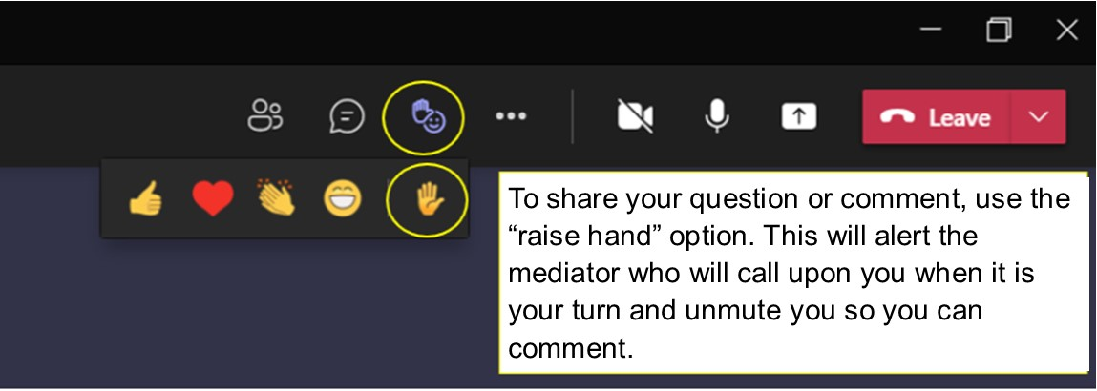
How to use “Raise Hand” function during Q&A session

Slide 4
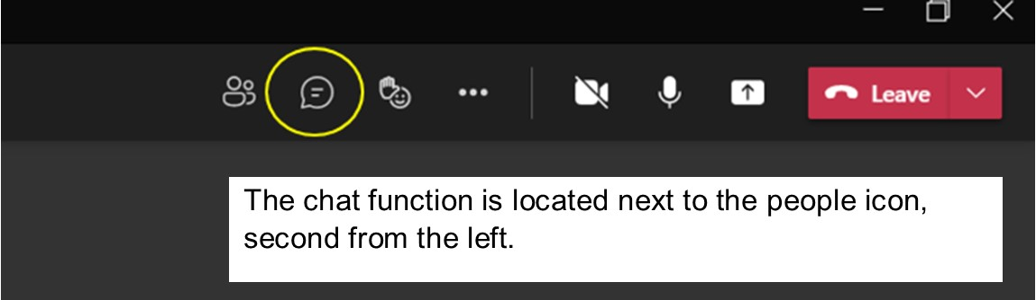
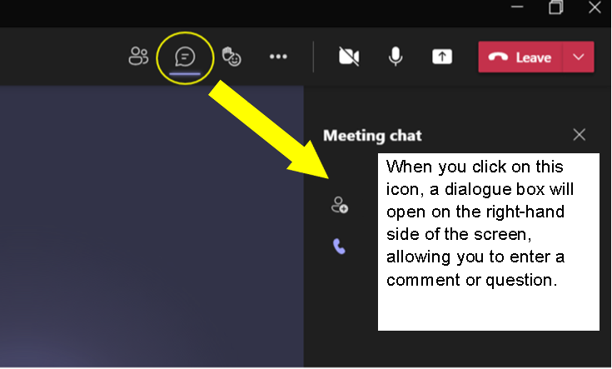
How to use “Chat” function

Slide 5

Meeting Agenda
Introduction to GSA
Environmental Assessment objectives
Topics for public comment
Project purpose and need
Project description
How to submit comments
Q&A session
Closing

Slide 6
Introduction to Public Building Services (PBS) and GSA
Serves other civilian federal agencies, who use GSA programs to provide workspace, furnishings at best value to the American taxpayer
Acquire space through new construction, leasing, maintaining federal properties nationwide
Own, lease more than 8,800 assets
Maintain more than 370 million square feet of workspace for 1.1 million federal employees
Preserve more than 500 historic properties

Slide 7
Scoping Meeting objectives
Gather public questions, comments about the proposed alternatives for Calexico West Land Port of Entry (LPOE) Temporary Pedestrian Process Facility

Slide 8
Environmental Assessment objectives
GSA has determined that an Environmental Assessment (EA) would need to be prepared to evaluate the significance of potential impacts resulting from proposed project
Council on Environmental Quality (CEQ) regulations provide guidance on the preparation of EA and define significance

Slide 9
Environmental Assessment objectives
National Environmental Policy Act (NEPA) of 1969
Provides interested public, agencies opportunity early in planning process to:
  Provide input
  Identify issues
  Offer solutions
GSA is lead agency for this EA

Slide 10
Environmental Assessment objectives
What is included in EA:
  Need for proposed project
  Alternatives considered
  Environmental impacts of each alternative
  Findings – determine if there is significant impact

Slide 11
Some environmental resources considered in EA
Air Quality/Climate Change
Cultural and Paleontological Resources
Environmental Justice
Farmlands – Prime or Unique
Floodplains
Land Use
Migratory Birds
Minerals
Native American Religious Concerns
Noise and Sensitive Receptors
Recreation
Public Health and Safety
Socioeconomic
Soils
Threatened or Endangered Species
Travel Management
Vegetation
Visual Resources
Wastes – Hazardous or Solid
Water Quality – Drinking or Ground
Weeds – Invasive and Non-native
Wetlands/Riparian Zones
Wild and Scenic Rivers
Wild Horses/Burros
Wilderness
Wildlife

Slide 12
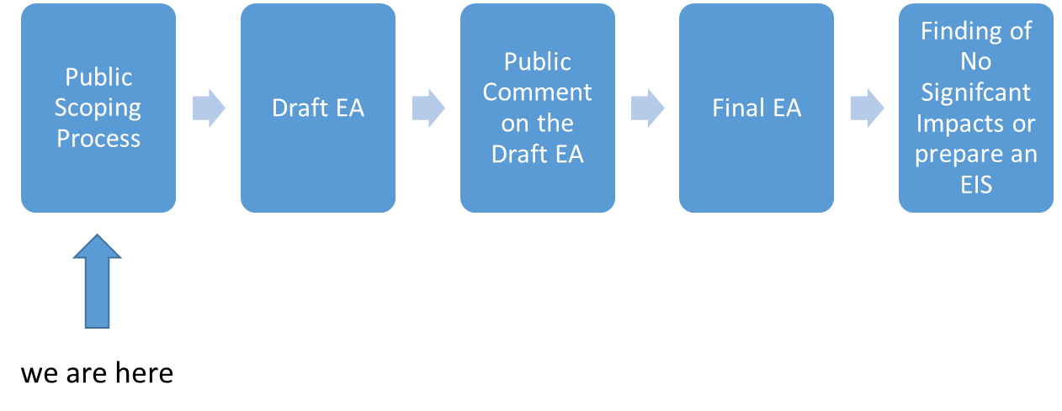
Environmental Assessment process overview

Slide 13
Topics for public comment
Observances about occurrence of protected species near project
Suggestions on ways to minimize traffic delays during construction
Comments about alternatives, environmental issues to be discussed in Draft Environmental Assessment
Suggestions about cultural resource data sources, applicable types of identification

Slide 14
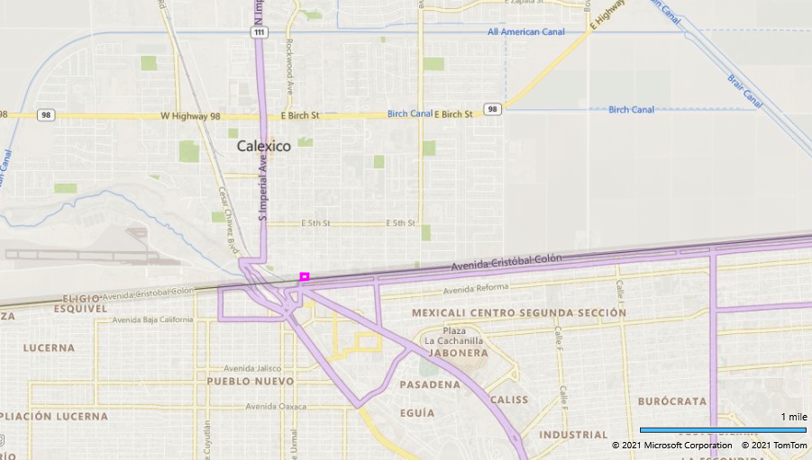
Calexico West Land Port of Entry Temporary Pedestrian Process Facility
Approximate Site Location

Slide 15
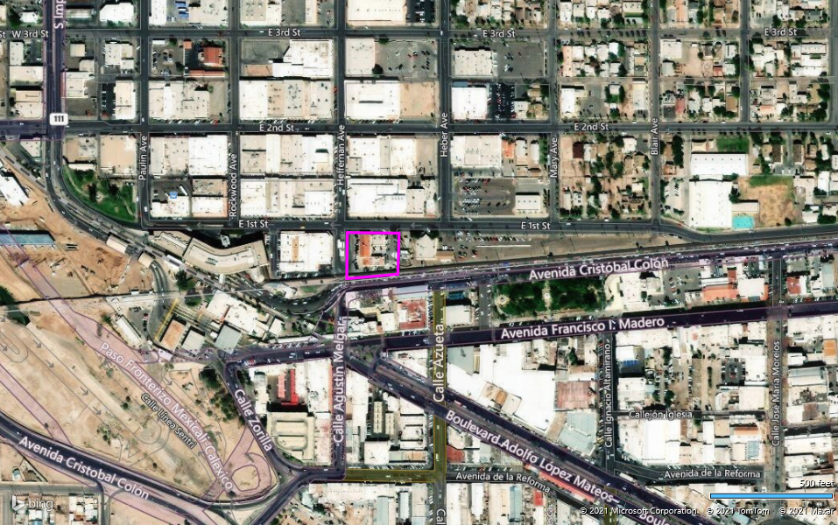
Calexico West Land Port of Entry Temporary Pedestrian Process Facility
Approximate Site Boundary

Slide 16
Calexico West LOPE Temporary Pedestrian Process Facility Project
Purpose and Need
  Construct a temporary pedestrian processing facility to be used by the United States Customs and Border Protection and partner agencies in Calexico, California
  While current facility, existing structures are demolished, new structure installed for Customs and Border Protection and Immigration and Customs Enforcement
Objective
  Ensure continued services for those crossing between the United States of America and Mexico while new facility is installed

Slide 17
Proposed project information
Proposed temporary facility located adjacent to Historic Customs House at 340 East 1st Street
Temporary, premanufactured modular building facility anticipated to be located on Heffernan Road
  South of East 1st Street
  West of Historic Customs House
Facility requires acquisition of Heffernan Road to south of East 1st Street

Slide 18
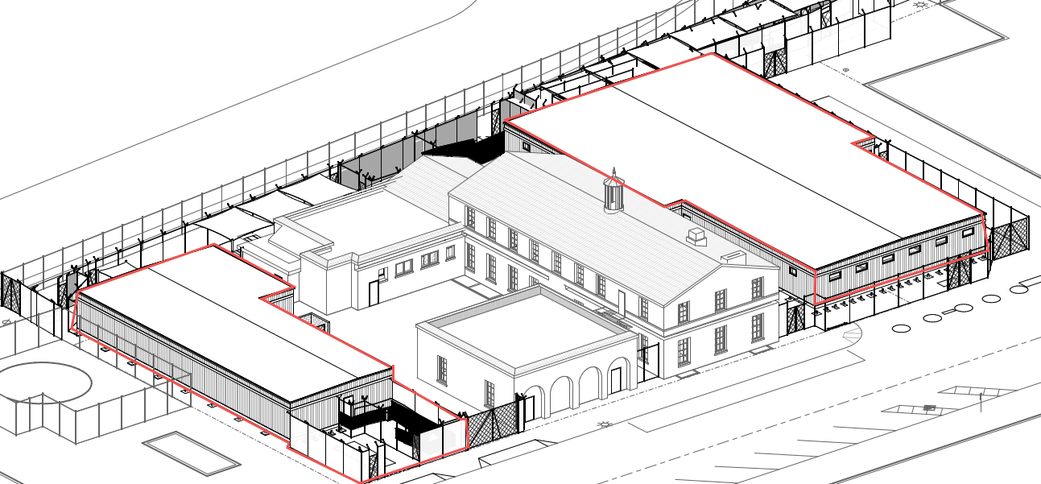
Proposed building rendering

Slide 19
Proposed project information
Two facilities will be approximately 8,804 square feet
Includes:
  Fire lane to west
  Shaded pedestrian ramps leading to/from building
  Pedestrian pick up/drop-off areas on north side
  Secured sally port
  Secured outdoor shaded ancillary area

Slide 20
Proposed project information
Interior of building includes:
  Wait areas
  Administrative offices
  Interview rooms
  Property storage
  Inspection areas
  Processing areas
  Restrooms

Slide 21
Proposed project information
Includes installation of one-story, pre-manufactured modular building
Structure will be used for the purpose of pedestrian processing at the Land Port of Entry

Slide 22
Alternative No. 1
Install Calexico West Land Port of Entry (LPOE) Temporary Pedestrian Process Facility, associated infrastructure
Structure will be used for pedestrian processing at LPOE
Building would be installed on portion of Heffernan Avenue, parking area to west of Customs House
No change in personnel staffing

Slide 23
Alternative No. 1
Construction likely to impact:
  Parking
  Loading/unloading merchandise for retail facility west of proposed temporary building
  Traffic flow along East 1st Street during construction

Slide 24
“No Action” Alternative
Assumes temporary facility would not be built
Operations in current facility would continue under current conditions

Slide 25
How to submit public comments
Public comments, questions accepted via:
  Email: osmahn.kadri@gsa.gov
  Snail mail:
  Attn: Ms. Bianca Rivera
  355 South Euclid Avenue, Suite 107
  Tucson, AZ 85719
Deadline: July 30, 2021
Public notification regarding project will continue:
  In Calexico Chronical
  On project website: https://www.gsa.gov/about-us/regions/welcome-to-the-pacific-rim-region-9/land-ports-of-entry/calexico-west-land-port-of-entry/calexico-west-lpoe-environmental-review

Slide 26
Q&A session
After meeting, email osmahn.kadri@gsa.gov with questions, comments

Slide 27
Thank you!
Public comments, questions accepted via:
  Email: osmahn.kadri@gsa.gov
  Snail mail:
  Attn: Ms. Bianca Rivera
  355 South Euclid Avenue, Suite 107
  Tucson, AZ 85719
Deadline: July 30, 2021

