Slide 1

Developing Effective Responses to Requests for Proposals (Part 1) - Beginners
GSA & APEX ACCELERATORS WEBINARS
March 7th, 2023

Slide 2
Agenda
What is an RFP?
Am I Eligible?
Gather Proposal Information
Ask Questions!
Build a Response Schedule
Draft Your Response
Review Your Response
Submission
Post Submission
Finn Kreidler, APEX Accelerator
Email: fkreidler@nystec.com
Website: https://igniteuny.com/ptac

Slide 3
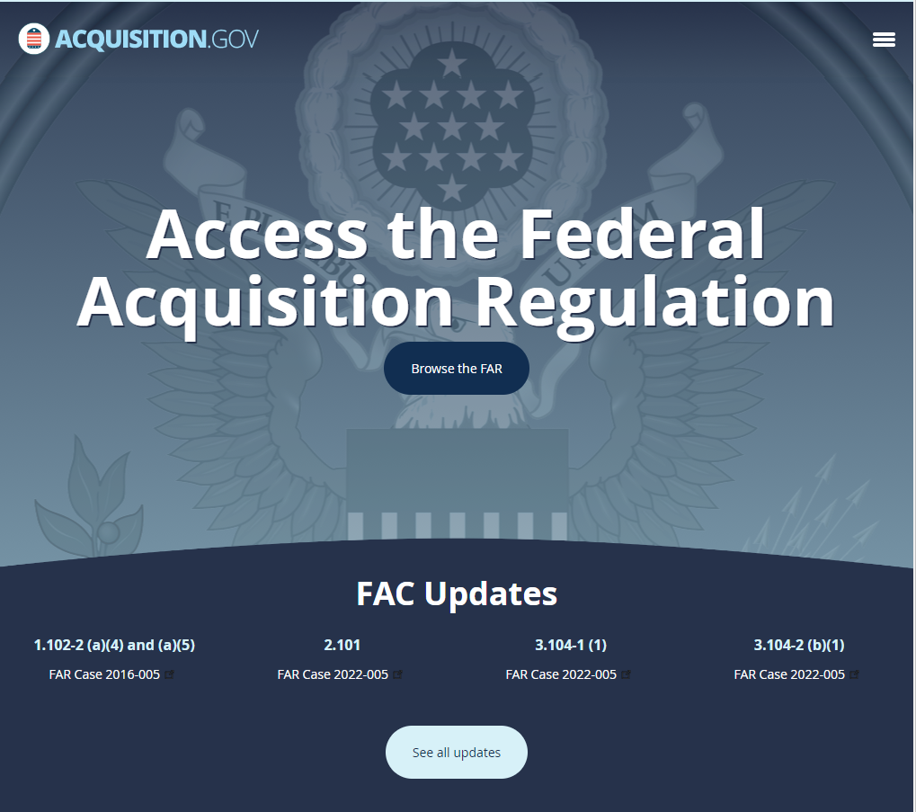
What is an RFP?
48 CFR § 15.203 – Requests for proposals.
  “Requests for proposals (RFPs) are used in negotiated acquisitions to communicate Government requirements to prospective contractors and to solicit proposals. RFPs for competitive acquisitions shall, at a minimum, describe the -
  (1) Government's requirement;
  (2) Anticipated terms and conditions that will apply to the contract. The solicitation may authorize offerors to propose alternative terms and conditions…
  (3) Information required to be in the offeror's proposal; and
  (4) Factors and significant subfactors that will be used to evaluate the proposal and their relative importance.”

Slide 4
What is an RFP?
Market Research
Acquisition Strategy
Draft RFP
RFP Release
Question Due Date
RFP Due Date
Evaluation/Clarifications
Contract Award
Still Important
Our Focus Today

Slide 5

Am I Eligible?
Is this contract a set-aside?
  If the set-aside is partial, do I need to find a subcontractor?
Can I perform the required work?
  Read the Section C Statement of Work (SOW) or Performance of Work Statement (PWS)
Do I have time to craft a proposal response?
  Sometimes you may find a contract too close to the deadline, but make sure to check addendum for extensions

Slide 6
Gather Proposal Information
Uniform Contract Format (FAR 15.204-1)
  SF-33 – Solicitation, Offer, and Award Document
  Section A – Procurement information, POCs
  Section B – Supplies or Services and Pricing/Cost
  Section C – Statement of Work (SOW) or Performance of Work Statement (PWS)
  Section D – Packaging and Marking
  Section E – Inspection and Acceptance
  Section F – Deliveries or Performance
  Section G – Contract Administrative Data
  Section H – Special Contract Requirements
  Section I – Contract Clauses/General Provisions
  Section J – Attachments
  Section K – Reps and Certs/Statement of Offerors
  Section L – Proposal Preparation Instructions
  Section M – Evaluation Criteria
Not all RFP are formatted the same, especially at the State or Local level
Read the whole RFP
  Prioritize Section L and Section M to frame your reading around crafting your response
Check for Supplemental Postings
  Addendum or Q&A, any additional notices

Slide 7

Ask Questions!
Ask the POC designated in Section A of the RFP
  It is better to reach then to wait until submission
  RFP Drafts can have mistakes
Ask your local APEX Accelerator!

Slide 8
Build a Response Schedule
Written Proposal – will need time to…
Draft the Technical Volume.
    Explain how you will meet the needs expressed in the SOW or PWS
Draft the Management Volume.
    Explain how you will manage the solution you have proposed
Draft the Past Performance Volume.
    Explain your relevant (sometimes relevant is even defined in the RFP) past performance to show previous success
Draft the Cost Volume.
    Explain how much this proposed solution will cost
Other Time Intensive Activities
Gathering all required documents.
    Legal documents, certification documents, past performance documents, etc. may be required
Determining Pricing
Working with subcontractor (if applicable)
Miscellaneous activities such as site visits

Slide 9

Draft Your Response
Provide a clear solution to the problem the RFP is addressing
  Your response should demonstrate a clear understanding of the issue
  Your solution should be clearly laid out and understandable to your audience
Do Not Overextend
  Do not promise more than you are capable of
  Do not overcomplicate your response – less is more
Price Your Work Fairly
  You need to make money
  The government needs to understand why your services are priced as they are

Slide 10

Review, Review, Review
Always leave time to review your RFP
  New sets of eyes are necessary
  Double check for addendum or additional Q&A
  Conduct a sample evaluation using Section M

Slide 11

Submission
Submit using the correct vehicle and format
  Is it a PDF via email? Are you submitting via mail?
Submit Early
  Account for mail delays
  Account for corrupted files
  Account for email bounce back
Look for Submission Confirmation

Slide 12

Post Submission
Keep track of the expected award date
If you lose, request a debrief
If you win, celebrate!

Slide 13
Questions?
Finn Kreidler, APEX Accelerator
Email: fkreidler@nystec.com
Website: https://igniteuny.com/ptac

