Slide 1


Employee Express (EEX) Guide
Earning and Leave Statements (ELS)

Slide 2
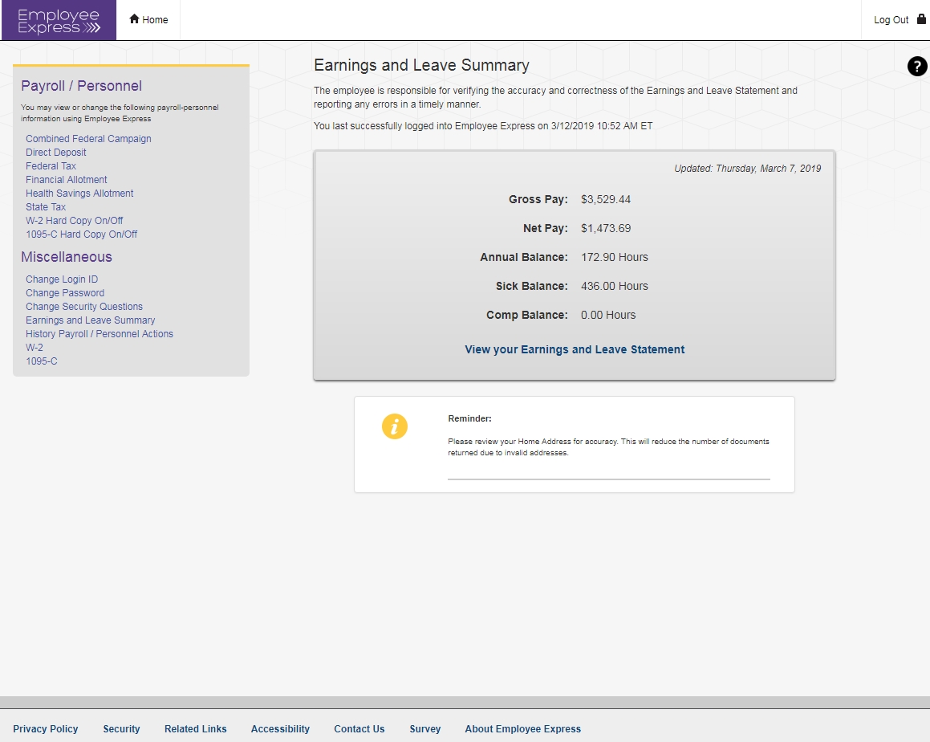
Once you have logged in to EEX, you will see this home page. From this page, click on “View your Earnings and Leave Statement”.

Slide 3
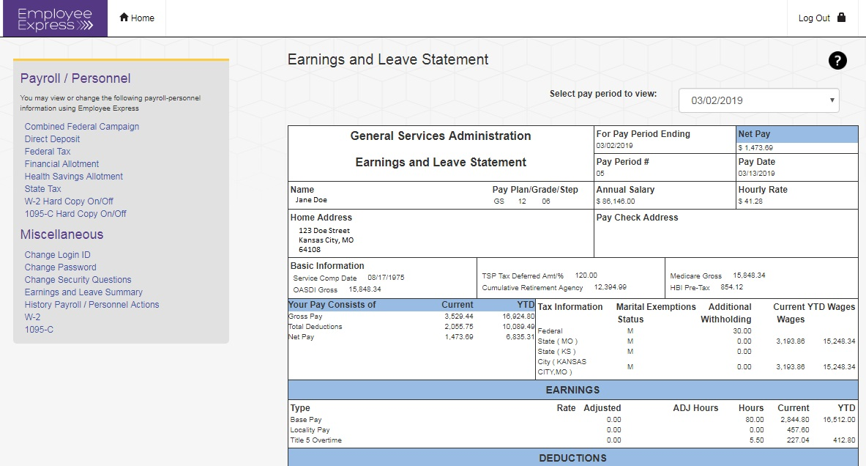
From this page, choose the ELS pay period you want to view by clicking on the drop down menu.

Slide 4
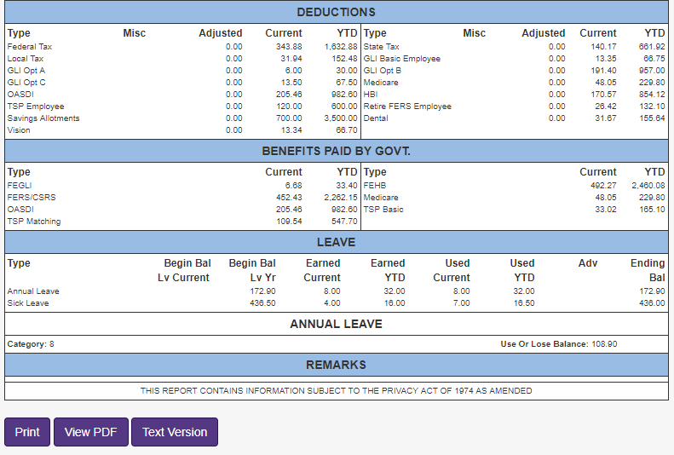
Once you have the ELS opened, you may navigate to the bottom of the page to print as is, view and print as a PDF document or view and print as a text version.

