Slide 1

FY2026 Exhibit 54
Guidelines
www.gsa.gov/exhibit54

Slide 2

Exhibit 54: PURPOSE
Tool used for assisting agencies in completing their Space Budget Justifications
Basis for Annual Rent Payments
PY : Current GSA Rent Bill + Anticipated
Inventory Changes after 3/15/2024
  CY & BY : GSA Base Rent Estimate + Anticipated Inventory Changes
  BY+1 : Automatically calculated using
  BY Budget Request x OMB CPI +
  Anticipated Inventory Changes

Slide 3
OMB Fiscal Year Naming Convention
Template color coding descriptions:
PY = 2024 Fiscal year
CY = 2025 Fiscal year
BY = 2026 Fiscal year
BY+ 1 = 2027 Fiscal year

Slide 4
Statement of Use
NOTE: The GSA Rent Estimate calculations, the GSA Anticipated Inventory Changes file and the modified Exhibit 54 template are provided to assist you in completing your Space Budget Justification report.
However, the user of this information is ultimately responsible for the accuracy of their Agency Budget Request.
We strongly recommend that you thoroughly review all of the data in these files and to make all necessary adjustments for any errors or omissions on our part that may have occurred in the compilation of this data.

Slide 5
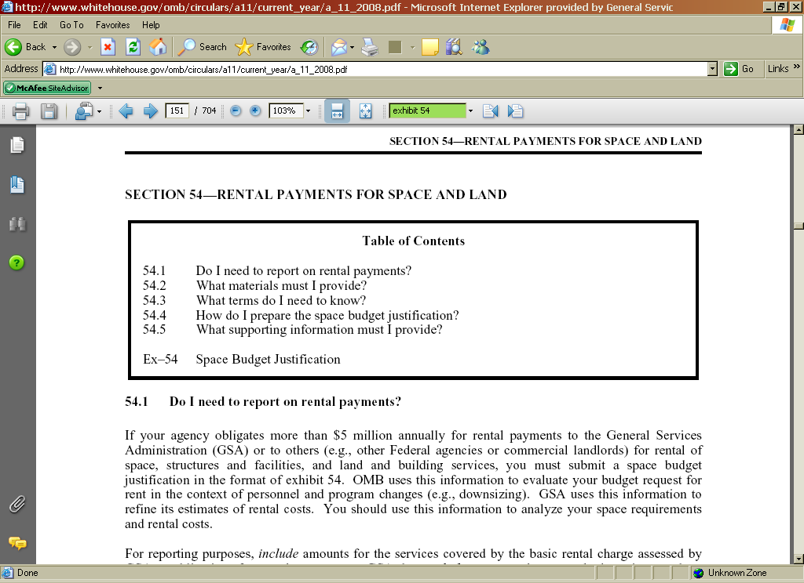
OMB Circular A-11, Section 54
OMB provides detailed requirements for Exhibit 54 submissions in the Circular A-11, Section 54 – Rental Payments for Space and Land
The A-11 will address budget/policy type requirements. This presentation will focus on actions within the Microsoft Excel template itself.

Slide 6
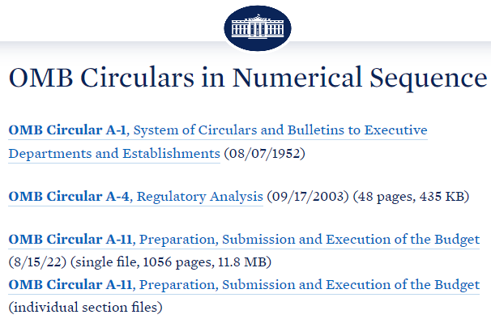
Accessing the A-11 and Section 54
Link to complete A-11 document:
https://www.whitehouse.gov/wp-content/uploads/2018/06/a11.pdf
Exhibit 54 excerpt:
https://www.whitehouse.gov/wp-content/uploads/2018/06/s54.pdf

Slide 7

Exhibit 54
STOP!
Did you know GSA provides PREPOPULATED exhibit 54 files for each bureau within your agency?
The same email containing your agency’s Rent Estimate (subject line “[your agency] Rent Estimate from GSA”) includes a .zip file with a separate Exhibit 54 excel file for each bureau that pays rent to GSA.
Note that some attachment limits/security features may remove the .zip file from the email you receive – reach out to the POCs provided on the last slide if the .zip doesn’t come through.
If you would prefer to populate a blank template Exhibit 54, continue to the next slide, otherwise jump ahead to Step 2

Slide 8
Accessing the Exhibit 54 template
The Exhibit 54 template and guidelines are available at this link:
https://www.gsa.gov/exhibit54

Slide 9
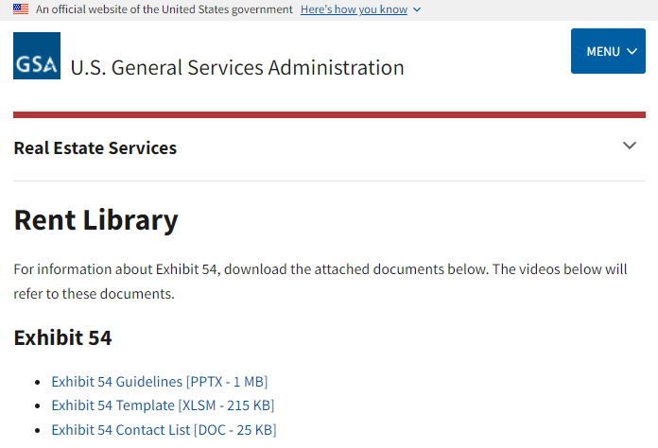
Accessing the Exhibit 54 template
Download the Exhibit 54 Template:

Slide 10
Required Files to Complete Exhibit 54
From the GSA website:
Blank Exhibit54 template
From the GSA Rent Estimate delivery**
Base Rent Estimate file (save to your PC)
Anticipated Space Changes file (save to your PC)
**The Rent Estimate is delivered to the agency POCs on our distribution list. If you would like to be added to the distribution for your agency, or need a copy of a current or previous Rent Estimate, please email gsa.pbs.revenue.division@gsa.gov with your name, agency/bureau, and email address.

Slide 11
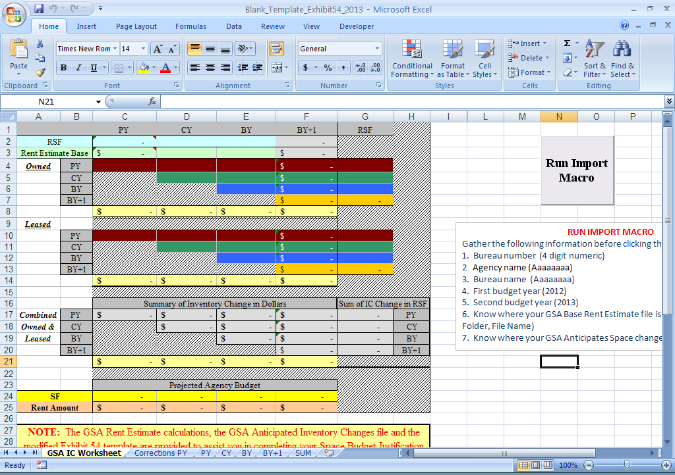
Blank Exhibit 54 Template
A simplified template was created which will automatically populate all tabs within the template
When opening the template in MS Excel, click “Enable Macros” if prompted
If you don’t receive a prompt when opening the file, you may need to enable in Excel Options → Trust Center → Macro Settings

Slide 12
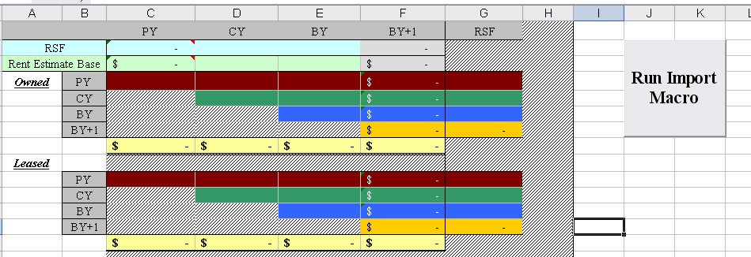
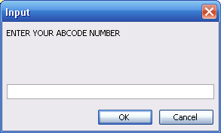
Step 1: GSA IC Worksheet
On the GSA IC Worksheet tab:
1. Click “Run Import Macro” button
2. Enter information at prompts (Agency A/B Code, Agency Name, Bureau Name)

Slide 13
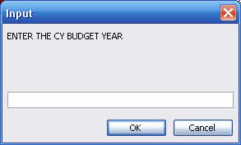
Step 1: GSA IC Worksheet (continued)
3. At prompt, enter your CY Budget Year (2025)
4. Enter your BY Budget Year (2026)
5. Next, you’ll be prompted for the Base Rent Estimate & Anticipated Space Change files
6. The macro will pull in all necessary data from the GSA provided files and populate the table on the GSA IC Worksheet
7. The next step is make any necessary adjustments or corrections to the GSA data (if no adjustments are necessary, the Exhibit 54 is complete!)

Slide 14
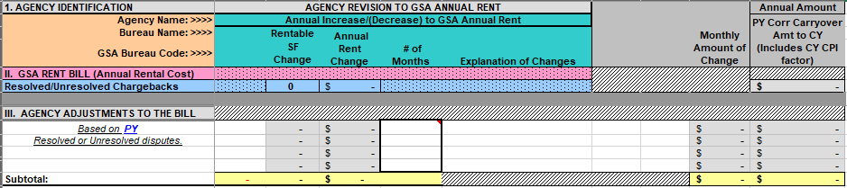
Step 2: Corrections & Adjustments
Use the PY Corrections tab to adjust for incorrect billing amounts in the March 2024 GSA rent bill, if needed
This can include chargebacks/disputes, but should not include missed billings
  (GSA may have already captured a missed billing with the Anticipated Space Changes. If not, a missed billing should be captured on the ‘PY’ tab)
Enter identifying information, the GSA bill amount, and your restated/corrected amount
  Hint: some columns contain tool-tips with instructions
The sheet will calculate the prorated adjustment for PY and the portion to carry-over into subsequent years

Slide 15
Step 2: Corrections & Adjustments (continued)
Use the PY, CY, BY and BY+1 tabs to adjust or add planned space changes, if needed
Most commonly, these will be space releases (or additions!) that GSA did not have a record of in the Anticipated Space Changes file
  You may also be correcting for an updated effective date, sqft, or rate for a space change
Same as the Corrections tab, you’ll need to enter identifying information, the existing data elements from the GSA files (if not null), and your restated amounts for Effective Date, sqft, and annual rent
  Again, the tool-tips will provide additional instructions for some columns
The template will calculate the net adjustment to apply to the year in which you’re adjusting AND any portion to carryover to subsequent fiscal years

Slide 16
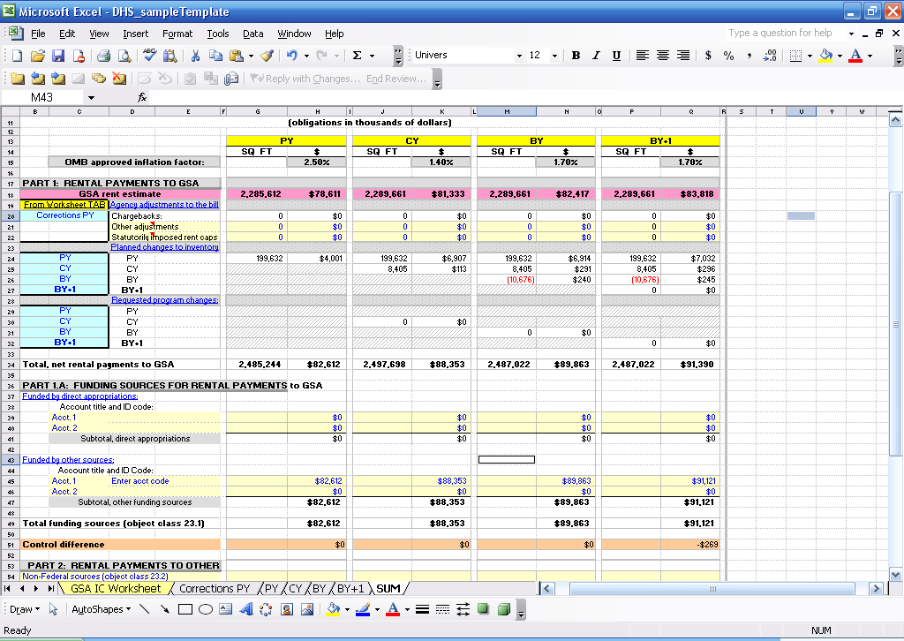
SUM Tab
This worksheet summarizes the information entered from the previous worksheets and provides opportunity for entry of additional information regarding sources of funds for rental payments to GSA and rental payments to others, which should be included in your budget request.
Only the yellow shaded areas require entries. The remaining cells will be calculated automatically. Control Differences should be $0

Slide 17
Exhibit 54 Summary
Recap:
  GSA IC Worksheet
  - Populated by the macro using data from the GSA Rent Estimate
  - Rows 24 & 25 add the Base and Space Change data together to calculate the total sqft and rent estimate amounts from GSA
  - No inputs required
  PY Corrections Tab
  - Include corrections for incorrect billings from the March 2024 rent bill & Charge-backs,
  - Do not include missed billings
  PY, CY, BY, BY+1
  - Enter discrepancies or omissions found in the provided BRE and Anticipated Space Change files
  SUM Tab
  - Summarizes data from all tabs, combining the GSA data with any/all adjustments made in the other tabs
  - Opportunity to incorporate funding sources

Slide 18
Total Workplace FIT
GSA’s Total Workplace Initiative FIT (Furniture & Information Technology) allows agencies to lease furniture over a 5-year term and lease information technology over a 3-year term, easing the burden of costs while giving agencies the furniture and technology they need to build a more efficient government.
If you plan to fund this from object class 23.1, it must be included in your Exhibit 54 on Row 33 of the SUM Tab

Slide 19
Total Workplace Experts (POCs)
PBS Chief Total Workplace Officer
Charles Hardy
Director, Total Workplace Program Management Office
charles.hardy@gsa.gov
Region 6
Jane E. Schuster
Interior Designer
jane.schuster@gsa.gov
Region 7
Becky Parham
Workplace Program Specialist
rebecca.parham@gsa.gov
Region 1
David Krassnoff
Leadership Initiatives Manager
david.krassnoff@gsa.gov
Region 2
Jean Keane
Senior Interior Designer
jean.keane@gsa.gov
Region 3
Nancy Sebastiano
Project Manager
nancy.sebastianowoloszyn@gsa.gov
Region 8
Jonna Larson
Mobility Program Manager
jonna.larson@gsa.gov
Region 9
Stacey Fong
Project Manager
stacey.fong@gsa.gov
Region 10
James Truhan
Workplace Program Specialist
james.truhan@gsa.gov
Region 11 (NCR)
Stephanie Leedom
Lead Architect
stephanie.leedom@gsa.gov
Region 4
John “JD” M. Dennis
Director gPM
johnm.dennis@gsa.gov
Region 5
Ronnie Bent
Workplace Program Specialist
ronnie.bent@gsa.gov

Slide 20
Antenna Charges
Some tenants have Antenna charges included on their monthly rent bills. These amounts are not Rent (Object Class 23.1) and are only included on the rent bill as a mechanism for processing through IPAC. The Antenna amount, which is not included in the Total Rent Amount, should be included under Object Class 25.3 in your OMB budget submission. The Antenna Amount should not be reported on Exhibit 54.

Slide 21
Exhibit 54: Points of Contact
GSA’s Rent Estimate team can be contacted at the following inbox:
gsa.pbs.revenue.division@gsa.gov

