Slide 1

Federal LCA Commons for Buy Clean
Peter Arbuckle, USDA-ARS-NAL
GSA GAP FAC
February 22, 2024

Slide 2
Executive Summary
Theory of Change
EPDs and the Nutrition Label Analogy
Federal LCA Commons is a Community of Practice and Data Repository
Knowledge Management and Background Data

Slide 3
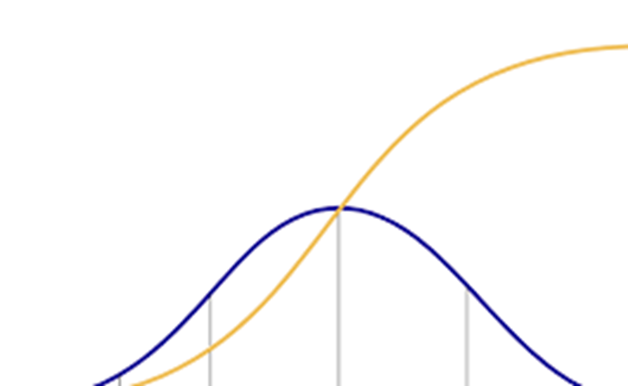
Theory of Change* and Innovation Diffusion
Context of Environmental Information and Labeling
Emerging Requirements, Qualitative Analysis, Enhancing Data & Identifying Hotspots
Improved Standardization, Measurement, & Reporting
Reliable Market and Product Information
Strong Market Demand Signals
Major Industrial Changes
Major Impact Reductions
Market Uptake
*Source: Alison Kinn, EPA
Adoption

Slide 4
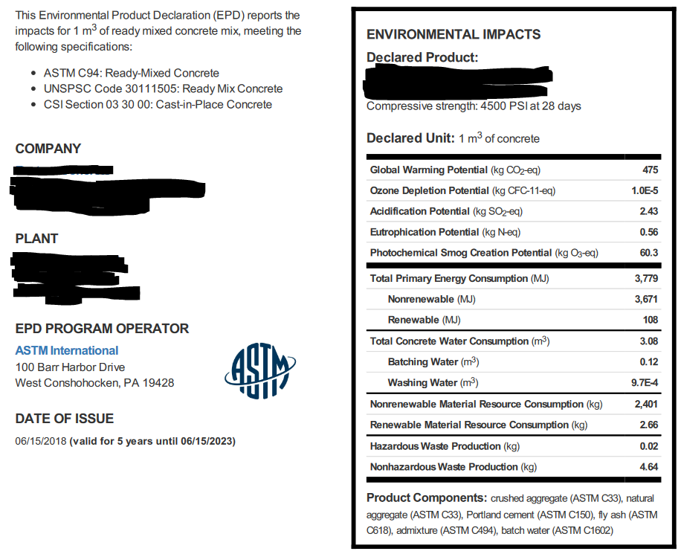

Environmental Product Declarations (EPDs)?
“Nutrition Labels for Products”
Or to be precise, EPDs are a specific form of LCA result.
The NAL hosts the National Nutrient Database and Food Data Central, the foundational data product for nutrition labels. The LCA Commons can provide the foundational data for EPDs.

Slide 5
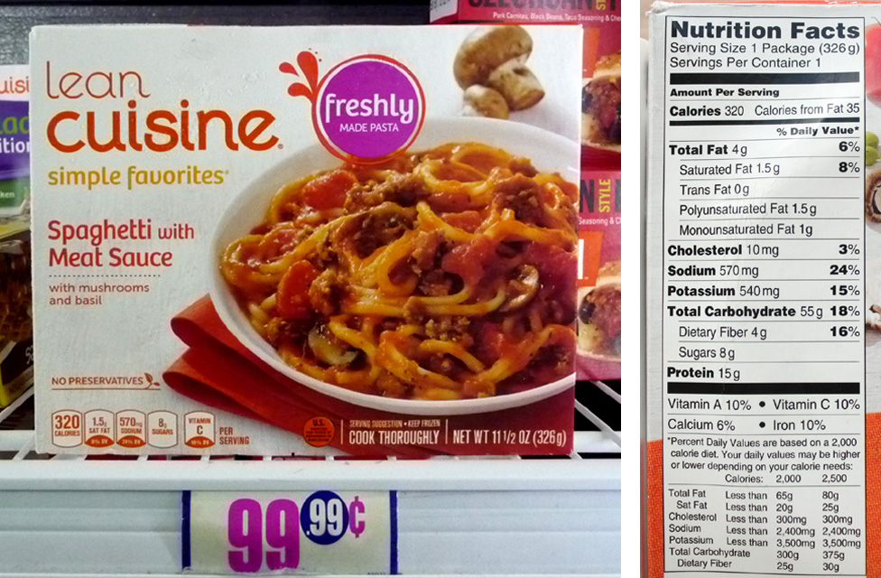
The Nutrition Label Analogy
This Photo by Unknown Author is licensed under CC BY

Slide 6
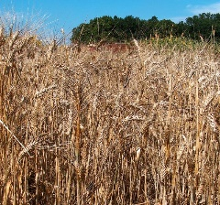

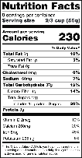

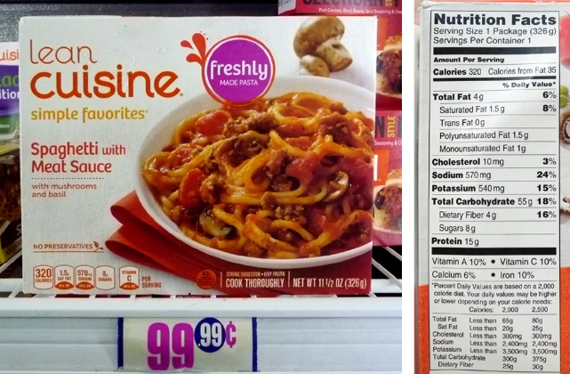



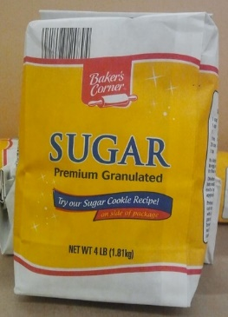
The Nutrition Label Analogy
This Photo by Unknown Author is licensed under CC BY-NC-ND
This Photo by Unknown Author is licensed under CC BY-NC

Slide 7
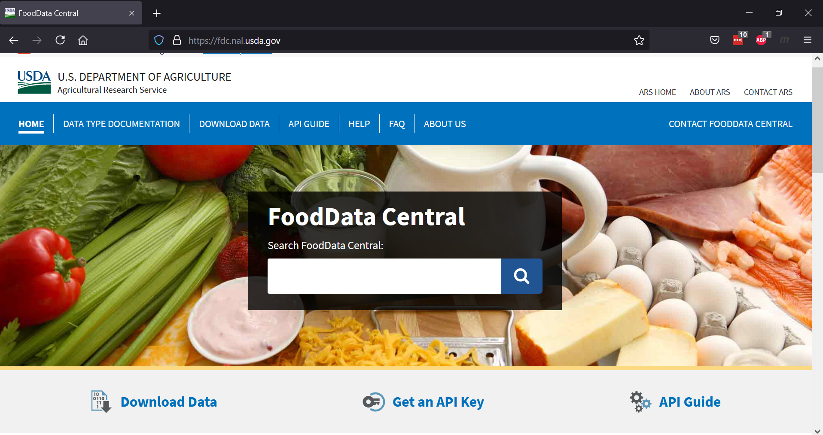
The Nutrition Label Analogy: Why does this work?
Inter-agency collaboration
Collaboration: FDA, USDA, NIST and Industry on Policy, Science, Standards and Measurement, and Data Management
https://fdc.nal.usda.gov/

Slide 8

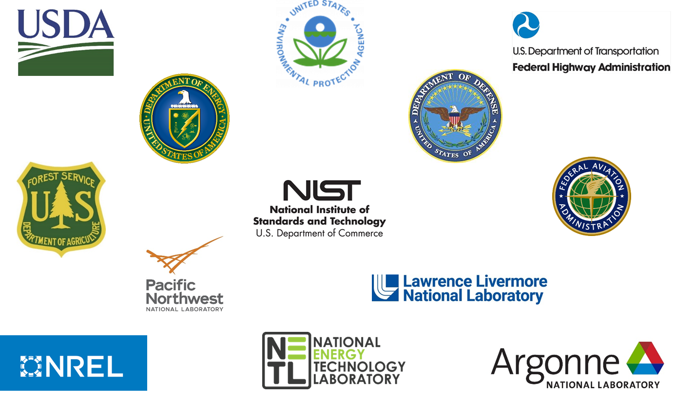
The Federal LCA Commons
Collaboration between Federal Agencies to advance LCA
Our Mission:
  Advance LCA data, research and information systems
  Improve modeling methods consistency
  Enhance public access to Federal LCI data
https://www.lcacommons.gov/memorandum-understanding-0

Slide 9












Community of Practice
Research and Methods
Knowledge Management
Whole building LCA analysis tools
Open access data repositories and publication workflows
Tools and resources for interoperability and data reuse
Model and Data development
Energy supply chains
Energy generation and transmission
Transportation systems
Waste management
Environmental impacts
Construction materials
Carbon capture and storage
Agricultural production
Knowledge Management
LCA Deployment and Policy Support
Use of LCA in pavement design and procurement through FHWA LCA PAVE tool
Guidance and technical reviews of LCA in support of Internal Revenue Service 45Q tax credit
Conduct LCAs for DOE, Loan Program Office greenhouse gas analysis loan requirements
Policy and Deployment

Slide 10
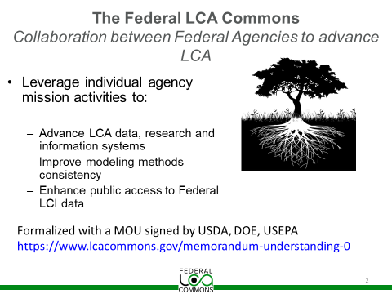
Work Products to Increase Consistency and Access
US Electricity Baseline: Consistent Background Models
Elementary Flow List: Consistent Elementary Flows and LCIA
Data Management Platform
www.lcacommons.gov

Slide 11
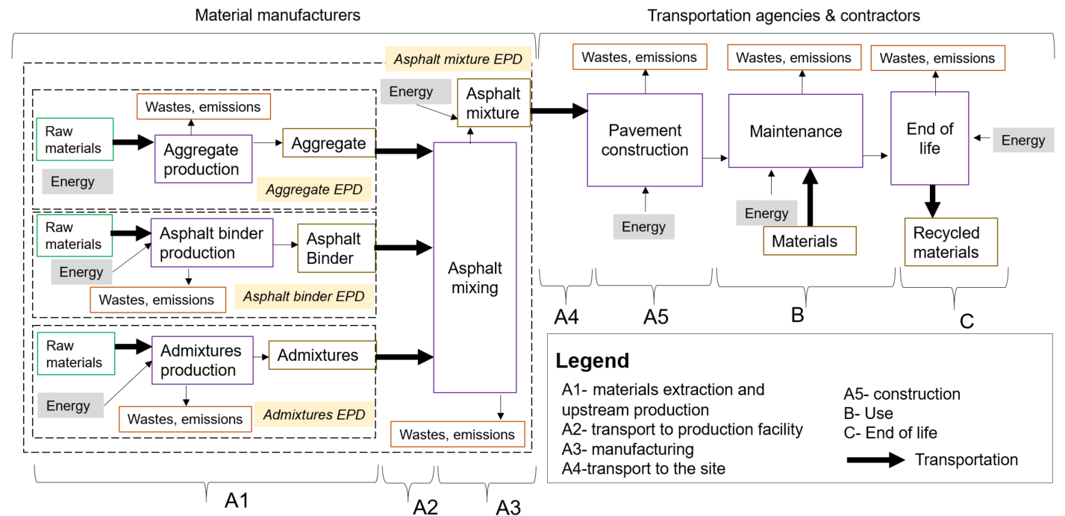
Background Data
Certain datasets go into everything

Slide 12
Important Federal Commons Background Data
Fossil fuels production and use
Electricity generation and transmission
Transportation
Waste management
Background data are a critical Public Good
Inconsistent Background Data:
Makes LCA results un-comparable
Distorts the impact of product design decisions
Many EPDs use privately generated background data which:
Require a fee-based license
Are not always transparent
Are not always temporally or geographically representative

Slide 13
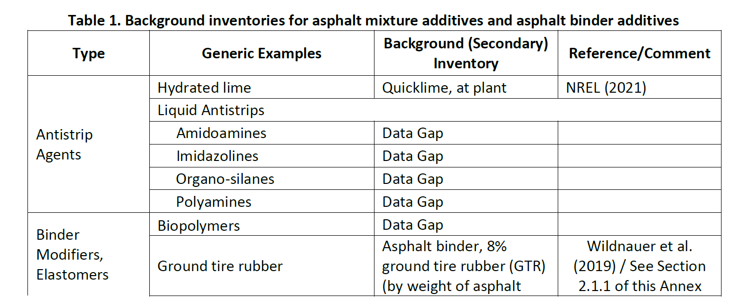
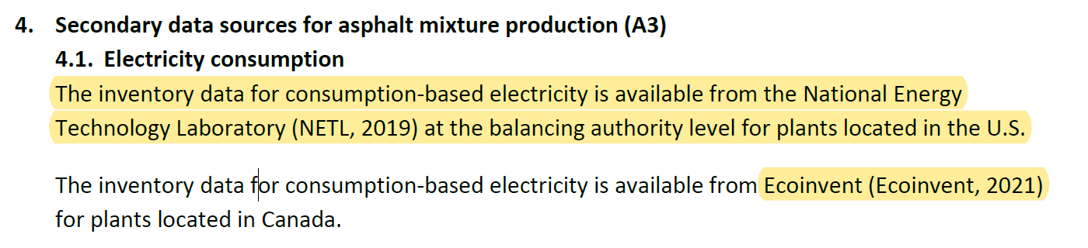
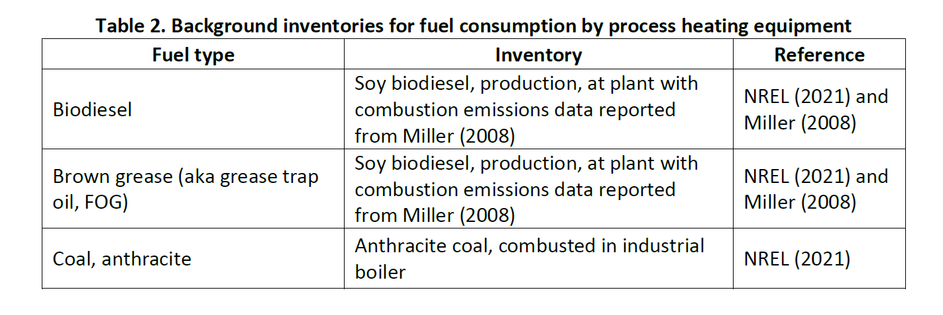
Current use of LCA Commons
Background Data Opportunities
National Asphalt Pavement Association (NAPA) Asphalt Mix Product Category Rule (PCR) specifies model and prescribes Background Data
NREL
c. 2000
c. 2007
NREL 2021 does not yet integrate NETL 2019 Electricity Baseline
c. 1998

Slide 14
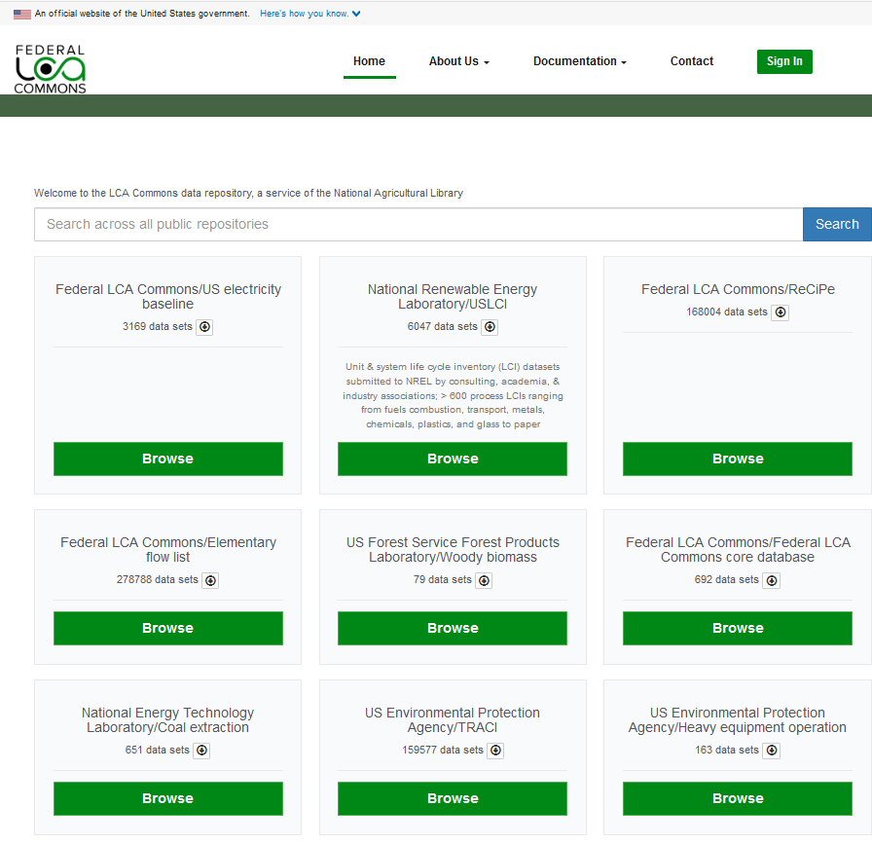
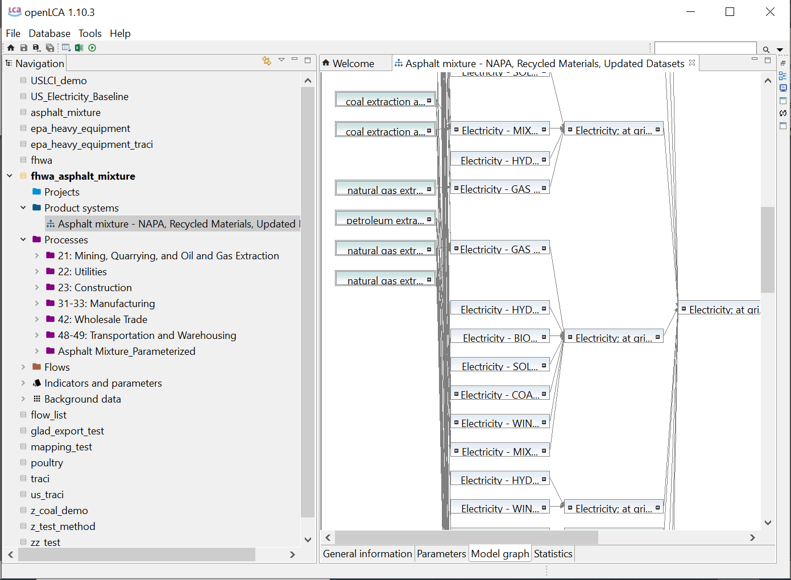
Federal LCA Commons Knowledge Management
Open Data Services
Integrated open data workflow
Metadata services
Interoperability and reuse guidance and standards

Slide 15
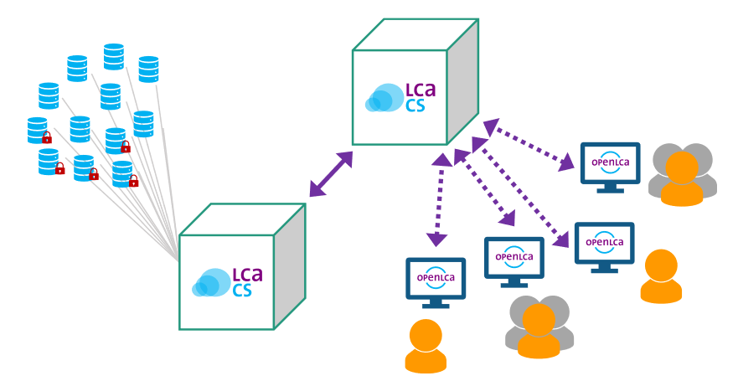


Federal LCA Commons Knowledge Management
Open Data Services
Managing community data and reference models
INDEPENDENT APPS
e.g. EPD Creation
Common data model and machine-readable exchange formats are critical
Public Access to Data and Models
API
Sector specific LCA modeling and reporting
Research groups and Background
data sources
Internal Data Curation and Management
Graphic source: greendelta

Slide 16









Federal LCA Commons Knowledge Management
Open Data Services
Background Data
Libraries
PCR Model Repositories
e.g. Asphalt
Modeling Software
Waste
EPA
Electricity
DOE-NETL
Research Groups/Data Providers
Transportation
DOE/DOT
e.g. Steel

Slide 17










LCA Commons Role
Labels
Background Data
Data and Informatics Best Management Practices
Product Specific Modeling/Data
*
  *US LCI is part of the Federal LCA Commons.

Slide 18
Summary
LCA Commons plays a key role in providing transparent, standardized and accessible foundational data and infrastructure to help industry develop EPDs.
We have come a long way, but there is still a long road ahead…interagency collaboration and support is critical to bring diverse expertise and perspectives to overcome challenges related to consistency and standardization.
Informatics infrastructure is critical to developing, maintaining, and sharing background data over the long-term.

