Slide 1
GSA Acquisition Policy Federal Advisory Committee (GAP FAC)
Public Meeting
May 22, 2024

Slide 2
WELCOME !
GSA Acquisition Policy Federal Advisory Committee - GAP FAC
Boris Arratia
Designated Federal Officer
Stephanie Hardison
Deputy Designated Federal Officer

Slide 3
Member Roll Call
Notes:
Take slides down after shown

Slide 4
Opening Remarks
Troy Cribb, GAP FAC Chair
Robin Carnahan, GSA Administrator
Jeff Koses, GSA Senior Procurement Executive
Notes:
Take slides down after shown

Slide 5
Agenda
Acquisition Workforce Subcommittee Recommendation
Industry Partnerships Subcommittee Recommendation
Policy and Practice Subcommittee Recommendation
Public Comment
Vote on Recommendations
Closing Remarks

Slide 6
Recommendations Introduction
Cassius Butts, GAP FAC Co-Chair
Notes:
Take slides down after shown

Slide 7
Overview of Recommendations
Acquisition Workforce Subcommittee
Amplify GSA’s Sustainability Change Acceleration Strategy
Industry Partnerships Subcommittee
Adopt Life-Cycle Management for Innovative Entrants
Policy and Practice Subcommittee
Adopt a Principles-Based Sustainability Data Framework

Slide 8
Acquisition Workforce Subcommittee
Nicole Darnall, Chair
Anne Rung, Co-Chair
Notes:
Take slides down after shown

Slide 9
Acquisition Workforce Subcommittee
Members
Nicole Darnall, Chair, Arizona State University
Anne Rung, Co-Chair, Varis
C. Gail Bassette, Bowie State University
Darryl Daniels, Jacobsen Daniels Assoc.
Mark Hayden, New Mexico Retiree Health Care Authority
David Malone, AquireIQ
Steve Schooner, George Washington University
Kristin Seaver, General Dynamics Information Technology
Clyde Thompson, GovStrive LLC
Notes:
Thank members.
The members bring different perspectives - in research and academia, industry, government, with applications in supply chain issues, procurement, and other areas.
This diversity is reflected in subcommittee’s tasks, priorities, and our recommendations as a whole.

Slide 10
Acquisition Workforce Subcommittee Mission & Priorities
MISSION
To empower and equip the Federal Acquisition Workforce to prioritize environmental outcomes and promote sustainability throughout the acquisition lifecycle.
PRIORITIES
Identify the essential pathways needed to make sustainability considerations a core competency in Federal acquisitions.
Identify the critical levers needed to empower the acquisition workforce to prioritize sustainability with the least amount of effort.

Slide 11
Who We Engaged – 1st Recommendations (May 2023)
GSA
Focus Group – Acquisition Workforce “Frontliners” Focus Group (5)
Focus Group – Acquisition Workforce Contract Officers, Program Managers (10)
Nicholas West – Acting Director, Office of Acquisition Policy, Integrity & Workforce Office of Government-wide Policy
Nicole Acevedo – Division Director, Acquisition Workforce Division
Jeff Koses – Senior Procurement Executive
Brennan Conaway – Branch Chief Acquisition Policy Division Office of Policy and Compliance Federal Acquisition Service
Danielle Mouw – Procurement Analyst, ITAWG Lead
Bea Dukes – Acquisition Career Manager/Strategic Acquisition Advisor
Notes:
1st Recommendations: 24 speaker interviews, presentations, discussions (GSA)

Slide 12
Who We Engaged – 1st Recommendations (May 2023)
Environmental Protection Agency
Holly Elwood, Senior Advisor, Environmentally Preferable Purchasing Program
Stephan Sylvan, Senior Policy and Program Advisor, Government-wide Category Management Program
Federal Acquisition Institute – Christine Heibeck, Learning & Development Program Mgr.
Office of Federal Procurement Policy – Joanie Newhart, Associate Administrator for Acquisition Workforce Programs
State and Local Government – Environmental Procurement Leaders
Danielle Hinz, formerly Chief Procurement Officer, King County, WA
Charleen Fain, Engineering Branch Chief, Procurement Division, Dept. General Services, State of California
Julia Wolfe, Director of Environmental Purchasing, Commonwealth of Massachusetts
White House Council on Environmental Quality – Katy Newhouse, Dir. for Sustainable Operations - Supply Chain, Office of the Federal Chief Sustainability Officer
Notes:
1st Recommendations: 24 speaker interviews, presentations, discussions (EPA, FAI, OFPP, State/local, CEQ)

Slide 13
Who We Engaged – 2nd Recommendations (Dec 2023)
GSA Tech Tools + Data (end purchasers)
Michael Bloom, High-Performance Green Buildings Program Advisor
Brennan Conaway, Procurement Analyst
Michael Cooper, Product Manager for GSA Advantage & eTools Systems - Federal Govt. Acquisition & Technology Services
Stephen Baker, E-Commerce Modernization - Catalog Management Office
Kehinde Odebo, IT Specialist Program Manager
GSA Category Management
Warren Blankenship, Program Manager for the IT Category
Denise Elsbernd, Deputy Category Manager for the Facilities and Construction Category
Bowen Fong, Management Analyst
Kelly Seacrist, Agency Engagement, Category Management, Member of IT Category team
Environmental Protection Agency
Holly Elwood, Senior Advisor, Environmentally Preferable Purchasing Program
Jenni Romer, Deputy Assistant Administrator for Pollution Prevention
Notes:
2nd Recommendations – Engaged a suite of 20 experts (across 5 agencies – GSA, EPA)...

Slide 14
Who We Engaged – 2nd Recommendations (Dec 2023)
DOE and DOI PRISM Users
Deshonjla Peterson - DOE, Chair, Federal PRISM Users Group
Ron Blake – DOE, Dir. of IT procurement system of acquisitions management
Jenny Beale – DOE, FPDS, PRISM user
Terri Diehl – DOE, PRISM User
Rebecca Reilly – DOI, Management analyst, PRISM user
IRS – Artificial Intelligence in Federal Purchasing
David Gill - IRS, Procurement Data Scientist
Vendor Perspectives
Steve Noyes - Senior VP, Global Accounts and Public Sector Sales, Clover Imaging
Savannah Kernc - Chief Operating Officer, Document Imaging Dimensions
Artificial Intelligence in Contract Management
Otto Hanson - Founder & CEO, Termscout
Notes:
DOE, Interior, and IRS. We also engaged representatives from the private sector, including vendors and technology developers.

Slide 15
Who We Engaged – 3rd Recommendations (May 2024)
GSA
Nicole Acevedo* – Division Director, Acquisition Workforce Division, Architect for GSA’s Acquisition Talent Development Program
Bea Dukes* – Acquisition Career Manager/Strategic Acquisition Advisor
Jennifer Heno – Program Manager, GSA Acquisition Credentials Acquisition Workforce Division
Kathy Fiedler - GSA Contractor, President, Acclaro Research Solutions, Inc.
Danielle Mouw* – GSA IT Acquisition/Innovation/Workforce Policy - Building a 21st Century Workforce to Meet Mandate of IT Modernization
* Engaged during multiple meetings.
Notes:
16 interviews, 13 individuals across GSA, DOE, NASA, local government, private sector
- GSA’s ITAP, FAC-C Modernization, GSA's Acquisition Talent Development Program, etc.

Slide 16
Who We Engaged – 3rd Recommendations (May 2024)
DOE
Cedar Blazek – Training Program Manager for DOE's Federal Energy Management Program
EcoVadis
John (JB) Bys – Executive Sales Leadership at EcoVadis
NASA
Stephen J. Shiplett – Director, E-Business Systems Office, Enterprise Service and Analysis Division - Office of Procurement
Geoff Sage – Acquisition Innovation Lab, Enterprise Service and Analysis Division - Office of Procurement
Melanie Landers - Project Manager for contract writing system
Fairfax County Government
Nathalie Owen – Sustainable Procurement Team & Zero Waste Team Lead
Christopher McGough – Sustainable Procurement Coordinator
Notes:
16 interviews, 13 individuals across GSA, DOE, NASA, local government, private sector
- GSA’s ITAP, FAC-C Modernization, GSA's Acquisition Talent Development Program, etc.

Slide 17
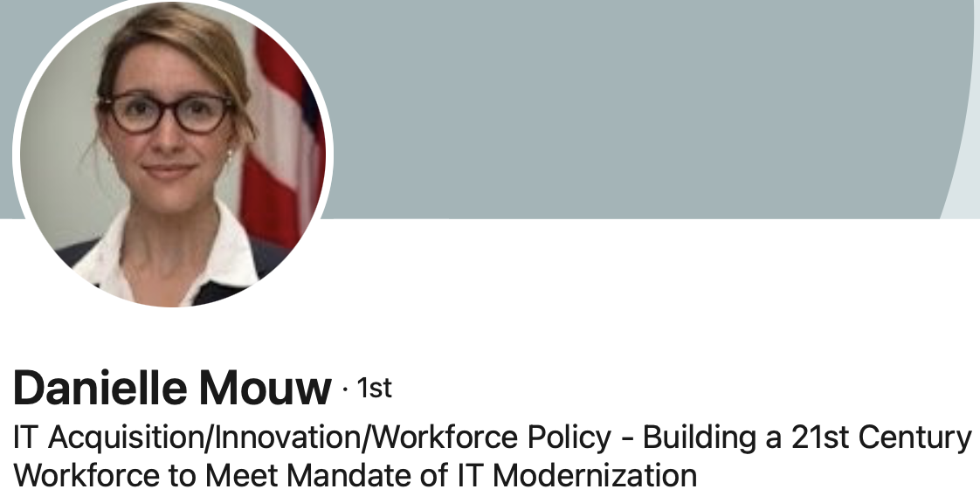
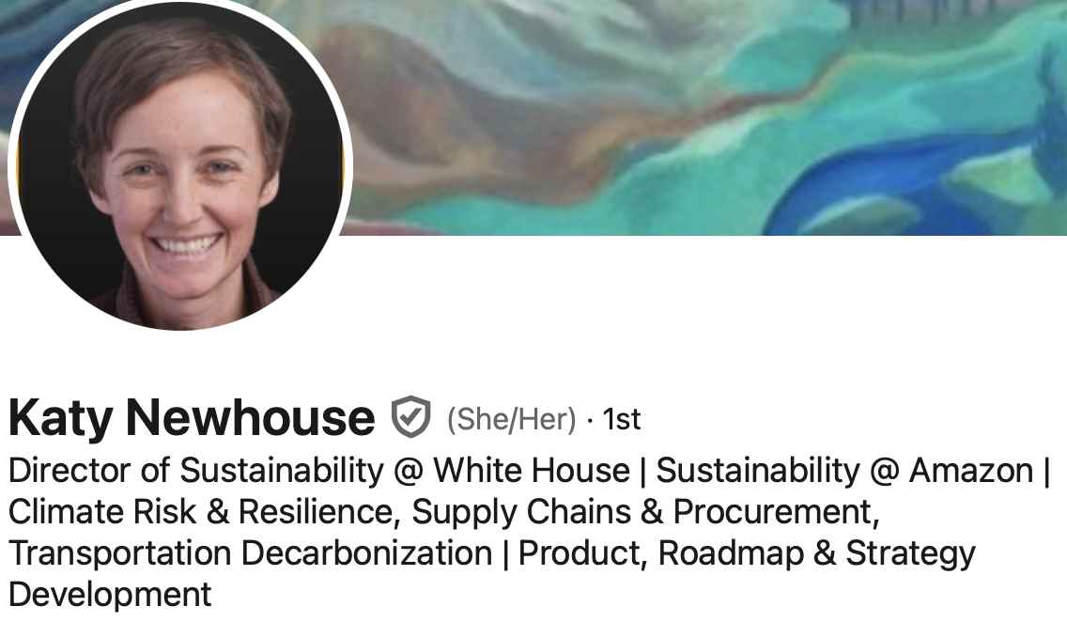
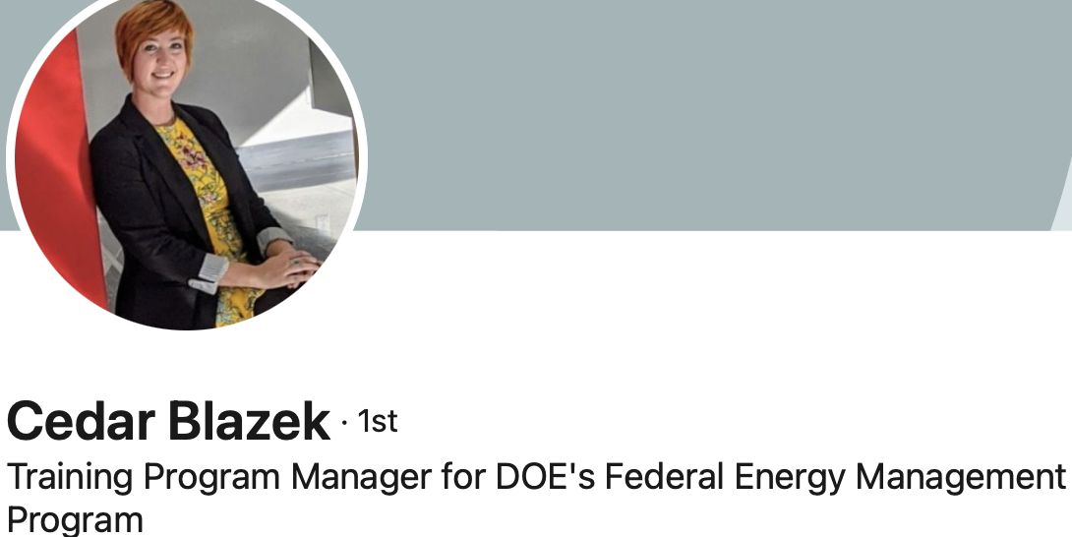
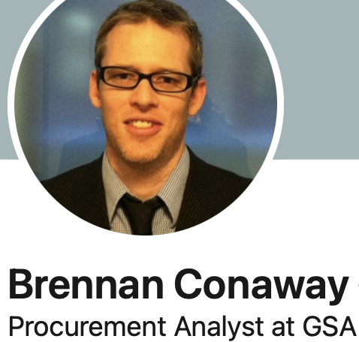
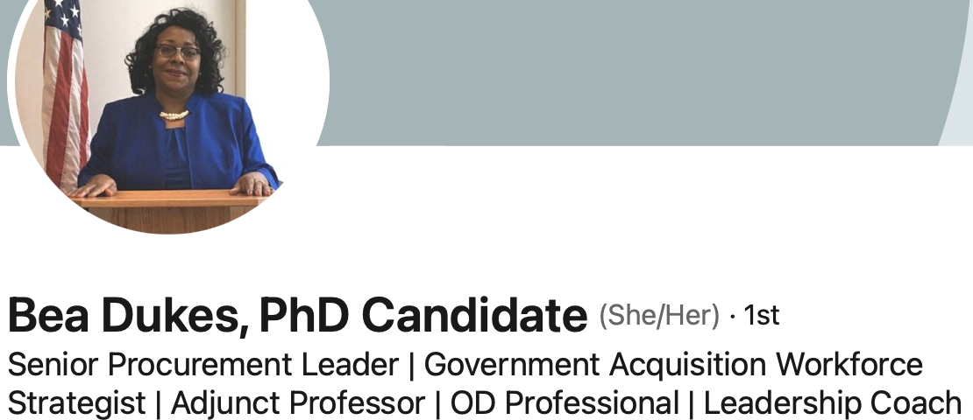
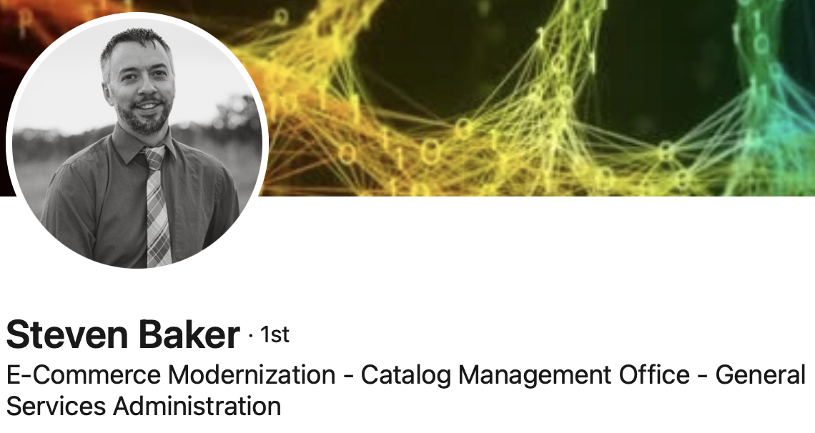
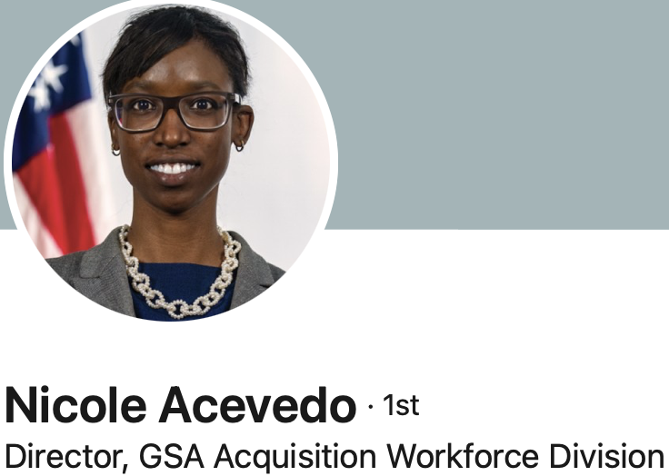
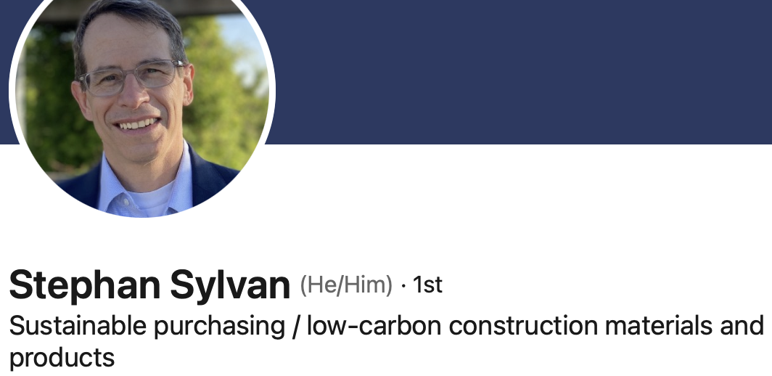
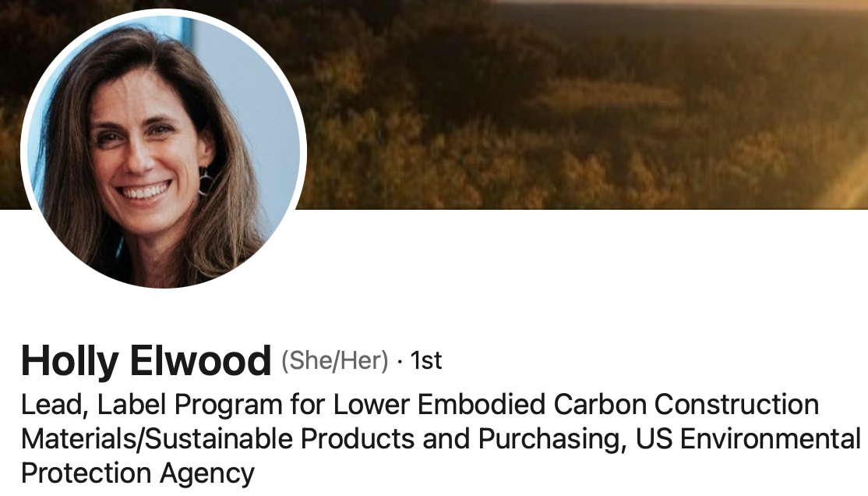
Who We Engaged
Notes:
All our speakers were all important. However, some spoke with us multiple times and/or provided significant materials/guidance to help inform our path.
Wish to recognize their incredible willingness to inform our work.

Slide 18
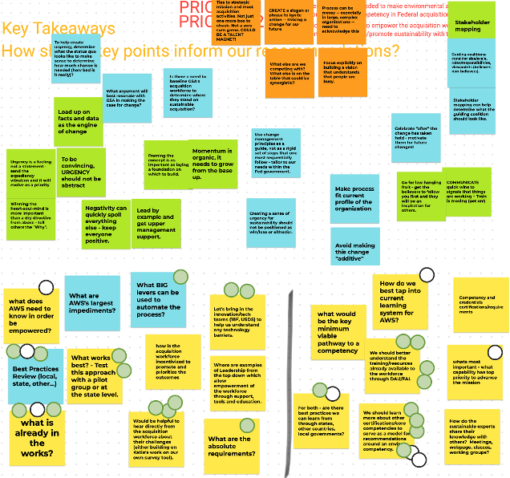
Data
57 speakers
60 interviews
~ 50 hours speaker interviews, presentations, discussions
Collaborative digital whiteboarding
Notes:
Over 1 ½ years we spoke with 57 individuals across 60 interviews
> 50 hours of interviews and interviewee presentations
Collaborative digital whiteboarding was essential for us to organize the information that we were receiving from our speakers around common themes

Slide 19
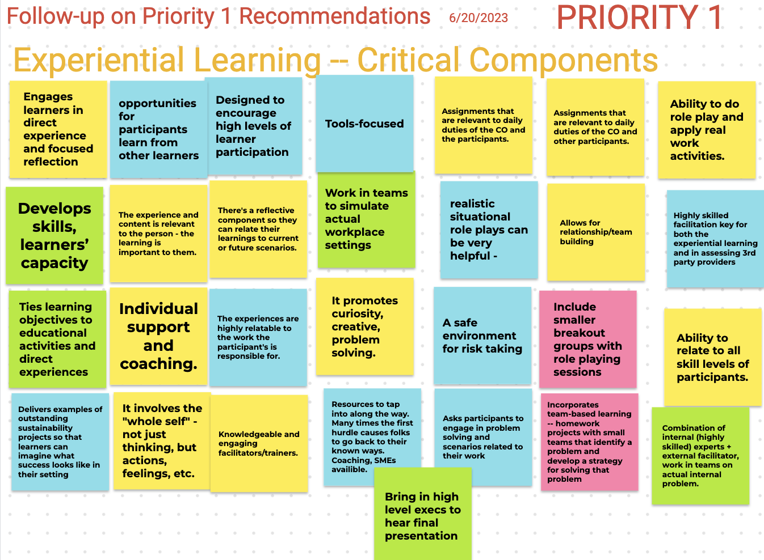
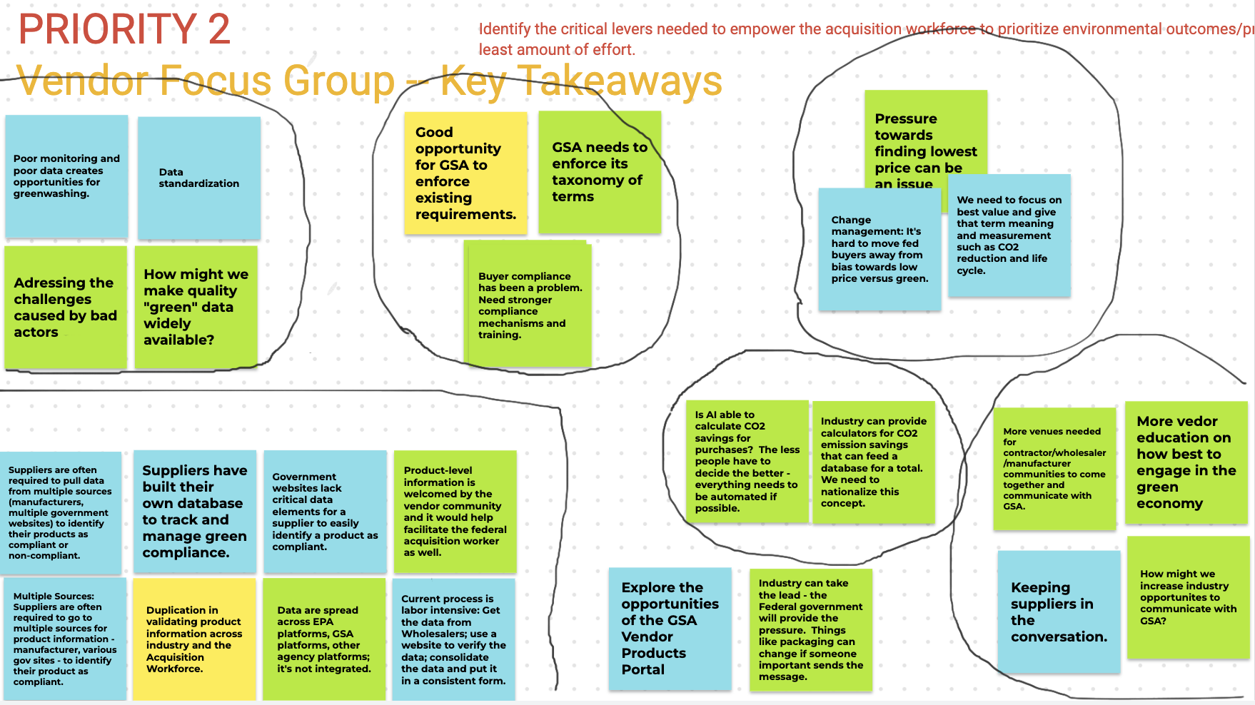
Data
57 speakers
60 interviews
~ 50 hours speaker interviews, presentations, discussions
Collaborative digital whiteboarding
Notes:
Identified pain points, began to understand pathways forward.

Slide 20
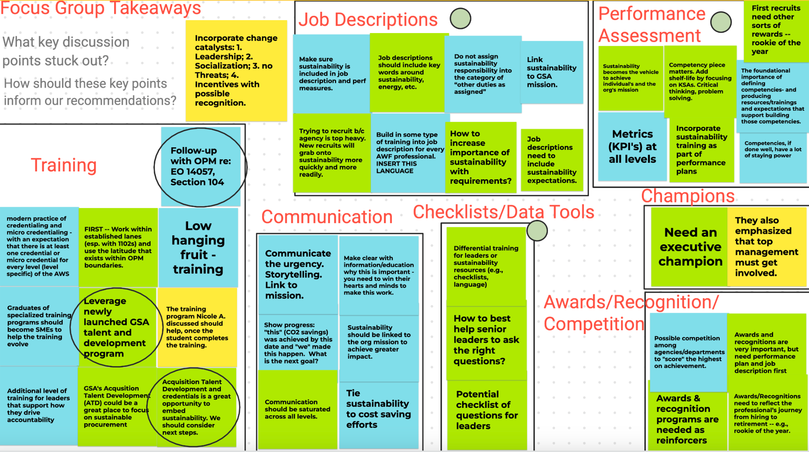
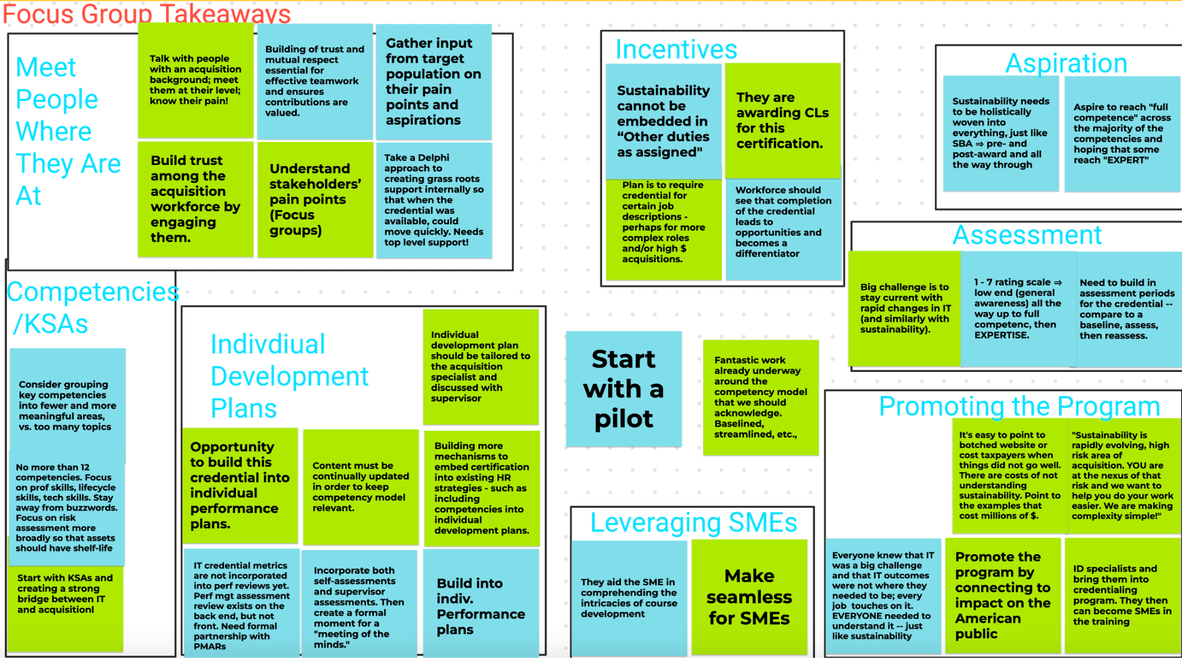
Data
57 speakers
60 interviews
~ 50 hours speaker interviews, presentations, discussions
Collaborative digital whiteboarding
Notes:
All this was done with the central goal of empowering and equipping the Federal Acquisition Workforce to prioritize and promote sustainability throughout the acquisition lifecycle.

Slide 21
Recommendations – 1st
May 2023
1.
Implement a change acceleration strategy
2.
Make sustainability a core, foundational capability across the acquisition workforce
3.
Create acquisition sustainability experts
Notes:
These recommendations related to Priority 1.
Identify the essential pathways needed to make sustainability considerations a core competency in Federal acquisitions.

Slide 22
Recommendations – 2nd
Dec 2023
1.
Third party training selection: Issue a request for information
2.
Emphasize experiential learning
3.
Establish federal data standard and protocols
4.
Convene an artificial intelligence task force
Notes:
Pivoted a bit to think more about tools + levers
Many third party trainers exist.
Five selection criteria for third party trainers:
Reputation and independence
Adaptability and quality
Track record and affordability
Accessibility and continuous learning
Scaling and networking
All training (including training offered by third-party providers) emphasizes experiential learning to foster a deeper understanding of the subject matter.
3 – Issues of accurate, reliable and consistent data are critical to empowering the acquisition workforce to meet the agency’s sustainability goals
We advocated that GSA develop and lead a cross-agency effort to establish a federal data standard and protocols for ecolabel certifications and their utilization.
4. Following the White House’s Executive Order on Safe, Secure, and Trustworthy Artificial Intelligence, and GSA’s recent support of this Executive Order…, GSA should assess how artificial Intelligence (AI) may be an important tool to empower the acquisition workforce to embed sustainability into federal acquisition. As a first step, we recommend that GSA should convene a task force to assess this potential. Other agencies (e.g., IRS and Treasury) have begun this exploration with some success. The GSA Task Force should consider these use cases

Slide 23
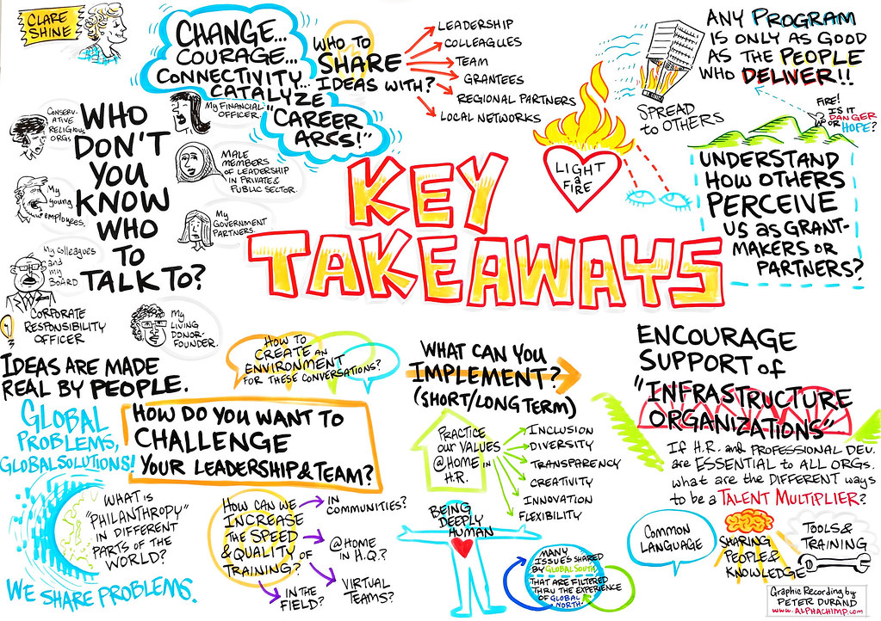
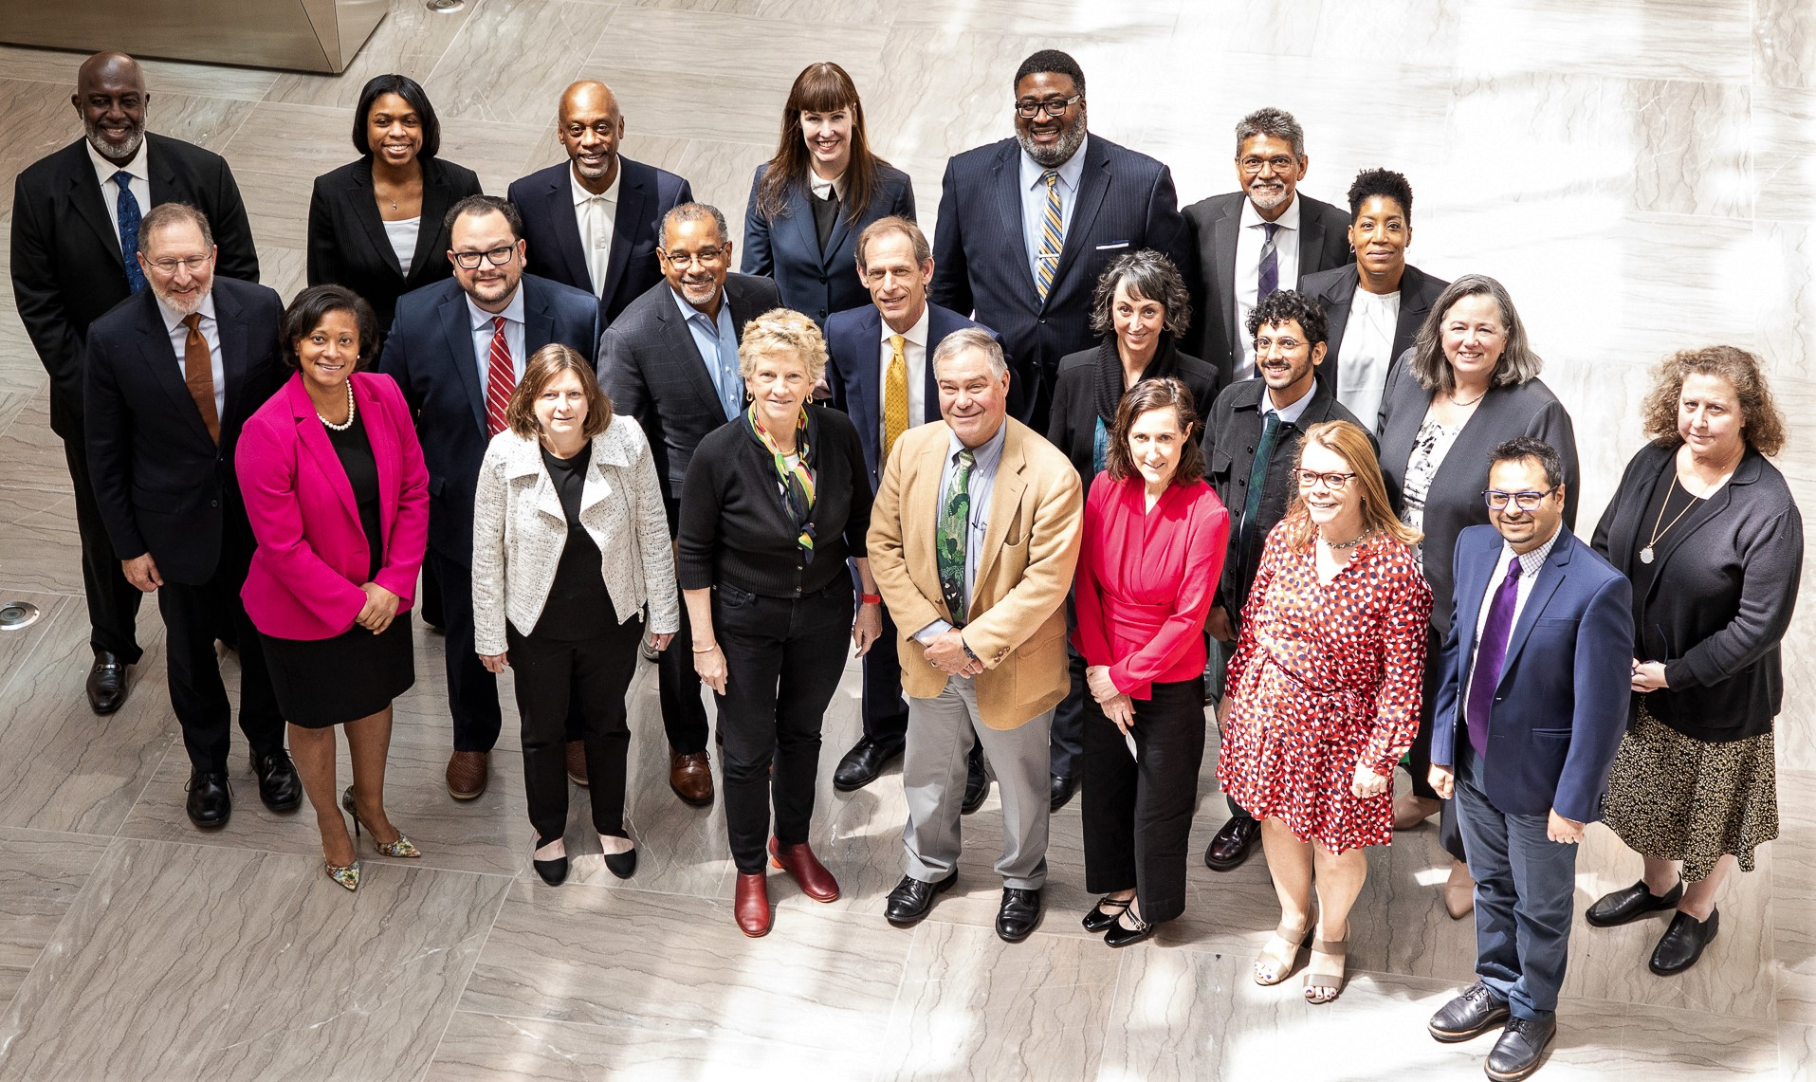
Let the Subcommittee Speak!
Notes:
This has been our journey to date.
David, Kristin, Mark, Clyde, and other members…
Before discussing the subcommittee’s third and final set of recommendations, we want to pause and take a moment to hear from the subcommittee about their key takeaways related to empowering and equipping the Federal acquisition professionals so that they can prioritize sustainability throughout the acquisition lifecycle.
Nicole’s thoughts: One of the most difficult items for us to wrestle with was figuring out (at a high level) what problems we were trying to solve. This took time. It was a little painful! Once we did this, it became easier to focus our efforts. Our strength then came with the experts we engaged. What really impressed upon me – across the 57 experts we engaged – was that related to the Acquisition Workforce, the biggest problem associated with embedding sustainability into the organization was managing and accelerating change and putting in place the important structures needed to support that change.

Slide 24
Recommendation – 3rd
May 2024
3 parts!
Amplify GSA’s
Sustainability Change Acceleration Strategy
Notes:
One overarching recommendation
Comes full circle

Slide 25
Recommendation – 3rd
A.
Integrate Sustainability in Recruitment Strategies
B.
Integrate Sustainability into Performance Assessment Strategies
C.
Develop a Competency-based Sustainability Acquisition Credential

Slide 26
A. Integrate Sustainability in Recruitment Strategies
By emphasizing sustainability in acquisition job descriptions and expectations, GSA can more closely
Align the agency’ broader organizational objectives with its sustainability goals
Attract new talent who are committed to addressing sustainability concerns
Foster a workforce that is poised to embed sustainability into federal acquisition.
Recommend three key approaches:
Integrate sustainability into recruitment announcements
Link sustainability with the agency’s overall mission
Embed sustainability training into GSA’s Acquisition Talent Development (ATD) Program

Slide 27
B. Integrate Sustainability into Performance Assessment Strategies
Foster accountability – ensuring that acquisition professionals meet GSA's sustainability objectives.
Inform decisions – regarding promotions, professional recognitions, and strategic directions, thus further aligning sustainability with GSA's overall mission.
Identify sustainability training needs – ensuring that acquisition professionals possess the necessary skills to excel in their roles and contribute to GSA’s sustainability success.
Recommend four key approaches:
Recognition and rewards
Acquisition workforce key performance indicators
Alignment with mission
Clear responsibility assignment

Slide 28
C. Develop a Competency-based Sustainability Acquisition Credential
Competencies = Core element of GSA’s new sustainability credential
Evergreen competencies – Links to the acquisition professional’s existing work
Suggested 6 elements that draw on lessons learned from GSA’s ITAC competency model:
Minimize the sustainability acquisition competencies
Emphasize both technical and professional competencies
Engage acquisition professionals
Make the credential relevant to daily work
Measure program impact
Scale the competency model
Notes:
Focus on competencies and how they connect to the acquisition lifecycle. Provide a number of examples in the report.

Slide 29
Bringing it Together
Change acceleration strategy
Recruitment
Training + Credentialing
Performance Assessment
Technology
Data
Notes:
All of our recommendations are intended to further GSA’s critical momentum as the agency embeds sustainability into the acquisition lifecycle.
Combined, they represent an important step towards creating a “sustainability mindset” across GSA’s AWF and creating vital pathways that reward sustainable acquisition.
Recruitment - Embed sustainability into recruitment
Performance Assessment - Embed sustainability into performance assessments
Data – Establish federal data standards and protocols
Technology – Convene an artificial intelligence task force
Training/Credentialing – 5 interrelated recommendations
Make sustainability a core, foundational capability across the acquisition workforce (e.g., integrate into ATD)
Create acquisition sustainability experts
Develop a Competency-based Sustainability Acquisition Credential
Emphasize experiential learning
Don’t reinvent the wheel – Third party training selection: Issue a request for information

Slide 30
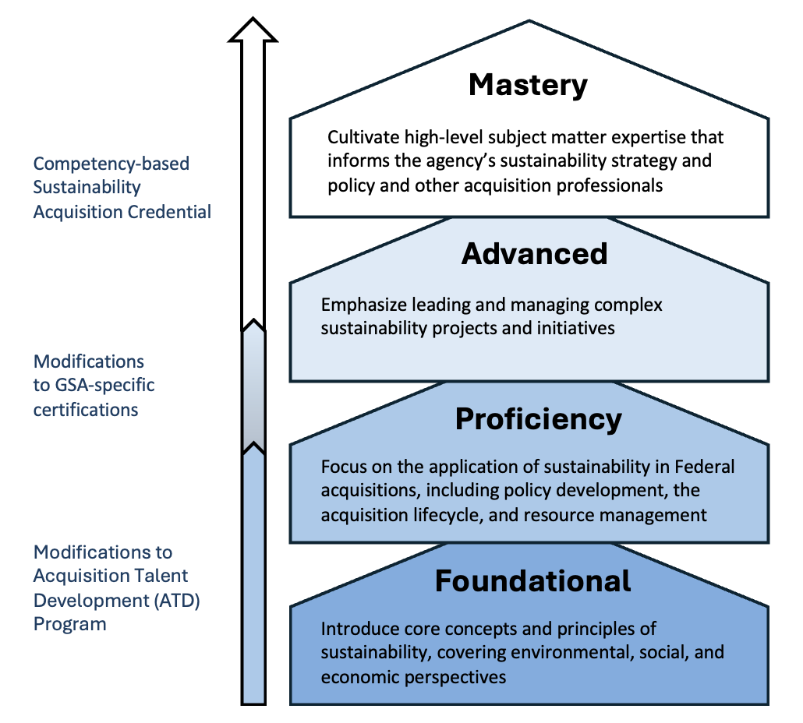
Bringing it Together: Comprehensive Sustainability Training Pathway
Notes:
Together, creates a comprehensive training pathway
Training/Credentialing – 5 interrelated recommendations
Make sustainability a core, foundational capability across the acquisition workforce (e.g., integrate into ATD)
Create acquisition sustainability experts
Develop a Competency-based Sustainability Acquisition Credential that is relevant to all acquisition workers
Emphasize experiential learning
Don’t reinvent the wheel – Third party training selection and how the agency selects those trainers

Slide 31
Bringing it Together: NCMA

Slide 32
Questions & Answers
Members
Nicole Darnall, Chair, Arizona State University
Anne Rung, Co-Chair, Varis
C. Gail Bassette, Bowie State University
Darryl Daniels, Jacobsen Daniels Assoc.
Mark Hayden, New Mexico Retiree Health Care Authority
David Malone, AquireIQ
Steve Schooner, George Washington University
Kristin Seaver, General Dynamics Information Technology
Clyde Thompson, GovStrive LLC
Thank you to the many individuals
who generously gave their time to meet with us and answer our questions.
Notes:
THANK YOU - Boris, Stephanie - the whole GSA team. Our speakers, subcommittee participants, colleagues on the Committee have been instrumental to our ability to advance our important work.

Slide 33
Industry Partnerships Subcommittee
Kristin Seaver, Chair
Farad Al, Co-Chair
Notes:
Take slides down after shown

Slide 34
Industry Partnerships Subcommittee
Members
Kristin Seaver, Chair, General Dynamics Information Technology
Farad Ali, Co-Chair, Asociar LLC
Denise Bailey, Philadelphia International Airport
C. Gail Bassette, Bowie State University
Susan Lorenz-Fisher, AmerisourceBergen Corp.
Deryl McKissack, McKissack & McKissack
Mamie Mallory, Mallory & Associates, LLC.
Stacy Smedley, Building Transparency
Nigel Stephens, Phoenix Strategies
Keith Tillage, Tillage Construction, LLC
Dr. David Wagger, Recycled Materials Association (formerly, Institute of Scrap Recycling Industries)
Dr. Kimberly Wise White, American Chemistry Council

Slide 35
Mission and Purpose
To provide the full GAP FAC, and in turn GSA, with recommendations on how best to identify, engage and equip a broader and more diverse supplier base to achieve the government’s goals of sustainability, environmental justice, economic equity, and a resilient domestic supply chain With a specific focus towards Small, mid sized, underutilized, underrepresented businesses as well as new entrants.
Impactful engagements that address the target market and broaden the pool of viable suppliers
Metrics, motivations and methods that can be developed and deployed to validate meaningful progress, inspire action beyond mere compliance, and share lessons learned and best practices across the federal supplier base

Slide 36
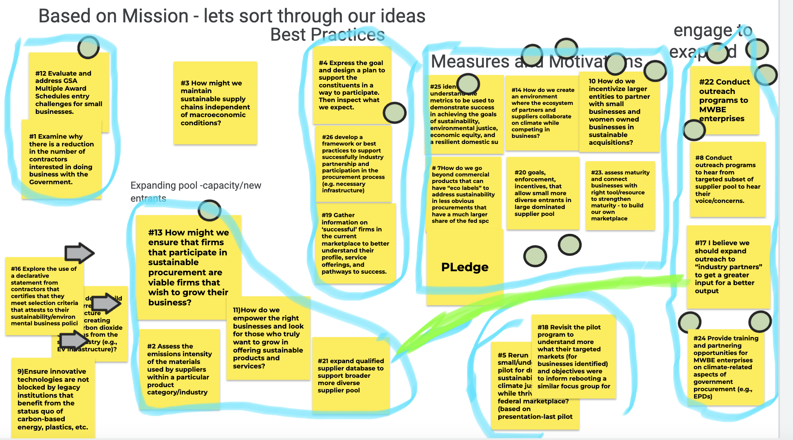
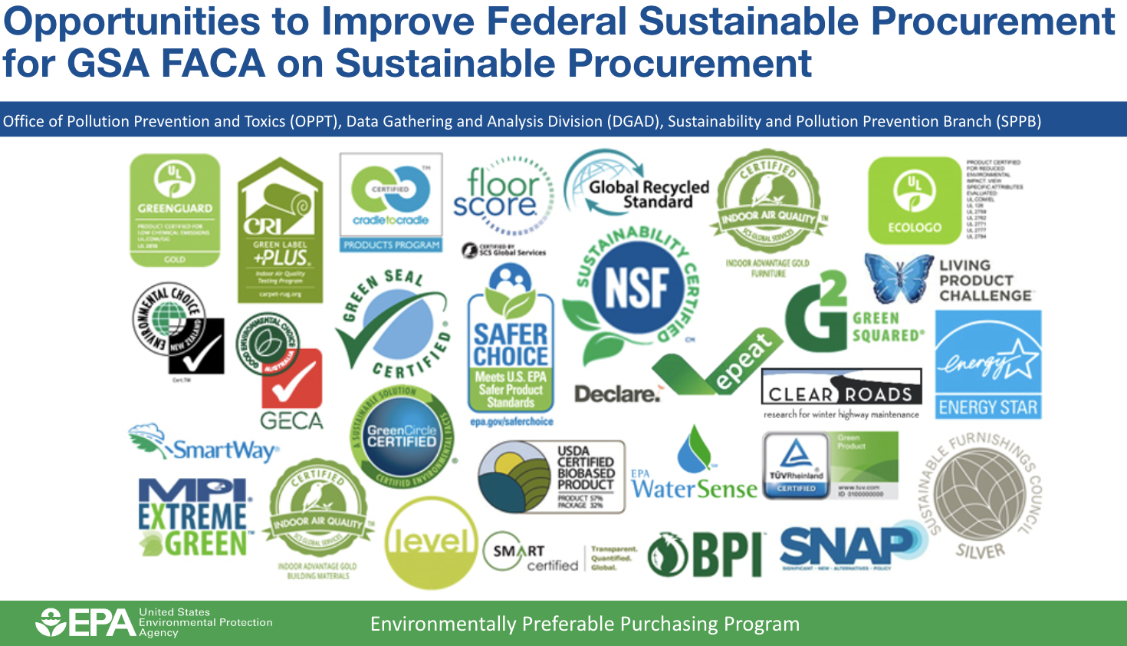
Achievements and Impacts
Extensive journey of discovery and understanding.
Significant and impressive efforts within GSA and across government to drive sustainability objectives and positive outcomes.
Opportunity for improved awareness, coordination and synergy of efforts.
Valuable perspectives on those trying to do business with the government and the challenges and barriers faced.
Curated recommendations for GSA consideration focused on diversifying the supplier base.
Reinforced the importance of Industry Partnerships, the value of seeking others perspectives, and opportunities for acceleration of efforts and impact.
Challenge.Gov
Innovative Entrants
Maturity Model
Build competency
Lighthouse
A network of networks
Journey Map
Innovative Entrants

Slide 37
Recommendations
Date | Recommendation
May 2023 | Identify, engage and onboard innovative new entrants
May 2023 | Sponsor maturity model for embedding sustainability and climate risk mitigation in federal acquisition
Dec 2023 | Leverage CHALLENGE.GOV, “where innovators are inspired to meet challenges big and small”
Dec 2023 | Sponsor sustainability and climate risk maturity model steering committee
Dec 2023 | Lighthouse- A network of networks
May 2024 | Adopt Life Cycle Management for Innovative Entrants

Slide 38
Recommendation
Strengthen LifeCycle Management for Innovative Entrants
Identify | Engage | Onboard | Pathways
Unify Go To Market collateral for all of GSA to leverage. Create targeted branding channeled to innovative entrants in necessary disciplines. Amplify opportunities for self identification and vetting. | INTRA GSA: Focus on areas to strengthen connectivity between FAS (Product Owners, Multiple Award Schedules, Customer Stakeholder and Engagement) and the Office of Small and Disadvantaged Business Utilization to drive speed to value for the engage and onboard segments. INTER GSA/GOV: Focus on efforts to strengthen connectivity and impact between GSA, SBA, EPA, CEQ and Agencies to better leverage existing offerings to drive innovation for sustainability (ie: SBIR and STTR) |  | Measure Outcomes Implement Line of Sight metrics that measure outcomes and impacts of efforts. Expand beyond numbers of participants to include growth statistics, success rates, and impact on GSA objectives.
Data, AI and Analytics

Slide 39
Reflection on the Journey
The federal procurement ecosystem can benefit from a collective engagement strategy that incorporates mission alignment, interoperability, and better coordination between Federal agencies.
Opportunity for GSA to amplify branding, demand signal and current offerings to expand the supplier base.
The process has exposed the crisis level of our Federal supply chain due to the lack of diversity, competition, innovation, and resiliency.
We recognize a significant untapped potential of non-traditional vendors/contractors that need amplification through improved processes, programs, and coordination so they can be better utilized.

Slide 40
Questions & Answers
Challenge.Gov
Innovative Entrants
Maturity Model
Build competency
Lighthouse
A network of networks
Journey Map
Innovative Entrants

Slide 41
Questions & Answers
Members
Kristin Seaver, Chair, General Dynamics Information Technology
Farad Ali, Co-Chair, Asociar LLC
Denise Bailey, Philadelphia International Airport
C. Gail Bassette, Bowie State University
Susan Lorenz-Fisher, AmerisourceBergen Corp.
Deryl McKissack, McKissack & McKissack
Mamie Mallory, Mallory & Associates, LLC.
Stacy Smedley, Building Transparency
Nigel Stephens, Phoenix Strategies
Keith Tillage, Tillage Construction, LLC
Dr. David Wagger, Recycled Materials Association (formerly, Institute of Scrap Recycling Industries)
Dr. Kimberly Wise White, American Chemistry Council

Slide 42
Thank you

Slide 43
Break
We Will Resume at 11am (EST)

Slide 44
Policy & Practice Subcommittee
Luke Bassis, Chair
Dr. David Wagger, Co-Chair
Notes:
Take slides down after shown

Slide 45
Policy & Practice Subcommittee
Members
Luke Bassis, Chair, Port Authority of New York and New Jersey
Dr. David Wagger, Recycled Materials Association
Richard Beutel, Cyrrus Analytics LLC
Leslie Cordes, Ceres
Nicole Darnall, Arizona State University
Antonio Doss, Small Business Administration
Mark Hayden, New Mexico Retiree Health Care Authority
Dr. Amlan Mukherjee, WAP Sustainability
Jennie Romer, Environmental Protection Agency
Steven Schooner, George Washington University
Stacy Smedley, Building Transparency
Nigel Stephens, Phoenix Strategies
Anish Tilak, Rocky Mountain Institute
Dr. Kimberly Wise White, American Chemistry Council

Slide 46
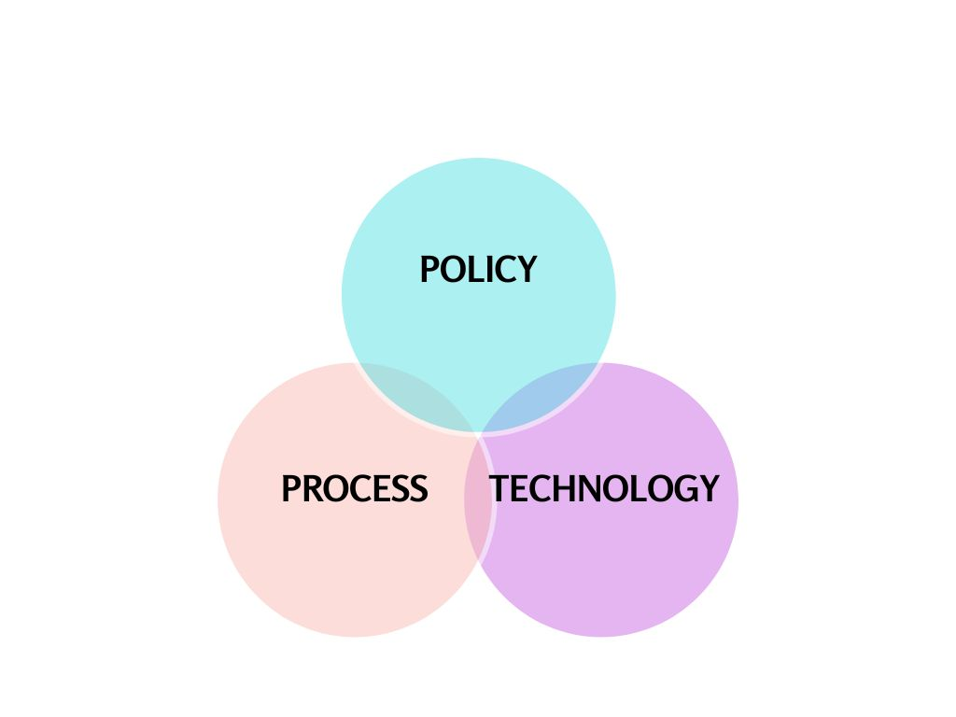
Mission and Priority Areas
The Policy and Practice Subcommittee’s mission is to recommend actionable changes to GSA procurement policies and practices that encourage innovation and streamline the acquisition process to accelerate the demand and utilization of goods and services from a diverse supplier base to achieve measurable progress on climate and sustainability goals.

Slide 47
Massive and Sustainable Impact
01
Single-Use Plastics and Packaging
(May 2023)
Summary: Issue a federal rule to reduce the U.S. Government’s reliance on and purchase of single-use plastics and packaging, plus implement short-term actions to demonstrate viability of reduction strategies
Purpose: To support the U.S. Government’s sustainability and climate change goals and to spur economy-wide procurement transformation
02
PFAS Recommendation
(December 2023)
Summary: Identify products that may contain per- and polyfluoroalkyl substances (PFAS) in current federal procurement and minimize acquisition of products going forward
Purpose: To reduce risks to human health (e.g., government staff) and environment associated with federal procurement via avoidance of PFAS
03
Summary: Provide guidance on how GSA can take meaningful next steps to develop improved procurement processes to reduce adverse impacts of procured products on the health of federal product users.
Purpose: To ensure the safety of federally procured products by addressing potential risks from possible exposure to chemicals
Reducing Human Health Risks
(December 2023)
04
Summary: Develop a cross-jurisdictional team of sustainable procurement experts to improve coordination amongst public bodies
Purpose: To provide leadership, training, guidance, and assistance on best practices to help embed sustainable procurement into public procurement policies, practices and procedures.
Sustainable Procurement Center of Excellence
(December 2023)

Slide 48
Subcommittee Reflections

Slide 49
Data Based Sustainability Policies Will Maximize Impact
The GSA has enormous power to influence and incentivize markets to drive national sustainability strategy
Evidence-based, data driven policies will maximize sustainability impact
Data based policies provide transparency to industry partners, accountability for contract holders, and simplified decision making for GSA acquisition professionals
Today’s Recommendation: Identification of important areas where the GSA should prioritize its development and approach to sustainable acquisition data

Slide 50
Data Has Always Been A Common Denominator
Sustainable Procurement Data: So many sources, so many uses, no mandate or imperative to act on it and limited integration and analysis
First Report:
Sponsor a maturity model for embedding sustainability and climate risk management - Data Management Model as an example
Second Report:
Develop and lead a cross-agency effort to establish a federal data standard and protocols for ecolabel certifications and utilization.
FAR Case 2022-006 (Sustainable Procurement) Comments:
Encourage GSA to develop and implement a plan to establish stronger federal data standards and protocols for ecolabel certifications.

Slide 51
Recommendation for GSA Approach to Data
GSA should immediately adopt a lifecycle approach to sustainable procurement data that capitalizes on existing resources and provides agility to incorporate new sources into a single framework to optimize product selection and vendor evaluation, track progress towards sustainability goals, and empower executive leadership with informed decision-making in order to develop sustainable acquisition strategies.
Notes:
This recommendations is consistent with our mandate to recommend actionable changes that encourage innovation and accelerate the demand and utilization of goods and services to achieve measurable progress on climate and sustainability goals.

Slide 52
Recommendation for GSA Approach to Data
Policy/Strategy
Policy and strategic decision making are constrained by availability and quality of data. Clear data strategy mandate for measuring sustainability success, progress, costs will increase effectiveness.
1
Vendor Evaluation
Measure data for transparent evaluation/selection criteria or accountability.
2
Product/Service Selection
Excellent, but dispersed resources result in challenging process for most sustainable selection.
Connectivity/Integration
Improve connectivity between existing tools - good data is diffused through agencies.
3
4
Principles-Based Sustainability Data Framework
Notes:
This recommendations is consistent with our mandate to recommend actionable changes that encourage innovation and accelerate the demand and utilization of goods and services to achieve measurable progress on climate and sustainability goals.

Slide 53
Data for Measuring Impact and Informing Strategy
GSA does not yet possess a unified global framework for data to measure, track or inform strategy on sustainability initiatives:
Consistency in data collection methods
Segregated data limits impact of decisions
Data on the cost-effectiveness of sustainable procurement
Tracking of exemptions
Lifecycle Data on Products and Services
Notes:
Consistency in data collection methods: The GSA does not uniformly collect sustainability data. This makes it difficult to aggregate and analyze the data to identify trends and patterns.
Improved data results in better decision making: The GSA’s and other agencies’ ability to develop, target, and implement specific strategic efforts to implement sustainability goals is limited by the poor, inadequate and inconsistent data needed to make informed decisions.
Data on the cost-effectiveness of sustainable procurement: CEQ has yearly scorecard to track a limited pool of data for certain areas (public buildings and electric vehicles), but it does not provide a comprehensive overview
Data on exemptions: There are exemptions to sustainability requirements related to price, performance and availability, but there is no tracking of those exemptions
Lifecycle Data on Products and Services: The GSA lacks data on the cost-effectiveness of sustainable products and services across their lifecycle
No comprehensive strategy on data related to social, economic and environmental (i.e., sustainability) impacts: The GSA does not have a comprehensive approach to data that tracks the sustainability impacts of its purchasing decisions.

Slide 54
Vendor Selection Data Gaps
The acquisition professional must have established, transparent, objective and measurable criteria upon which to evaluate a vendor for a contract award
Firm sustainability performance as a basis for award can incentivize behavior
The GSA is constrained from maximizing sustainable performance as a criteria due to:
Need for a uniform approach to sustainability KPIs to assess vendor performance.
Limited data and consistency on existing vendor sustainability performance.
Vendor sustainability certifications not tracked.

Slide 55
Vendor Selection Approach
Sustainability based data can inform the assessment of vendors in specific areas:
Use of sustainability performance on existing contracts
Firm’s past sustainable experience/behavior and policies
Firm’s sustainability approach to the specific contract
Potential: Proposed Rule on GHG Disclosure

Slide 56
Data to Procure Sustainable Goods and Services
The acquisition professional/purchaser is faced with an overwhelming number of resources and options when attempting to select sustainable goods or services
More connectivity and integration of tools on sustainable product or services will increase sustainable selections
Some tools lack interoperability, can be confusing and are therefore underutilized.

Slide 57
Existing Goods and Services Resources
Relevance
1
GSA’s Green Procurement Compilation
Identify minimum Federal sustainable acquisition requirements, sample source selection criteria, and sample contract language.
2
GSA’s Sustainable Facilities Tool
Modules within Learn and Plan sections (water efficiency, healthy indoor environments, responsible business conduct) to research best practices
3
GSA Environmental Program Aisle
Easy access to wide variety of environmental products and services
4
SFTool Framework for Managing Climate Risks to Supply Chains
Provides guidance to Federal agencies ready to assess observed and expected climate or weather related risks to supply chains
5
FAS Best In Class Designated Solutions
Designation identifies government-wide contracts that satisfy key criteria defined by OMB

Slide 58
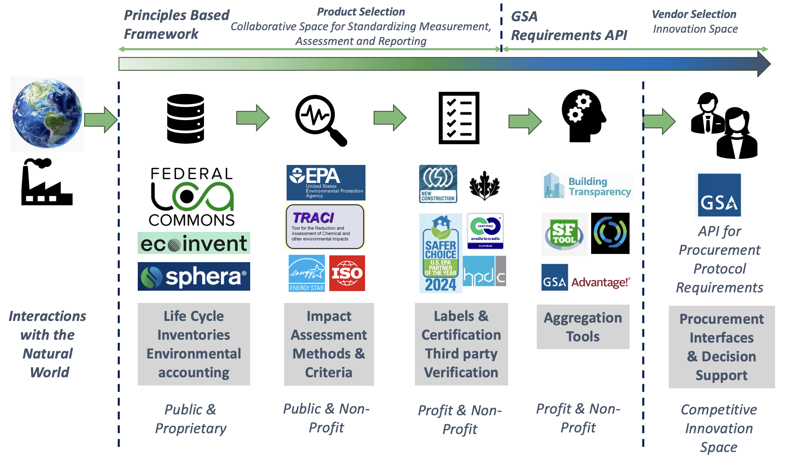
Framework

Slide 59
Recommendation: Develop A Principles Based Framework
Adopt a life cycle assessment based approaches as foundational to all sustainable procurement:
Standardized life cycle inventory development
Standardized impact assessment methods
Adopt comprehensive midpoint and endpoint indicators and metrics to guide procurement
For example CEQ’s Net Zero Guidance
Work with federal partners
For example the Federal LCA Commons

Slide 60
Recommendation: Develop A Principles Based Framework
Adopt third party certified ISO Type III Labels:
Standardized assessment and reporting processes
Increase transparency in certification
Ensure standards in assessment
For example the Facilities Standards for Public Buildings (P100)
Develop standard principles of practice for third party certifiers and label reviewers.
For example the Framework for the Assessment of Environmental Performance Standards and Ecolabels for Federal Purchasing

Slide 61
Recommendation: Procurement Requirements API
Develop and make available a Procurement Requirements Application Programming Interface (API):
Encourage Market Innovation - adoption of AI approaches
Integration with Existing Tools
Scalability and interoperability across applications
Prioritize Sustainable Products in GSA Advantage Results
Notes:
Develop a Procurement Requirements API (Application Programming Interface): The infrastructure will provide for both product selection and vendor selection in accordance with all applicable federal sustainable procurement requirements. Product selection will be based on standardized product impact assessment methods as discussed above. Vendor selection will be based on the development of a procurement requirements API that innovative software companies can base tools and interfaces for GSA procurement specialists to use. This API should integrate with PRISM, identify all relevant sustainable procurement requirements for each product or service category, sustainability evaluation criteria, and contractual sustainability data reporting requirements, and automate the inclusion of these clauses into RFPs.
Maximize the utility and use of existing tools: Assessing existing Federal government tools that promote sustainable acquisition and ensuring seamless integration to simplify decision-making, including the integration of the GSA Advantage Environmental Aisle, Green Procurement Compilation, Sustainable Facilities Tool (SFTool), SFTool Product Search, EPA Recommendations of Specifications, Standards, and Ecolabels, and other Federal government acquisition tools that promote sustainable acquisition. Once integrated, GSA should train the acquisition workforce about these tools to ensure maximum utilization (this builds on the GAP FAC’s December 2023 Recommendation Report). The use of tools should be incentivized to encourage federal purchasers to utilize them. Increased training will be amplified if performance KPIs integrate the ability to effectively use these tools.
Test the Market: The advent of Artificial Intelligence, readily available APIs and innovations in data collection, display, and tracking, and the rapid development of tools to track spending and vendor management have demonstrated that the market offerings in this space are significantly more mature than when this GAP FAC began its work. AI and advanced tools may now be implemented to help augment data otherwise difficult to collect, standardize, and analyze. As such, we recommend testing the market with a Request for Information specifically targeting technology tools related to sustainable data capture, analysis, and decision making, with specific inquiries targeting capabilities related to vendor performance, vendor selection, the selection of sustainable goods and services, and appropriate KPIs for dashboards, reporting and executive decision making, and integration with existing federal systems and tools like PRISM, SFTOOL.
Consider Prioritization in Results: If the GSA cannot limit results in GSA Advantage of other tools to only include products and/or services that meet current federal sustainable procurement requirements, then it should give priority to providing results to users about compliant products. Allowing and listing non-compliant products in GSA procurement sites can confuse federal purchasers, who assume that GSA has done the due diligence to ensure that all listed products and services meet federal sustainable procurement requirements.

Slide 62
Conclusions
Adopting a broad sustainability data framework as recommended today will improve sustainability performance in all aspects of the procurement lifecycle from requirements definition to contract closeout while empowering executive leadership with informed decision-making in order to develop sustainable acquisition strategies.

Slide 63
Questions & Answers
Members
Luke Bassis, Chair, Port Authority of New York and New Jersey
Dr. David Wagger, Recycled Materials Association
Richard Beutel, Cyrrus Analytics LLC
Leslie Cordes, Ceres
Nicole Darnall, Arizona State University
Antonio Doss, Small Business Administration
Mark Hayden, New Mexico Retiree Health Care Authority
Dr. Amlan Mukherjee, WAP Sustainability
Jennie Romer, Environmental Protection Agency
Steven Schooner, George Washington University
Stacy Smedley, Building Transparency
Nigel Stephens, Phoenix Strategies
Anish Tilak, Rocky Mountain Institute
Dr. Kimberly Wise White, American Chemistry Council

Slide 64
Thank You!

Slide 65
Public Comment
Notes:
Take slides down after shown

Slide 66
Voting Instructions for Committee Members
Yes - Use the Zoom raise hand feature and physically raise your hand
Abstain - You won't raise your hand
No - You will type “No” in the chat

Slide 67
Vote
Acquisition Workforce Subcommittee
Amplify GSA’s Sustainability Change Acceleration Strategy

Slide 68
Vote
Industry Partnerships Subcommittee
Adopt Life-Cycle Management for Innovative Entrants

Slide 69
Vote
Policy and Practice Subcommittee
Adopt a Principles-Based Sustainability Data Framework

Slide 70
Closing Remarks
Notes:
Take slides down after shown

Slide 71
Thank You!
Written comments can be sent to gapfac@gsa.gov

Slide 72
GAP FAC Member Biographies
Notes:
Take slides down after shown

Slide 73
Chair and Co-Chair Biographies
Troy Cribb, Chair
Cassius Butts, Co-Chair
Director of Policy at Partnership for Public Service. She works to improve government management and strengthen the United States civil service through development of policies to help modernize government management.
Chief Strategy Officer and Managing Partner at Global Leader Group. Currently leads start up corporation focused on helping organizations achieve excellence through the expert areas via practitioner consulting, learning, and development.

Slide 74
Member Biographies
Farad Ali
Denise Bailey
C. Gail Bassette
Executive Director for Economic Development and Strategic Engagement at Bowie State University. Vast knowledge and experience as a federal government contractor and business advisor working with state and federal government lawmakers.
President and Chief Executive Officer of Asociar Limited Liability Company. For 20 years, he has worked to strengthen the asset base of diverse populations through policy, education and economic opportunities for women and minority business enterprises.
Deputy Director of Aviation for Business Diversity and Accessibility, Philadelphia International Airport. She has years of experience managing and growing small, minority and women-owned businesses. She is a subject matter expert in a variety of areas in government contracting and transportation arenas.

Slide 75
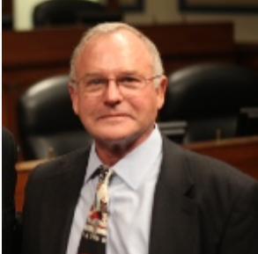
Member Biographies
Luke Bassis
Richard Beutel
Leslie Cordes
Vice President for Programs at Ceres. She has extensive background in clean energy and energy efficiency program development, domestic and international energy policy, strategic planning, nonprofit operations, and budget development.
Procurement Director for Port Authority of New York and New Jersey. A proven innovator and leader with accomplishments in strategic procurement transformation and implementing innovative solutions in complex institutions to meet diverse business goals.
Principal Researcher at Cyrrus Analytics LLC. He believes that modernizing government infrastructure is essential to bringing a modern customer experience to underrepresented communities.

Slide 76
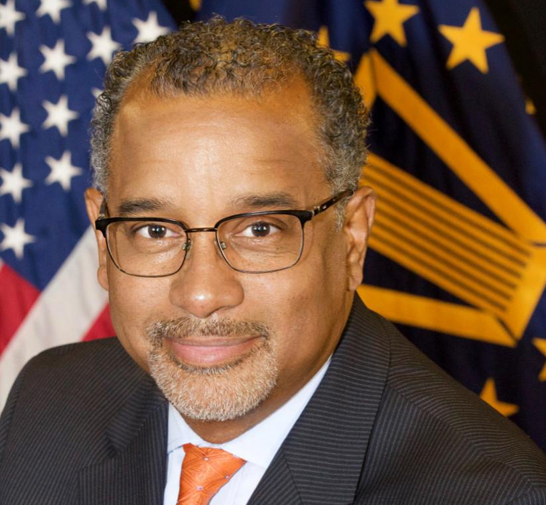
Member Biographies
Darryl Daniels
Nicole Darnall
Antonio Doss
Principal and Chief Executive Officer of Jacobsen Daniels Associates. Background and experience as a professional architect, planner, and aviation thought leader that provides the unique combination of lived and professional knowledge relevant for the work of the committee.
Deputy Associate Administrator for Office of Government Contracting and Business Development for United States Small Business Administration. He is passionate about growing local economies and supporting the development needs of all entrepreneurs.
Foundation Professor at Arizona State University's School of Sustainability and Founding Director of ASU’s Sustainable Purchasing Research Initiative. Her research uses theories of change to assess organizational approaches to improve global sustainability, especially related to sustainable procurement.

Slide 77
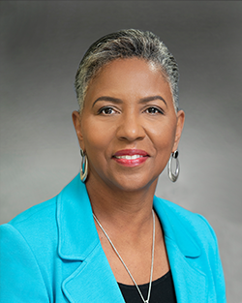
Member Biographies
Mark Hayden
Susan Lorenz-Fisher
Mamie Mallory
General Counsel for New Mexico Retiree Health Care Authority. Recognized leadership in state government strategy including legislative drafting and promulgating procurement code rules.
Senior Vice President of Corporate Responsibility & Sustainability at AmerisourceBergen Corporation. Leading sustainability developer responsible for environmental, social, and governance practices in the healthcare industry.
President and Chief Executive Officer of Mallory and Associates, LLC. Her career includes many years of experience as a project manager and management/executive experience in Federal service.

Slide 78
Member Biographies
David Malone
Deryl McKissack
Amlan Mukherjee
David is the founder and president of AcquireIQ, LLC, a supply chain consulting and training company focused on helping organizations expand their procurement and supply chain value proposition through the optimization of people, process, and technology.
Founder, Chairwoman and Chief Executive Officer for McKissack & McKissack. As the founder and CEO of one of the nation’s largest and oldest minority- and women-owned architecture, engineering and construction firms, she brings decades of experience.
Director of Sustainability at WAP Sustainability Consulting. His professional work has direct implications to sustainable procurement methods using Life Cycle Assessment based instruments.

Slide 79
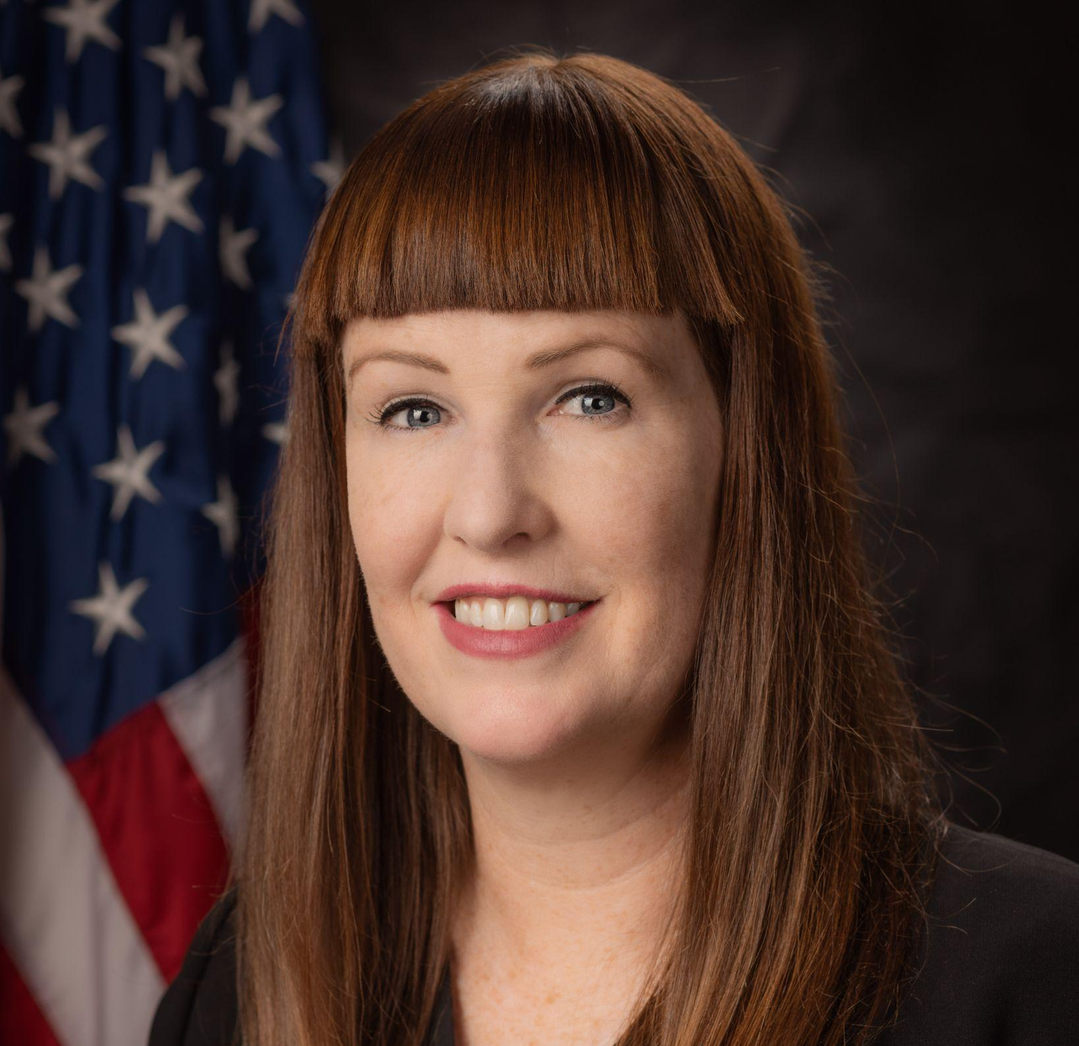
Member Biographies
Jennie Romer
Anne Rung
Steven Schooner
Deputy Associate Administrator for Pollution Prevention at the United States Environmental Protection Agency's Office of Chemical Safety and Pollution Prevention. She has more than a decade of experience as an attorney and sustainability consultant.
Senior Vice President for the Public Sector at Varis LLC. Served as U.S. Chief Acquisition Officer, she was responsible for implementing acquisition policies on behalf of the White House covering more than $440 billion in annual federal contract spending.
Nash and Cibinic Professor of Government Procurement Law at George Washington University Law School. He has decades of experience in acquisition policy and sustainability, with a strong background in acquisition; U.S. public procurement law and Federal Acquisition Regulations.

Slide 80
Member Biographies
Kristin Seaver
Stacy Smedley
Nigel Stephens
Vice President of Strategic Client Engagement for the Federal Civilian Division at General Dynamics Information Technology. As Chief Information Officer at the Postal Service, she was highly engaged with industry, building partnerships and technology roadmaps and facilitating agile, impactful procurements.
Executive Director for Building Transparency in Seattle Washington. Sustainability leader for the building and construction industry, prioritizing the development of sustainable built spaces to improve the occupant experience and create positive impacts on the humans.
Principal at Phoenix Strategies, Inc. He has been working on political campaigns to drive initiatives around innovation and Information Technology modernization, small business and entrepreneurship, minority business development, modernizing government, and economic development.

Slide 81
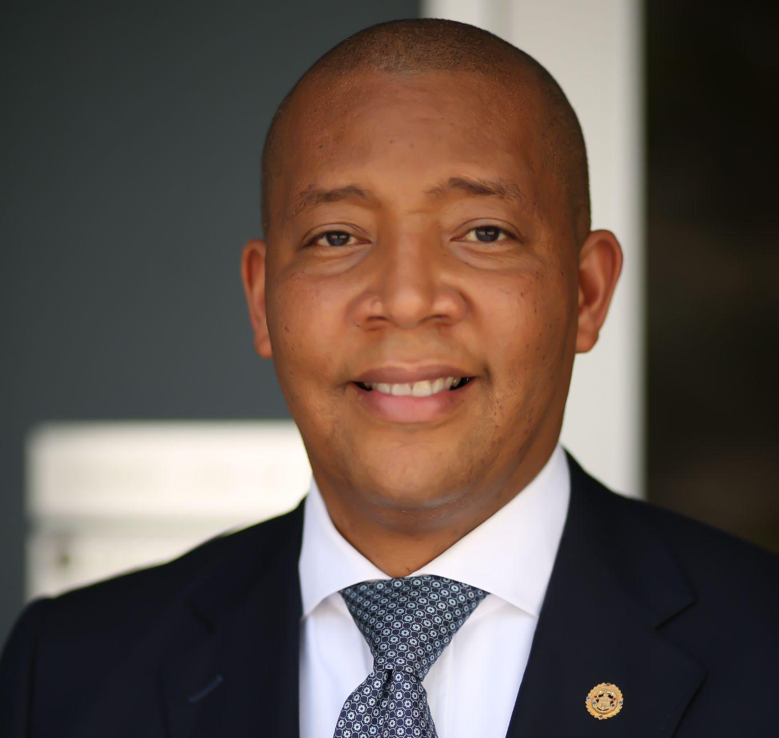
Member Biographies
Clyde Thompson
Anish Tilak
Keith Tillage
Senior Vice President for GovStrive LLC. While at the United States Department of Agriculture, he set management agendas, executed multi-billion dollar annually appropriated budgets, and safeguarded portfolios valued in excess of $125 billion.
Manager with the Rocky Mountain Institute's Carbon-Free Buildings program. He comes from a strong building science background, and is developing technical research to provide subject matter expertise to support public agencies in advancing decarbonization programs and policies.
Co-founder and Chief Executive Officer of Tillage Construction, LLC. He participates directly as the Principal-in-Charge on all projects: oversees all projects: and ensures they are executed and completed on time and below budget.

Slide 82
Member Biographies
Dr. David Wagger
Dr. Kimberly Wise White
Chief Scientist and Director of Environmental Management for the Recycled Materials Association. He represents the recycled materials industry on scientific and R&D matters and on environmental regulatory issues.
Vice President for Regulatory and Scientific Affairs at American Chemistry Council. She has the scientific training, technical and policy expertise, and industry perspective needed to provide the views of an industry sector that touches virtually every product or material used.

