Slide 1

How to Develop a Capabilities Statement
Michelle Simoes & Sean Murphy
Small Business Specialists
Office of Small Disadvantaged Business Utilization (OSDBU)
U.S. General Services Administration

Slide 2

Today’s Agenda
GSA OSDBU Overview
What is a Capabilities Statement?
Importance of a Capabilities Statement
Preliminary Steps
Content of a Capabilities Statement
Designing Elements
Important Tips

Slide 3

GSA Overview
GSA’s mission is to deliver value and savings in real estate, acquisition, technology and other mission support services across the Federal government.
GSA is the Federal government’s procurement expert, helping other agencies acquire space, products, and services needed from commercial sources.
The Public Buildings Service, (PBS), provides real estate space, architecture, interior design, and construction to Federal agencies.
Our Federal Acquisition Service (FAS) delivers a vast number of commercial goods and services, at the best value, across government.

Slide 4
GSA OSDBU Overview
According to the Small Business Act as amended by Public Law 95-507, the Office of Small & Disadvantaged Business was established to:
  Advocate, within each Federal Executive Agency, for the maximum practicable use of all designated small business categories within the Federal Acquisition process.
  Ensure inclusion of small businesses as sources for goods and services in Federal acquisitions as prime contractors and subcontractors.
  Manage the small business utilization programs for OUR respective organization.

Slide 5
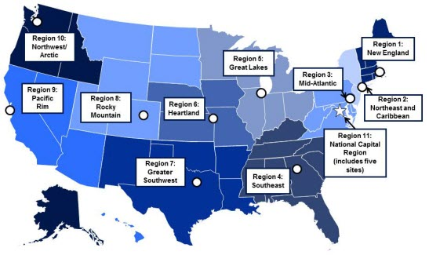
GSA OSDBU OVERVIEW
GSA’S Regional Offices
Region 1: Boston, MA
Region 2: New York, NY
Region 3: Philadelphia, PA
Region 4: Atlanta, GA
Region 5: Chicago, IL
Region 6: Kansas City, MO
Region 7: Ft. Worth, TX
Region 8: Denver, CO
Region 9: San Francisco, CA
Region 10: Tacoma, WA
Region 11: Washington, DC

Slide 6
What is a Capabilities Statement?
Understand how the Government works
At-a-glance
Decision Makers
Market your company
Mitigate
Risks
Competitors

Slide 7
What is a Capabilities Statement?
A Capability Statement is a critical marketing tool to help you look your best during your initial outreach
A Capability Statement could be referred to as a “Business Resume”
You can have more than one Capability Statement

Slide 8
What is a Capabilities Statement?
A Capabilities Statement helps you be as successful as possible, no matter what size company you represent. Successful firms use their Capability Statement for a number of purposes:
  Required in many government registration processes
  A door-opener to new agencies
  Proof of qualification
  Proof of past performance
  It will set you apart from your competitors

Slide 9



Importance of a Capabilities Statement
Required by most Government Agencies/Primes
Foot in the Door
Be Remembered/Stand Out

Slide 10
Importance of a Capabilities Statement
Briefing with Contracting Officers/Specialist and Program Managers
Sources Sought or Request for Information
Procurement Fairs or Networking events
Sometimes Required for the Request for Proposal
Send to Primes for Sub-contracting Opportunities

Slide 11
Capabilities Statements
Primary purpose is for marketing outreach
Helps Contracting Officers (CO) drill down to your key areas of expertise quickly and efficiently
Adding information about awards, certifications & current/past clients, your capability statement will help you to:
    Establish a level of expertise
    Show business maturity
    Create a sense of trust

Slide 12
A Capabilities Statement is NOT…
A PowerPoint presentation
More than two sides of one page
.jpg or .tif file
A large file over 1MB
A personal resume
A Capabilities Brief

Slide 13
Capabilities Statements
BEFORE YOU BEGIN

Slide 14

Before you begin…
- Obtain your CAGE Code and UEI
- FREE to register (beware of 3rd party companies)

Slide 15
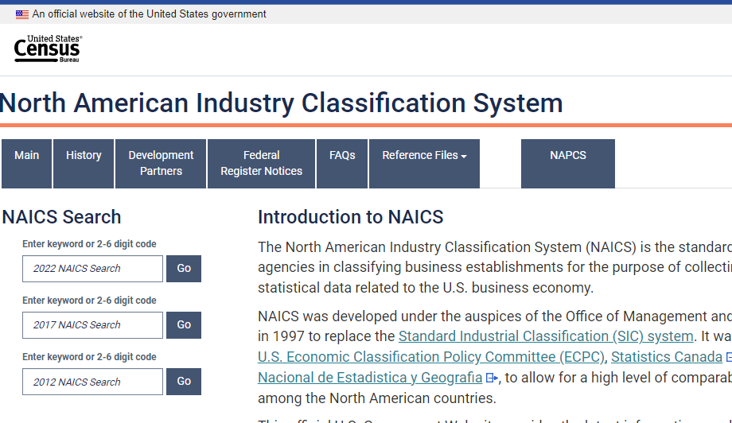
Before you begin…
Enter Keywords to describe your product or service
https://www.census.gov/naics/

Slide 16
Before you start…
  Select your company’s Product Service Codes (PSC) or Federal Supply Class (FSC)
  Product service code (PSC) or Federal Service Code (FSC) is a four-digit code used by all federal government contracting activities for identifying and classifying the services and Supplies & Equipment (S&E) that are purchased under contract
  https://www.acquisition.gov/psc-manual
  https://flisancillaryu.dla.mil/H2/search.aspx

Slide 17
Keep It Simple
Use bullet points
Short sentence fragments
No long narratives
Simple language
No “trade” language or jargon
Call the document a “Capabilities Statement”
Show branding and logo elements

Slide 18
Capabilities Statements
CONTENT

Slide 19
What does a Capabilities Statement Look like?
CONTACT INFORMATION
These are KEY elements that the
Government agency or Prime Contractor will expect to see on this document.
CORE COMPETENCIES
DIFFERENTIATORS
PAST
PERFORMANCES
Company Data
List of Pertinent Codes & Data

Slide 20
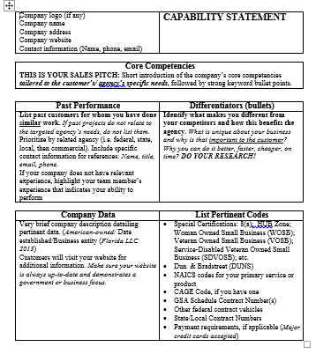
Capabilities Statements Content
CONTACT INFORMATION
Company’s Name
Website “HYPERLINK”
Phone Number
Address
Contact Person and email address
Logo
Be sure to label this document
“Capability Statement”
&
label each section

Slide 21
Capabilities Statements Content
CORE COMPETENCIES
Core competencies (also called “capabilities” or “core capabilities”) are the things your company does best.
This is your Sales Pitch:
Short introduction of your company’s core competencies that relate to the agency or prime you are targeting followed by strong keyword bullets.

Slide 22
Capabilities Statements Content
CORE COMPETENCIES SECTION
Example:
XYZ Construction LLC provides high quality civil
construction capabilities and our civil construction scope of
work includes:
Sub divisions
Mine Site works
Road works
Industrial and commercial site preparation
Water storages
Pipe laying
Sewerage and water treatment
Supply of blue metal aggregates
Company’s Core Competencies
Agency’s Mission or specific Opportunity

Slide 23
Capabilities Statements Content
DIFFERENTIATORS SECTION
A differentiator can be defined as the business attribute(s) and/or unique value that clearly separates it from the competition in a particular marketplace.

Slide 24

Capabilities Statements Content
DIFFERENTIATORS SECTION
Questions to ask yourself:
Why did your biggest customer want you?
How and Why is your company the best choice?
What is it about your employees that give you the advantage over your competitors?
How do you solve a unique problem for your customers?

Slide 25
Capabilities Statements Content
DIFFERENTIATORS SECTION
Product
  Added features
  Made with a special material
  Performance
  Special machinery or equipment to make product special
  Delivery of the product
  Professional Expertise
CYBER SECURITY
DFARS COMPLIANT
Service
  Quality Assurance
  Installation – special equipment
  Delivery of the service
  Certified Specialist

Slide 26
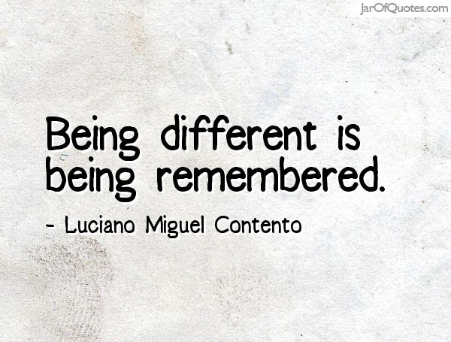
Capabilities Statements Content
DIFFERENTIATORS SECTION
Other examples of what can make your company different:
Training
Location
ISO
Relationships
Experience
How do these relate to the targeted Agency, Prime or Team?

Slide 27
Capabilities Statements Content
DIFFERENTIATORS SECTION
Differentiators must meet three important principles:
It must be true information
It must be important to potential clients
It must be provable

Slide 28

Capabilities Statements Content
DIFFERENTIATORS SECTION
Differentiators are NOT:
Socioeconomic certifications
Vague Statements or words – such as Best in class or World Class
Years of experience

Slide 29
Capabilities Statements Content
DIFFERENTIATORS SECTION
Example:
Our company has the largest painting and media blasting booths in the Northeast Region.
Our paint booth is 20’ wide x 55’ long and 14’ tall
Our media blasting booth is 20’ wide x 70’ long x 16’ tall
Bottom line – We can sandblast and paint anything that can be transported
Remember – this information must be provable; so when you are meeting face to face with the Government or a Prime, make sure you can back this information up.
Tips:
Hard for your competitor to copy
Identify your company’s key internal strengths

Slide 30
Capabilities Statements Content
PAST
PERFORMANCE
Provide three or four agencies or customers you have done business with, starting with those as similar to your target agency as possible.
If you haven’t done other federal work, provide state or local government or commercial references.

Slide 31
Capabilities Statements Content
PAST
PERFORMANCE
Begin by listing past customers for whom your business has done similar work.
Prioritize starting with the related agency
List all federal or other government work and finally to commercial contracts.
If the past projects do not relate to the targeted agency's needs, do not list them.
Ideally, include specific contact information for each that may be used for immediate references. (May not always be permitted to use – check with the contact first)
Include name, title, email and phone number.

Slide 32
Capabilities Statements Content
Company Data
Company data (also called “corporate data” or “business information”)
Provide a sentence or two describing your company’s:
History
Size of your firm
Financial stability
Number of employees
Teams
Geographic area you serve

Slide 33
Capabilities Statements Content
List of Pertinent Codes & Data
List of Specific Pertinent Codes & Data:
Unique Entity Identifier (UEI)
CAGE Code
NAICS - (fewer than 15)
Product Service Codes or Federal Supply Class (PSC & FSC)
Socio-economic certifications: 8(a), HUBzone, SDVOB/VOSB, WOSB etc.
Accept Credit and Purchase Cards
GSA Schedule Contract Numbers
Other federal contract vehicles
Pertinent teaming agreements

Slide 34

Capabilities Statements Content
List of Pertinent Codes & Data
Never put highly sensitive information on this document
Federal Employer Identification Number (FEIN)
Employer Identification Number (EIN)
Social Security Number

Slide 35
Capabilities Statements
DESIGNING ELEMENTS

Slide 36
Capabilities Statements
3 Important Tips When Tailoring Your Capability Statement
Use the government’s language
Past Performance is Relevant
Differentiators match needs

Slide 37
Capabilities Statements
Other Important Tips
Tailor a Capabilities Statement for each agency you want to target
Have a General one on hand just in case
Gather important information:
Review Targeted Agency or Prime’s Website – News Headlines, Doing Business with, google latest articles within your industry
Check out Forecasts (agency websites) or Sam (Contracting Opportunities)
Important Note** - If attending a Networking event, find out what agencies will be at the event a head of time

Slide 38
Capabilities Statements
Designing Elements
If your cap statement looks messy, then it could reflect how the reviewer looks at your company (as messy, unorganized).
TIPS:
Use your company’s LOGO, Branding and Colors
Do NOT use long paragraphs – bullets are best
Use FONTS that are “Easy to Read”
- Not too small or fancy
Don’t jam information together – make use of white space
Don’t be too wordy
One page ONLY but no more than front and back

Slide 39
Capabilities Statements
Good and Bad Example
TIPS:
Use your company’s LOGO, Branding and Colors
Do NOT use long paragraphs – bullets are best
Use FONTS that are “Easy to Read”
- Not too small or fancy
Don’t jam information together – make use of white space
One page ONLY but no more than front and back
TIPS:
Use your company’s LOGO, Branding and Colors
Do NOT use long paragraphs – bullets are best
Use FONTS that are “Easy to Read”
- Not too small
- Use Sans Serif fonts (not extending the end strokes)
Don’t jam information together – make use of white space
One page ONLY but no more than front and back

Slide 40
Capabilities Statements
More Important Tips
Use a designing/graphics company – if you or no one in your company has the ability, or
Hire a Marketing or Communication intern from a local university or community college
Remember to
Save as Word doc - in order to make changes easily
Have it available in a PDF format to send out electronically
First Impressions are everything

Slide 41
Capabilities Statements
Other things to consider:
Never use a Government Agency LOGO
Put yourself in the eyes of the reviewer
Have someone review a draft to look for common mistakes
Is your Capability Statement easy to understand
Place your Capability Statement on your website
Use the government’s terminology

Slide 42
Capabilities Statements
Other things to consider:
Doing business with the government is highly competitive – Don’t just throw something together……take the time, make the effort and put in the extra mile to create the best Capability Statement possible.

Slide 43




Additional Resources:
www.gsa.gov/events
www.gsa.gov/smallbizresources

Slide 44
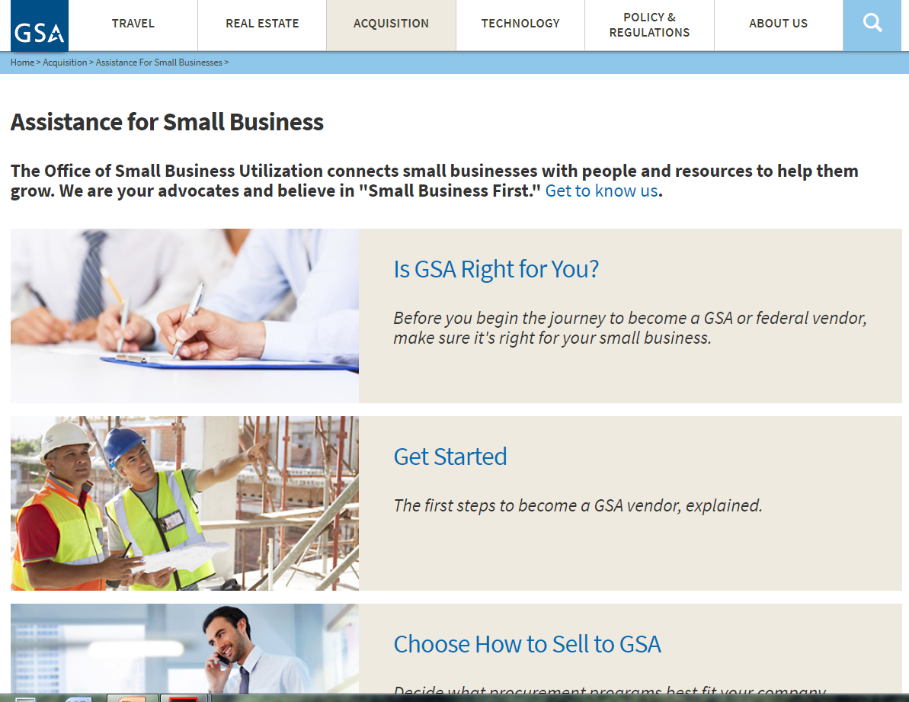
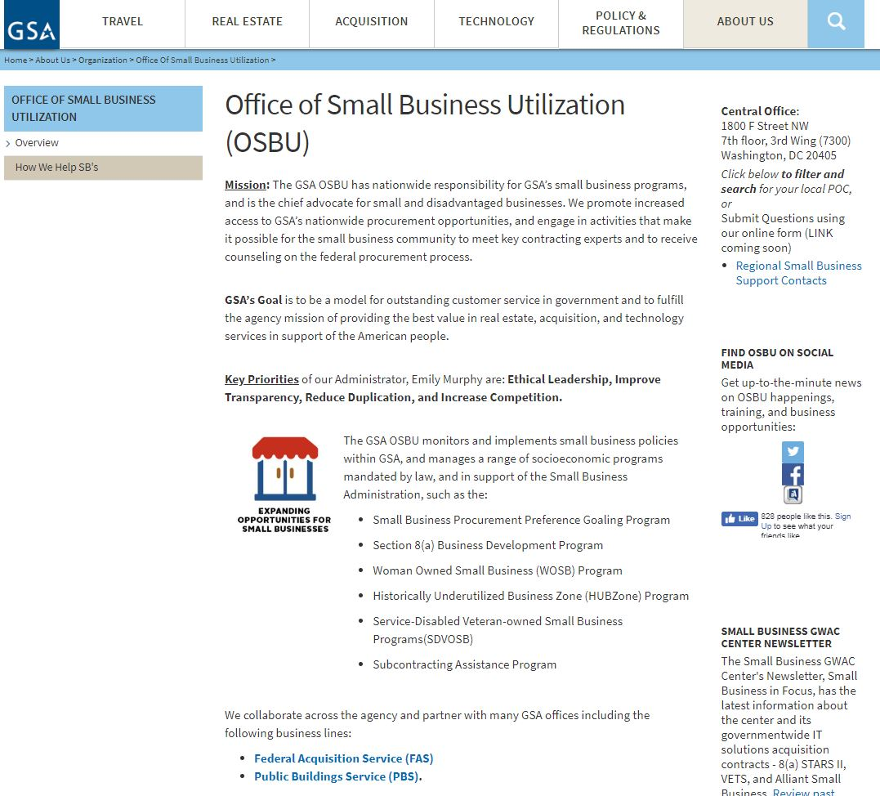
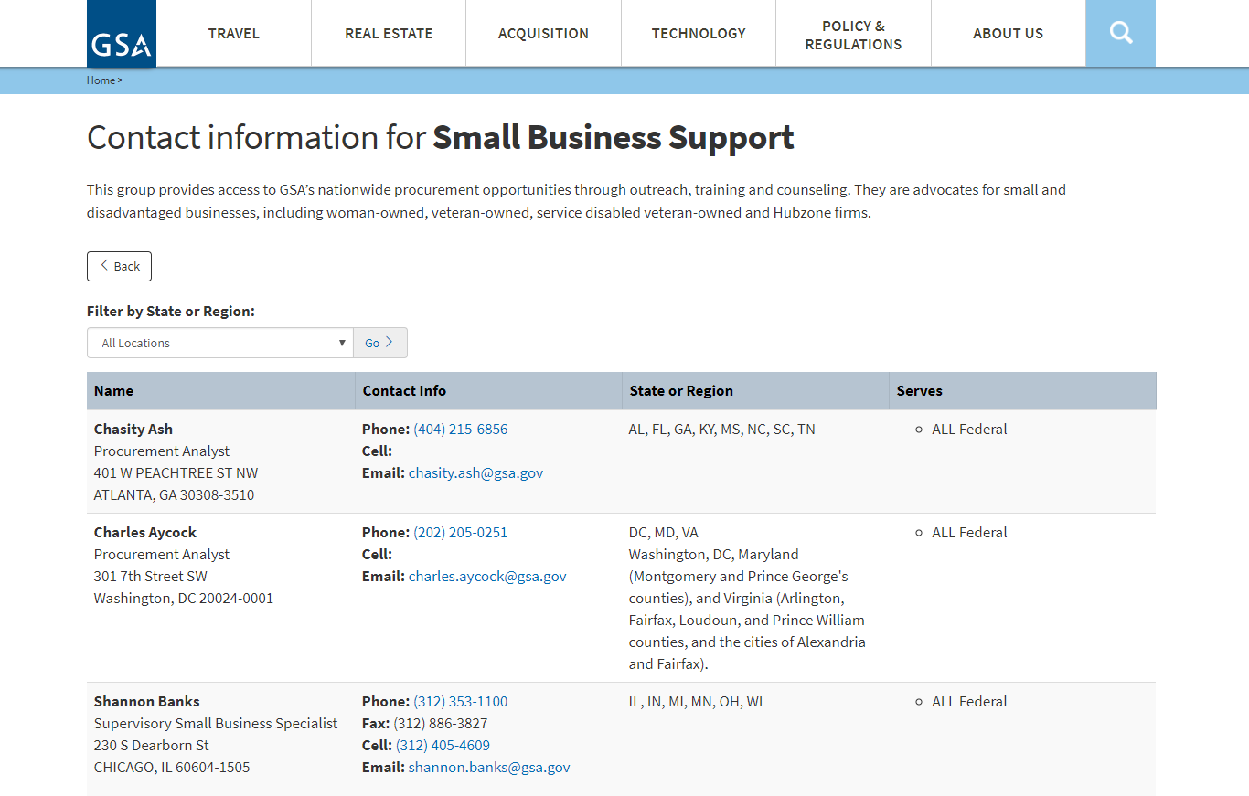
Contact Our Regional Staff
Still Have Questions?
Select Regional Small Business Support Contacts
Go to www.gsa.gov/smallbizsupport then select “Get to Know Us.”
Choose your location for the OSBU POC.

Slide 45
QUESTIONS ?
Michelle Simoes: Michelle.Simoes@gsa.gov
Sean Murphy: Sean.Murphy@gsa.gov

