Slide 1

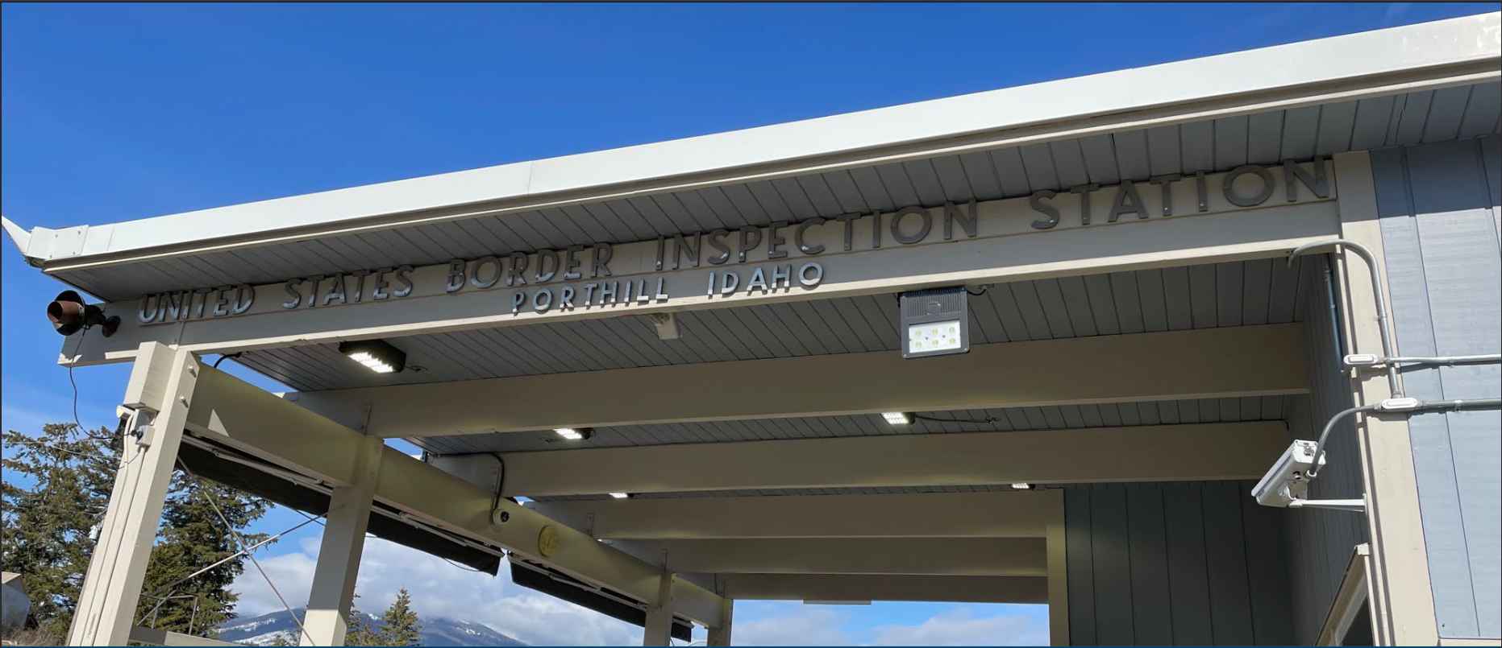
Porthill Land Port of Entry
Draft Environmental Assessment
U.S. General Services Administration
Public Hearing
Tuesday, January 16, 2023
6 PM PST
Presented by
GSA and Solv, LLC

Slide 2
Welcome and Housekeeping
Meeting Recording and Accessibility
  The meeting is being recorded with closed captioning
  The GSA Porthill Project Webpage is available here: www.gsa.gov/Porthill
Comment Submission
  Instructions for submitting public comments will be provided before the commenting session
  Participants will have an opportunity to speak; please limit comments to three minutes
A full recording of this meeting will be made available online after this meeting.

Slide 3
Agenda
Purpose of Meeting
National Environmental Policy Act (NEPA)
Environmental Assessment (EA) Timeline
Project Background
Project Overview, Purpose and Need, Project Alternatives
Resources Evaluated in the Draft EA and Summary of Impacts
Next Steps for the EA and Overall Project Schedule
How to Comment
Commenting Session

Slide 4
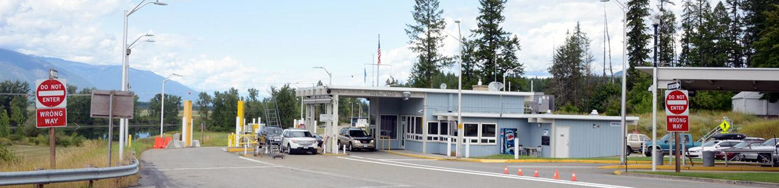
Purpose of this Meeting
Describe the NEPA process
Provide an overview of GSA’s proposed project
Review findings of the Draft EA
Provide an opportunity for public comments on the Draft EA
GSA is hosting this meeting to provide information about the proposed project with the community. This meeting is part of the NEPA public involvement process intended to inform the public of the findings of the Draft EA. GSA welcomes public comments on the Draft EA.

Slide 5
National Environmental Policy Act
NEPA requires Federal agencies to:
Consider the impacts of their proposed projects on the natural and human environment;
              Involve the public in the decision-making process; and
              Document anticipated environmental effects.
Areas for Public Input:
Which project alternatives should be analyzed
Which resource areas should be studied
  GSA has prepared a Draft EA per NEPA requirements to assess the potential impacts from the proposed changes to the Porthill LPOE.

Slide 6
EA Timeline
Project Announcement
Public Scoping
Comment Period
May 4, 2023 -
Jun. 5, 2023
Draft EA
Draft EA
Comment Period
Started January 4, 2024
Ends Feb. 6, 2024
Final EA
June 2024
Public Scoping Meeting:
May 17, 2023
Draft EA
Public Meeting:
Jan. 16, 2024
Final Decision Document
June 2024
End of NEPA Process or Preparation of EIS
We are here
Opportunities for Public Involvement
Notes:
Add durations for required comment period and waiting period durations

Slide 7
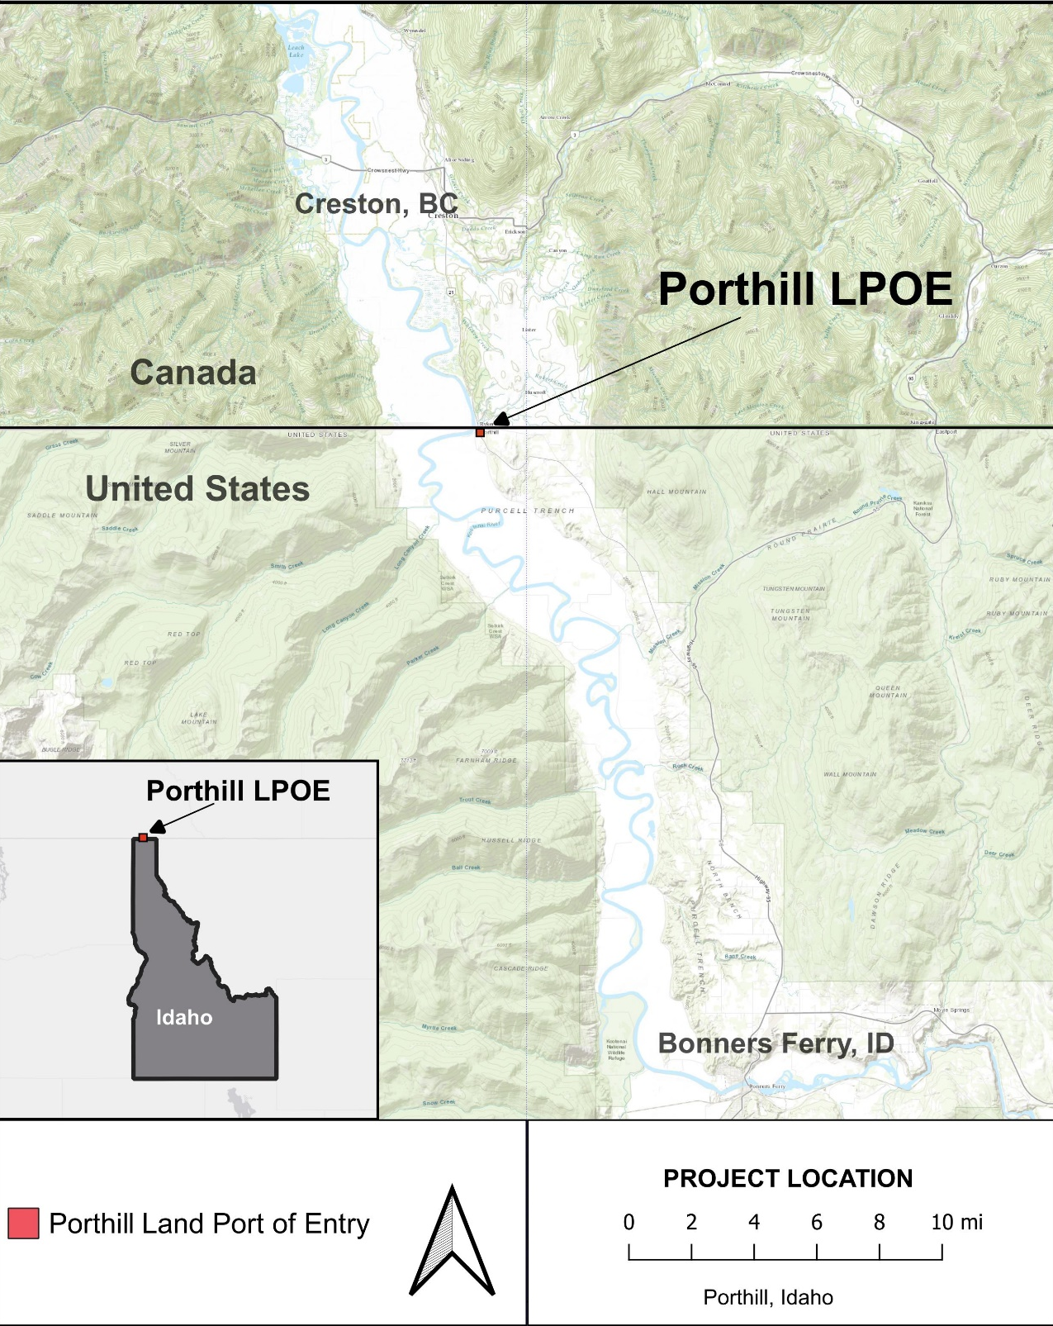
Porthill LPOE Background Information
Located between Porthill, Idaho and eastern British Columbia, Canada, approx. 27 miles NW of Bonners Ferry, ID
Operates 7:00 AM to 7:00 PM, seven days per week
Primarily serves personal vehicles and buses, but also serves pedestrians (mostly hikers) and permitted commercial traffic
The Porthill LPOE no longer meets the operational needs of CBP

Slide 8
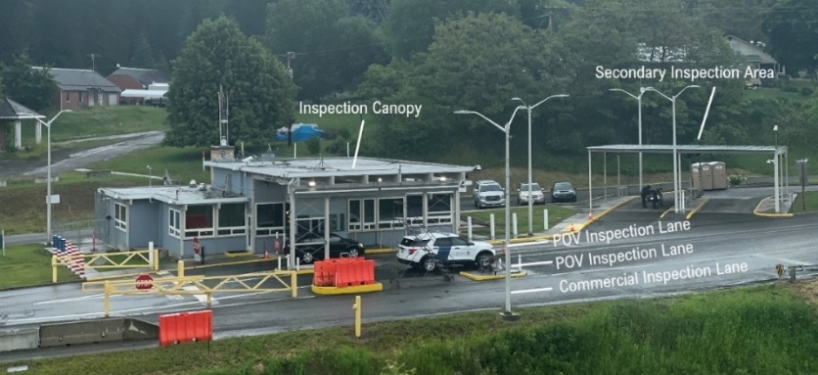
Existing Facilities

Slide 9
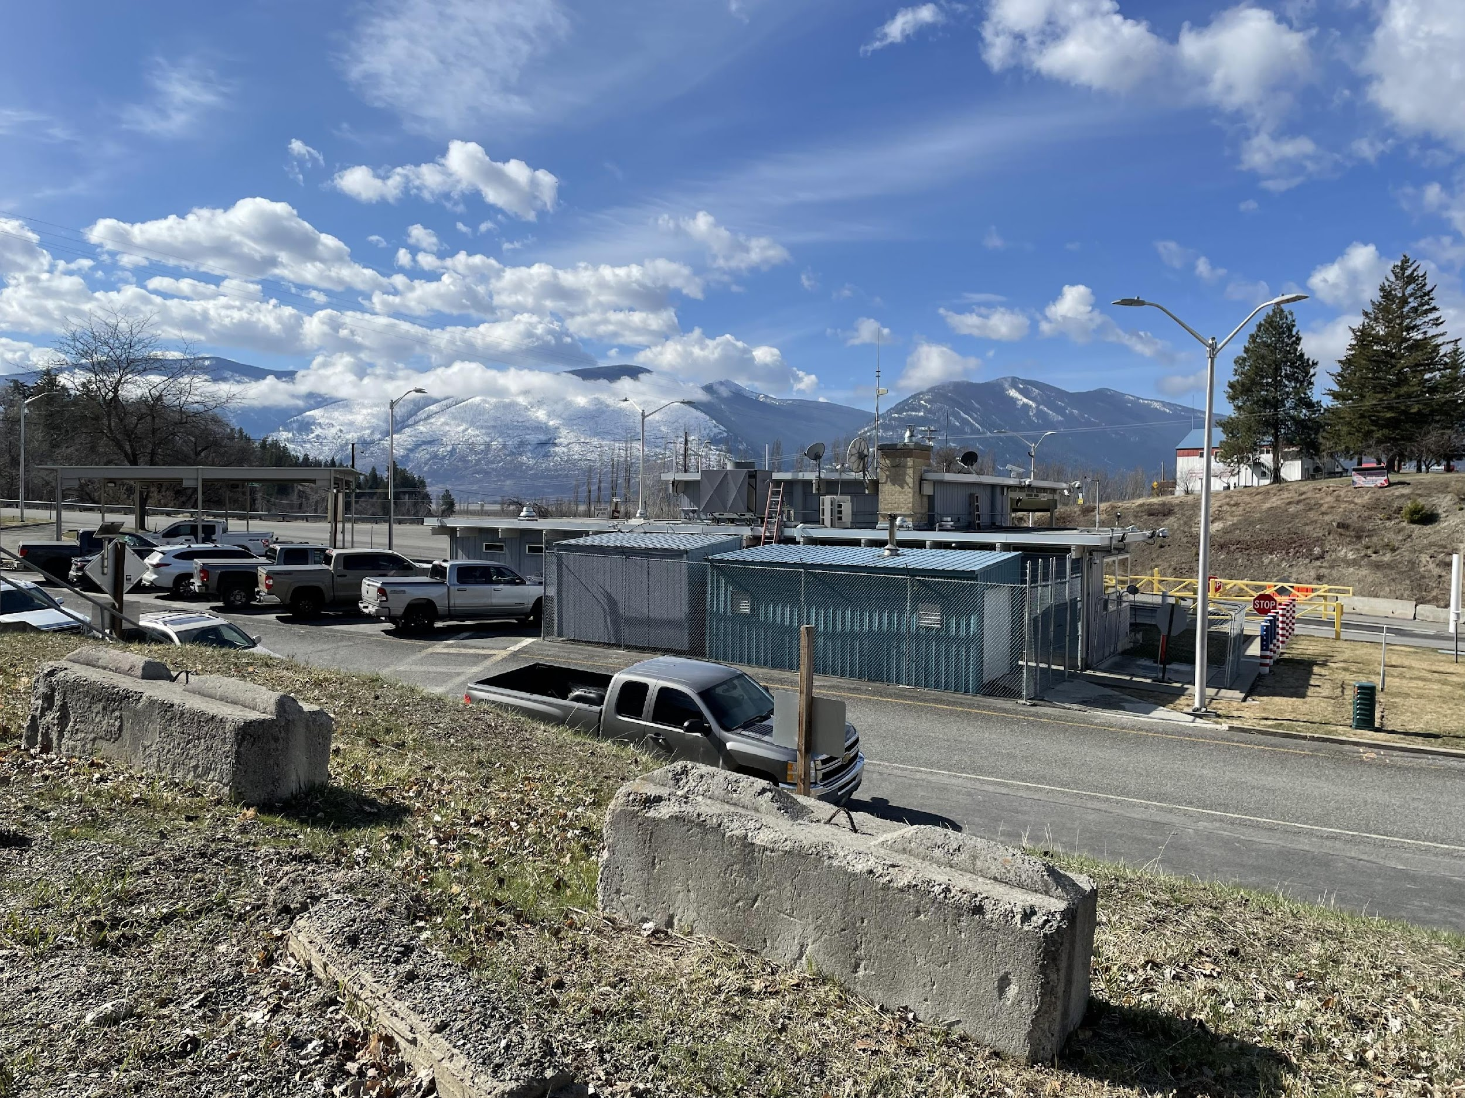
Proposed Project Purpose and Need
Purpose:
To expand and modernize the Porthill LPOE to improve functionality, capacity, and sustainability
Need:
Reroute inefficient traffic flow and increase inspection capacity, which will improve port safety and security and customer service to travelers
Increase the square footage of the LPOE facilities to support port staff and other personnel

Slide 10
Project Overview
The majority of improvements would take place on the current LPOE site
Potential for expansion onto acquired private, county, or state properties
The two action alternatives evaluated in the Draft EA are based on the small port prototype design, which includes:
  Primary screening inspection booths
  Protective lane systems
  Canopy systems
  Interior processing centers
  Secure holding areas for detainees
  Improved lighting in accordance with CBP’s Design Guidelines
  Buildings that provide weather protection and security for detailed vehicle inspections and nonintrusive inspections

Slide 11
Project Alternatives
The Draft EA considers one “no action” alternative and two “action” alternatives:
Alternative 1:
No Action Alternative
  LPOE would continue to operate under existing conditions
  No demolition or construction would take place
Alternative 2:
Small Port with Partial Demolition
  Property acquisition for the expansion of LPOE facilities
  Partial demolition of the LPOE for construction of a small port on existing foundations and utilities
  One-story port building with basement and revised lane formation for incoming traffic
Alternative 3A/B:
Small One- (A) or Two-Story (B) Port with Full Demolition
  Property acquisition for the expansion of LPOE facilities
  Complete demolition of the LPOE
  One-story port building with basement (Option 3A) or two-story port building (Option 3B) and revised lane formation for incoming traffic

Slide 12
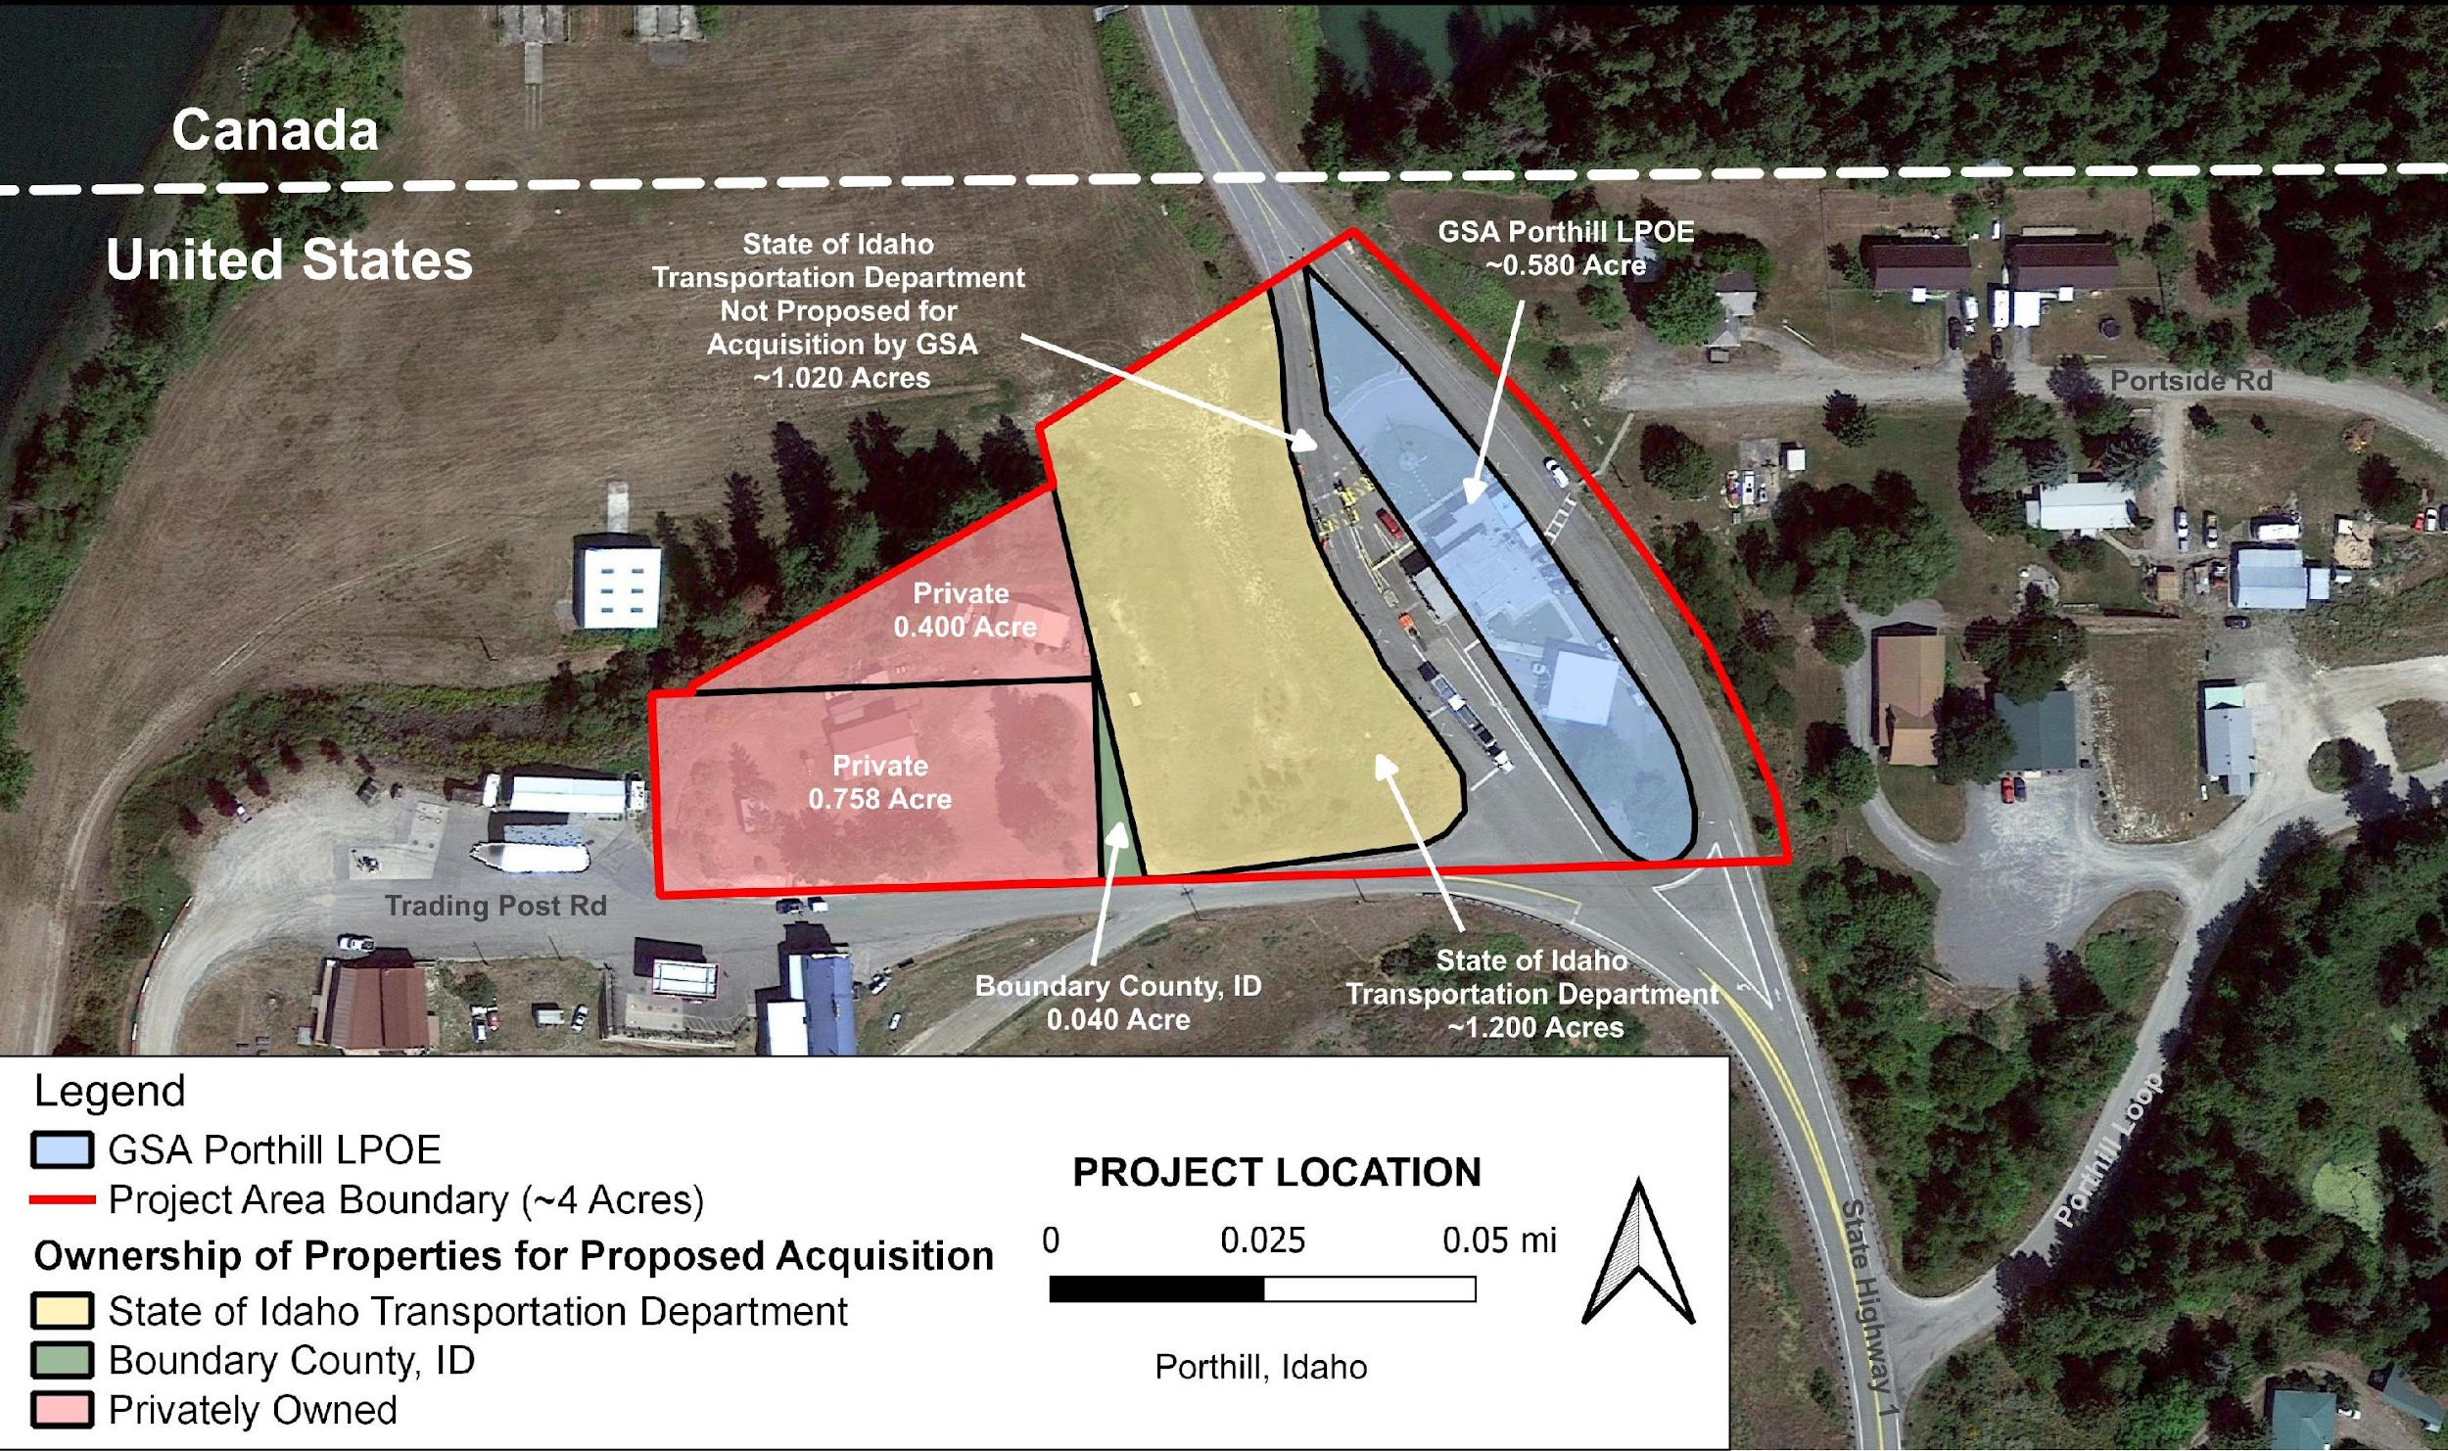
Potential Land Acquisition:
Alternatives 2 and 3

Slide 13
Affected Environment:
Documenting Existing Conditions
The affected environment section of each resource area considered in the Draft EA, listed below, contains a “snapshot” of existing conditions within and nearby the proposed project area.
Cultural and Tribal Resources
Geology, Topography, and Soils
Biological Resources
Utilities
Noise
Water Resources
Air Quality
Climate Change
Environmental Justice
Resources analyzed and dismissed from detailed analysis: Solid and Hazardous Materials; Recreation; Transportation and Traffic; Socioeconomics; Visual Resources; and Land Use.

Slide 14
Environmental Consequences: Documenting Potential Impacts
The environmental consequences section includes an analysis of the potential impacts to each resource area that may occur because of the proposed project.
Impacts can be beneficial or adverse and can vary in magnitude, duration, and extent. All impacts are adverse, unless otherwise noted as beneficial.
The No Action Alternative analyzes the impacts that would occur if the project does not move forward and the port continues to operate under existing conditions.
Impacts on each resource area evaluated are summarized in the next slides.

Slide 15
Potential Effects to
Cultural and Tribal Resources
Alternative 1:
No Action Alternative
  No impacts from routine maintenance activities occurring at the existing LPOE
Alternative 2:
Small Port with Partial Demolition
  Minor, short-term, local impacts on the adjacent 1938 historic LPOE from construction related noise and visual effects
  Minor, short-term, local effects on subsistence or tribal resources from increased noise and air emissions during demolition and construction
  If archaeological resources are uncovered during ground-disturbing activities, potential for adverse or beneficial, major, long-term, site-specific effects on cultural resources
Alternative 3A/B:
Small One- (A) or Two-Story (B) Port with Full Demolition
  Impacts would be the same as those under Alternative 2
  Ongoing consultation with the Kootenai Tribe: Memorandum of Agreement with state and Kootenai Tribe, if needed
Mitigation & Best Management Practices (BMPs)

Slide 16
Potential Effects to
Geology, Topography, and Soils
Alternative 1:
No Action Alternative
  No impacts to geology or topography
  Long-term, negligible, site-specific impacts to soils from routine maintenance activities at the existing LPOE
Alternative 2:
Small Port with Partial Demolition
  Minor, long-term, site-specific impacts to geology due to rock excavation and moderate impacts to topography from grading and filling
  Minor, short- and long-term, site-specific impacts to natural soil functions from soil erosion, sedimentation, compaction, and increased impermeable surfaces
Alternative 3A/B:
Small One- (A) or Two-Story (B) Port with Full Demolition
  Impacts would be slightly greater than those under Alternative 2 due to additional excavation
  Implementation of a Stormwater Pollution Prevention Plan and use of silt fencing, sediment traps, and other BMPs to minimize erosion and sedimentation
Mitigation & BMPs

Slide 17
Potential Effects to
Biological Resources
Alternative 1:
No Action Alternative
  Continued negligible, long-term, local effects to biological resources from routine maintenance activities occurring at the existing LPOE
Alternative 2:
Small Port with Partial Demolition
  Adverse and beneficial, minor, short- and long-term, local impacts on vegetation due to destruction and removal of native and invasive plant species and wildlife habitat during construction activities
  Minor, short- and long-term, local impacts to wildlife due to noise and visual disturbance during construction and operations
  No impacts to state- or federally-listed species are anticipated because no listed species are expected to occur in the area of analysis
Alternative 3A/B:
Small One- (A) or Two-Story (B) Port with Full Demolition
  Impacts would be the same as those under Alternative 2
  Adherence to state permit; vehicle speed limits to prevent wildlife collisions and other construction BMPs; federal or state consultation, if needed
Mitigation & BMPs

Slide 18
Potential Effects to
Utilities
Alternative 1:
No Action Alternative
  No impacts from routine maintenance activities occurring at the existing LPOE
Alternative 2:
Small Port with Partial Demolition
  No impacts to the public electrical service
  Potential impacts on local community well and water supply due to construction and operation of the LPOE to be determined during the design phase
Alternative 3A/B:
Small One- (A) or Two-Story (B) Port with Full Demolition
  Impacts would be similar but less than those under Alternative 2 due to increased efficiency of the modern utility system

Slide 19
Potential Effects to
Noise
Alternative 1:
No Action Alternative
  Negligible, short- and long-term, local effects from continued noise associated with operation and routine maintenance activities at the existing LPOE
Alternative 2:
Small Port with Partial Demolition
  Minor, short-term, local effects from noise associated with disturbance from demolition and construction activities
  Negligible, long-term effects from continued noise from operation and routine maintenance activities at the existing LPOE
Alternative 3A/B:
Small One- (A) or Two-Story (B) Port with Full Demolition
  Impacts would be the same as those under Alternative 2

Slide 20
Potential Effects to
Water Resources
Alternative 1:
No Action Alternative
  Negligible, short- and long-term, local impacts to water resources during continued LPOE operation
Alternative 2:
Small Port with Partial Demolition
  Minor, short-term, local effects on surface water and stormwater and negligible effects on groundwater during demolition- or construction-related activities
  Negligible impacts to water resources during LPOE operation
Alternative 3A/B:
Small One- (A) or Two-Story (B) Port with Full Demolition
  Impacts would be the same as those under Alternative 2
Mitigation & BMPs
  Adherence to state permitting requirements; installation of stormwater diversion gutters and culverts

Slide 21
Potential Effects to
Air Quality
Alternative 1:
No Action Alternative
  Continued negligible, short- and long-term, local impacts on air quality resulting from vehicle emissions from traffic traveling through the port
Alternative 2:
Small Port with Partial Demolition
  Negligible, short-term, local effects to air quality from demolition and construction actions
  Negligible, long-term effects to air quality from vehicle emissions from traffic traveling through the port
  Minor, long-term, beneficial impact to air quality due to decrease in facility emissions as required for Leadership in Energy and Environmental Design (LEED®) certification
Alternative 3A/B:
Small One- (A) or Two-Story (B) Port with Full Demolition
  Impacts would be the same as those under Alternative 2

Slide 22
Potential Effects to
Climate Change
Alternative 1:
No Action Alternative
  Negligible, long-term, regional impacts to climate change from continued emissions from vehicle traffic, HVAC, and emergency generator
  Moderate, long-term, regional impacts from climate change on the LPOE causing higher risk of wildfires, flooding, and other extreme weather events
Alternative 2:
Small Port with Partial Demolition
  Negligible regional effects from demolition and construction equipment emissions (short-term) and from vehicle traffic, HVAC, and emergency generator during port operations (long-term)
  Beneficial, minor, long-term, regional effects with decreased facility emissions, as required for LEED® certification
  Impacts of climate change on the LPOE would be the same as those under the No Action Alternative
Alternative 3A/B:
Small One- (A) or Two-Story (B) Port with Full Demolition
  Impacts would be the same as those under Alternative 2

Slide 23
Potential Effects to
Environmental Justice
Alternative 1:
No Action Alternative
  No impacts from routine maintenance activities occurring at the existing LPOE
Alternative 2:
Small Port with Partial Demolition
  Minor, short-term, local impacts to nearby resident communities and to tribal cultural, or recreational activities occurring along the Kootenai River due to construction-related noise and emissions
Alternative 3A/B:
Small One- (A) or Two-Story (B) Port with Full Demolition
  Impacts would be the same as those under Alternative 2

Slide 24
Next Steps for the EA and
Anticipated Project Timeline
Project Planning and Development (January 2023 – November 2025)
    NEPA
  Draft EA Publication (we are here)
  Public Review Period (January 4 to February 6, 2024)
  Develop Final EA (February – June 2024)
  FONSI (Anticipated June 2024, if no significant impacts are determined)
Design
  Anticipated November 2025
Construction
  Anticipated September 2026
Substantial Completion: Anticipated July 2028
https://www.gsa.gov/porthill

Slide 25
Submitting Public Comments
GSA welcomes public input and will be accepting comments from January 4th through February 6th. GSA has provided multiple ways to submit comments:
    Provide verbal or written comments at this time. To ensure everyone has the opportunity to speak, please limit your comment to three minutes.
    Email your comment to: PorthillLPOE@gsa.gov with subject line “Porthill LPOE Draft EA.”
    Mail your comment to:
    For press inquiries only, please contact Christi Chidester Votisek, at 253-931-7127 or christina.chidester@gsa.gov
Attention:
Melissa Hibray, Capital Project Manager U.S. General Services Administration
1301 A Street, Tacoma, WA 98402

Slide 26
Commenting Etiquette
Once called please say and spell your first and last name at the start of your comment.
Be respectful of participants and presenters.
Remain quiet while others are speaking.
Verbal comments will be limited to 3 minutes.
If time allows, participants may be permitted to speak again after all commenters have had the opportunity to speak.
Comments can also be submitted in writing via Zoom Chat during this hearing or via email or mail after the hearing.
A recording of the meeting will be at gsa.gov/Porthill, and your comments will be included in the administrative record.
Thank you!

Slide 27

U.S. General Services Administration logo

