Slide 1
SBA U.S. Small Business Administration

Slide 2
SBA’s Subcontracting Network
(SUBNet)
January 2025

Slide 3
Today’s Speaker
Stephanie Lewis
Subcontracting Program Manager
U.S. Small Business Administration
Office of Government Contracting
Email: stephanie.lewis@sba.gov

Slide 4
What is SUBNet?
SBA’s Subcontracting Network System (SUBNet) is a centralized, public, no cost system that facilitates the matching of other-than-small businesses (aka large businesses) that have Federal contracts with small business subcontracting plans that are looking for small business subcontractors to fulfill their subcontracting needs with small businesses interested in fulfilling those needs.

Slide 5
Primary Users of SUBNet
Large Businesses that are trying to locate small business contractors can use SUBNet to post subcontracting opportunities/solicitations.
  Although primary purpose is for posting of Federal subcontracts, SBA does allow and encourage other contractors (including state, city and municipalities) to post non-Federal subcontracting opportunities
  For use by companies with current, active, and real subcontracting opportunities to fulfill current or potential contracts
Recent Changes:
  No longer using General Login System (GLS) to register in SUBNet to post opportunities
  SUBNet has moved to the cloud. Now must sign in through SBA Connect (https://connect.sba.gov/) to publish opportunities.

Slide 6
Importance of SUBNet
13 CFR 125.3(b)(3) – Responsibilities of Prime Contractors
Efforts to provide the maximum practicable subcontracting opportunities for small business concern may include, as appropriate for the procurement, one or more of the following actions:
…
ii) Conducting market research to identify small business subcontractors and suppliers through all reasonable means, such as performing online searches via the System for Award Management (SAM) (or any successor system), posting Notices of Sources Sought and/or Requests for Proposal on SBA’s SUBNet, participating in Business Matchmaking events, and attending pre-bid conferences;

Slide 7
Importance of SUBNet (continued)
13 CFR 125.3(d) Contracting officer responsibilities. The contracting officer (or administrative contracting officer if specifically delegated in writing to accomplish this task) is responsible for evaluating the prime contractor's compliance with its subcontracting plan, including:
(3)(ii) Examples of activities reflective of a failure to make a good faith effort to comply with a subcontracting plan include, but are not limited, to:…
(G) Failure to conduct market research identifying potential small business concern subcontractors through all reasonable means including outreach, industry days, or the use of federal database marketing systems such as SBA's Dynamic Small Business Search (DSBS) or SUBNet Systems or any successor federal system.

Slide 8
Primary Users of SUBNet (continued)
Small Businesses searching for subcontracting opportunities at https://subnet.sba.gov/client/dsp_Landing.cfm
  Do not need to register with SBA Connect to view postings
  Should not request SUBNet posting access
  Can use SUBNet to identify business contacts
  Can use SUBNet to gain information on types of work being subbed by large businesses in order to have more targeted marketing
SUBNet is NOT to be used for posting marketing materials.
SBs advertising their own company or capabilities will be removed.

Slide 9
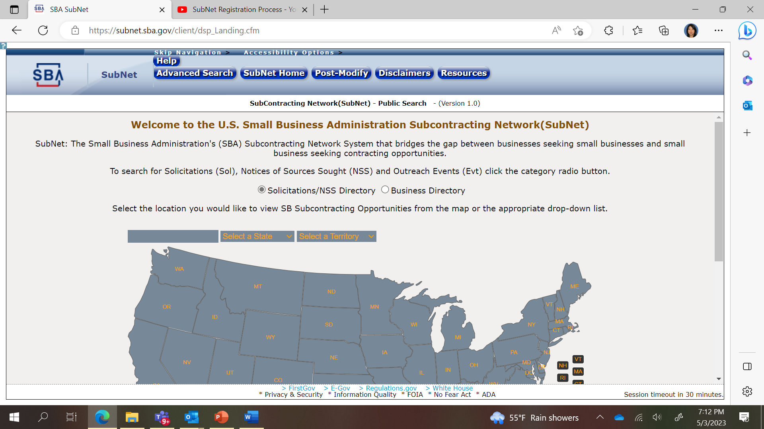
Searching for Subcontracting Opportunities
(Future Enhancement)
Can select State from drop-down or click on State from map

Slide 10
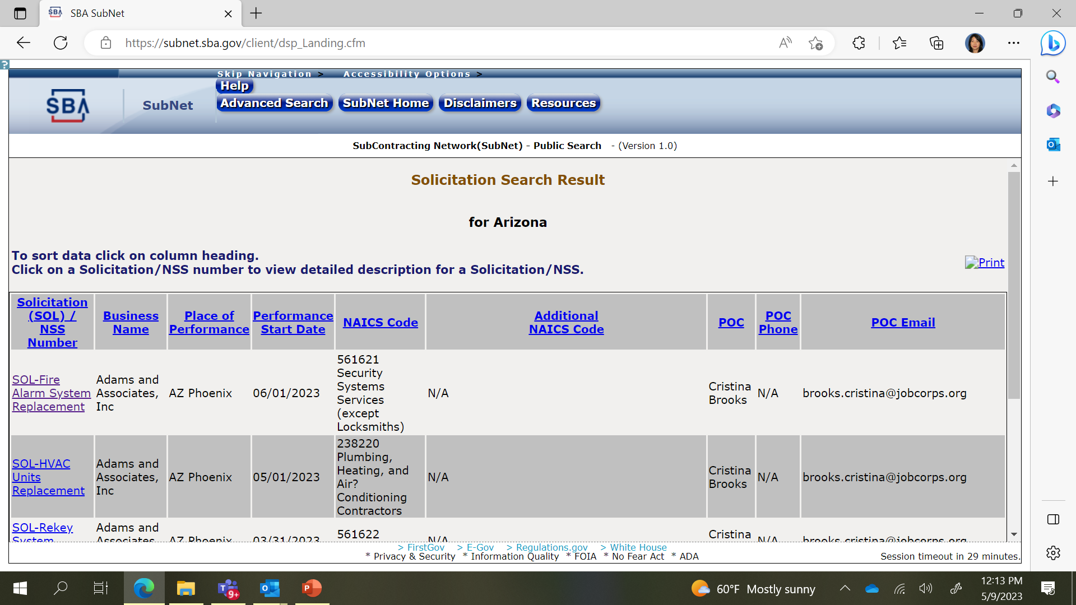

Search Results – Place of Performance

Slide 11
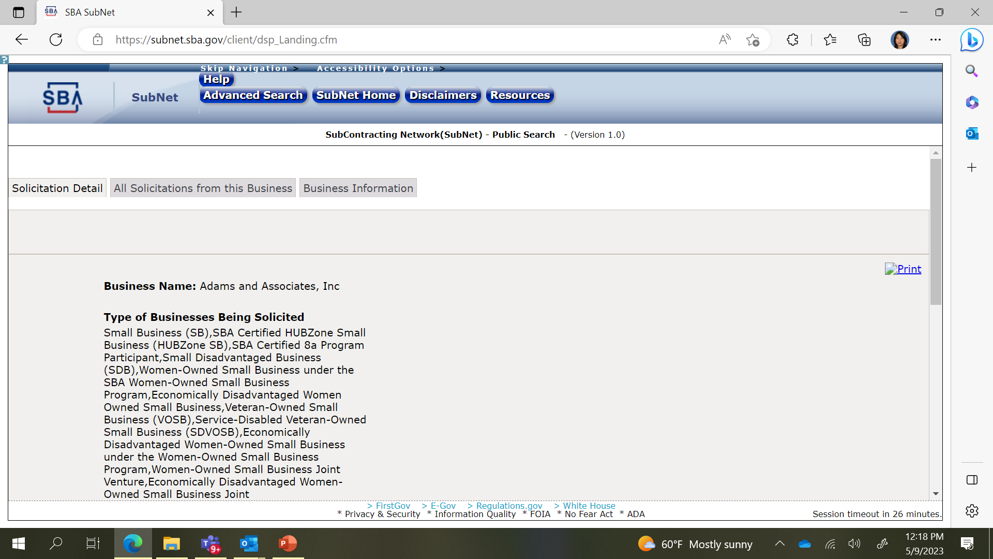
Solicitation Details

Slide 12
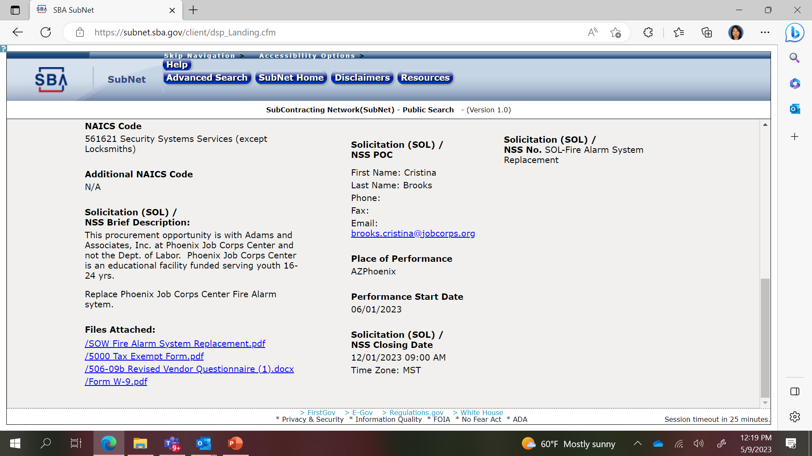
Solicitation Details (continued)

Slide 13
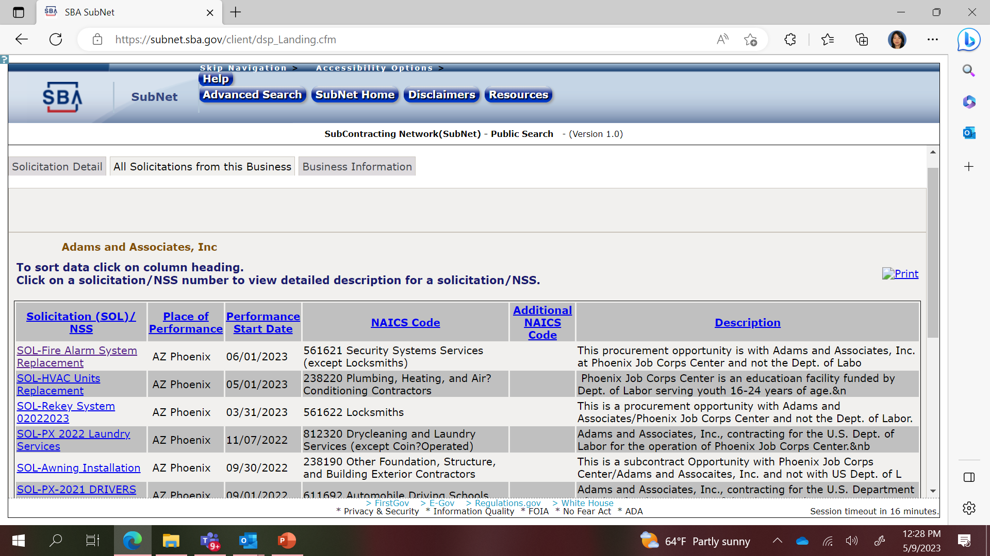
All Solicitation from this Business

Slide 14
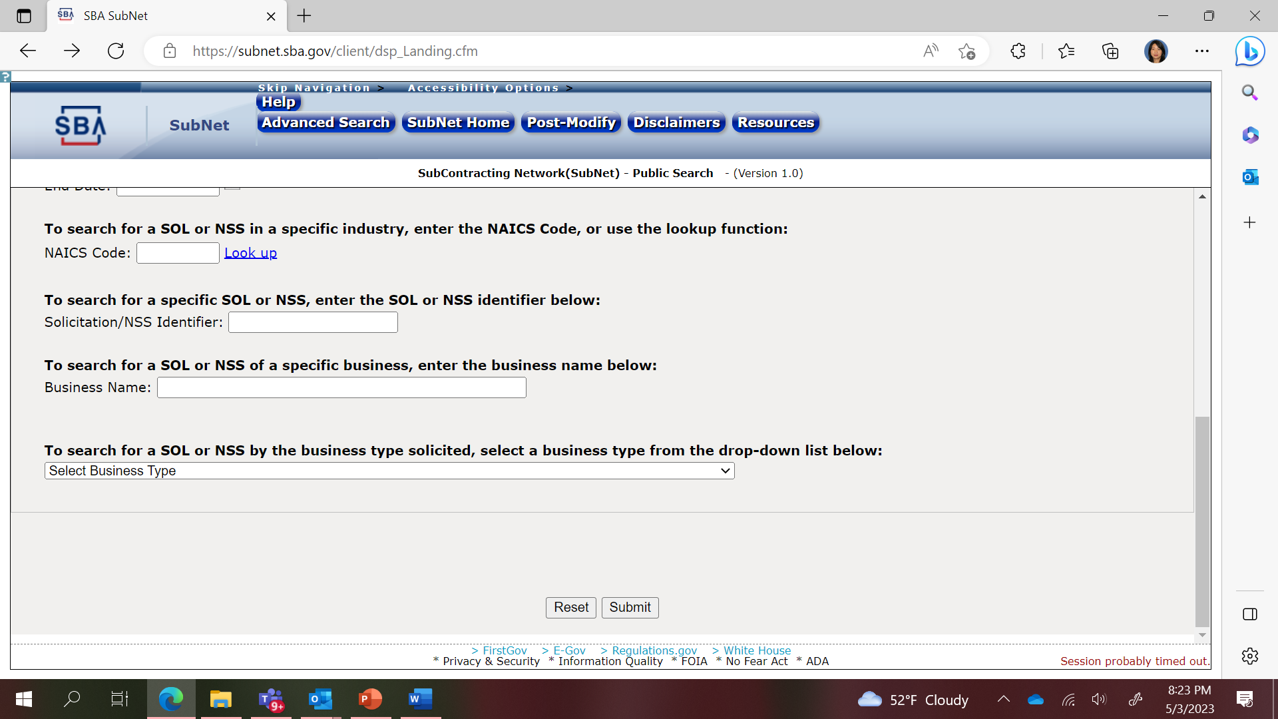
Using Advanced Search (continued)
If get “Internal Error” message, ignore message. Click ok and “Submit.”

Slide 15
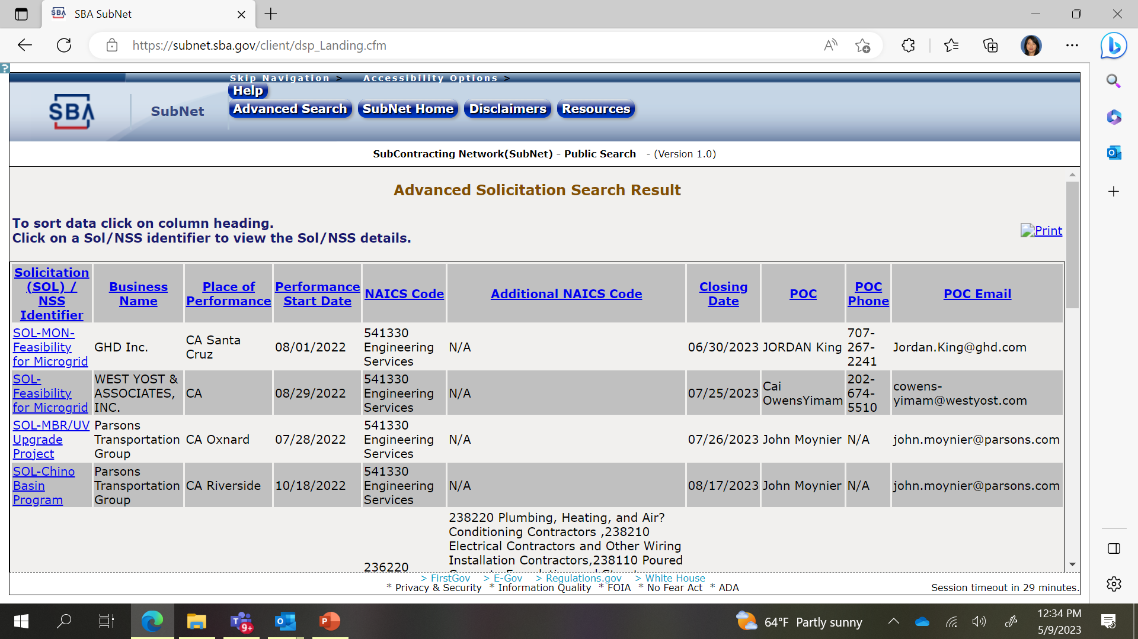
Using Advanced Search (continued)

Slide 16
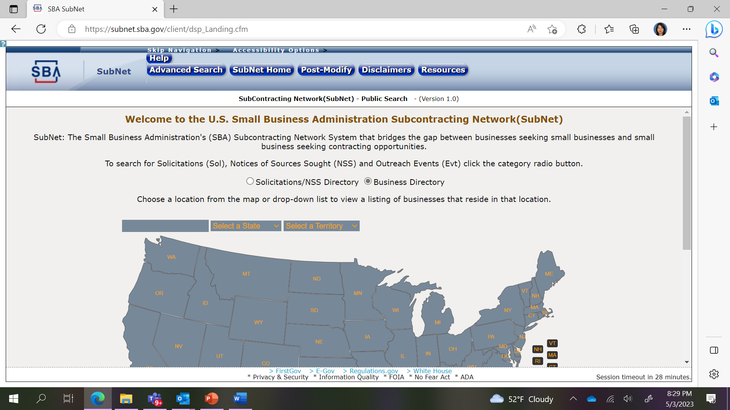
Searching Business Directory

Slide 17
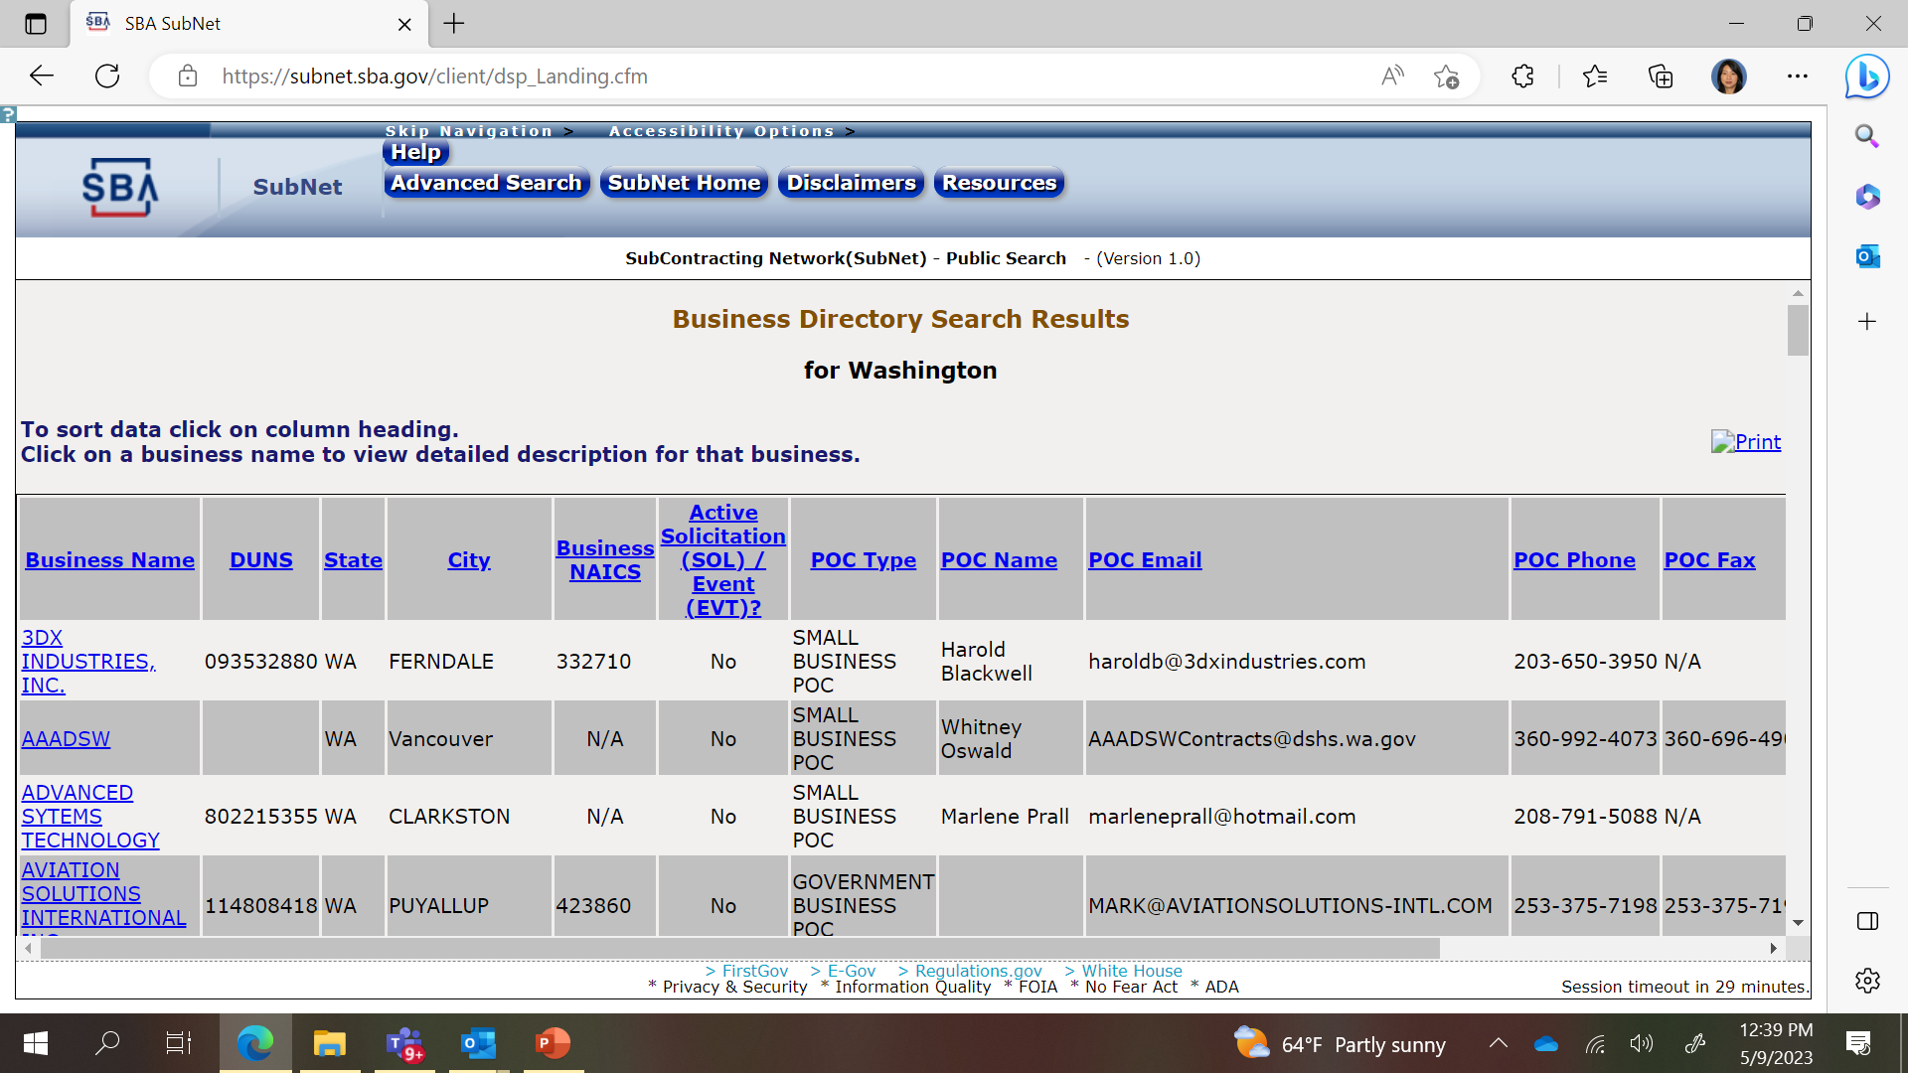
Business Directory Results
Check for Active Solicitations

Slide 18
Things of Note
States:
  Larger states have more postings
  Some states have no postings
Industries:
  Most common are in construction
  Other popular industries are computer related/IT related and consulting
Contract Types
  Many of the subcontracting opportunities are for local/municipal work

Slide 19
Needing Assistance
If you have non-technical questions or need assistance with the Subcontracting Program, contact a Commercial Market Representative (CMR Directory on SBA website at https://www.sba.gov/federal-contracting/counseling-help/commercial-market-representatives or email subcontracting@sba.gov
If youhave questions regarding a posting (posting/notices of sources sought), contact the business directly.

Slide 20

Benefits of Subcontracting
Starting point for Federal contracting
Builds capacity
Creates past performance
Access to the Federal Government indirectly
Faster way to enter the Federal Marketplace
Notes:
Subcontracting could be your starting point into the Federal Government marketplace
The simpler, faster, and less burdensome way to get into the Federal Government marketplace is through subcontracting
Subcontracting allows an SB to work with the Federal Government indirectly
Subcontracting builds capacity and creates past performance
Allows more opportunities for small businesses

Slide 21

Why are Subcontractors Needed?
When a federal government contractor needs assistance fulfilling certain project components.
Contract requirements and business goals.
Notes:
When a federal government contractor needs assistance fulfilling certain project components, they will typically look for subcontractors to perform the work.
Subcontractors are also needed due to contract requirements and business goals.

Slide 22
Important Subcontracting Terms
Federal Government Prime Contractor: A person/business who
has entered into a prime contract with the Federal Government to obtain supplies, materials, equipment, or services.
Federal Government Large Business (LB) Subcontractor: A person/business that doesn’t meet the qualifications of a small business that was awarded a subcontract to provide supplies or services necessary in the performance of someone else’s Federal Government’s contract.
SB Federal Government Subcontractor: A concern that does not exceed the size standard for the North American Industry Classification Systems (NAICS) code that the Federal Government contractor determines best describes the product or service being acquired by the subcontract.
NAICS: Economic classification system used to classify economic activity.
Notes:
What is a Federal Government Prime Contractor?
A person/business who has entered into a prime contract with the Federal Government for the purpose of obtaining supplies, materials, equipment, or services.
What is a Federal Government Large Business (LB) Sub-Contractor?
A person or business that doesn’t meet the qualifications of a small business that was awarded a subcontract to provide supplies or services necessary in the performance of someone else’s Federal Government’s contract.
What is an SB Federal Government Subcontractor?
Small business subcontractor means a concern that does not exceed the size standard for the North American Industry Classification Systems (NAICS) code that the Federal Government contractor determines best describes the product or service being acquired by the subcontract.
What is a NAICS?
The North American Industry Classification System (NAICS) economic classification system used to classify economic activity. Identifying your NAICS and those you are prepared to do business with allows you to strategically target ideal prospects eliminating the waste of resources on ineffective and ill-targeted marketing.

Slide 23
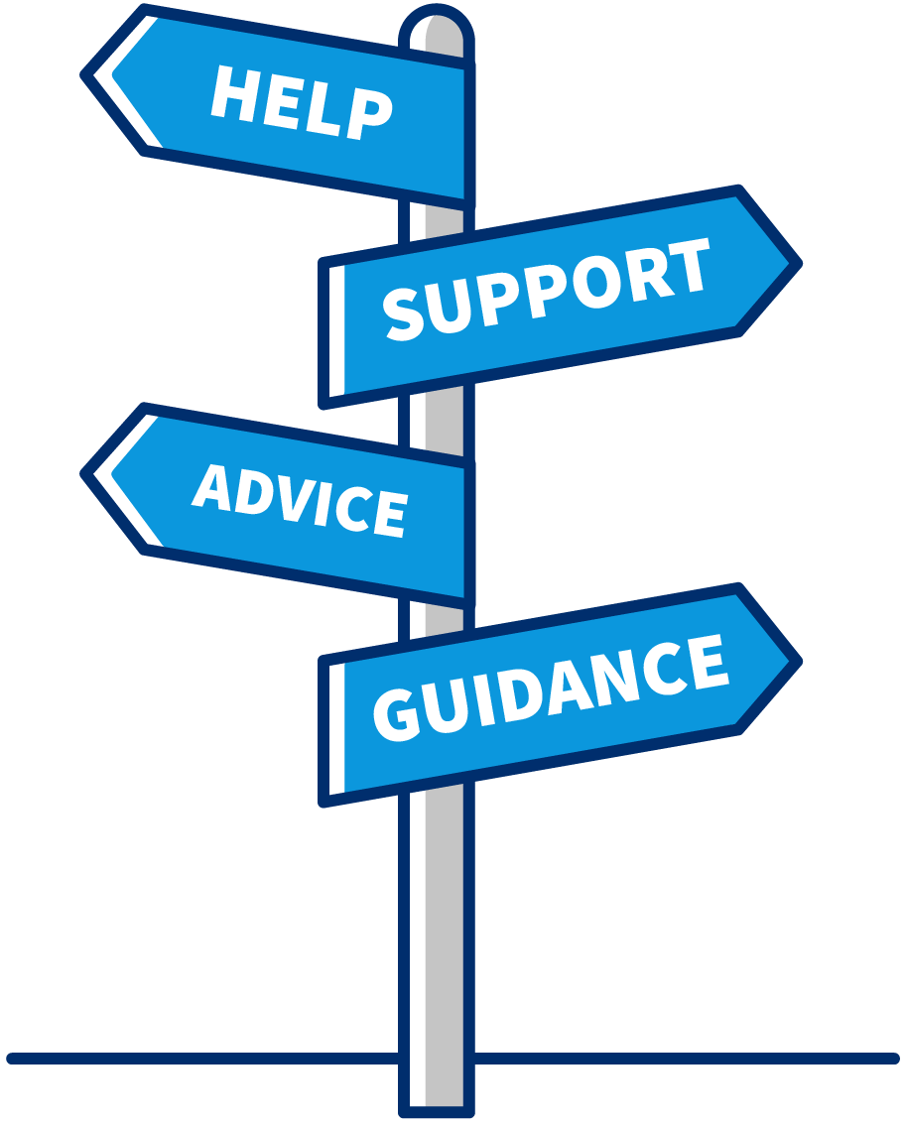
Additional Subcontracting Terms
Subcontract: A contract for a company/person to do work for another company/person as part of a larger contractual project.
Notices of Sources Sought (NSS): A notice to gain information about an industry.
Subcontract Possibility: When a firm has identified a need for outside support, but they have not provided the opportunity to bid on any requirement.
Subcontract Opportunity: A Subcontract Opportunity is when a Federal Government Contractor has identified a need and is seeking a subcontractor.
Notes:
What is a subcontract?
A contract for a company or person to do work for another company as part of a larger contractual project.
What are Notices of Sources Sought (NSS)?
An NSS is a notice to gain information about an industry. It is a subcontract possibility that is often confused with a subcontracting opportunity. A person or firm is seeking to ascertain who in the market can perform work and find out information about capabilities.
What is a subcontract possibility?
A subcontract possibility is when a firm has identified a need for outside support, but they have not provided the opportunity to bid on any requirement. Please note just because a Federal Government contractor has a requirement to utilize an SB doesn’t mean there will be an opportunity for you to be awarded a subcontract. This could be due to the firm already having their subcontracting team established or identified. However, there may be a possibility for future suppliers, and you want to be in the pipeline when this opportunity opens.
What is a subcontract opportunity?
A subcontract opportunity is when a Federal A Subcontract Opportunity is when a Federal government contractor has identified a need and is seeking a subcontractor to fulfill that need.

Slide 24

Understanding the Subcontracting
Federal Acquisition Regulation (FAR)
  Small business subcontractors must:
  Adhere to the FAR clauses in their contract
  Be aware of all regulatory requirements
  Subcontract regulation that governs the SB Subcontracting Program
  FAR Subpart 19.7 SB Programs
  FAR 52.219-8 Utilization of SB Concerns
  FAR 52.219-9 SB Subcontracting Plan
  13 CFR 125. Government Contract Programs
Notes:
What shall SBs know about the Federal Government SB Subcontracts Program?
SB Subcontractors must adhere to the FAR clauses in their contract
SB Subcontractors must be aware of all regulatory requirements
What are the FAR regulations that govern the Federal Government SB Subcontracts Program?
Subcontract regulation that governs the performance of a large business
FAR Subpart 19.7 SB Programs
FAR 52.219-8 Utilization of SB Concerns
FAR 52.219-9 SB Subcontracting Plan
In order to participate in government contracting, you must comply with all laws and regulations. The Federal government's purchasing process is governed by the Federal Acquisition Regulation (FAR). It is important for SB to obtain an understanding of the regulations so that they are informed of the requirements of being awarded a federal government contract or subcontract under the SB Subcontracting Program and the protections the regulations afford them.

Slide 25

Small Business Subcontracting Opportunities
Locate a contractor who has been awarded a Federal government prime or subcontract that utilize what you supply
Locate a firm that is seeking a Federal Government contract and establish a Team Arrangement
Notes:
There are two ways to become a subcontractor:
Locate a contractor who has been awarded a Federal government prime or subcontract that utilize what you supply
The United States Congress created the SB Subcontracting Program under the Small Business Act to ensure SB receives maximum practicable opportunity to participate in Federal Government contracts.
However, Federal government agencies do not have the authority to prescribe the amount of subcontracting to be subcontracted to an SB or require the Federal Government contractor to use a particular small business.
Locate a firm that is seeking a Federal Government contract and establish a Team Arrangement as it relates to being a subcontractor is defined in FAR 9.601 (2) a potential prime contractor agrees with one or more other companies to have them act as its subcontractors under a specified Government contract or acquisition program if they win the prime contract.

Slide 26
Subcontracting Risk
1
Bait and Switch
Providing information on a proposal but not being given the work once the contract has been awarded
Federal Regulation prohibits and addresses what a SB shall do when they are a victim of Bait and Switch
2
Untimely Payments
Federal Regulation prohibits untimely payments and addresses what is acceptable for late payment and what a SB shall do when they are a victim of Untimely payments
3
Delay
  No control over the delay caused by dependency (work that must be done prior to you starting your work
4
Project Performance
  Federal Government contractor’s overall contract performance assessment is dependent on all subcontractors’ performance. A subcontractor’s poor performance can give them a bad name in the industry
26
Notes:
Bait and Switch
Providing information on a proposal but not being given the work once the contract has been awarded
Be sure to contact the Federal Agency who awarded the contract to inform them of any Bait and switch issues
Timely payment
Be sure to contact the Federal Agency who awarded the contract to inform them of any late payments
Delay
A delay in performing a subcontract may delay other projects you have in your pipeline. You may want to have a contingency plan in place in case this occurs to ensure your performance on either contract is not considered negligence.
No control over the delay caused by dependency (work that must be done prior to you starting your work
Project Performance
Federal Government contractor’s overall contract performance assessment is dependent on all subcontractors’ performance. A Subcontractor’s poor performance can give them a bad name in the industry

Slide 27
How Do I Become a Federal Government SB Contractor
Meet Federal Government requirements
Identify your target market
Federal Government systems that provide promotional marketing assistance
Become familiar with the Federal Government contractors in your market and their suppliers
Identify subcontracting possibilities and opportunities
Submit a bid with an SB self-certification
Review and accept contract terms
27

Slide 28
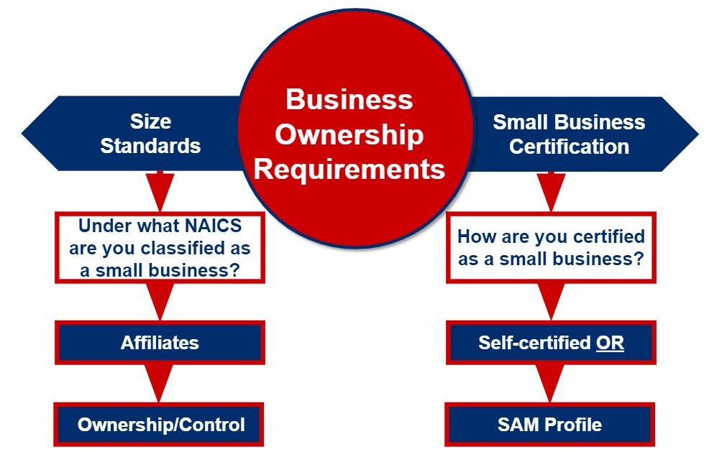
Requirements for a Small Business Subcontractor
28
Notes:
What are the Federal Government Requirements to become an SB Subcontractor?
Business Ownership Requirements are outlined under 13 CFR 121.105 - How does SBA define “business concern or concern”?
(a)(1) Except for small agricultural cooperatives, a business concern eligible for assistance from SBA as a small business is a business entity organized for profit, with a place of business located in the United States, and which operates primarily within the United States or which makes a significant contribution to the U.S. economy through payment of taxes or use of American products, materials or labor.
Affiliates
You must include the employees or receipts of all affiliated when determining the size of a business. Affiliation with another business is based on the power to control, whether exercised or not or whether a third-party controls or has the power to control multiple businesses. The power to control exists when an external party has 50 percent or more ownership. It may also exist with considerably less than 50 percent ownership by contractual arrangement or when one or more parties own a large share compared to other parties. Check the SBA’s compliance guide for size and affiliation for more detailed information.
Size Standards
To be eligible for government prime or subcontract contracts reserved for small businesses, your business must meet size requirements set by the SBA. These size standards define the maximum size that a business — and its affiliates — can be to qualify as a small business for a particular contract. The SBA assigns a size standard to each NAICS code. A Business Size is based on the Size Standard associated with the NAICS. To determine if your business qualifies as "small" for government contracting purposes, use the SBA’s Size Standards Tool at www.sba.gov or register in SAM
Certification as an SB
How Does a firm certify they are small on subcontracts?
13CFR§121.411 What are the size procedures for SBA's Section 8(d) Subcontracting Program? Provides detail information about self-certification of small business size under a subcontract
A business can self-certify themselves as a SB at the time of submitting a proposal based on the NAICS used in the solicitation or
Being certified as a small through SAM
Whichever method the SB is certified as small they must submit either the self-certification or the valid SAM profile in accordance to the FAR with the proposal
Self -certifications can be:
An active and accurate SAM Profile
SAM calculates the size standards for each NAICS and provides the size status of the firm
SB with an updated registration can use their SAM Profile as a self –certification document submitted with proposals for all NAICS the business qualifies as small based on the NAICS size standards
SB with an updated registration can use their SAM Profile as a self –certification document submitted with proposals for all NAICS the business qualifies as small based on the NAICS size standards
A document certifying they are small, the document must include:
Those claiming a status under SBA’s Certification Program must be verified in the Dynamic Small Business System (DSBS)

Slide 29
Identify Your Target Market
Subcontracting could be your starting point into the Federal Government marketplace
The simpler, faster, and less burdensome way to get into the Federal Government marketplace is through subcontracting
Subcontracting allows an SB to work with the Federal Government indirectly
Subcontracting builds capacity and creates past performance
Allows more opportunities for small businesses
YOUR TARGET MARKET
29
Notes:
Understand how the government marketplace works:
Federal government contractors utilize the NAICS to publish subcontract opportunities and to determine the size of a subcontractor’s business. Therefore, understanding how the government marketplace works help you identify where you fit in, prevents the waste of resources and gives you a better return on investment
Do research to identify
The NAICS that best describes your firm’s products and services. You’ll need to match your products and services to a NAICS. NAICS codes classify businesses based on the particular product or service they supply. A business will generally have a primary NAICS code, but it can also have multiple NAICS codes if it sells multiple products and services. To find your NAICS code, view the NAICS code list at the U.S. Census Bureau.
Further identify your size under those NAICS
Are you a large or small business?
Identify what NACIS can use your business products or services
Industry Targeting
Market Segmentation
Potential New Market
Identify government-sponsored SB expos, trade shows, and other forums through FedBizOpps and other resources to meet and make contacts with other potential and existing Federal Contractors

Slide 30
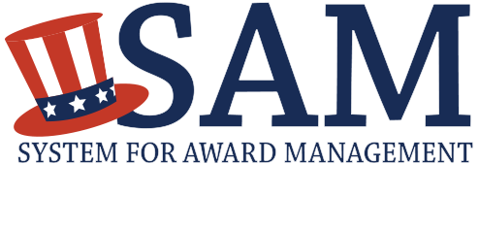
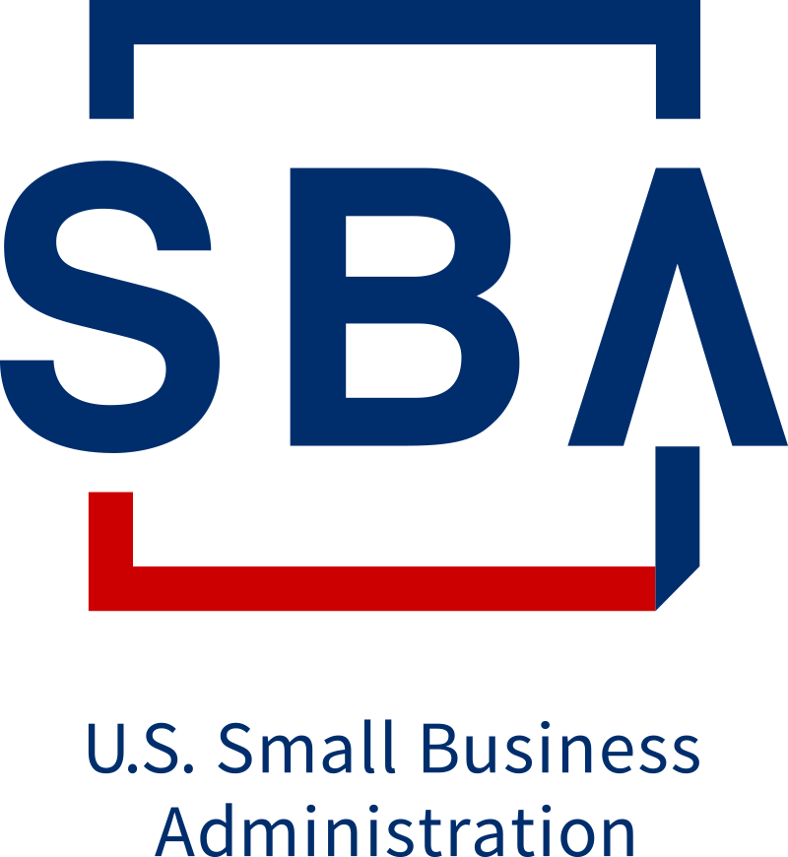
Promotional Marketing Assistance
DSBS displays a SB’s capability statements, bonding levels, insurance, certifications, security clearance levels and other pertinent business information
Searching for SB using DSBS is mandatory for all Federal government contractors needing to identify SB sources
SAM provides the size status for the entire NAICS Table
The valid SAM profile can be used as the self-certification
Business seeking SB can locate SB by searching both SAM and DSBS
Dynamic Small Business Search
Notes:
The Systems (DSBS and SAM) and how they can help promote your business. Your small business’ profile in SAM and DSBS is like a résumé. Creating a profile that’s accurate and appealing is important to winning a government contract. Make sure to use accurate, descriptive terms about your business so that you will be easily identifiable in search queries by those seeking to locate small businesses.
SAM
SAM is the Federal Government Contractors Registration System. All prime contractors are required to register in SAM. SAM is also a tool that can assist Small Business subcontractors. Using SAM, you’ll able to certify that your business is eligible for contracts that are reserved for small businesses.
SAM certifies each business registered to the entire NAICS table in accordance with the NAICS size standards. Therefore it can be used to verify small business size and socio-economic status. If a firm has a valid SAM profile, they do not have to complete a self-certification to submit during subcontract proposal submittal. The small business can print its SAM profile and submit it with the proposal.
SAM is a database that government agencies, individuals and business use to search to find large and small business contractors.
SB with an updated SAM registration can apply for prime contracts
DSBS
DSBS is a database that is dedicated only for small businesses and government agencies, individuals and business use to search to find SB contractors. DSBS is searchable by using by business type, certifications, security levels and many other criteria.
The Dynamic Small Business Search (DSBS) is a free database hosted by the SBA that provides a listing of small business contractors. Contractors as well as government entities use DSBS to locate small businesses. No system log in is required to perform a search of small businesses. DSBS is available at www.dsbs.sba.gov.
Small businesses use DSBS as a marketing tool. If you are a small business and would like to be listed in DSBS, you must first register in the System for Award Management (SAM). SAM will review revenue/employee information inputted by a firm to validate their small business size status SAM is available at www.sam.gov. Once your SAM registration is complete you will be entered in DSBS. To get more information about DSBS visit www.dsbs.sba.gov
DSBS will verify whether a small business has received a certification from SBA under the 8(a) Business Development and/or HUBZone programs.

Slide 31

Become Familiar
Get to know the NAICS code for what the
Federal Government needs and you can supply
Federal Contract Award Data
Federal Procurement Data System (FPDS-NG)
USA Spending
Federal Procurement Directories
Federal Agency: Office of Small Business Utilization (OSDBU)
List of major Federal Government contractors
Information on SB opportunities
Listing of agency’s acquisitions
Other Resources
Government and industry's events, matchmaking, expos and trade shows
Current and potential Federal Government suppliers
FedBizOpps
31
Notes:
Identify who has a Federal Government contract under the NAICS that your business wants to supply by reviewing Federal Government contract award data. This information can be found in:
Federal Procurement Data System (FPDS-ng)
USA Spending
Federal Procurement Directories
SBA
GSA
DOD
Where they can be found
Current Federal Government suppliers are identified through:
Federal Procurement Directories
Attending Federal Government procurement events
Searching SBA’s Subcontracting Network System (SUBNet)
Review the Federal Government agencies Office of Small Business Utilization (OSBU) website to view:
Listing of their major Federal Government contractors
Information on upcoming SB events
Information on what the agency buys
Goals for increasing small business participation
FedBizOpps (Federal Business Opportunities) www.fbo.gov
Small business events
Vender collaboration opportunities
Prime contract opportunities
Subcontract identification information
Attend government-sponsored expos, trade shows, and other forums
To meet and make contacts with current and potential Federal Government suppliers
Learn about subcontract opportunities and best practices
Each agency puts on SB events that introduce SB on how to do business with them
Agencies also do match making events that allow SB to meet other Federal government contractors

Slide 32
Gathering Information
R
Relationships always matter, and relationships with Federal government suppliers are no exception, and first impressions
are lasting.
Conduct research on an organization’s processes, procedures and needs
Look to form long-term business relationships
Review subcontractor requirements and opportunities
Research existing suppliers
Use events to network and meet influencers
Notes:
Relationships always matter, and relationships with Federal government suppliers are no exception, and first impressions are lasting. Therefore it is not recommended to contact the Federal government supplier by telephone or email to ask about subcontracting opportunities.
It is recommended that the SB develop a strategy to introduce themselves and inspire the large firm to award them a subcontract by utilizing the information they have obtained through research of the organization processes, procedures and need. SB can obtain valuable information by using the company’s website to gather information. This will not only help you understand a company better but will also give you an advantage. Remember your looking to form long-term relationships so do your research and follow the companies processes and procedures.
Information found on the company’s website includes:
The type of subcontract opportunities
How to become a subcontractor (supplier, partner, etc..) or How to do business with the organization
Existing suppliers
Subcontractor requirements
Events (where you can meet influencers)

Slide 33

Tools to Help Identify
Subcontract Possibilities
  Federal Procurement Data System – New Generation
  Federal Directories
Subcontract Opportunities
SBA’s Subcontract Network System (SUBNet)
  Solicitations
Firm’s Websites
  Provide instruction on what they buy, how to become a partner, and outreach events
Is it a Subcontract Possibility or
Subcontract Opportunity?
Notes:
A subcontract possibility is often confused with a subcontracting opportunity. A person or business who is seeking another person or business to perform work is a subcontract opportunity. A person or business that is seeking information, identifying vendor’s capabilities or has a contractual requirement to subcontract is only a subcontract possibility.
Federal Procurement Data System – New Generation
Notices of Sources Sought (NSS), data from FPDS-NG and Federal directories are possibilities.
Solicitations posted in SUBNet or on Government and vendors websites are opportunities.
When using FPDS-NG and Federal directories pay close attention to the contract end date.
FPDS-NG and Federal Government Procurement Directories
Listing of every Federal Procurements awarded by each government agency
Allows you to search by:
Federal Government Contractor’s Name
Federal Government Agency’s Name
NAICS
Federal Government Procurement Directories
Listing of Federal Procurements awarded with a Subcontract Plan
SUBNet:
Businesses seeking SB subcontractors post subcontracting opportunities in Sub-Net. There is no cost to use Sub-Net. If you are a SB looking for subcontracting opportunities searching is easy and no log in is required. SBA encourages you to frequently visit the Sub-Net website to seek available subcontracting opportunities in your area of expertise that you would like to submit a proposal. Sub-Net is located at www.sba.gov/subnet
Firm Websites
Provides a variety of information on the company buying trends

Slide 34




Consider the Pricing Factors
Subcontract pricing history
Work with a local APEX Accelerator to get pricing data
Special requirements
Consider all costs associated with special requirements
Quality requirements
Know all costs associated with certifications and fees
Overhead and profit
Consider all overhead costs to ensure you are making a profit
Notes:
Take into account the following requirements, costs, and other subcontract pricing factors before you sign a contract:
Subcontract pricing history: Find out what your competitors are charging for similar services or contact an Apex Accelerator to ask if it has any history of what subcontractors were paid for projects that required similar services. You can also ask to look at a few past contracts to see what was required of the subcontractor, and to make a fair evaluation of the subcontract pricing structure.
All special requirements: Extra requirements, such as special deliveries, can add up. If you are simply adding on a percentage of your overall subcontract price, be aware that you will need to factor in gas, mileage, and the delivery person’s fee to accurately estimate delivery costs.
Quality requirements: If certifications or acknowledgements are required, will there be an added cost to your subcontracting business? See what additional fees may be involved with getting the needed certifications or acknowledgements, and how that will affect the ending subcontract price.
Overhead and profit: Although the bidding process can be very competitive, remember that you need to make a profit. Bidding on a contract just to win does not make good business sense if you will not profit in some way. Be sure to consider all overhead costs when calculating your end prices, including salaries, insurance, lease payments, utilities, postage charges, etc.
Until you know your true subcontracting costs, you will not be sure if you’re actually making money in certain areas or not. Even if you see an increase in sales, it does not mean that you have an increase in profit. If your cost information is not accurate, then you will not have a competitive price.

Slide 35
Submit a Bid with a SB Self-Certification
1
2
Follow the Bid instructions.
Do not deviate.
Attach a self-certification for the NAICS code identified in the solicitation.
Notes:
Follow the Bid instructions do not deviate
Attach a self-certification for the NAICS code identified in the solicitation you will be submitting the bid to fulfill

Slide 36

Review Contract Terms Before Signing the Subcontract
Make sure you understand the subcontract agreement terms and conditions, including payment terms.
Notes:
Make sure you understand the subcontract agreement terms and conditions, including payment terms. If the Federal Government contractor is late in paying you or stops payment, as a subcontractor, you will have the right to discuss this matter with the Federal Government agency that awarded the contract or SBA’s CMRs.

Slide 37




Are You Ready to Be a Subcontractor?
Do you have the capacity, capability and capital to perform a subcontract?
Do you have the proper qualifications, certifications and experience to support your capability statement?
Have you identified your target market?
Are you prepared to agree to the terms and conditions of a subcontract?
Notes:
Do you have the capacity, capability and capital to perform a subcontract?
Do you have the proper qualifications, certifications and experience to support your capability statement?
Have you identified your targeted market?
Are you prepared to agree to the terms and conditions of a subcontract?

Slide 38
Other Federal Government Resources

Slide 39
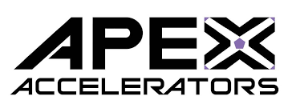
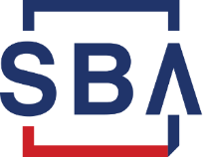

Procurement Assistance
APEX Accelerators (formerly Procurement Technical Assistance Centers [PTACs])
Government prime and subcontract assistance
Consulting and workshops
Information and resources
SBA Resources
SBA’s Learning Center
SBA Commercial Market Representative (CMRs)
Other Resources
Federal Agency Procurement Directory
  SBA’s Federal Government Prime Contractors with Subcontracting Plan
  GSA Subcontracting Directory
  DoD Prime Contracting Directory
Notes:
Apex Accelerators (previously called Procurement Technical Assistance Centers (PTACS)) - help businesses pursue and perform under contracts with the Department of Defense, other federal agencies, state and local governments and with government prime contractors. Most of the assistance the Apex Accelerators provide is free. Apex Accelerators support to businesses includes registration in systems such as the System for Award Management (SAM), identification of contract opportunities; help in understanding requirements and in preparing and submitting bids. For more information on Apex Accelerators visit www.sba.gov search Apex Accelerator.
SBA’s Learning Center has resources that are available 24 hours a day/7 days a week to assist with growing, marketing and understanding government contracting and a host of other topics. These resources are located at www.sba.gov search learning center.
CMRs administer the SBA’s subcontracting program to ensure that small businesses are provided maximum practicable opportunity to participate in Federal subcontracts
Federal Agency Procurement Directory: The directory is a listing of Federal government contractors that have a requirement to subcontract to small businesses. This listing is intended for small business concerns seeking to find subcontracting possibilities with Federal Government prime contractors. Although, the prime has an obligation to subcontract to small business (SB) doesn’t mean they are seeking new subcontractors. They may already have teams of small business subcontractors. Therefore, this directory is only used as a source to identify potential subcontracting opportunities. The directories can be found by searching the Federal Agency website not all Federal agencies list this information, but it is available to the public through FPDS-NG.

Slide 40

QUESTIONS?

