Slide 1


Small Business Works 2024
GSA OSDBU A.C.T.S on Maximizing Small Business Opportunities
U.S. General Services Administration

Slide 2

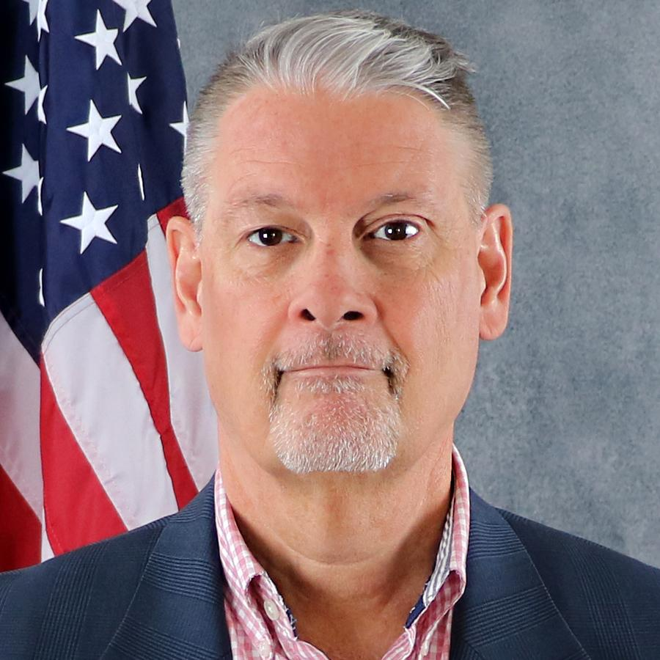
OASIS+
The Next Generation Services MAC
Bill Niess
OASIS+ Program Manager
Office of Professional Services and Human Capital (PSHC)
Federal Acquisition Service (FAS)
U.S. General Services Administration (GSA)
william.niess@gsa.gov
OASISPlus@gsa.gov

Slide 3
What is OASIS+
One Acquisition Solution for Integrated Services Plus (OASIS+) is a government wide, multiple award, IDIQ acquisition program that provides best-in-class contracts and vendors who offer customer agencies a full range of integrated professional services to help them meet their mission requirements.
Using a phased approach, OASIS+ will eventually combine the scope of:
  OASIS (SB, 8(a), and UR);
  Building, Maintenance & Operations (BMO);
  Human Capital & Training Solutions (HCaTS); and
  New areas of previously undefined services.

Slide 4
OASIS+ Contract Program
OASIS+ consists of six separate and distinct IDIQ contracts:
Total Small Business (SB)
SBA-Certified 8(a) Small Business (8(a))
SBA-Certified HUBZone Small Business (HZ)
SBA-Certified Service-Disabled Veteran-Owned Small Business (SDVOSB)
SBA-Certified Women-Owned Small Business Small Business (WOSB)
Unrestricted (UR)

Slide 5
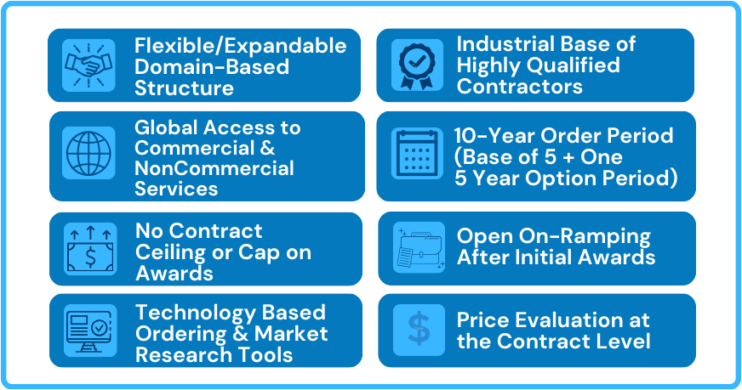

OASIS+ Unique Features
Domains
On-Ramps

Slide 6
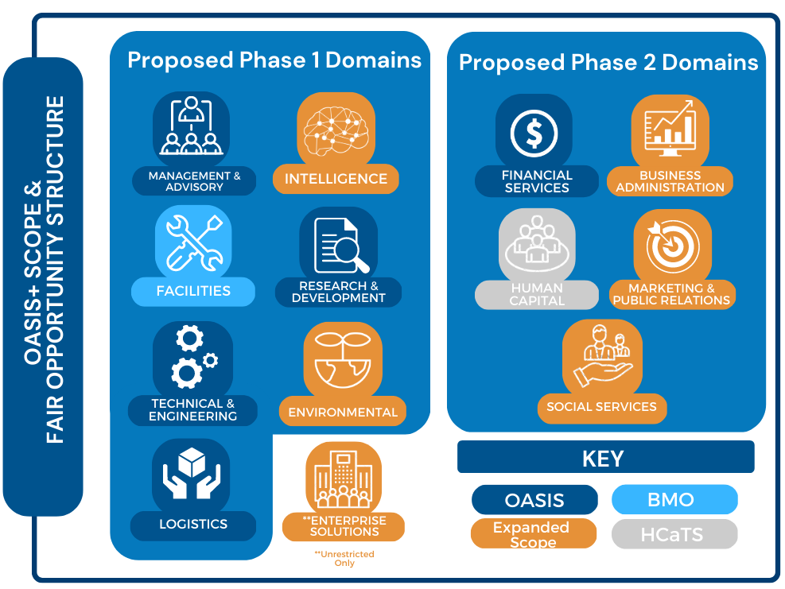
OASIS+ Domains
The scope of each OASIS+ contract is categorized into functional groupings known as Domains.
Eight (8) Domains are in the Phase I OASIS+ contracts
  Contract Awards / NTP – FY24 (Q3/4)
  Open Continuous – FY25+
Five (5) Domains are planned for Phase II OASIS+ contracts
  Contract Awards / NTP – FY25/26
  Open Continuous – FY27+
Phase 1 Domains
Proposed Phase 2 Domains
BOLO
BOLO

Slide 7
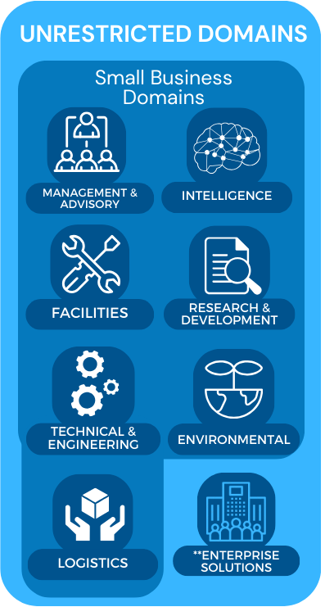
OASIS+ Domains – cont’d
Domains are based on groupings of North American Industry Classification System (NAICS) codes.
Each Domain contains multiple NAICS codes. OASIS+ Contractors may qualify for award of some or all NAICS included in the specific Domain (provided they meet all qualifications for award).
Ordering Contracting Officers (OCOs) will:
  Determine the appropriate OASIS+ contract vehicle;
  Select the appropriate Domain; and then
  Select the appropriate NAICS that best represents the scope of their requirement.
NOTE: Fair Opportunity is provided at the individual NAICS level.

Slide 8
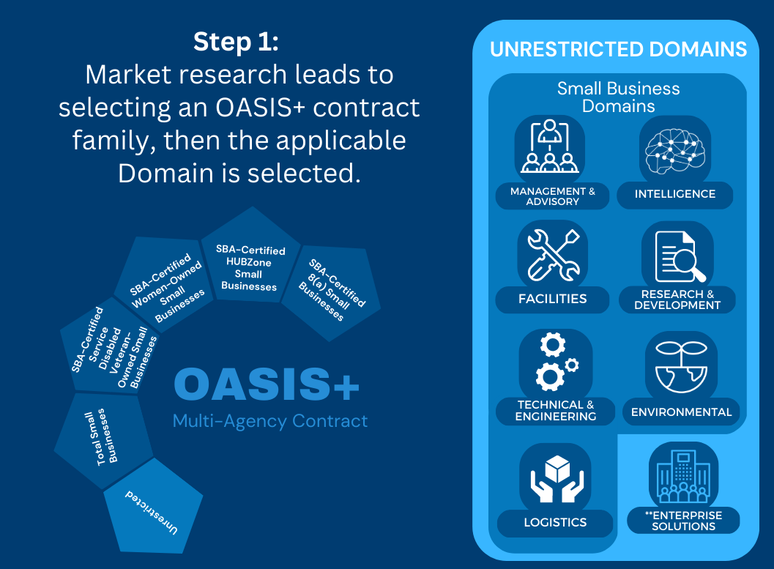
OASIS+
Task Order Process
Ordering Official
Perspective

Slide 9
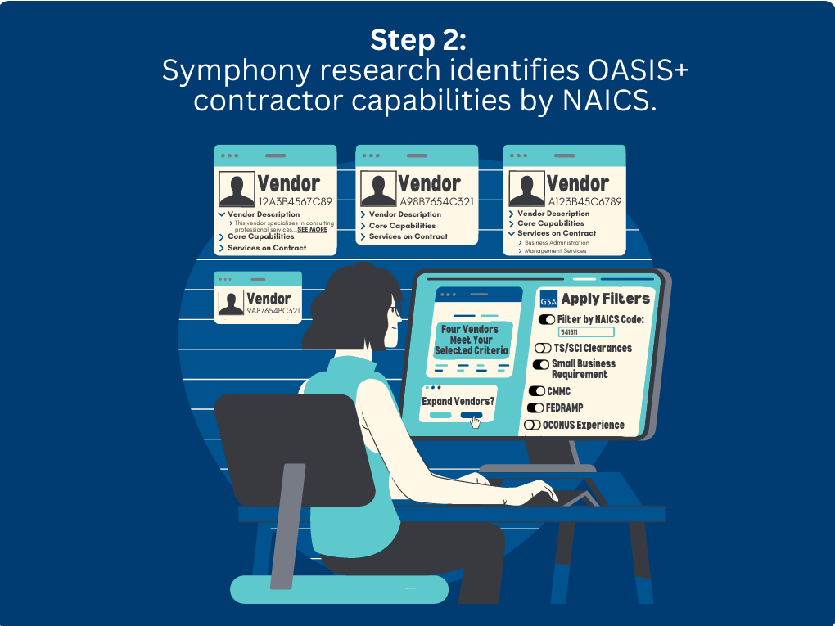
OASIS+
Task Order Process
Ordering Official
Perspective

Slide 10
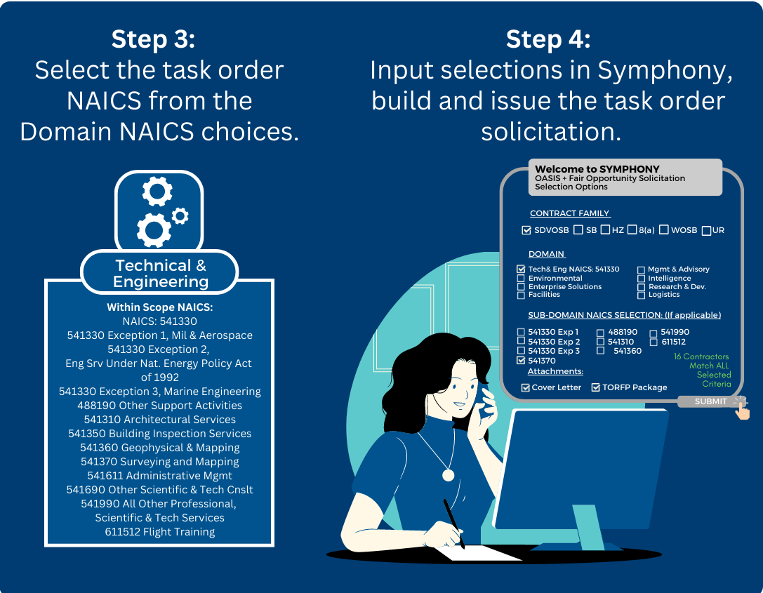
OASIS+
Task Order Process
Ordering Official
Perspective

Slide 11
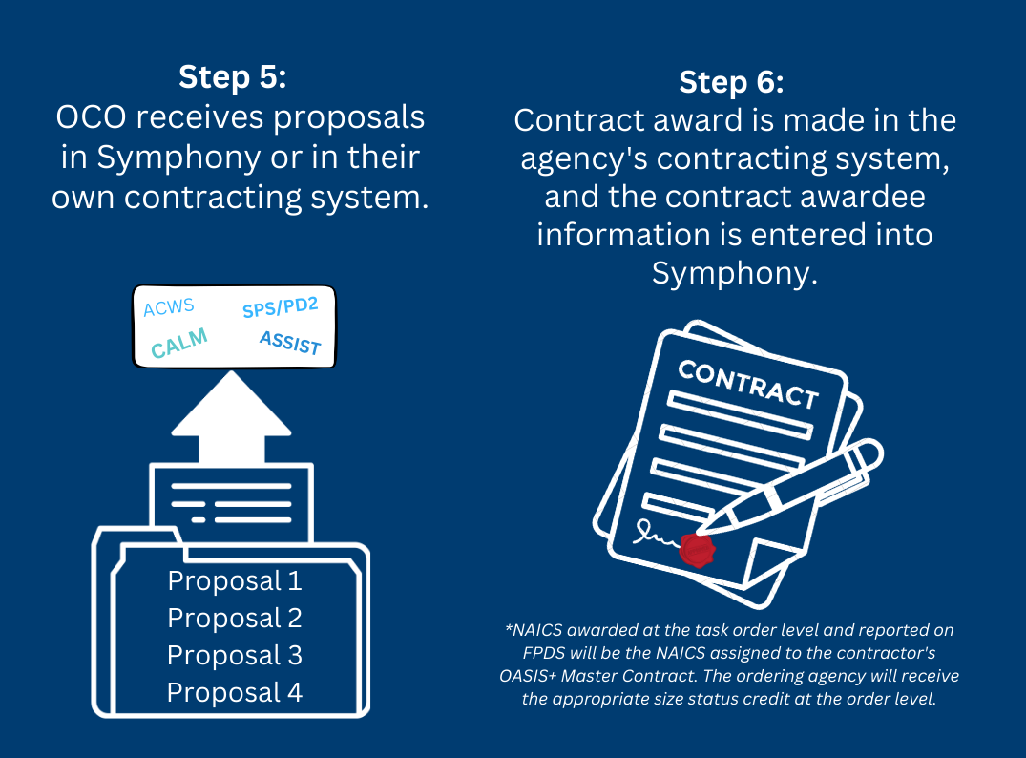
OASIS+
Task Order Process
Ordering Official
Perspective

Slide 12
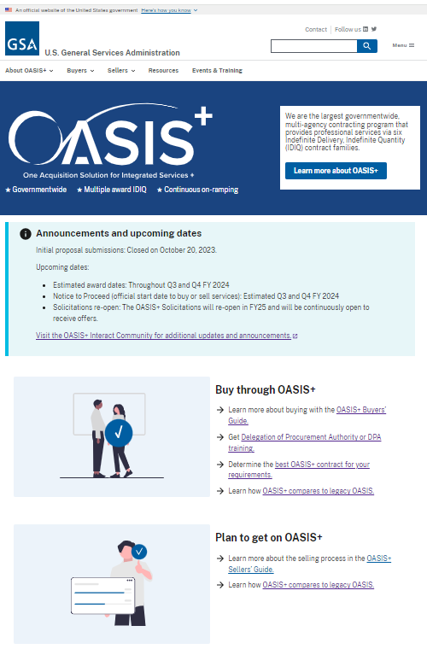
OASIS+ Reference
OASIS+ Website:
https://www.gsa.gov/oasis-plus/
OASIS+ Email:
OASISPlus@gsa.gov
OASIS+ Interact Community:
https://buy.gsa.gov/interact/community/196/activity-feed
New

Slide 13
OASIS+ High-Level Milestone Chart (FY21-25)
Market Research
Acquisition Planning
Release Draft RFPs
Release Final RFPs
OSP/Symphony webinars
Stakeholder Communications
Task Order Activity Continues
OASIS+ PMR #1
OASIS+ Phase 1 “Open Continuous”
OASIS+ Phase 2
FY21
FY23
FY25
Today
FY22
FY24
Prepare Draft RFPs
Proposal Evaluation (Q1-4)
Ordering Guide/DPA Training (Q2-4)
BIC Designation (Q2-3)
Contract Awards/NTPs (Q3/4)
Task Order Activity Begins (Q3/4)
Expiration Dates – Legacy OASIS Contracts
Name | Contract Holders | Expires
OASIS SB | 488 | 12/19/2024
OASIS 8(a) | 115 | 12/19/2024
OASIS UR | 147 | 3/01/2025

Slide 14
Thank You!

Slide 15

GSA

