Slide 1
Maintenance Repair Facility Supplies (MRFS)
Purchasing Channel, a Best in Class (BIC) Solution
U. S. General Services Administration
Last Updated: 10/09/2019

Slide 2
Why should I use MRFS?
  Average prices 9% lower than the market* for same or similar products
  Six business day delivery and simple destination pricing on millions of items
  Spend smarter for your Agency; 20 lines of transactional data for every purchase, spend analytics dashboards
  Additional discounts triggered at Government-wide spend thresholds, at $12.5M, $25M, $37.5M, $50M, and $62.5M
Notes:
*savings calculation based on lowest commercial available price for same or similar item
-7.4 million items offered under MRFS and counting
-some larger items come with FOB Origin terms; always read the product listing before purchasing

Slide 3
Why should I use MRFS?
  Low or no minimum orders
  Expedited delivery options (for a fee)
  Multiple platforms: Items available for purchase online at gsaadvantage.gov, contractor websites, FedMall, brick and mortar (in-store) options**
Notes:
Minimum order threshold of $25 with no processing fee; minimum order threshold of $0 but an additional fee applies, ranging from no additional fee to $18.00 additional fee, with an average fee of $7.82 across all contractors
**For those contractors who offer in-store purchasing. Inquire at mrfs@gsa.gov for further details

Slide 4
MRFS: a Best in Class Solution
Best in Class Designation from OMB Based on numerous key benefits:
  Provides Transactional data
  Improves requirements development, procurement and management
  Partners strategically with industry
  Reduces contract duplication
  Fosters cross-agency collaboration
  Helps buyers better understand category and sub-category markets
  Deeper discounts based on spend thresholds

Slide 5
MRFS: a Best in Class Solution
Best in Class Designation from OMB Based on numerous key benefits:
  Improved customer selection/in stock percentages
  Improved pricing based on contractor core supply chain strengths
    No more market basket frees contractors to focus on providing more of what they actually have in their catalogs at best possible pricing
  Ability to on-ramp and off-ramp contractors to maintain a high-quality pool of providers
  Majority of awards were to small businesses. 26 of the 30 awards were to small businesses; 7 of which are SDVOSB Vet-Biz certified.

Slide 6
MRFS and Category Management
Category management is an approach the Federal Government is applying to buy smarter and more like a single enterprise. The goals of government-wide category management are to:
Deliver more savings, value, and efficiency for Federal agencies;
Eliminate unnecessary contract redundancies; and
Meet the government’s small business goals.
MRFS fits into Category Management by:
  Better leveraging the Government’s purchasing power
  Reducing total cost of ownership
  Improving mission delivery and performance
  Seeking a more effective Government-wide acquisition approach

Slide 7
Available Items on MRFS
  Hardware
  Tools & Tool Cabinets
  Paints, Adhesives, & Sealants
  Cleaning Compounds and Related Dispensers
  Non-Motorized Cleaning Equipment and Trash Receptacles
  Paper Products and Related Dispensers
  Motorized Cleaning Equipment and Accessories

Slide 8
MRFS Period of Performance
Period of Performance
  Base Period: One year from the date of BPA establishment
  Option Years: Four one-year potential option periods
  BPA Against MAS
  All the regulations, laws, and Government program requirements applicable to the contractor’s MAS 51V, 73, and/or 75 Schedule Contract will apply at the MRO BPA order level
Notes:
BPA established (award date) July 12, 2019

Slide 9
Awardees
Contractor information available at www.gsa.gov/mrfs
BPA holders consist of 4 other than small and 26 small businesses
  7 SDVOSB with VetBiz Certification
  All Contractors are AbilityOne Authorized Distributors

Slide 10
Terms & Conditions
Standard delivery CONUS is 6 business days, FOB destination
International, OCONUS, and delivery to Alaska, Hawaii, Puerto Rico, and U.S. territories available from contractor
  Fees may apply
Contractors may provide overnight, second day, and expedited (3 to 4 day) delivery for an additional fee
Damaged goods are the contractor’s responsibility if received in damaged condition
  Contractors have 3 business days to send replacement items
  Adheres to timeframe of the original order

Slide 11
Terms & Conditions (continued)
  30 day returns
    Returned items must be in original packaging
    Restocking fees may apply
  Purchases made on behalf of the Federal Government are exempt from imposition of most taxes
    BPA price includes all applicable federal, state, and local taxes
  For specific requirements such as IUID, RFID, MIL-STD-129, or agency-level restrictions
    Include requirements within delivery orders
    Communicate directly with MRFS BPA contractors

Slide 12
Data Driven
MRFS Contractors capture data on the every transaction in order to help you and your agencies spend smarter. Data includes:
  Contract Number, Quantity Sold, Item Price, Item Description
Most of the data is automatically captured
Depending on the ordering platform, some of it may not be automatically captured (DODAAC, VA Station Number, delivery Zip Code, or other fields)
MRFS Data-to-Decisions (d2d) Acquisition Analytics Dashboard

Slide 13
Product Compliance
Products fulfill customer regulatory requirements
  All contractors are AbilityOne-authorized distributors
  Products are Trade Agreement Act compliant
  For DoD orders exceeding $250,000, products are Berry Amendment compliant

Slide 14
Buying Options
Customers can use GSA SmartPay3® or Government-issued purchase card
  GSA Advantage!®
  DoD FEDMALL
  Direct from contractor operated websites, phone, fax, or brick and mortar store
Agency contracting personnel can issue purchase orders directly to contractors if not using SmartPay3® or Government-issued purchase card
$25 minimum order threshold
  Customers order direct from contractors for under $25*
    Fee may apply
Notes:
*gsaadvantage.gov cannot currently handle sub-$25 orders for contractors who charge a fee. In those instances, please order directly from the contractor (contractor website, phone, fax, or brick and mortar as available)
Minimum order threshold of $25 with no processing fee; minimum order threshold of $0 but an additional fee applies, ranging from no additional fee to $18.00 additional fee, with an average fee of $7.82 across all contractors

Slide 15
Procurement Tools - eBuy
eBuy.gsa.gov is an electronic Request for Quote (RFQ) system designed to allow Government buyers to request information, find sources, and prepare RFQs
Compete your requirement among MRFS Contractors

Slide 16
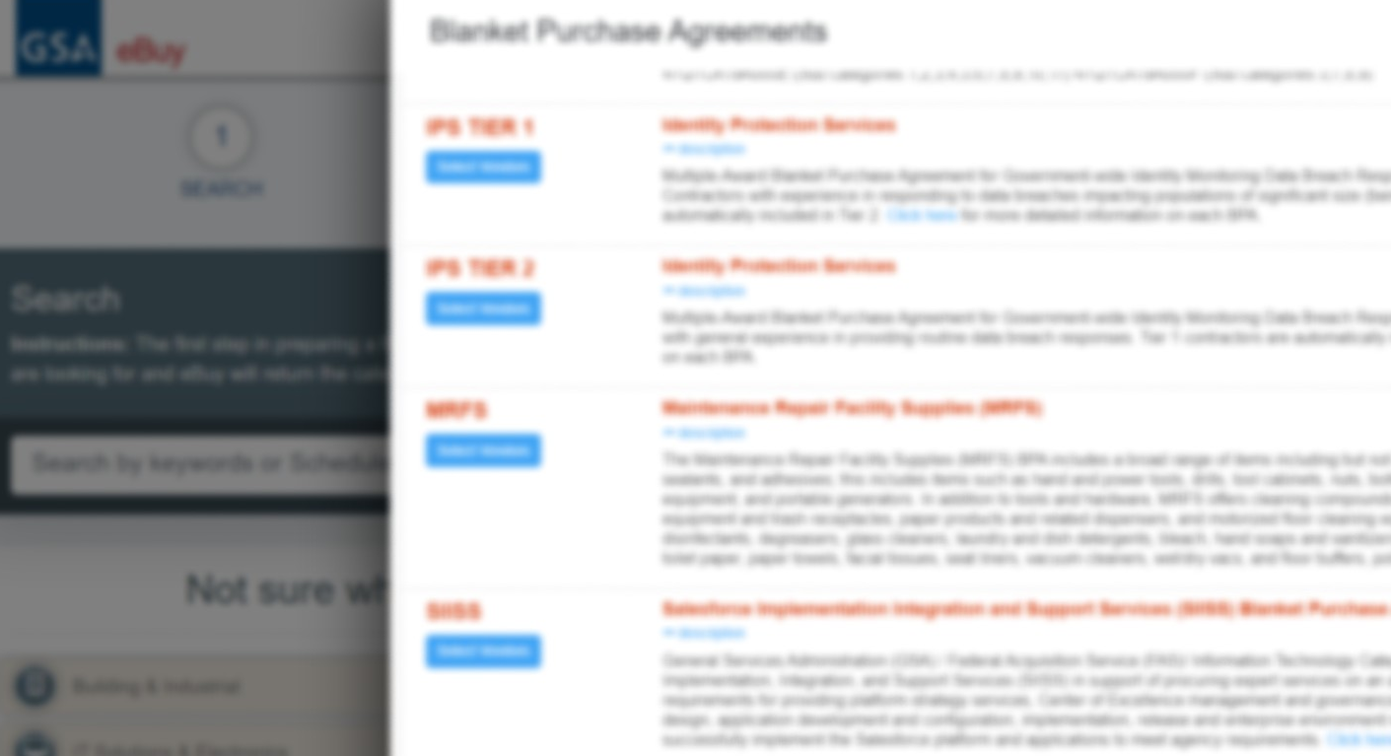
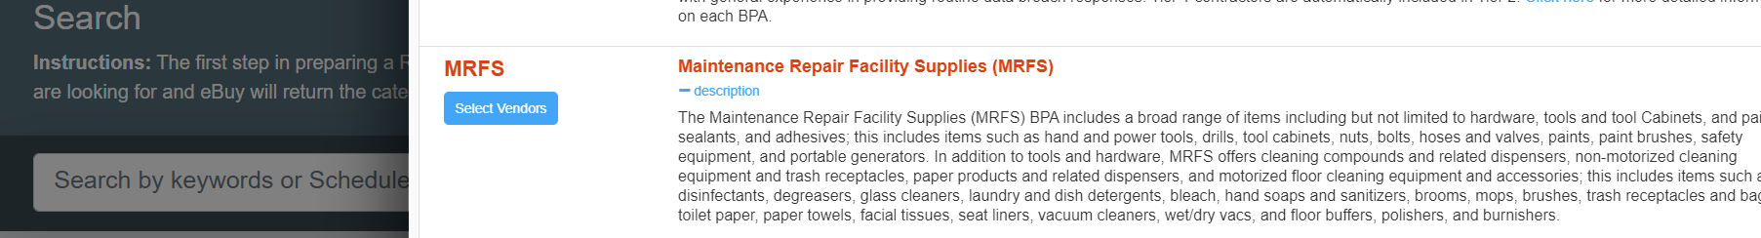
Procurement Tools - eBuy

Slide 17
FAR 8.4 Ordering Requirements
For Orders At or Below the Micro-Purchase Threshold (MPT)
May place orders at, or below, micro-purchase threshold with any MRFS contractor that can meet agency needs [FAR 8.405-3(c)(2)]
Comparative price analysis is not required
Not required to solicit from a specific number of schedule contractors
Justification is not required for brand name or sole source requirements
Ordering activities should attempt to distribute orders among BPA holders

Slide 18
FAR 8.4 Ordering Requirements For Orders Exceeding MPT, but not Exceeding the Simplified Acquisition Threshold (SAT)
Place orders with the MRFS contractor that can provide the supply that represents the best value [FAR 8.405-3(c)(2)(ii)]
Provide each contractor a fair opportunity to be considered for each order
Document circumstances for restricting consideration to less than all MRFS contractors offering required supplies and services
Follow justification requirements for brand name or sole source items
Conduct a comparative price analysis

Slide 19
FAR 8.4 Ordering Requirements For Orders Exceeding SAT
Place orders with the MRFS contractor that can provide the supply that represents the best value [FAR 8.405-3(c)(2)(iii)]
Provide your RFQ to all contractors offering required supplies
Include description of the supplies to be delivered and the basis upon which selection will be made
Fairly consider all responses received and make award in accordance with your RFQ selection procedures
Document circumstances for restricting consideration to less than all MRFS contractors offering required supplies and services
Follow justification requirements for brand name or sole source items
Conduct a comparative price analysis

Slide 20
Best Value
Past performance
Special features of supply required for effective program performance
Trade-in considerations
Probable life of selected item, compared with similar item
Warranty considerations
Maintenance availability
Delivery terms
Environmental and energy-efficiency considerations
AbilityOne preference
Berry Amendment compliance
Trade Agreement compliance
Agency set socio-economic goals

Slide 21
How to Order using
GSA Advantage!®

Slide 22

Introducing the Acquisition Gateway
https://hallways.cap.gsa.gov

Slide 23
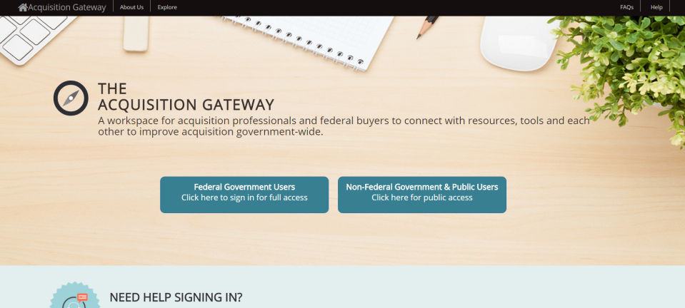
Register at OMB MAX first,
OMB MAX, then sign in

Slide 24
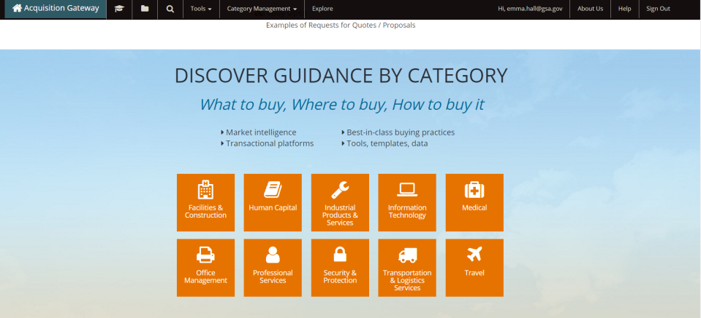
Your Acquisition Workspace

Slide 25

Learn, Connect, Act on the Gateway
Log in and explore at Acquisition Gateway
Connect and contribute ideas, join conversations, and share best practice samples and templates
Check out MRFS on the “Industrial Products & Services Hallway”

Slide 26
Resources
You can reach us directly by email at mrfs@gsa.gov
See what your agency is saving at GSA’s Data to Decisions (d2d) dashboard*
More information available on our web page: www.gsa.gov/mrfs.gov
  More information on how to order
  Training schedule and training slide deck
  Check out MRFS news at Interact.gov
  Category Management: One-stop information portal at Acquisition Gateway
Notes:
*relies on your OMB Max authentication / CAC/PIV Card

Slide 27
THANK YOU!

Slide 28
gsaadvantage.gov ordering guide below

Slide 29
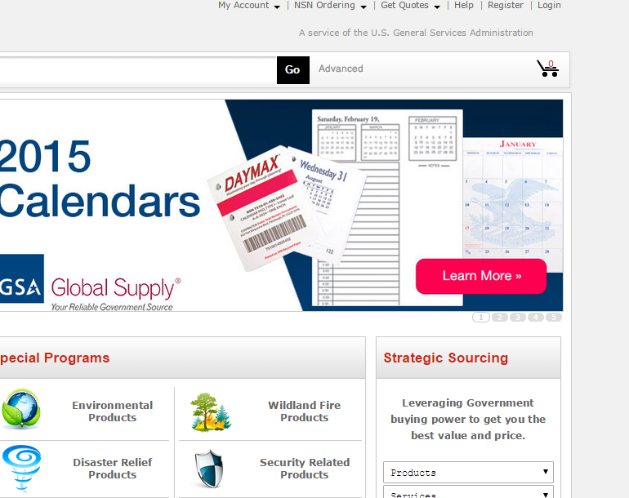
Log in or register
Log in or register at the link to GSA Advantage

Slide 30
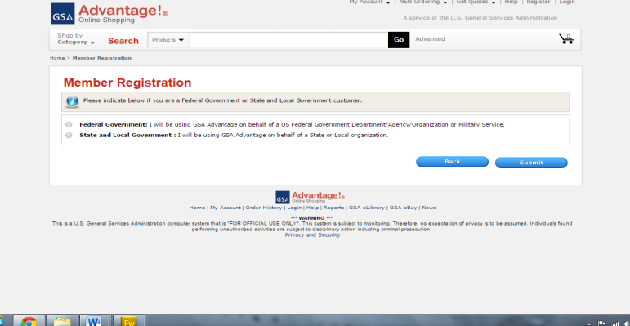
Indicate if you are with Federal or State and Local Government

Slide 31
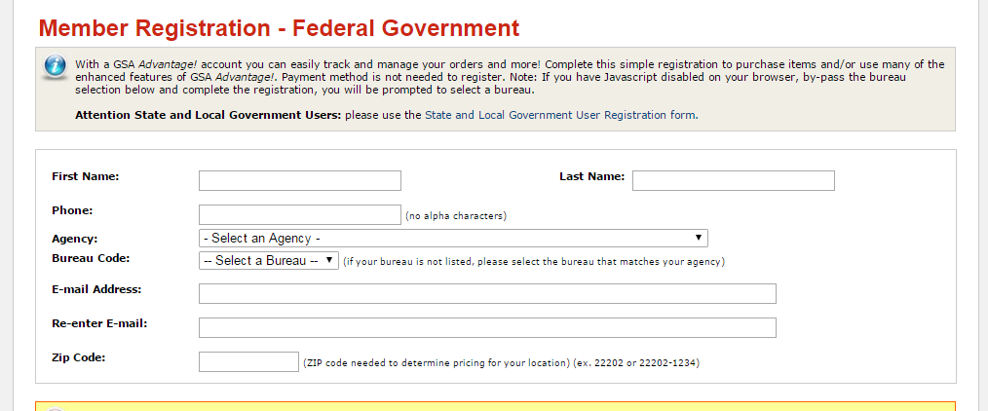
Complete User Profile
On the registration page, make sure your user profile includes your Agency and Sub-Agency or Bureau. If your Bureau isn’t listed, select your Agency name again.

Slide 32
Helpful Information:
Each contractor has loaded hundreds of thousands of items into GSA Advantage!® to support these BPA's. If you are unable to locate the item(s) that you need through MRFS, please contact the vendors or the MRFS Team.
The blue FSSI Icon is utilized for all FSSI solutions. Searching for MRFS products using the general search field on the Home Page, will provide results for all FSSI solutions, with multiple items offered from different vendors. If you follow the instructions on the following slides, your search will reveal only MRFS products. The MRFS vendors can be found on the following website: MRFS Awardees

Slide 33
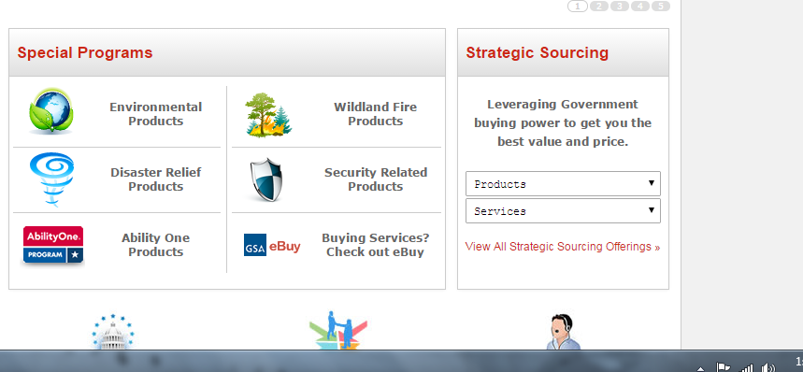
You’re ready to start ordering
When you are ready to order, return to the homepage. Halfway down the page, you will see two dropdown menus under the words “Strategic Sourcing.” Click on “Products.”

Slide 34
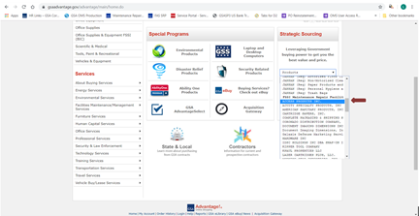
Drop down listing of contractors
After clicking on the product drop down, you will see all of the MRFS BPA contractors. Click on contractor name to search their MRO BPA offerings.

Slide 35
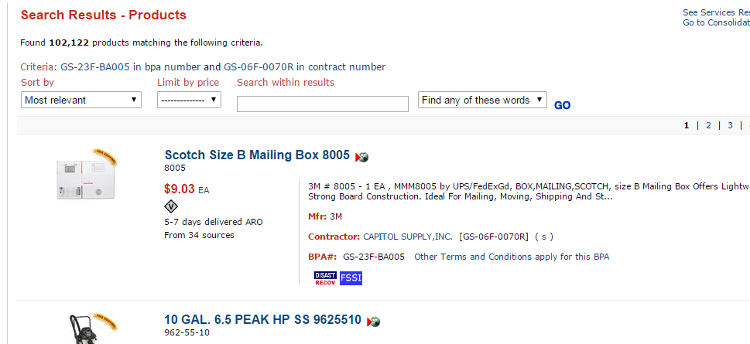
When you click on a MRFS contractor, this will show you their catalog’s product listing

Slide 36
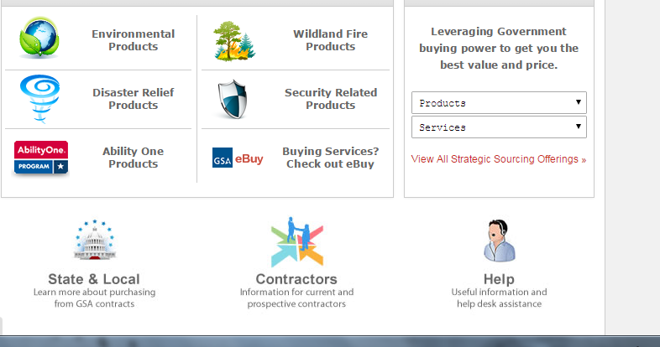
To search the MRFS BPA products by category, click on “View All Strategic Sourcing Offerings”

Slide 37
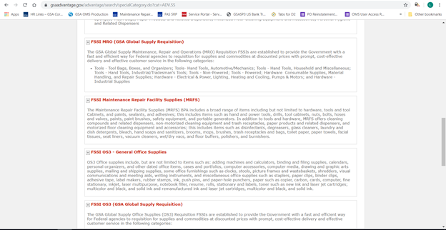
This screen shows you multiple categories to choose from. For instance, you can search for products under “FSSI Maintenance Repair Facility Supplies (MRFS)”

Slide 38
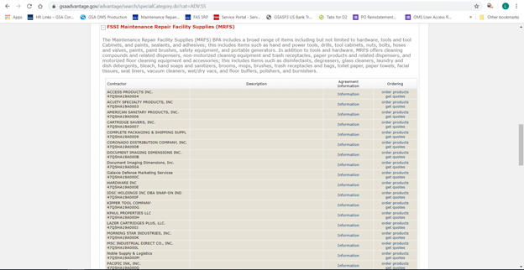
To see the BPA products offered by each contractor, click on the “Order Products” from the “Ordering” column on the far right

Slide 39
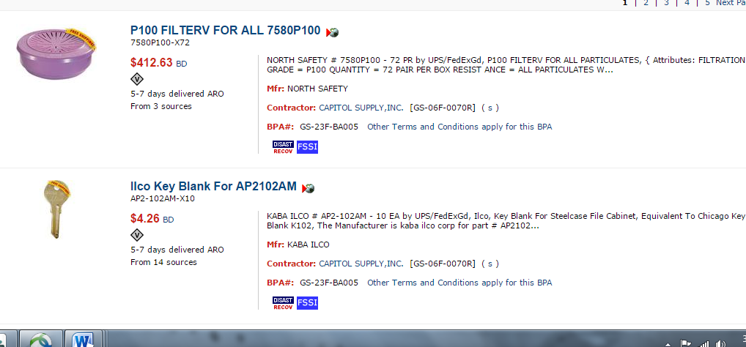
Here you can see individual products and which contractors carry particular MRFS items, marked with a blue FSSI icon

Slide 40

Ending Slide with GSA Logo

