Slide 1
How to Develop an Effective Capabilities Statement and How to Use it!
Northwest Commission APEX Accelerator
How to Develop an Effective Capabilities Statement and How to Use it!
Robyn Young, Government Contracting Manager
January 26, 2023

Slide 2
Today’s Discussion
What is an APEX Accelerator
What is a Capability Statement
Importance of a Capability Statement
Preliminary Steps
Content of a Cap Statement
Designing Elements
And other important tips

Slide 3

APEX ACCELERATORS
Department of Defense Office of Small Business Programs (DoD OSBP)
Formerly known as PTAC
The Procurement Technical Assistance Program (PTAP) was authorized by Congress in 1985 in an effort to expand the number of businesses capable of participating in the government marketplace.
Administered through the
Department of Defense,
the program provides matching funds through cooperative agreements with state and local governments and non-profit organizations for the establishment of PTACs to provide procurement assistance.
This APEX Accelerator is funded in part through a cooperative agreement with the Department of Defense.
Notes:
We just move to our new home with the Office of Secretary of Defense (OSD), under the direction of Farooq Mitha.

Slide 4

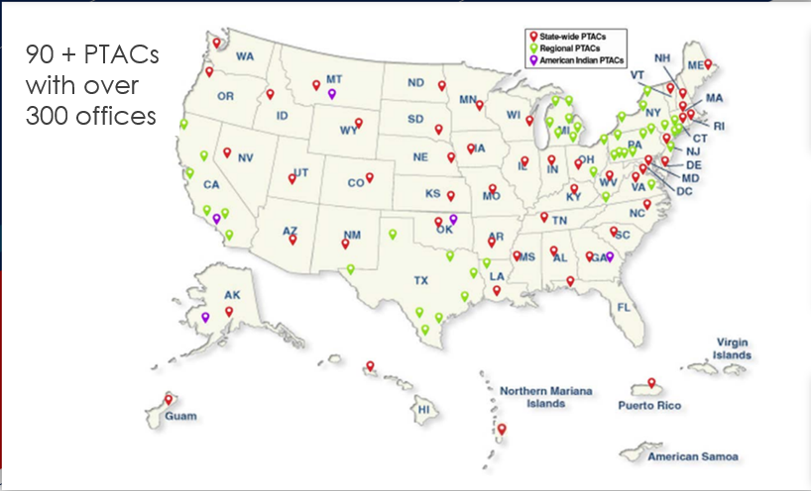
DOD OSBP APEX ACCELERATORS
This nationwide program has one common GOAL:
To bring Gov’t Buyers together with U.S. Suppliers
Each APEXs mission is to increase government contracts in the region they serve
FREE Services:
One-on-One Counseling & Training

Slide 5



Mission
Serve as the axis for existing and new business to strengthen the defense industrial base by accelerating innovation, fostering ingenuity, and establishing resilient and diverse supply chains.

Slide 6
What is a Capability Statement?
Market your company
Decision Makers
At-a-glance
Competitors
Mitigate
Risks
Understand how the Government works
Notes:
A Capability Statement is one of the most effective ways to market your company to the government.
It is a short, ‘get-to-know-me’ type of document that shows what your business can do and why potential customers should buy from you.
Capability Statement is a tool that will help:
Convey the most important information about your company to decision-makers
Show your clients, at-a-glance, what your business is and what you can do for them
Prove your qualifications, abilities and past performance
Set you apart from your competitors
MITIGATE RISKS for the Government or Prime
Convey the message that you understand the language and processes of government contracting as well as the market you are pursuing

Slide 7
Importance of Capability Statement
Required by most Government Agencies/Primes
Foot in the Door
Be Remembered/Stand Out

Slide 8
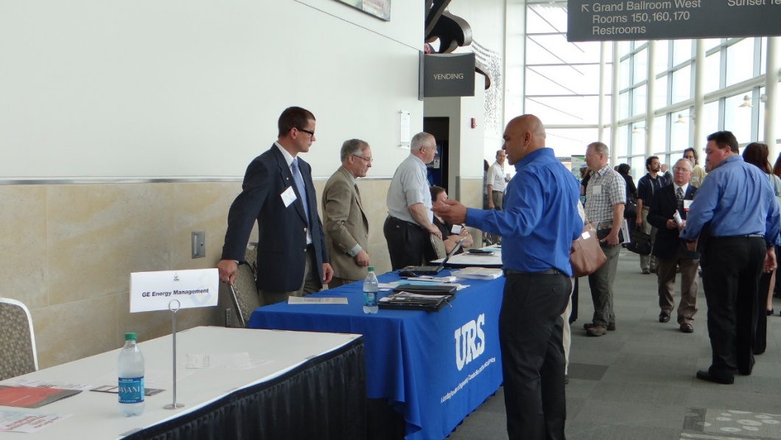
Importance of Capability Statement
Briefing with Contracting Officers/Specialist and Program Managers
Sources Sought or Request for Information
Procurement Fairs or Networking events
Sometimes Required for the Request for Proposal
Send to Primes for Sub-contracting Opportunities

Slide 9
Before you start
Gathering the Appropriate Information

Slide 10
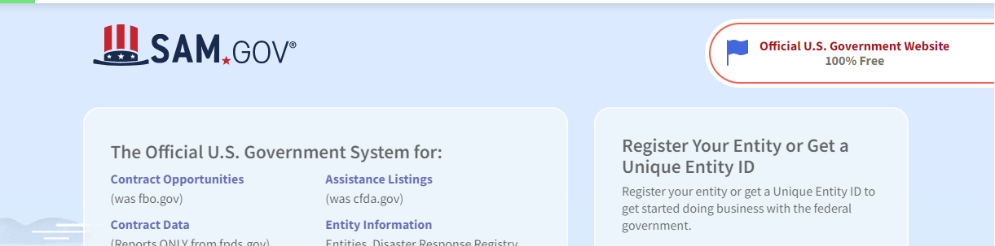
Before you Start – Cage Code & UEI
https://sam.gov/content/home
FREE to Register
Beware of 3rd Party Companies

Slide 11
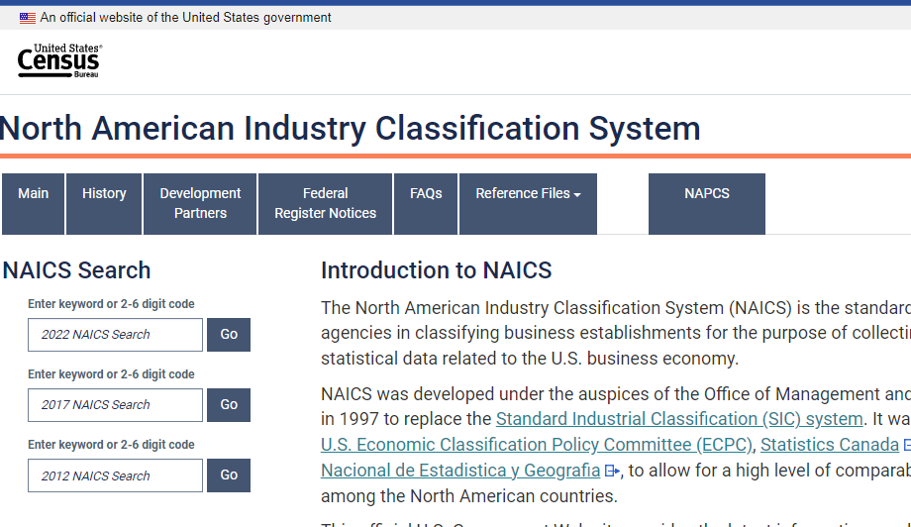
Before you Start –
Select your Company’s NAICS Codes
Enter Keywords to describe your product or service
https://www.census.gov/naics/
Notes:
NAICS Code (pronounced NAKES)
Used by government for a specific opportunity
Standard for classifying business products and services
All industries have at least 1 or more NAICS Codes

Slide 12
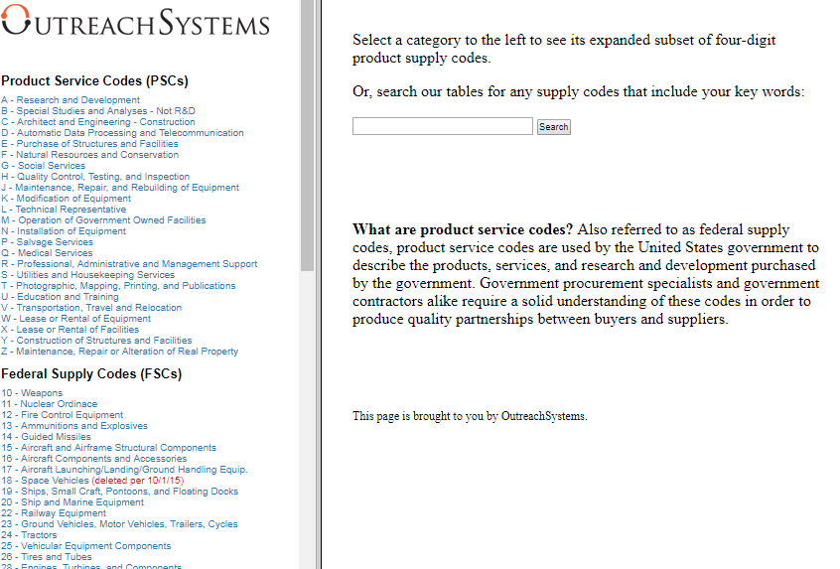
Before you Start –
Select your Company’s Product Service Codes (PSC) or Federal Supply Class (FSC)
Product service code (PSC) or Federal Service Code (FSC) is a four-digit code used by all federal government contracting activities for identifying and classifying the services and Supplies & Equipment (S&E) that are purchased under contract.
Notes:
NAICS Code is type of activity and the PSC/FSC code is what they are actually buying

Slide 13
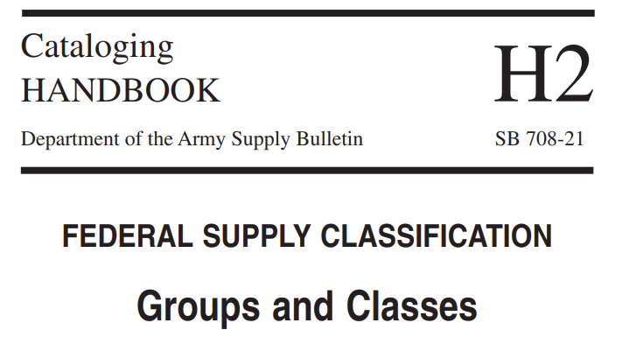
Before you Start –
Select your Company’s Federal Supply Class (FSC)
https://mn.gov/admin/assets/DISP_h2book%5B1%5D_tcm36-281917.pdf
Notes:
NAICS Code is type of activity and the PSC/FSC code is what they are actually buying

Slide 14
Content
What does a Capability Statement Look Like?

Slide 15
Capability Statement Content
CONTACT INFORMATION
These are KEY elements that the
Government agency or Prime Contractor will expect to see on this document.
CORE COMPETENCIES
DIFFERENTIATORS
PAST
PERFORMANCES
Company Data
List of Pertinent Codes & Data

Slide 16
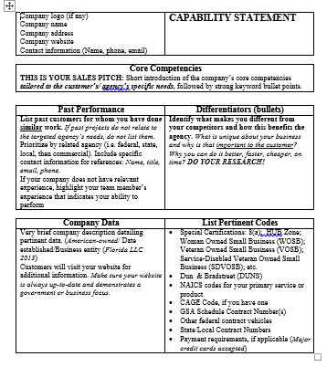
Capability Statement Contents
CONTACT INFORMATION
Company’s Name
Website “HYPERLINK”
Phone Number
Address
Contact Person and email address
Logo
Be sure to label this document
“Capability Statement”
&
label each section

Slide 17
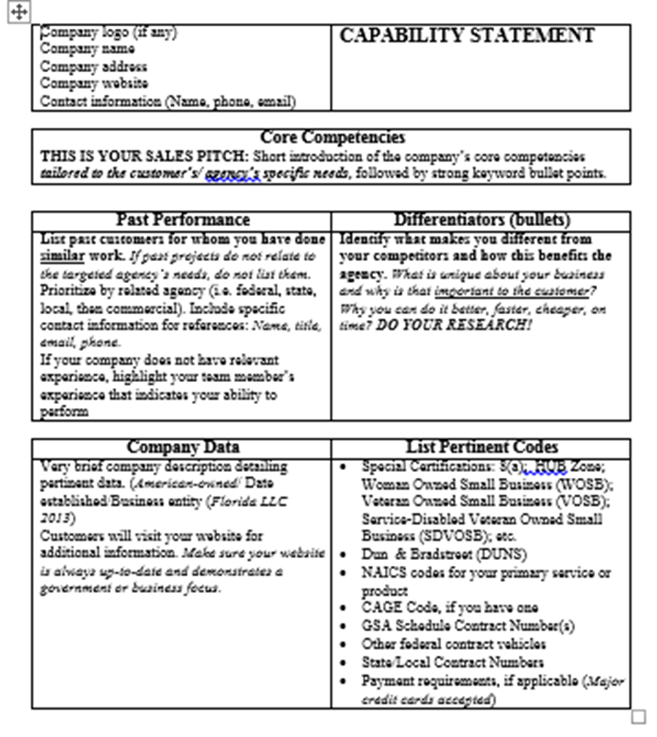
Capability Statement Contents
CORE COMPETENCIES
Core competencies (also called “capabilities” or “core capabilities”) are the things your company does best.
This is your Sales Pitch:
Short introduction of your company’s core competencies that relate to the agency or prime you are targeting followed by strong keyword bullets.

Slide 18
CORE COMPETENCIES SECTION
Example:
McCloskey Excavations LLC provides high quality civil
construction capabilities and our civil construction scope of
work includes:
Company’s Core Competencies
Agency’s Mission or specific Opportunity
Sub divisions
Mine Site works
Road works
Industrial and commercial site preparation
Water storages
Pipe laying
Sewerage and water treatment
Supply of blue metal aggregates
Notes:
It is a living document that will change depending on the targeted agency. Why is this? each agency has it's own mission and focus, and your CS should speak directly to those a targeted agency
Example: Army Corp has a lot of Civil Construction opportunities (237990) Heavy & Civil Engineering Construction. Your company may specialize in more than just this type of construction, but the Army corp is now in need for that; tailor to what the Army Corp is buying.

Slide 19
DIFFERENTIATORS SECTION
A differentiator can be defined as the business attribute(s) and/or unique value that clearly separates it from the competition in a particular marketplace.

Slide 20

DIFFERENTIATORS SECTION
Questions to ask yourself:
Why did your biggest customer want you?
How and Why is your company the best choice?
What is it about your employees that give you the advantage over your competitors?
How do you solve a unique problem for your customers?

Slide 21
DIFFERENTIATORS SECTION
Product
Added features
Service
Quality Assurance
Performance
Installation – special equipment
Special machinery or equipment to make product special
Delivery of the service
Delivery of the product
Professional Expertise
Certified Specialist
Made with a special material
CYBER SECURITY
DFARS COMPLIANT
Notes:
Use the LARGE DAM GATES Story
DO NOT list your Level of Cybersecurity (confidential)

Slide 22


DIFFERENTIATORS SECTION
Other examples of what can make your company different:
Location
Training
ISO
Relationships
Experience
How do these relate to the targeted Agency, Prime or Team?

Slide 23
DIFFERENTIATORS SECTION
Differentiators must meet three important principles:
It must be true information
It must be important to potential clients
It must be provable
Notes:
You can’t simply make it up
If no, what’s the point
If you can’t demonstrate that it is true, it won’t be believed.

Slide 24

DIFFERENTIATORS SECTION
Differentiators are NOT:
Socioeconomic certifications
Vague Statements or words – such as Best in class or World Class
One type fits all
Years of experience
Notes:
Not a place to note your Years of experience; you can do this in your COMPANY DATA SECTION

Slide 25
DIFFERENTIATORS SECTION
Example:
Our company has the largest painting and media blasting booths in the Northwest PA Region.
Our paint booth is 20’ wide x 55’ long and 14’ tall
Our sand and media blasting booth is 20’ wide x 70’ long x 16’ tall
Bottom line – We can sandblast and paint anything that can be transported
Remember – this information must be provable; so when you are meeting face to face with the Government or a Prime, make sure you can back up this information up.
Tips:
Hard for your competitor to copy
Identify your company’s key internal strengths

Slide 26
PAST
PERFORMANCES
Provide three or four agencies or customers you have done business with, starting with those as similar to your target agency as possible.
If you haven’t done other federal work, provide state or local government or commercial references.

Slide 27

PAST
PERFORMANCES
Begin by listing past customers for whom your business has done similar work.
Prioritize starting with the related agency
List all federal or other government work and finally to commercial contracts.
If the past projects do not relate to the targeted agency's needs, do not list them.
Ideally, include specific contact information for each that may be used for immediate references. (May not always be permitted to use – check with the contact first)
Include name, title, email and phone number.
Notes:
Do Not Relate – for an example – If your company is an Excavating Company and you have experience in the Oil and Gas industry, but the agency you’re targeting is the U.S. Army Corps – mostly Dams and Water -

Slide 28
Company Data
Company data (also called “corporate data” or “business information”)
Provide a sentence or two describing your company’s:
History
Size of your firm
Financial stability
Number of employees
Teams
Geographic area you serve

Slide 29
List of Pertinent Codes & Data
List of Specific Pertinent Codes and Data:
Unique Entity Identifier (UEI)
CAGE Code
NAICS - (a reasonable number, fewer than 15)
Socio-economic certifications: 8(a), HUBzone, SDVOB/VOSB, WOSB/WBE etc.
Accept Credit and Purchase Cards
GSA Schedule Contract Numbers
Product Service Codes or Federal Supply Class (PSC & FSC)
COSTARS or ITQ
Other federal contract vehicles
BPAs and other federal contract numbers
Pertinent teaming agreements
Notes:
Socio-economic certification – make sure you use the appropriate LOGO

Slide 30

List of Pertinent Codes & Data
Never put highly sensitive information on this document
Federal Employer Identification Number (FEIN or EIN)
Or
Social Security Number

Slide 31
Designing elements
Other Important Tips

Slide 32
3 Important Tips When Tailoring Your Capability Statement
Use the government’s language
Past Performance is Relevant
Differentiators match needs
Notes:
Look at previous contracts in your industry (Grounds Keep vs Landscaping) or (Site Prep vs Excavation)
Try your best to match Past Performance with the Targeted Agency or Prime –
Find out what the needs of the Agency or Prime before you meet and indicate on your Cap Statement that you have the equipment or services needed to fix their problem or need or provide them with information that will outshine your competitors

Slide 33

Other Important Tips
Tailor a Cap Statement for each agency you want to target
Have a General one on hand just in case
Gather important information:
Review Targeted Agency or Prime’s Website – News Headlines, Doing Business with, google latest articles within your industry
Check out Forecasts (agency websites) or Sam (Contracting Opportunities)
Important Note** - If attending a Networking event, find out what agencies will be at the event a head of time

Slide 34

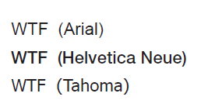
Designing Elements
If your cap statement looks messy, then it could reflect how the reviewer looks at your company – messy, unorganized.
TIPS:
Use your company’s LOGO, Branding and Colors
Do NOT use long paragraphs – bullets are best
Use FONTS that are “Easy to Read”
- Not too small
- Use Sans Serif fonts (not extending the end strokes)
Don’t jam information together – make use of white space
Don’t be too wordy
One page ONLY but no more than front and back
Notes:
Sans means without Serif mean extending strokes

Slide 35
Good and Bad Example
TIPS:
Use your company’s LOGO, Branding and Colors
Do NOT use long paragraphs – bullets are best
Use FONTS that are “Easy to Read”
- Not too small
- Use Sans Serif fonts (not extending the end strokes)
Don’t jam information together – make use of white space
One page ONLY but no more than front and back
TIPS:
Use your company’s LOGO, Branding and Colors
Do NOT use long paragraphs – bullets are best
Use FONTS that are “Easy to Read”
- Not too small
- Use Sans Serif fonts
(not extending the end strokes)
Don’t jam information together – make use of white space
One page ONLY but no more than front and back

Slide 36

First Impressions are everything
Use a designing/graphics company – if you or no one in your company has the ability, or
Hire a Marketing or Communication intern from a local university or community college
Remember to
Save as Word doc - in order to make changes easily
Have it available in a PDF format to send out electronically

Slide 37

Other things to consider:
You got this!!
Never use a Government Agency LOGO
Put yourself in the eyes of the reviewer
Have someone review a draft to look for common mistakes
Is your Capability Statement easy to understand
Place your Capability Statement on your website
Use the government’s terminology
Doing business with the government is highly competitive – Don’t just throw something together……take the time, make the effort and put in the extra mile to create the best Capability Statement possible.

Slide 38
Thank You!
Find your local APEX Accelerator (formerly known as PTAC)
Robyn Young, Government Contracting Manager
robyny@northwestpa.org

