Slide 1



Welcome
How to Market to the Federal Government:
A Panel Discussion

Slide 2
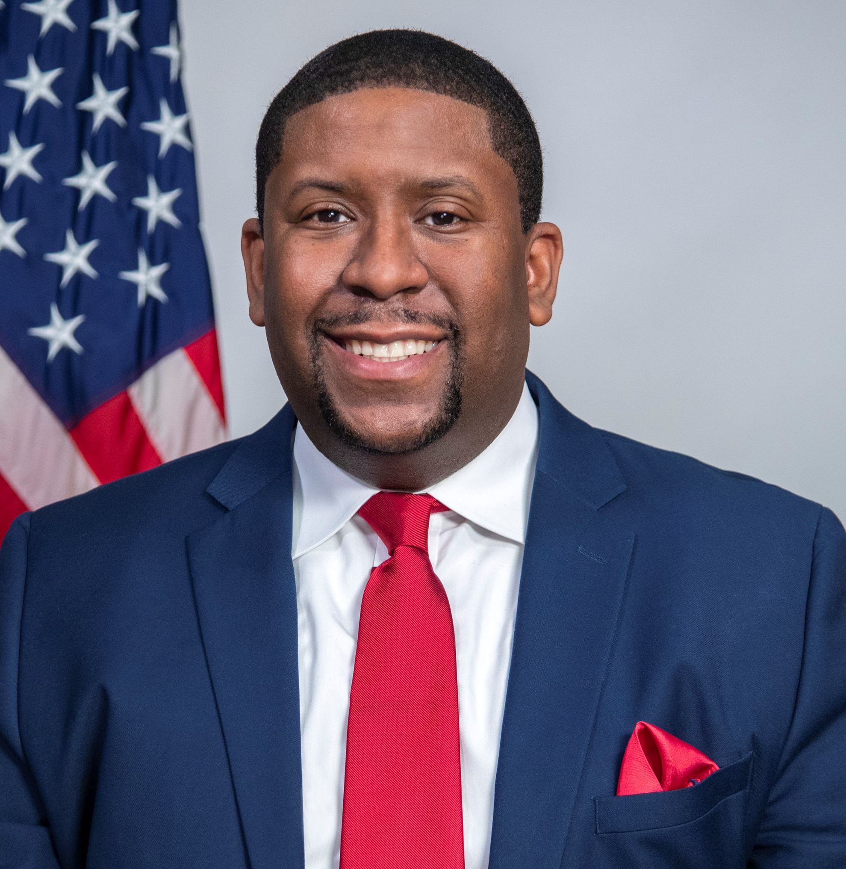
Today’s Moderator
Exodie C. Roe III
OSDBU Associate Administrator
U.S. General Services Administration

Slide 3
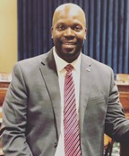

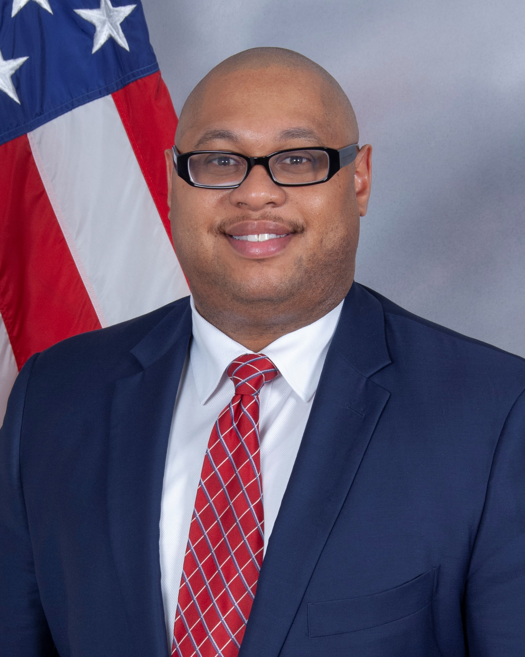
INTRODUCING TODAY’S PANELISTS
Calvin Mitchell Jr.
Director, OSDBU,
Department of Education
Wallace D. Sermons II
Deputy Director,
Area & Field Program Execution, SBA
Dwight D. Deneal
Director, Office of Small Business Programs, DLA

Slide 4

QUESTION:
SMALL BUSINESS WORKS 2021
What are some unique considerations when marketing to the Federal government?

Slide 5
QUESTION:
SMALL BUSINESS WORKS 2021
How should small businesses engage buyers and the acquisition workforce?
Notes:
Ludmilla
Gissa
Typically, small businesses will e-blast capabilities statements to the acquisition workforce in hopes of making connections. Let’s push this conversation further.
From your perspective, can you provide some tips and best practices about communicating and engaging with government stakeholders?

Slide 6
QUESTION:
SMALL BUSINESS WORKS 2021
How should small businesses use their capabilities statements to introduce their business to your federal agency?
Notes:
Ludmilla
Gissa
A key part of marketing to the Federal is that capabilities statement.
Tell us your perspective of capabilities statements in terms of how they are organized and presented?

Slide 7
QUESTION:
SMALL BUSINESS WORKS 2021
What pitfalls do you see small businesses getting into when marketing to the federal government and how can they avoid these issues?
Notes:
Ludmilla
Gissa

Slide 8
QUESTION:
SMALL BUSINESS WORKS 2021
Why is it important for small businesses to respond to Requests For Information and Sources Sought Notices?
Notes:
Ludmilla
Gissa
Let’s talk about the importance of market research.

Slide 9
QUESTION:
SMALL BUSINESS WORKS 2021
What are some factors that small businesses should consider when marketing their business as a subcontractor?
Notes:
Ludmilla
Gissa
We’ve been talking about marketing small businesses to the federal government as prime contractors. Let’s now talk about marketing your business as a subcontractor.

Slide 10

QUESTION:
SMALL BUSINESS WORKS 2021
Quick round robin, last words of advice.
In 30 seconds, tell us parting comments that you really want small businesses to know when marketing to the federal government?
Notes:
Ludmilla
Gissa

Slide 11
Questions?

Slide 12
Contact us:
Wallace D. Sermons II
Prime Contracting inbox: contracting@sba.gov
Subcontracting inbox: subcontracting@sba.gov
Calvin Mitchell
small.business@ed.gov
Dwight D. Deneal
DLAHQSmallBusiness@dla.mil

Slide 13
Small Business Resources
U.S. General Services Administration (GSA) - https://www.gsa.gov
  Office of Small & Disadvantaged Business Utilization (OSDBU) - https://www.gsa.gov/osdbu
  Federal Acquisition Service (FAS) - Commercial Products & Services - https://www.gsa.gov/fas
  Public Buildings Services (PBS) - Construction, Architecture, Interior Design, and Real Estate - https://www.gsa.gov/pbs
Small Business Administration (SBA) - https://www.sba.gov
  SBA Size Standards - https://go.usa.gov/xFR9p
  Small Business Loans - https://go.usa.gov/xFRPD
Procurement Technical Assistance Centers (PTACS) - https://www.aptac-us.org/
System for Award Management (SAM) - https://go.usa.gov/xFNkS
Federal Agency Procurement Forecasts - https://go.usa.gov/xFRbn

Slide 14
Thank You!

