Slide 1
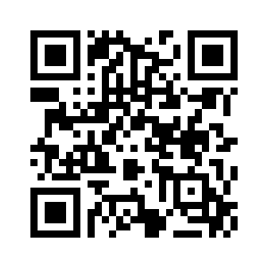
MARYLAND APEX ACCELERATOR
Marketing Your GSA Contract
November 9, 2023

Slide 2
ABOUT US
Maryland APEX Accelerator Center, formerly known as “PTAC”, Mission Statement:
“OUR MISSION: “It is our mission to help position businesses registered in the state of Maryland to fully compete in the federal, state, and local government procurement processes.“
We do this by offering:
One-on-one counseling to new and existing businesses interested in government contracting.
Specialized training and outreach events.
A Bid Match service that sends notifications of solicitations to your email.
Tara Scott
Procurement Specialist Maryland APEX Accelerator
“A goal without a plan, is just a wish” -anonymous
5825 University Research Court, Ste 1300 College Park, MD 20740
Website: https://www.marylandapex.org
Email: tscott21@umd.edu
Phone: (301)-405-6550
No Walk-ins, Appointments are mandatory!

Slide 3
FY’21 SUCCESS HIGHLIGHTS
Lakeysha Claxton is the President of Homeland Custodial Services, Inc. – a facilities maintenance company in Columbia, Maryland.
Lakeysha who was a former bus driver wanted to expand her janitorial business overseas. After working with her APEX Accelerator counselor to create a strategy to bid and win contracts in Japan her business won a $1.1 million contract with the Commander Fleet Activities Okinawa (CFAO) at Kadena Air Base Okinawa, Japan. She continues to win awards with US Army and recently expanded into Department of Interior (Bureau of Reclamation) and Defense Finance & Accounting Service-Rome.
2,051
Counseling Hours
1,062
Small Businesses
2,942
Attendees at Events
$65 Million
Contract Awards
The APEX Accelerator is funded in part through a cooperative agreement between the Department of Defense and The University of Maryland-College Park

Slide 4
MARKETING YOUR GSA MAS!
The road map to successful marketing
RESEARCH
Know all the stakeholders and what’s purchased through GSA
EVALUATE
your service offerings and your competitors
STRATEGIZE
Create good marketing plan and materials
EXECUTE
Your plan and stay current through training
SUCCESS
Increase government contract awards

Slide 5
HOW TO GET STARTED
Know the details of your GSA Multiple Award Schedule
Through the MAS Program, GSA establishes long-term, Governmentwide Acquisition Contracts (GWACs) with commercial firms to provide ordering activities with access to a wide variety of commercial supplies or services.
Multiple Award IDIQ (5-year award, three 5-year options)
Fixed Price EPA (Economic Price Adjustment)
Fair and reasonable pricing
Price reductions may be applied at the order level
Performance requirements established at the order level
GSA is solution provider that’s designated by OPM’s Category Management program to be “Best in Class” https://www.gsa.gov/buy-through-us/category-management#:~:text=Category%20Management%20is%20the%20practice,and%20effectiveness%20of%20acquisition%20activities.

Slide 6
KNOW THE MAS PROGRAM CHANGES
Understand the solicitation: Download, read, and understand the solicitation and applicable category attachment(s) and AMENDMENTS located on sam.gov
Minimum Sales Requirements: Acquisition Letter MV-2023-01,Supplement 1
This supplement amends FAS FSS clause I-FSS-639, Contract Sales Criteria by:
Changed the period of performance for your MAS contract to a standardized 60 months
Adjusted the required GSA sales dollar thresholds FROM: $25,000 within the first 24 months following contract award, and $25,000 in sales each additional year TO: a single $100,000 threshold for the first 60 months of the contract, and a $125,000 threshold for each 60-month option period thereafter
Make the consideration of sales a part of a FSS contracting officer’s determination to exercise (or not) an option to extend the term of the contract.
Notes:
The Small Business Development Center
https://www.sba.gov/local-assistance/resource-partners/small-business-development-centers-sbdc
Find assistance and counseling in your area to start, run, or grow your business.

Slide 7
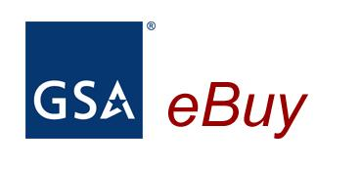
REVIEW YOUR CONTRACT DATA
www.gsaelibrary.gsa.gov
_{eLibrary}
MARKETING STRATEGY TIP#1
SEE WHAT YOUR COMPETITORS ARE DOING!
Category
Subcategory
SIN
Contractor Details
Size Status
Contract Clauses
eLibrary - The official online source for complete GSA and VA Schedules information – a great market research tool.
Notes:
GSA eLibrary is your one source for the latest GSA contract award information. GSA offers unparalleled acquisition solutions to meet today’s acquisition challenges. GSA’s key goal is to deliver excellent acquisition services that provide best value, in terms of cost, quality and service, for federal agencies and taxpayers.
www.gsaelibrary.gsa.gov

Slide 8
REVIEW CONTRACT DATA
Schedules Sales Query Plus (SSQ+)
Designed to provide small businesses with the data you need to track your sales information.
SSQ+ is a tool that depicts sales in both report and dashboard format.
SSQ+ replaces the SSQ and offers searchable and filterable information from FY 1991 to present, including sales dollars for TDR contracts.
FAS Schedule Sales Query Plus (SSQ+)
Notes:
The Small Business Development Center
https://www.sba.gov/local-assistance/resource-partners/small-business-development-centers-sbdc
Find assistance and counseling in your area to start, run, or grow your business.

Slide 9
RESEARCH – Awardees
TOP 100 CONTRACTORS REPORT FY22 (GSA)
Ultimate Parent Legal Business Name | Number of Actions | Dollars Obligated | % Total Actions | %Total Dollars
BOOZE ALLEN HAMILTON HOLDING COMPANY | 648 | $1,656,573,505.84 | 0.04196% | 7.89867%
CACI INTERNATIONAL INC. | 332 | $1,358,479,325.28 | 0.0215% | 6.47733%
SCIENCE APPLICATIONS INTERNATIONAL CORPORATION | 394 | $951,998,867.99 | 0.02552% | 4.5392%
GENERAL DYNAMICS CORP. | 357 | $734,985,126.41 | 0.02312% | 3.50447%
PERATON CORP. | 387 | $727,973,024.95 | 0.02506% | 3.47103%
MARKETING STRATEGY TIP#2
Gather information about these Prime or Sub Contractor awardees and discuss with your colleagues who may be able to offer a referral and/or introduction. (USASpending.gov)
Look at the Prime’s contract awards in fpds.gov, pick a few of them (ultimate expiring dates 12 months out) and set up a meeting with their Small Business Liaison Officer.
Customize your CAP Statement and Pitch decks to reflect your relevant past performance AND GSA MAS CONTRACT # !!!!
Create a Partner sheet for viable teammates, with all capture information.
Notes:
UNDERSTAND THE FEDERAL GOVERNMENT BUYING HABITS. Out of the top ten NAICS codes, small businesses accounted for less than 20% of total federal government contract awards. However, under the GSA/VA Schedule, small businesses accounted for 45% of awards within the top ten NAICS.

Slide 10
RESEARCH – NAICS Codes
Top 10 NAICS Codes for GSA Awards in FY 2022 | Dollars Awarded
541519- Other Computer Related Services | $6,072,936,6600
541611- Administrative Management and General Management Consulting Services | $4,065,405,641
541511- Custom Computer Programming | $3,556,951,010
511210- Software Publishers | $2,572,137,267
541512- Computer Systems Design Services | $1,583,250,764
541330- Engineering Services | $1,072,185,583
541211- Offices of Certified Public Accountants | $622,521,600
561210- Facilities Support Services | $605,572,140
541614- Process, Physical Distribution, and Logistics Consulting Services | $532,934,587
334111-Electronic Computer Manufacturing | $518,863,645
NAICS codes with the highest amount of awards through: GSA Multiple Award Schedule (MAS)
and
VA Federal Supply Schedule
Notes:
When it comes to awards through the GSA/VA Schedule, services dominate, accounting for nine of the top ten NAICS codes. While the Professional, Scientific, and Technical Services sector accounts for approximately 30% of all government contract awards, it accounts for more than 60% of awards under the GSA/VA Schedule.

Slide 11
RESEARCH - GSA’s SMALL BUSINESS GOALS
PI 2.3.1(a) Percent of GSA contract dollars awarded to small businesses through prime contracting.
Lead Office: Office of Small and Disadvantaged Business Utilization
Fiscal Year | Target* | Results
2017 | 36.5% | 42.68%
2018 | 35.0% | 38.82%
2019 | 30% | 42.69%
2020 | 29.0% | 49.43%
2021 | 30.0% | N/A
2022 | TBD | N/A
60% of awards under
GSA Multiple Award Schedule (MAS)
and
VA Federal Supply Schedule
are in:
Professional, Scientific and Technical Services Sectors
*Targets reflect goals established by SBA for fiscal year performance.
Small Business Goal Achievement FY 22 (GSA)
Total Small Business Eligible Actions - 1,222,385
Total Small Business Eligible Dollars - $5,955,134,116.02
Small Business Actions - 883,406
Small Business Dollars - $2,829,007,041.67
Notes:
When it comes to awards through the GSA/VA Schedule, services dominate, accounting for nine of the top ten NAICS codes. While the Professional, Scientific, and Technical Services sector accounts for approximately 30% of all government contract awards, it accounts for more than 60% of awards under the GSA/VA Schedule.

Slide 12
TIPS FOR SELLING TO AGENCIES
Through Relationship-Building. Get to know your customer!
Target two or three agencies that purchase what your firm sells
What is their mission?
What do they need? Especially on an ongoing basis.
How do they like to communicate? “Vendor Communication Plans or How to do Business”
https://www.acquisition.gov/procurement-forecasts/vendor-communication-plan
Why select your firm over one of your competitors? “Differentiators”
Select an Agency:
Locate their procurement forecasts as well as any open requirements for Bid. https://www.acquisition.gov/procurement-forecasts
Review their SBA Scorecard to see if they’re NOT meeting small business procurement goals and talk up your certifications, contract ID/IQ or GWACs, GSA MAS contract.
Attend any networking events or industry days found on their websites. FOLLOW-UP
Develop several capability statements to market your product or services
MARKETING STRATEGY TIP #3
ALL MARKETING MATERIALS (email signatures, websites, CAP/Pitch decks should reference your GSA MAS Contract # and provide a link/ QR CODE to its location.

Slide 13
DEVELOP AN INTELLIGENCE LIST
Decide which agency is buying your product/service?
Use Federal, State, & local procurement databases such as those listed below to assist in developing “relevant & factual” market research
https://www.usaspending.gov/ -Look for awarded & expiring contracts
https://sam.gov - Current open federal opportunities for Bid, RFI, Notice of Award
https://hallways.cap.gsa.gov/app/#/gateway/federal-osdbu-directors-interagency-council/10333/training-library
Office of Small Disadvantaged Business Utilization (OSDBU) Directory (some federal agencies JUN2023)
https://procurement.maryland.gov/ - Procurement Officers page, learn small business thresholds
https://emma.maryland.gov/page.aspx/en/usr/login?ReturnUrl=/page.aspx/en/buy/homepage eMMA is Maryland’s Bid board system
https://gomdsmallbiz.maryland.gov/Pages/Forecasting.aspx - Maryland Procurement Forecast Lists
https://eweb1.sba.gov/subnet/client/dsp_Landing.cfm SBA’s Subcontracting Networking System
How do you reach them?
Who is your competition?
How do you register to obtain future bid information?
Best value considerations – what are the customer hot buttons and insights into problems and potential solutions?
MARKETING STRATEGY
TIP #4

Slide 14
WATCH THE CONTRACT AWARDS
MARKETING STRATEGY TIP #5
Why? Contracts tend to “repeat” because a customer’s need is ongoing.
Service and product contracts tend to be awarded, reach the expiration date and then re-competed.
Track previously awarded contracts that map to your core competencies. Review “ultimate end dates” and contract vehicles used, set-asides for small businesses.
Make a list of those awards and then market to the awarding agency, primes and subs through meetings and emails with specific references of why you’re contacting them and why your business is a valuable partner. DO THIS 18 months prior to contract expiration date.

Slide 15
WHAT NOT TO DO
Don’t rely on “outsiders” to do the direct selling for you
Don’t rely solely on marketing; it is not effective if there is no follow-up and no customer relationship
Don’t rely on small, disadvantaged, 8(a), woman-owned, etc. Socioeconomic certifications are value adds but don’t guarantee contract awards.
Don’t rely on having a GSA Schedule as you still need to market your services and build relationships.
Don’t ASSUME a member of Congress will open doors for you or automatically solve any contract issues your firm encounters.
Think that you’re the only game in town that can solve a client’s need, and that you can do it on your own.
BE A JACK OF ALL TRADES but MASTER OF NONE!!!

Slide 16
WHAT TO DO
Do your homework first and ask relevant questions based on market research you have already conducted.
Be persistent, consistent and patient
Develop a contract pipeline and effectively market your products and services on a regular basis. Stay in front of your potential customer attending networking events or industry days.
Don’t primarily utilize email as your main form of marketing. It’s no substitution for individual one-on-one contact, which is where a true relationship is built.
Learn as much as you can about your customer and generate reasons to reach out in order to meet their ever-growing needs over time.
Don’t be adversarial or a “know-it-all” – LISTEN!
REMEMBER, GOVERNMENT EMPLOYEES AND PRIME CONTRACTORS ARE PEOPLE JUST LIKE YOU.

Slide 17
RESOURCES – GSA Assistance
Contracting Officer and/or Specialist listed in GSA-eLibrary, type your company in the search bar
GSA MAS Contract Email: maspmo@gsa.gov
Vendor Support Center—EVERYTHING is here to manage your contract
Acquisition Gateway VIDEO: https://mail.google.com/mail/u/0/?ogbl&pli=1#search/Brandy.wynn%40gsa.gov/WhctKKZGhKwDdmhJBNKKZpRVchlvgqGQzPRPrKLdzMvcJnCdkNPGvtjhtZbZTzfGZGCFqXQ?projector=1
The Office Customer and Stakeholder Engagement (CASE)
Variety of programs to promote use of GSA solutions
Customer Service Directors (CSDs) work with buyers in territories
National Account Managers (NAMs) work with individual buyers
Helpful Links
Stay current by attending TRAINING and EVENTS
www.gsa.gov/smallbizresources
https://interact.gsa.gov/groups/small-business-solutions

Slide 18
RESOURCES – e-Marketplaces
e-Marketplaces to Access Government Contracting Opportunities
https://ndvsb.com/
https://www.unisonglobal.com/product-suites/acquisition/marketplace/
Defense Logistics Agency
https://www.dla.mil/Working-With-DLA/Applications/Details/Article/2921495/dibbs-dla-internet-bid-board-system/

Slide 19
INDUSTRY RESOURCES
US Small Business Administration
https://www.marylandsbdc.org/
https://www.sba.gov/local-assistance/resource-partners/score-business-mentoring
WOMEN’S BUSINESS CENTERS
https://www.sba.gov/local-assistance/resource-partners/womens-business-centers
https://www.sba.gov/local-assistance/resource-partners/veterans-business-outreach-center-vboc-program
https://www.marylandboc.org/

Slide 20
QUESTIONS?

Slide 21
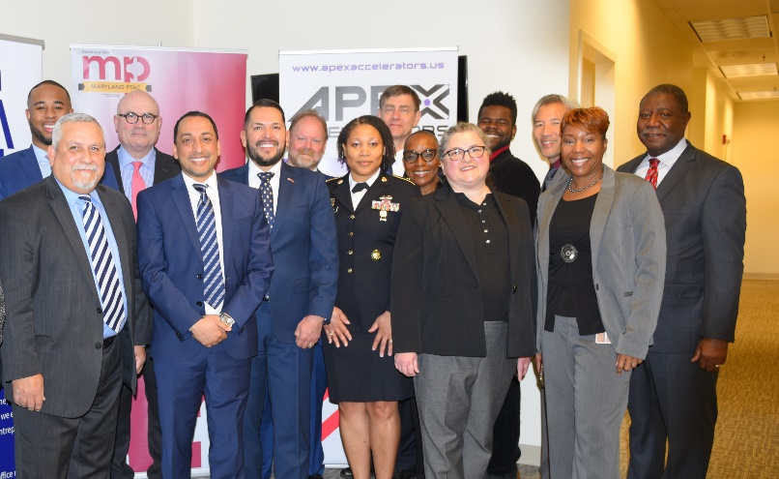
MARYLAND APEX ACCELERATOR
We Prepare You for Government Contracting Success!
5825 University Research Court, Ste 1300 College Park, MD 20740
Website: https://www.marylandapex.org/
Email: ptapadmn@umd.edu
Phone: (301)-405-6550
Social: @mdptac
FIND YOUR LOCAL APEX CENTER (“PTAC Locator”)
https://www.aptac-us.org/
https://twitter.com/MarylandAPEX
This procurement technical assistance center is funded in part through a cooperative agreement with the Department of Defense
https://www.facebook.com/MarylandPtac
https://www.linkedin.com/in/marylandapexaccelerator/

