Slide 1

Welcome
Opportunities in Construction, Facilities, and Maintenance:
Take a Virtual Walk with GSA’s Public Buildings Service

Slide 2
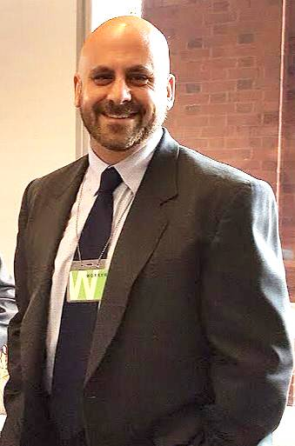

INTRODUCING TODAY’S PRESENTERS
Peter Genovese,
Facilities Operations and Tenant Services Officer,
Office of Facilities Management,
Mid-Atlantic Region
Dustin Stewart,
Facilities Engineering Program Manager,
Office of Facilities Management,
Mid-Atlantic Region

Slide 3
Today’s Agenda:
Facilities Engineering: The Philosophy
Facilities Engineering: The Practice
Case Study: Region 3’s DelVal Office and the VA at 5000 Wissahickon

Slide 4
Facilities Engineering: The Philosophy

Slide 5
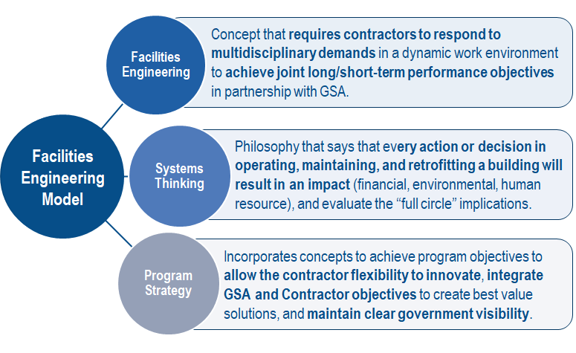
What is Facilities Engineering?

Slide 6
Differences in Requirements
Traditional O&M Contract |  | Facilities Engineering Contract
Includes typical O&M services that are prescriptive and task oriented. A typical O&M contractor does not evaluate the impact of actions, rather they provide maintenance. |  | Includes traditional O&M contract services, but also requires the contractor to provide additional technical, managerial and decision-making expertise. A facilities engineering contractor is expected to: Participate in asset modernization planning Assist in the evaluation of proposed projects Service as GSA’s trusted partner

Slide 7
Comparing the Two Models
Traditional O&M Model | Facilities Engineering Model
Task Oriented | Holistic/Long term facility orientation
Prescriptive Scope of Work | Outcome based scope with management plan
Decision making defaults to the Government | Leverage contractor technical, managerial, and decision making expertise
Heavy Government Oversight | Lean Government Staffing, Customized oversight
Monetary deductions to enforce performance | Integrated contractor/government approach. Business partnership with shared risk
5 year contracts | 10 year contracts
Stand alone contracts | Aggregation of contracts, services, facilities
Low cost procurement | Competitive best value procurement strategy
Minimal upfront evaluation of offerors prior to award | Multiphase and multi-factor evaluation with management plan

Slide 8
Facilities Engineering: The Practice

Slide 9
The Theory:
Objectives of the Facilities Engineering Model include:
  Allowing the contractor maximum flexibility to innovate while managing program costs, schedule, performance, risks, warranties, contracts and subcontracts, vendors and data required to deliver an effective program
  Integrate GSA and contractor objectives to create best value solutions that maintain and preserve real property assets while enhancing the level of comfort for tenants
  Maintaining a clear government visibility into the program deliverables, costs, schedules, technical performance, and shared risk

Slide 10
The Practice:
Facility Engineering contractors:
Share program objectives including tenant satisfaction, energy conservation, maximizing investment value, maximizing infrastructure lifecycle, etc.
Maximize the use of data, diagnostics/assessment, and analytics for the delivery of strategic asset management
Steer capital planning including short and long term asset planning and reinvestment decision

Slide 11
The Practice (continued):
Facility Engineering contractors:
Engage in Regional and field construction projects
  Provide technical expertise and management support
  Provide project management utilizing Global Project Management (gPM) principles
  Are engaged throughout the project lifecycle
Co-manage PBS strategic measures and KPIs
Provide Property Management including tenant communications, coordination and satisfaction initiatives

Slide 12
The Management Plan:
The contractor furnished Management Plan:
Allows the contractor to layer their corporate model on top of the Government’s minimum PWS requirements adding, potentially, a layer of value AND site specific detail
Identifies vendor processes and approach with sufficient detail to allow the Government an opportunity to align for service execution and meaningful contract administration
Provides the Government the benefit of a contractor’s industry expertise, innovation and resources

Slide 13
Maintenance:
Utilizes the GSA Preventive Maintenance Guide as the baseline for the maintenance in a facility
Contractors should leverage industry expertise to further refine the baseline
Industry best practices such as predictive maintenance techniques, technology solutions, and leveraging advanced data analytics and monitoring techniques should be incorporated

Slide 14
Technology Integration:
Contractors must administer their maintenance program within the National Computerized Maintenance Management System (NCMMS), GSA’s system of record (Maximo)
Maintenance approach must be tailored to maximize the capabilities of NCMMS
Contractors will need to partner with GSA to achieve various measures and KPI concerning NCMMS and utilizing data from NCMMS

Slide 15
Technology Integration:
Contractors are expected to leverage the building automation system (BAS) to optimize facility performance
GSA relies upon contractors’ industry expertise to stay on top of, and bring to the table, emerging technologies to the benefit of our facilities

Slide 16
Repair Liabilities:
Repair liabilities are limited to a contract specific dollar threshold
Calculated by parts and materials only (including any approved subcontracting costs).
Repair thresholds and deductible inclusion vary depending on regional approach.
The IDL and equipment repair assessment requirement work in tandem to formulate the start of a capital program
Information provided by contractors feed into the GSA planning process

Slide 17
Repair Liabilities:
Repair liabilities are limited to a contract specific dollar threshold
Calculated by parts and materials only (including any approved subcontracting costs).
Repair thresholds and deductible inclusion vary depending on regional approach.
The IDL and equipment repair assessment requirement work in tandem to formulate the start of a capital program
Information provided by contractors feed into the GSA planning process

Slide 18
Energy Conservation/Sustainability:
Energy Conservation/Sustainability are a major focus of GSA
Most low-hanging fruit has already been achieved in low and no-cost opportunities
Building operations remains the largest potential to meet the Administration’s goals
Advanced tactics and strategies are needed to continue to reduce energy consumption
GSA is looking for Facility Engineering Contractors to partner with GSA to monitor energy consumption, provide strategies to reduce consumption, and meet energy goals

Slide 19
Technical Program, Property & Project Support:
The Contractor is responsible to exhibit tactical stewardship of assets via awareness of projects and activities occurring within the property, regardless of who initiates and/or performs
Via standard and above standard services with threshold
A la carte line item options for ordering
Facilities Engineering vendors have a seat at the table to help ensure projects are properly executed and functional

Slide 20
Reporting & Communication:
Reporting and Communication is the an essential piece of the partnering relationship
Stakeholder management is essential in today’s multidisciplinary environment
Contractors are required to develop and implement a mutual framework around all types of information to be conveyed, captured, and reconciled over the term of the contract
Framework should ensure that holistic FE concepts are being employed
Framework includes dashboards, reports, data, analytics, etc

Slide 21
Case Study: Region 3’s DelVal Field Office and the VA at 5000 Wissahickon

Slide 22
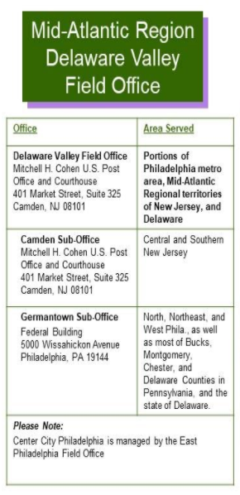
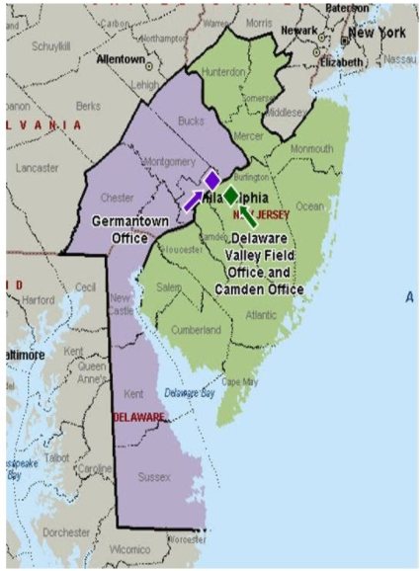
Field Office & Contract Overview:
5 facilities totaling 1.3 million GSF with multiple tenant agency missions
Facilities in 3 states with different environmental regulations
3 CBAs
Multitude of services within scope

Slide 23
Video
Virtual Tour of Philadelphia VA Facility:

Slide 24
Questions?

Slide 25
Small Business Resources
U.S. General Services Administration (GSA) - https://www.gsa.gov
  Office of Small & Disadvantaged Business Utilization (OSDBU) - https://www.gsa.gov/osdbu
  Federal Acquisition Service (FAS) - Commercial Products & Services - https://www.gsa.gov/fas
  Public Buildings Services (PBS) - Construction, Architecture, Interior Design, and Real Estate - https://www.gsa.gov/pbs
Small Business Administration (SBA) - https://www.sba.gov
  SBA Size Standards - https://go.usa.gov/xFR9p
  Small Business Loans - https://go.usa.gov/xFRPD
Procurement Technical Assistance Centers (PTACS) - https://www.aptac-us.org/
System for Award Management (SAM) - https://go.usa.gov/xFNkS
Federal Agency Procurement Forecasts - https://go.usa.gov/xFRbn

Slide 26
Thank You!

