Slide 1
Overview of Reporting:
Focus on HCaTS
HCaTS@gsa.gov
SBHCaTS@gsa.gov
Office of Professional Services
& Human Capital Categories
To access slides:
Industry Guidance and Resources,
HCaTS homepage
Under CPRM +
Kim Schumacher
Program Analyst, Business Operations
November 2021
Notes:
Training directed at administrative users, in charge of reporting on HCaTS task orders. Demonstrate where to get slides on HCaTS homepage, Industry Guidance and Resources, CPRM Section (“Bookmark it!”)

Slide 2

Roadmap
Slide 3 4 5 6 7 8 9-10 11 12-16 17-18 19 20 21 22 23 24 | What is CPRM? Training Resources Support Accessing CPRM Adding contact information for your company Contractual reporting and CAF requirements Entering new task orders/awards Quarterly reporting and zero invoices Entering and editing invoices Reporting Prices Paid Data (PPD) for labor CLINs Quarterly Reconciliation Enter CAF Payment Data (Vouchers) Remit CAF via Pay.gov Entering modifications (Mods) Uploading Required Documents Task order closeout
Notes:
Roadmap also serves as a table of contents for those using this as a reference outside of a live presentation

Slide 3
What is CPRM?
Contract Payment Reporting Module
CPRM was designed to:
Meet the reporting requirements of stakeholders, such as OMB;
Provide data for required Prices Paid Analysis;
Track Obligations;
Track Revenue.
What this means to Industry Partners:
Streamlined reporting capabilities;
Reduced manual data calls and other task order activity reporting;
Payment status is tracked.
Notes:
CPRM = data for GSA and federal government acquisition professionals; calculate and remit CAF. It is important to remember that CPRM supports multiple contract vehicles. Not all functionality/”tips” will apply to HCaTS. Refer to the HCaTS contract for specific reporting and CAF requirements.

Slide 4
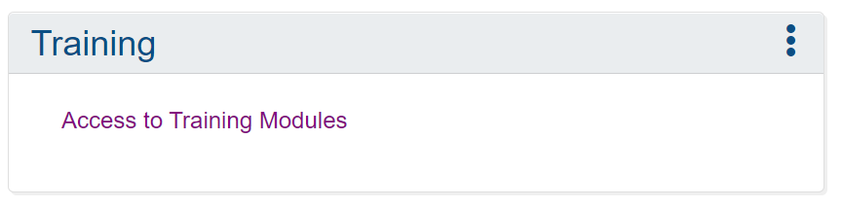
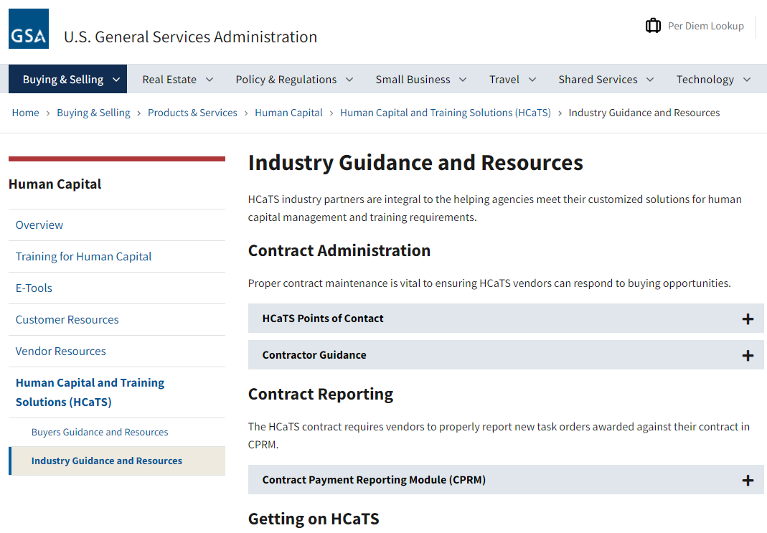
Training Resources
CPRM Training Portlet
Available on your CPRM homepage
New search tool for easy access
CPRM +, Industry Guidance and Resources, HCaTS Homepage
Slides: Intro to CPRM, How to Report Your Prices Paid
CPRM Invoice Upload Template
HCaTS CPRM Analysts
Team inbox: HCaTS@gsa.gov & SBHCaTS@gsa.gov
Specific reporting, CAF, or CPRM questions
Available for call or teleconference
Notes:
I have cited specific CPRM training modules where appropriate. Demonstrate where to find the Training Portlet on CPRM.

Slide 5
CPRM Support
ASSIST Service Desk for general IT Support
assist.servicedesk@gsa.gov
(877) 472-4877
(858)-412-8075 outside the continental US)
Always use your contract number in correspondence
with the Service Desk
HCaTS Questions
HCaTS@gsa.gov
SBHCaTS@gsa.gov
User Account Registration
Username / Password Reset and Recovery
Contact Grouping
Contract Registration
User Account Updates
Order Process Issues
Workflow Support
Problem Reports
Security POC Contact

Slide 6
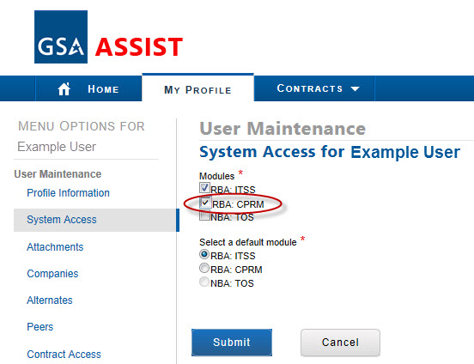
Accessing CPRM
CPRM is located within the ASSIST portal
URL: https://portal.fas.gsa.gov/web/guest
To self-register:
Select menu option: Registration - Register Contractor
Select ‘RBA: CPRM’ on registration profile
To add CPRM access to an existing ASSIST user account:
Edit your account profile and request additional access to CPRM
Your company POC must approve the role
We recommend:
Assign a primary and a back-up
Note: the main CPRM user may be different from the COPM or COCM
This role can view, add, or edit:
Company Contact Data in CPRM
Orders and Order Mods
Invoice Data and Zero Invoice Data
Contract Access Fee (CAF) Payment Data

Slide 7
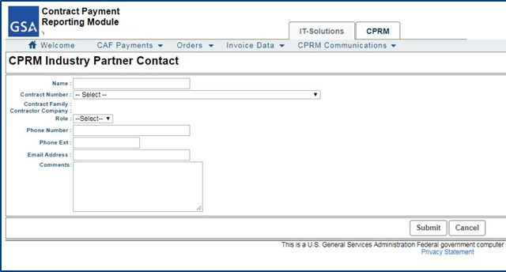
Add Your Contact Information
Industry Partner Contact Form
GSA will reach out to these contacts when questions arise about data in the system or CAF payments
Enter the individual(s) responsible for reporting in CPRM
Include a group mailbox, administrative user, and COPM/COCM
Access form via the CPRM Communications dropdown,
> Search CPRM Industry Partner Contacts > Add
  Enter the contact person name.
  Select the contract for which this person is a contact.
  Select the role for the contact person.
  Enter the phone number and email address for the contact.
  A group email address should be used for at least one person.
  Click Submit to save your changes or Cancel to dismiss the form without saving any changes. You can also Edit previously entered contacts.

Slide 8
Contractual Reporting & CAF Requirements
Reporting
CPRM should be an accurate representation of Task Order activity [G.3.2.]
Report new Task Orders within 30 days of award [G.3.2.1.]
You will report on each paid invoice [G.3.2.3.]
  When you report, you also remit
Report on active Task Orders every (Calendar) quarter [G.3.2.3.]
CAF - Contract Access Fee
Should be a separate CLIN on every invoice [G.3.1.]
  Paid on the entire invoice (including Travel, ODCs, Materials, etc)
  Bid CAF at the proper rate
CAF is a pass through from your customer to GSA
  Expectation → Invoiced CAF = Estimated CAF = paid CAF
Every task order/award should include CAF. If you see RFP for HCaTS that doesn’t include CAF, reach out to the Ordering CO (OCO).
Notes:
Most important slide. The rest of the deck describes how, this is why.

Slide 9
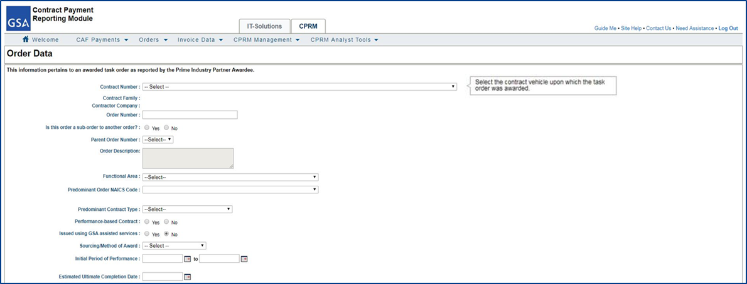
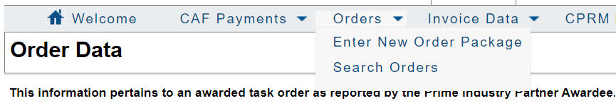
How to Enter New Task Orders (1)
Order Data Form
Report new Task Orders within 30 days of award
Form functionality is customized based on the type of contract
  Click the ‘Guide Me’ link to access the Help Document for the form.
Access form via the Orders dropdown
> Enter New Order Package
  Tool tips will appear to the right-hand side to help you enter the correct information into the form field.
  Start by selecting the contract number associated to the task order award.
  Some fields may change based on your contract selection.
  Enter the Period of Performance start and end dates associated to the initial funded award.
Notes:
Once created, the Order Data Page is command central for the task order. You will return to it again and again to enter invoices, enter mods, and add payments/vouchers.

Slide 10
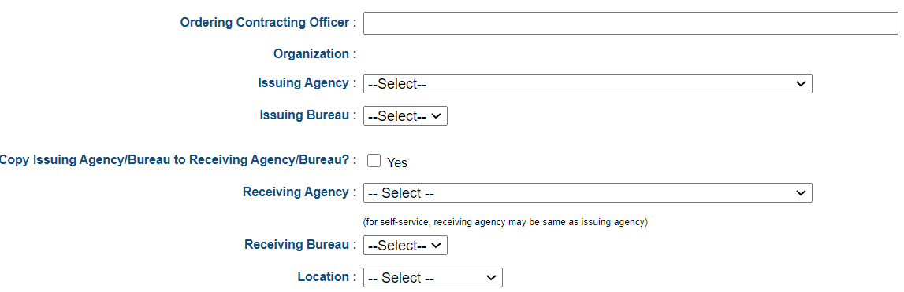
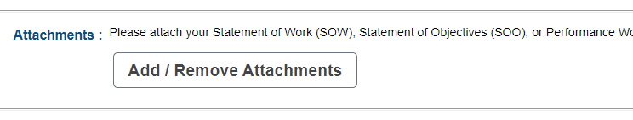


How to Enter New Task Orders (2)
Order Data Form
  Begin typing the name of the OCO and it should come up automatically. If not, enter their email address.
  Select the Receiving Agency from the dropdown.
  Attach relevant documents such as the signed award, SOW/SOO/PWS, and mods.
  Click Submit to save your changes or Cancel to dismiss the form without saving any changes.
  Once created, return to a Task Order via the Orders dropdown
  > Search Orders
  > Click on Task Order number
  After saving the Task Order, you can return to make edits as needed. Edit button is at the bottom of the Order Data page.
Notes:
Once created, the Order Data Page is command central for the task order. You will return to it again and again to enter invoices, enter mods, and add payments/vouchers.

Slide 11
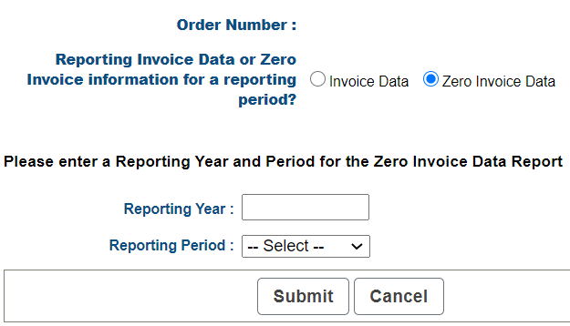
Quarterly Reporting & Zero Invoices
Quarterly Reporting Deadlines
Calendar Quarters [G.3.2.4.]
All active task orders EVERY quarter
Report invoices by paid date
  On each paid invoice
Expectation → Invoiced CAF = Estimated CAF = paid CAF
Zero Invoices
Intentional gap in reporting
Satisfies quarterly reporting requirement
Added the same way as new invoice data
Calendar Quarters |  | CAF & Reporting Due Date
1st Quarter | January 1 - March 31 | No later than April 30th
2nd Quarter | April 1 - June 30 | No later than July 30th
3rd Quarter | July 1 - September 30 | No later than October 30th
4th Quarter | October 1 - December 31 | No later than January 30th
Notes:
Refer back to Slide 8, CAF and reporting requirements

Slide 12
Entering Invoices

Slide 13
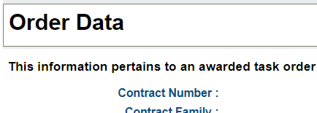
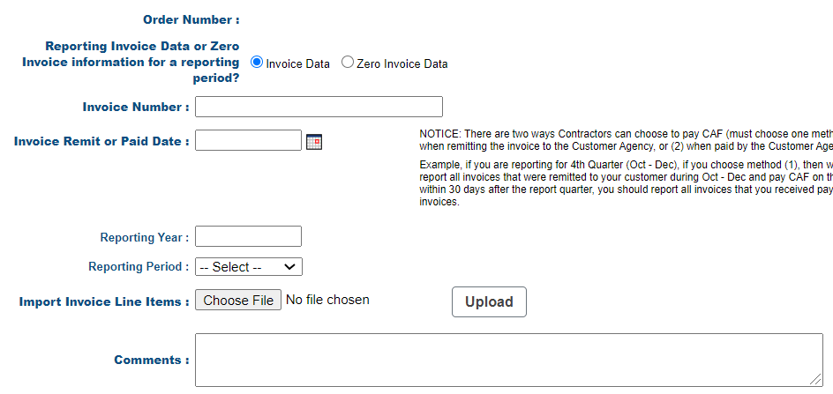

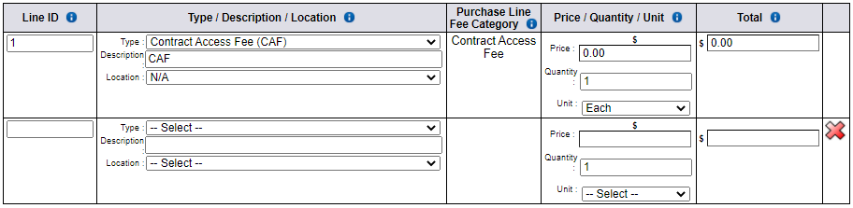
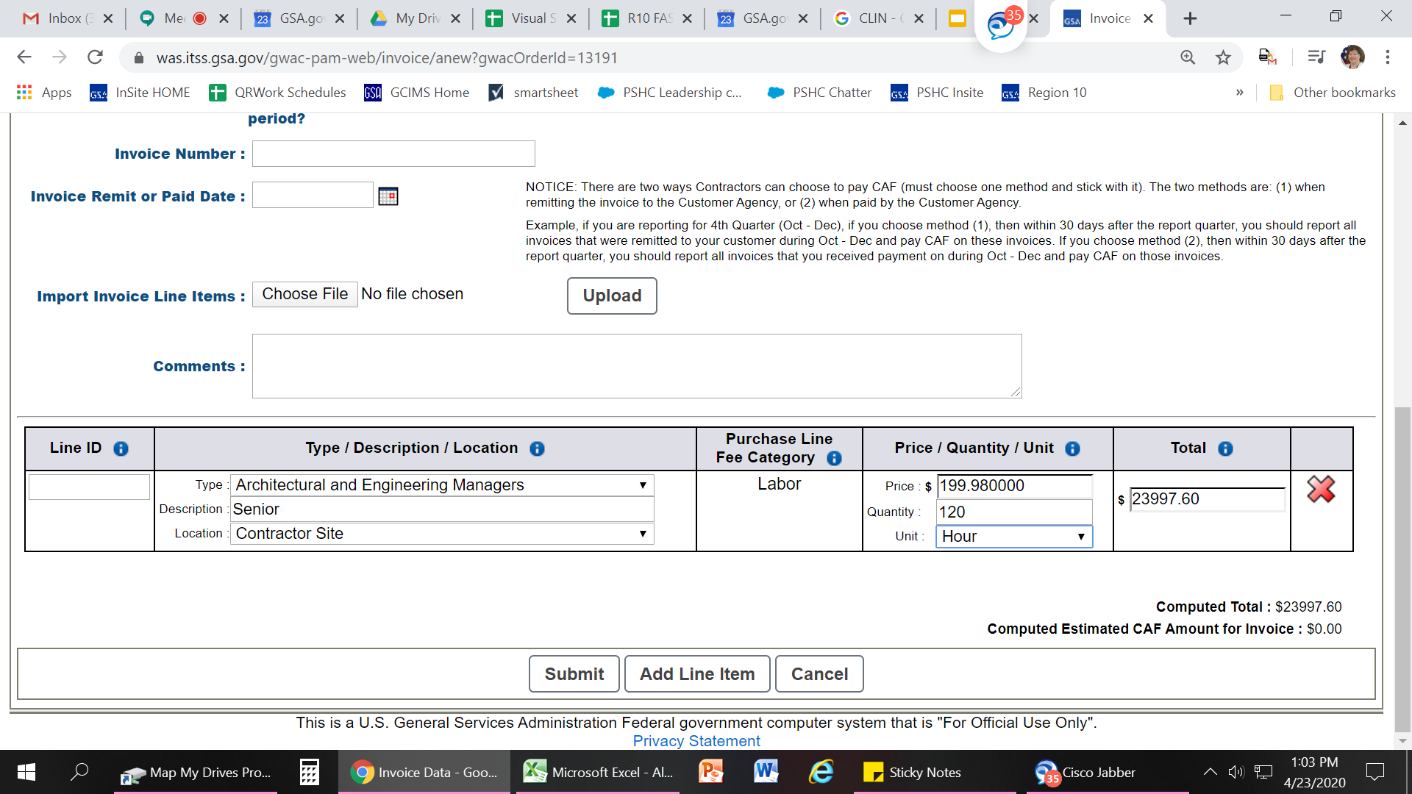
Method 1: Line by Line (1)
For new users or orders with few line items
Access the Invoice Data Form via the Order Data Page.
  Scroll down to the Invoice Data section and click ‘add’.
  Select the Invoice Data radio button.
  Enter the date associated with the invoice, the reporting year, and the reporting period.
  You can disregard the import function and ‘Upload’ button with this method.
  The form will require a Comment if the entered CAF does not match the estimated CAF.
Notes:
Comment field can be used to communicate with CPRM analysts, GSA. Other things to include might be if it’s a hybrid type order.

Slide 14
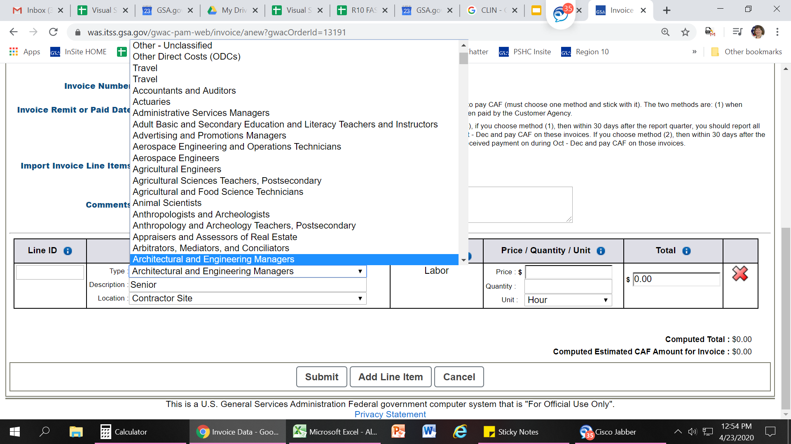
Method 1: Line by Line (2)
For new users or orders with few line items
  Use the line item table to report your invoice line items, at least 1 row per CLIN. The CAF line is provided on every invoice by default.
  Type, Price, Quantity & Unit fields will depend on the prices paid guidance for contract type (slides 18-19). CPRM will calculate totals and estimated CAF based on CAF rate rules.
  Click the ‘Add Line Item’ button to add new line items. Click ‘Submit’ to save changes, once submitted, you can return at any time to edit an invoice.
Notes:
The CAF line is provided by default, that’s a nudge because the OASIS contract requires CAF to be on every invoice.

Slide 15
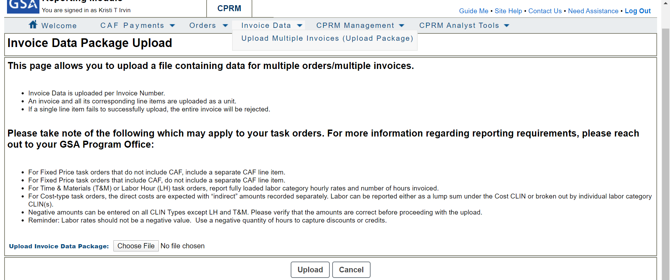
Method 2: Upload Multiple Invoices
For users with a large number of task orders
From the Invoice Data dropdown, select Upload Multiple Invoices (Upload Package)
Download the ‘CPRM Invoice Upload Template’ from the HCaTS Industry Guidance and Resources page.
Format your document according to the ‘Instructions’ tab.
Save your document.
Navigate to the Invoice Data Package Upload page in CPRM.
Click ‘Choose File’, select your document, and click ‘Upload’.
Verify that the invoices uploaded correctly (to the right task orders).
Tips:
This method can also be used to upload a single invoice.
“Set it and forget it” - for T&M/LH orders, enter labor categories/rates once and just update with actual amounts
Notes:
Comment field can be used to communicate with CPRM analysts, GSA. Other things to include might be if it’s a hybrid type order. 4th time linking Industry Guidance and Resources page.

Slide 16

Final Tips for Invoices
‘Submit’ early and often to save your work
You can always return to submitted invoices to make edits
[From Order Data Page, click on the invoice number, then click ‘Edit’]
Notes:
Comment field can be used to communicate with CPRM analysts, GSA. Other things to include might be if it’s a hybrid type order.

Slide 17
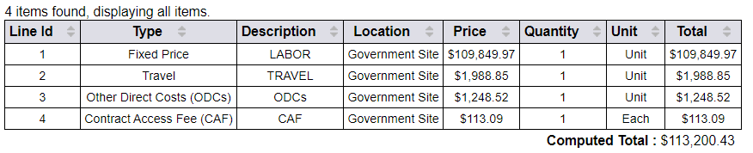
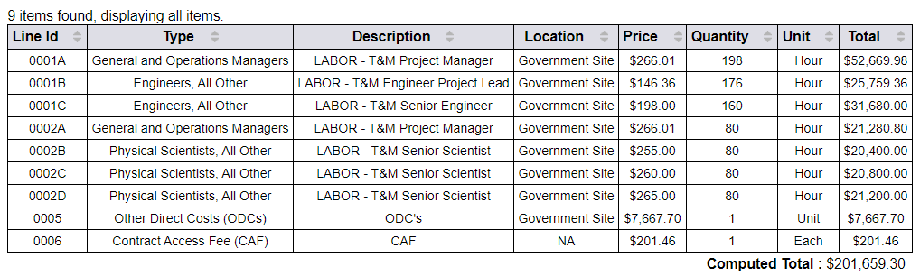
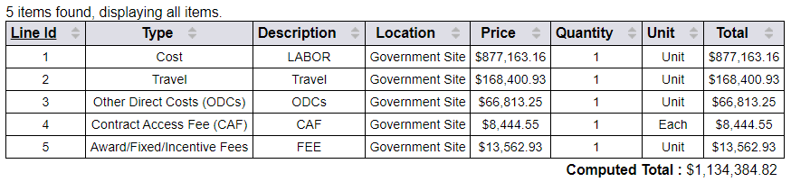
Prices Paid Data (PPD) (1)
Reporting actual invoiced labor rates
Required by OMB for Best-In-Class contracts - All HCaTS families are BIC
Supports greater acquisition transparency
Data is shared with acquisition professionals government-wide for price analysis
To avoid accidentally reporting proprietary data, do NOT include PPD on Firm Fixed Price or Cost Plus type orders.
For Labor Hour and Time & Materials type task orders:
Report fully loaded labor category hourly rates and number of hours invoiced
One line item for each different labor category and labor rate
Firm Fixed Price Example
Labor Hour, Time & Materials Example
Cost Plus Example

Slide 18
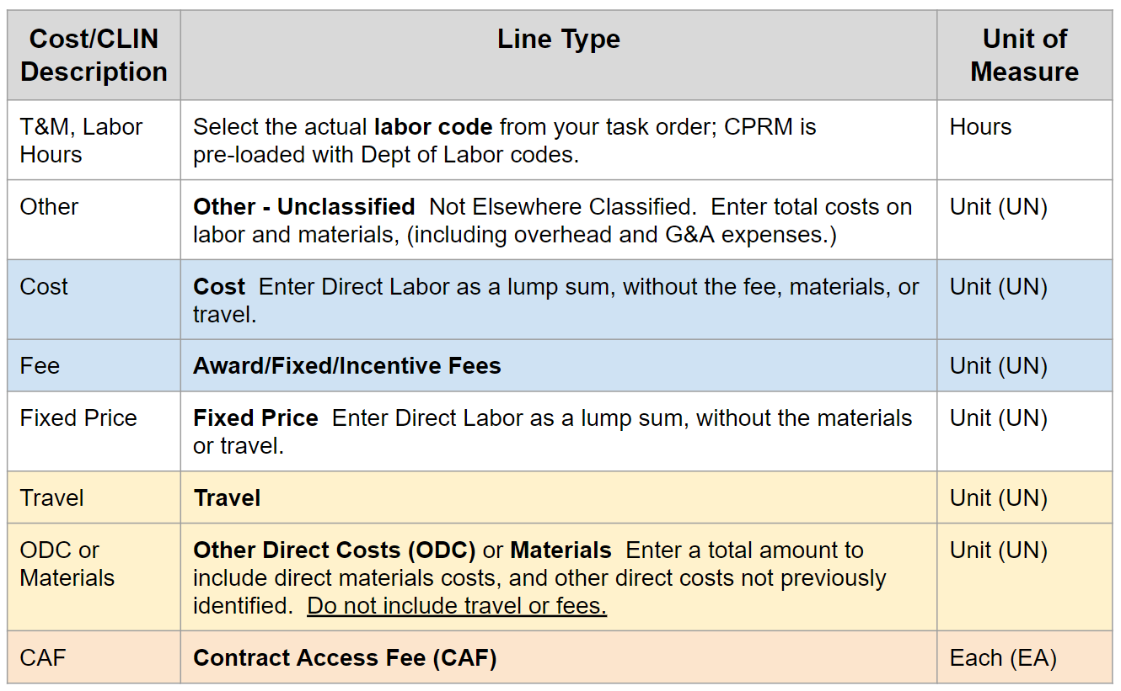
Prices Paid Data (PPD) (2)
Summary of Codes for CPRM Invoices

Slide 19
Invoice Reconciliation
GSA reviews invoice reporting & CAF remittance
Reviews begin immediately following the reporting deadline ex: Q3 review began Nov 1
CPRM Analysts:
Compare Order Data Page to what is reported by OCOs in FPDS-NG
Ensure invoice or zero invoice was reported for each Task Order
CAF invoiced = CAF remitted = Estimated CAF
Review Prices Paid Data
Ensure all required documents are attached to the task order
To resolve reporting and remittance issues:
Analysts reach out to Contractors
Engage IOAs or ConOps as necessary

Slide 20
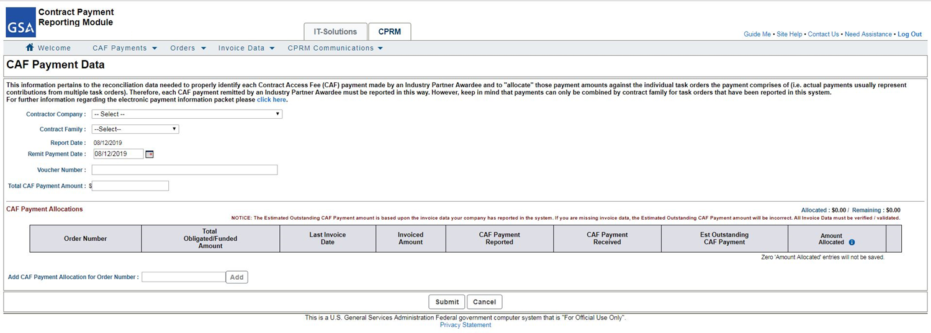
Enter CAF Payment Data (Vouchers)
CAF Payment Data Form Report CAF payments and connect to Pay.gov
Access form via the CAF Payments dropdown,
> Enter CAF Payment Data
  Select your company. If you are supporting multiple divisions in your company, you will select one entry from multiple options.
  Select the contract family for which you will be making the CAF payment. Once you select an option, the CAF Payment Allocations table will populate with all your task orders for which there is invoice data.
  Enter the date that corresponds to when you will submit the actual payment.
  The Voucher Number is a way for you and the GSA to communicate about a payment. Example of a Voucher Number might be ‘1st QTR 2014’ or some type of payment tracking ID.
  Additional task orders may be added to the Allocations table using this Add feature. Start to type a Task Order number and the system will find matches. Select the correct match and click ‘Add’.
  The Total CAF Payment Amount must be fully allocated to one or more task orders in the allocation table. The allocated amounts are entered in the Amount Allocated column.
  The Total CAF Payment Amount should be the exact amount that you will remit to the GSA for this payment.

Slide 21
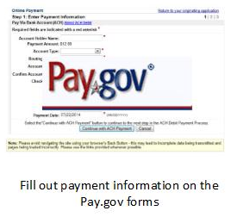
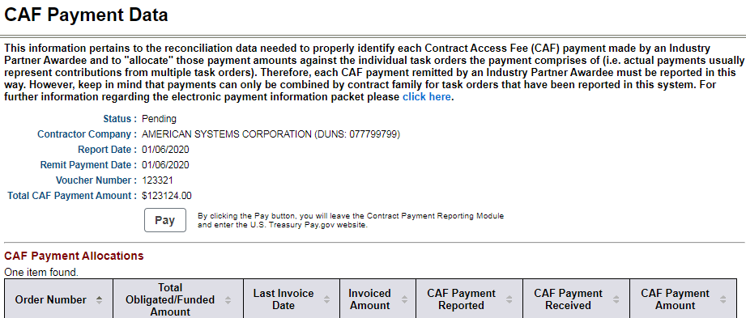
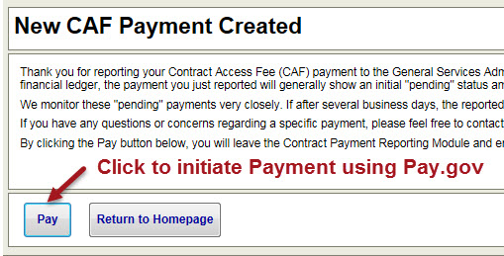
Remit CAF with Pay.gov
Pay Button
Enables you to remit your CAF payment to the GSA using U.S. Treasury’s Pay.gov system
Pay button appears on pending CAF Payment Data Forms and after you submit the CAF Payment Data Form
You will leave CPRM and open a connection to Pay.gov, but your contract number and payment amount will be carried over
Pay.gov payments are done by electronic bank transfer

Slide 22

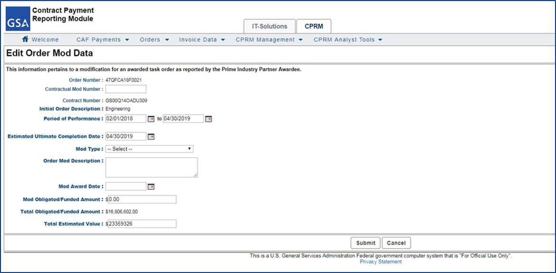
Entering Modifications (Mods)
Order Mod Data Form
Report changes to the Task Order as reflected in the modification award document
Access the Mod Data Form via the Order Data Page,
Scroll to the Order Modifications section and click ‘add’
  The Period of Performance reflects the overall order’s performance start and end dates. If the modification extended or shortened the overall period of performance, edit the end date to accurately reflect the end date for the order.
  Enter a short description on the nature of the mod.
  Enter the increase/decrease to the awarded, funded amount as reflected on the modification award document. The amount should not include un-exercised options.
  The Total Estimated Value is automatically updated to match the Total Obligated/Funded Amount when a mod increases the Total Obligated/Funded Amount beyond the previously entered Total Estimated Value. This value may be edited on the Order Data form, if needed.
  Click ‘Submit’ to save. Return to edit by selecting the Mod from the Order Modifications list.

Slide 23
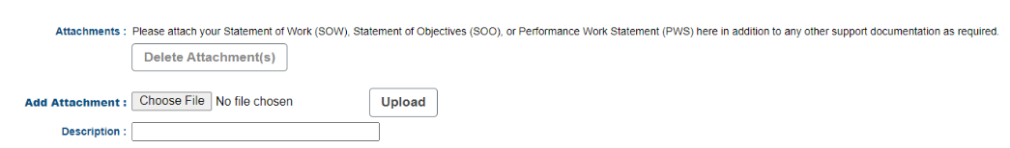
Uploading Required Documents
Required Documentation
Per section G.3.2.1: Attachment (attach an electronic copy of the complete task order Award documents that includes Statement of Work (SOW)/Statement of Objectives (SOO), or Performance Work Statement (PWS))
This should include an electronic copy of all Mods
  *Located at the bottom of the screen*
  CLICK Submit to SAVE

Slide 24
Task Order Closeout
Contractors should close out their Task Orders in CPRM
Accomplished at the quarter following the ‘ultimate completion date’
CPRM notifies when a Task Order reaches the ‘ultimate completion date’
OCO should issue a closeout mod to remove any un-expensed obligated funds
  OR the Contractor can submit a Release of Claims in CPRM
Contractor should:
  Ensure all invoices are properly reported, and sum to the remaining obligated balance
  Ensure the CAF paid to GSA matches the CAF invoiced and Estimated CAF
  Once all actions to close out have been taken, validate the task order
GSA will complete final reconciliation of task order
  The task order will then be validated by GSA or rejected pending further action
Notes:
CPRM = data for GSA and federal government acquisition professionals; calculate and remit CAF

Slide 25

Questions?
Thank you for attending the training!

