Slide 1

RFIs, RFQs, RFPs:
Understanding the Difference
U.S. General Services Administration

Slide 2




Welcome
Jessica Pate
Branch Chief
GSA FAS
Direct Client Support Division (DCSD)

Slide 3
Today’s Agenda
The power of responding to Requests for Information (RFI)/Sources Sought Notices (SSN)
Differences between Requests for Quotes (RFQ) and Requests for Proposals (RFP)
Tips on creating more effective responses
Common mistakes to avoid
Insights from federal contracting officers

Slide 4
Core Purpose:
RFI/
SSN
Finding the Right Supplier
RFQ
RFP

Slide 5
Definitions
Request for Information (RFI) / Sources Sought Notice (SSN): A market research tool used to obtain price, delivery, capabilities, interest, etc. for planning purposes
Request for Quote (RFQ): A solicitation method used to obtain price, cost, delivery, and related information from suppliers
Request for Proposal (RFP): A solicitation method which communicates the Government’s requirements and requests proposals

Slide 6
Where are we in the Acquisition Process?
Planning
  RFI
  SSN
Solicitation
  RFQ
  RFP
Evaluations
Award
Administration

Slide 7
Key Differences
 | Why | Where
RFI/SSN Request for Information Sources Sought Notice | Solicit industry input: Government’s: Requirement Strategy Industry’s: Capability Interest | FAR subpart 8.4 FAR part 12 FAR parts 13, 15 FAR 16.505 | GSA Schedules Commercial Items Open Market (GSA OASIS, Alliant)
RFP Request for Proposal | Communicate Requirement & Solicit Proposals | FAR part 12 FAR parts 13, 15 FAR 16.505 | Commercial Items Open Market (GSA OASIS, Alliant)
RFQ Request for Quote | Obtain: Price Cost Delivery Related Information | FAR subpart 8.4 FAR part 13 | GSA Schedules Open Market (Below the SAT)

Slide 8
Poll Question
Has your organization responded to an RFI?

Slide 9
What to Expect
What is in an RFI?
How Should I Respond?
No standard format
Shorter response times
Overview of the Government’s Requirement
Questions for Industry
Follow the format specified in the RFI
Interest – Will you submit an offer?
Business Size & Primary NAICS
Relative Experience
Subcontractor Involvement
Conflicts of Interest

Slide 10
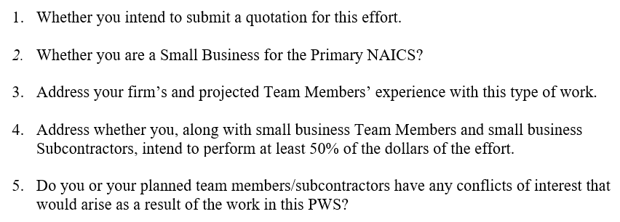
RFI Example - Less Complex

Slide 11
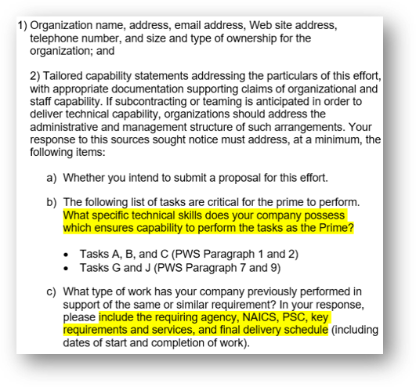
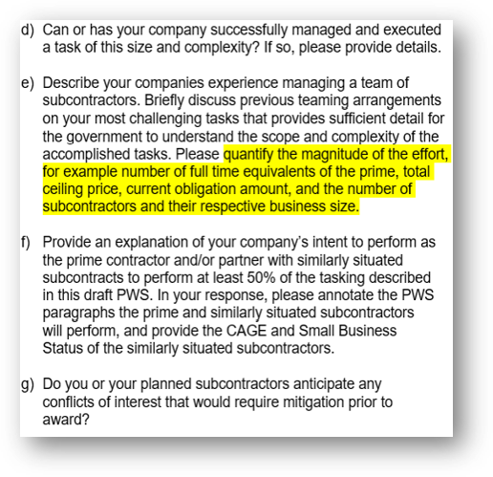
RFI Example - More Complex

Slide 12
RFI Tips
Dos:
Timely
Complete
Focus on the Requirement
Specific-Agencies, Contract Numbers, Figures, Dates, Tasks, Roles, etc.
Don’ts:
Underestimate the importance of your response
Make Assumptions

Slide 13

Question
How does the Government use the information submitted through an RFI response?

Slide 14
RFPs - What to Expect
In accordance with FAR 15.203, at a minimum:
The Government’s Requirement
Terms & Conditions
Instructions (Information required to be in the proposal)
Evaluation Criteria:
  Factors
  Relative importance

Slide 15
RFQs - What to Expect
In accordance with FAR 8.405-2 (c), at a minimum:
Statement of Work (SOW) or Performance Work Statement (PWS)
Evaluation Criteria
Quotes do not establish a binding contract agreement with the Government.
The contract is established when the contractor accepts the Government’s subsequent offer to work by
    Signing the quote, or
    Performance/Delivery

Slide 16
RFQ & RFP Tips
Do:
Read, read, read! (instructions to offerors, PWS/SOW, evaluation criteria)
Ask Questions
Self-evaluate
Be detailed, specific, and responsive (timeliness, no exceptions to the solicitation, ensure all instructions are followed)

Slide 17
RFQ & RFP-Tips
Don’t:
“Low bid”
Grammar mistakes
Restate the requirement
Make assumptions

Slide 18
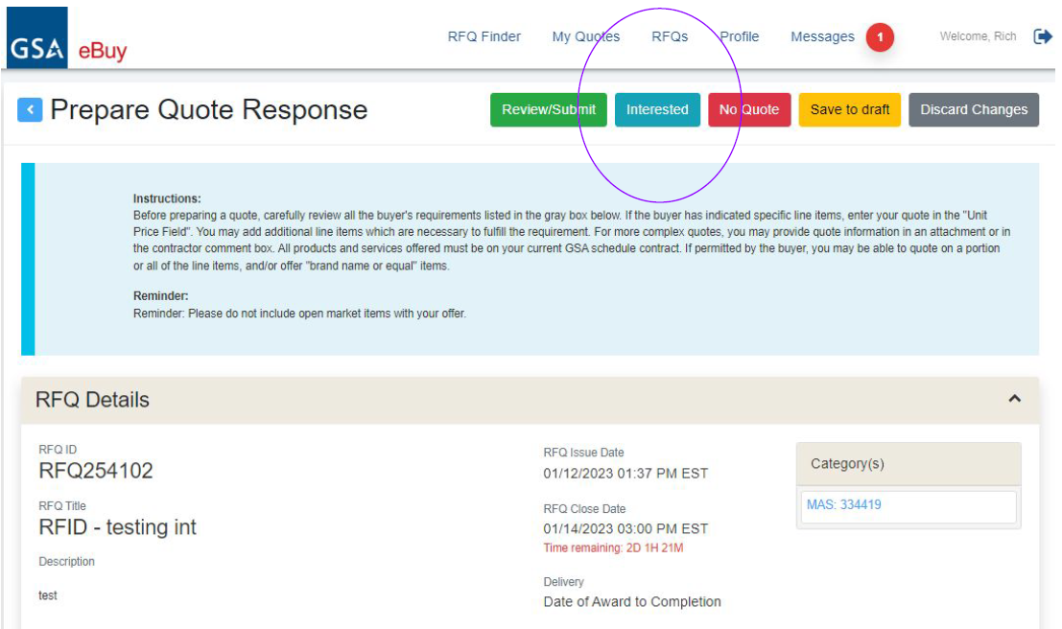
eBuy “Interested” Feature
Sellers can notify buyers that they are interested in an RFI/RFQ before submitting a response.
Seller’s My Quotes page will display all interested action.

Slide 19
Questions
How can I ensure my quote/proposal is responsive?
How does the government evaluate my quote/proposal?

Slide 20
MAS Resources for Assistance
www.gsa.gov/schedule
Email: MASPMO@GSA.GOV

Slide 21
Questions?

Slide 22
Thank You!

