Slide 1



Beta.Sam.gov
How to Run ad Hoc Reports

Slide 2
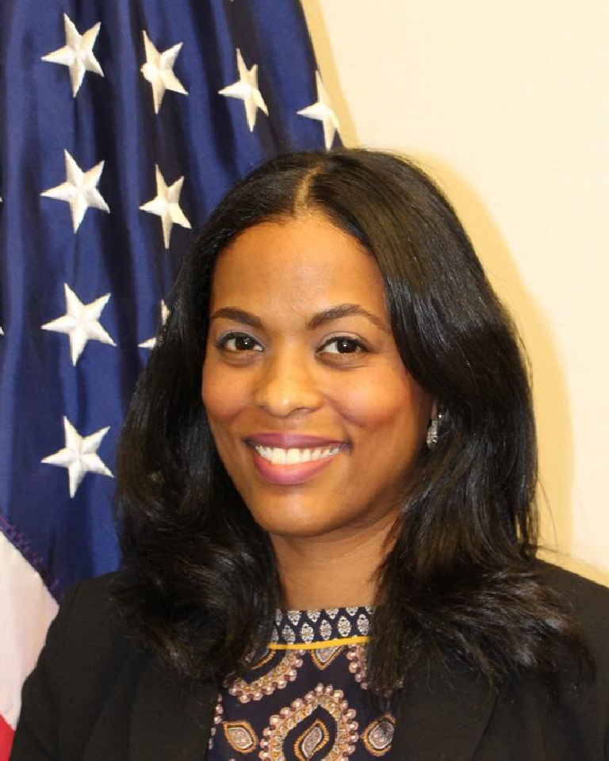

Welcome
Syretta Dyson
Supervisory Small Business Specialist National Small Business Advocacy and Engagement Division

Slide 3
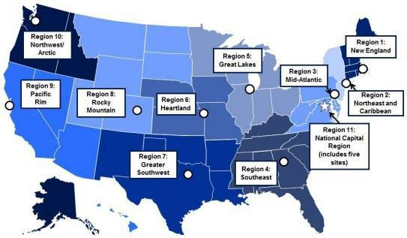
OSDBU Overview
“GSA's Office of Small and Disadvantaged Business Utilization connects small businesses with people and resources to help them grow.
We are your advocates
and believe in
‘Small Business First.’”
GSA OSDBU
has offices in 11 regions across the country.

Slide 4
Goals for today
Provide you with a basic understanding of the adhoc reporting feature on SAM.gov
o I want you feel comfortable with the terminology to understand
how to access information in the system.
Understand what information can be provided in the data bank to help you conduct market research
How to access basic information needed to run an Ad-Hoc Report.

Slide 5
Poll Question #1
Do you know what the data bank is?

Slide 6
Poll Question #2
Do you use the data bank to run reports?

Slide 7










What contracts are set to expire that I can compete for in the future?
Steps to Developing Leads in the Federal ^{Market}
Who are my competitors? Who holds the current contract?
How much are they buying?
Have they awarded any set-asides?
Which federal agencies are purchasing my product or service?
The Unknown can cause Frustration & Disappointment

Slide 8
Let the Data Refine Your Overall Strategy!
Use Data to Develop a Targeted Strategy
Choose the Right Event to Attend
Maximize Time at Matchmaking Events
Know which Agency Forecast Tools to Use
Become More Efficient
And much more!

Slide 9

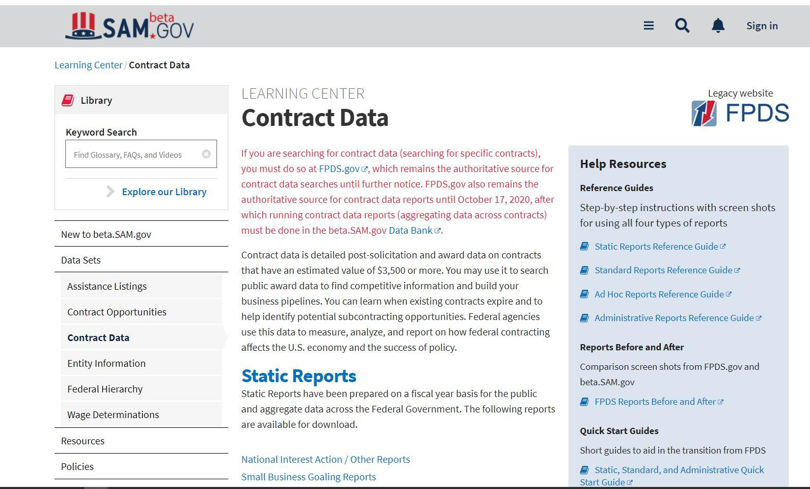
Beta.SAM.Gov
What is reported to FPDS:
→ Contract actions valued at $10,000.
Every contract modiﬁcation is reported as well.
Where is the data from?
→ The data is fed from 90+ agency contract writing systems.

Slide 10
Beta.SAM.Gov
→ Migrated the FPDS reporting function to beta.sam.gov on Oct 17th.

Slide 11
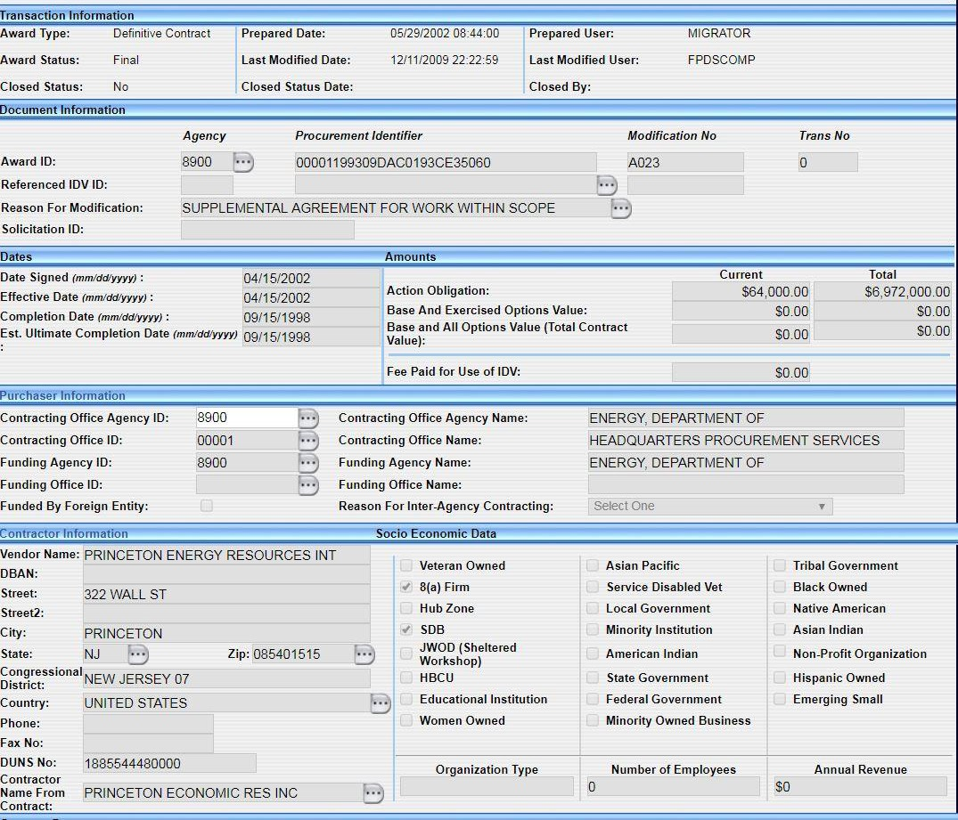
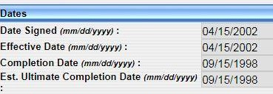

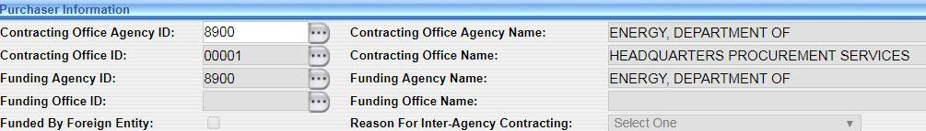

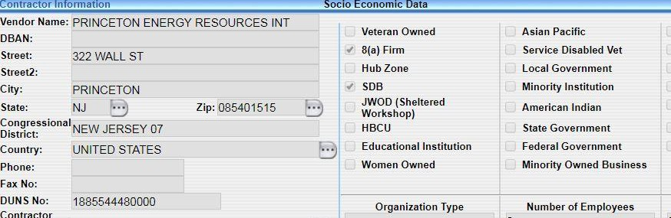

Contract Action Report (CAR)
ABC123
00000-0000-0000

Slide 12
Poll Question #3
Do you know your Product Service Code?

Slide 13




What is needed to use FPDS:
Your Product Service Code (PSC)
1. Industry Classification used to identify specific types of industry.
NAICS
NAICS is a broad classification
The NAICS is what you do
1. PSC’s can help you narrow down what exactly your business does
PSC
PSC’s are specific and can yield better data for market research and analysis
Your PSC is how you are doing it

Slide 14
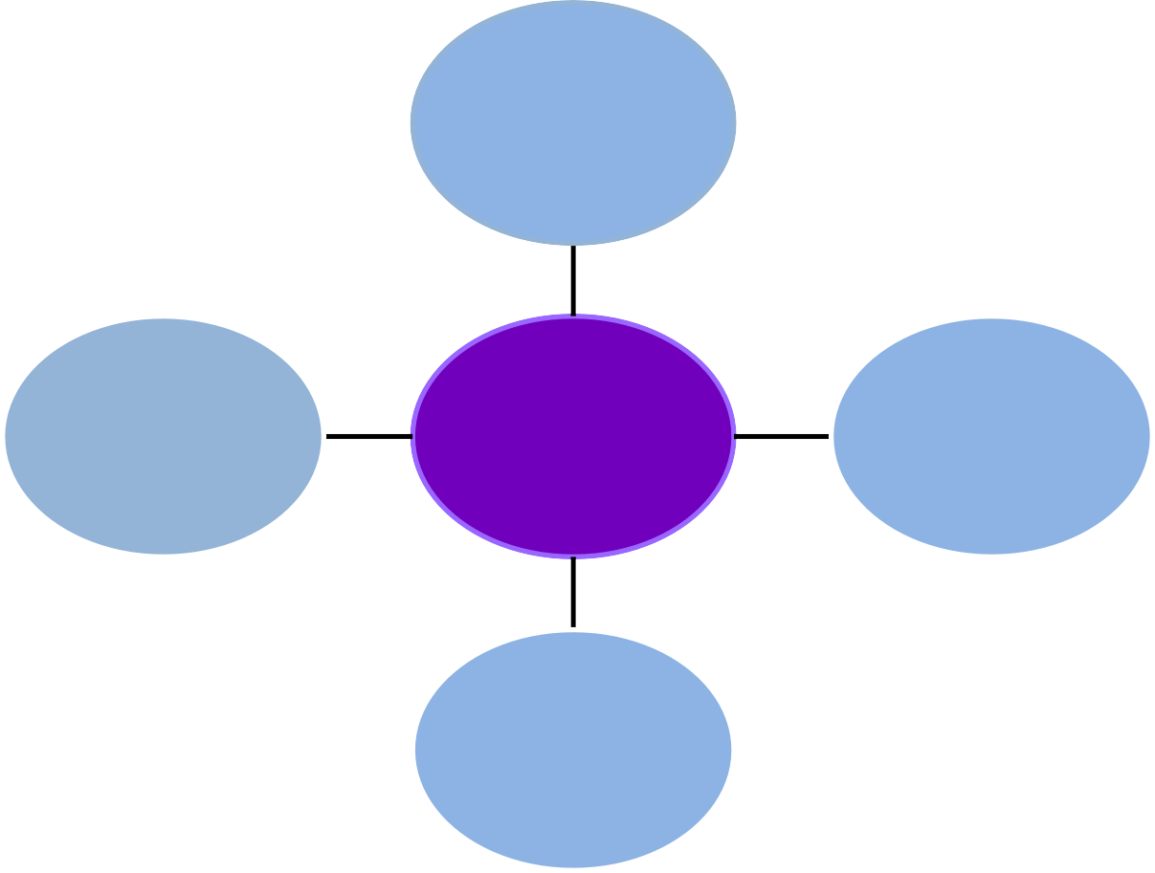
PSC R704
Support MGMT: Auditing
Support MGMT: Data Collection
Excludes: Market
Research/Public Opinion, to Include Telephone and Field Interviews, Focus Testing, and Surveys .
PSC R702
NAICS CODE 541611
PSC R422
Professional: Market Research, Public, Opinion
Includes: Telephone and Field Interviews, Focus Testing, and Surveys
PSC R710
Financial (Includes credit Card services)
Administrative Management and General Management Consulting Services

Slide 15
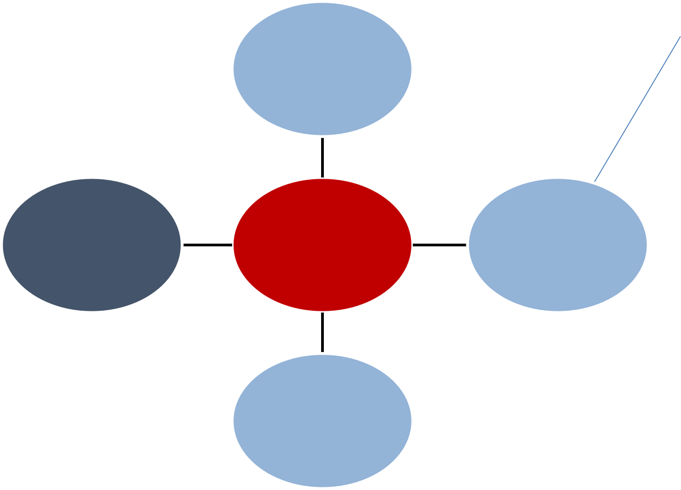
PSC R704
Support MGMT: Auditing
20%
Support MGMT: Data Collection
Excludes: Market
Research/Public Opinion, to Include Telephone and Field Interviews, Focus Testing, and Surveys .
PSC R702
NAICS CODE 541611
PSC R422
Professional: Market Research, Public, Opinion
Includes: Telephone and Field Interviews, Focus Testing, and
Surveys
PSC R710
80%
Financial (Includes credit Card services)
Administrative Management and General Management Consulting Services

Slide 16











Conduct Market Research
Identify Target Agencies
Refine your Approach
Lead Generation &
Business Development
Process
Develop Marketing Strategy
Develop Strategic Plan

Slide 17










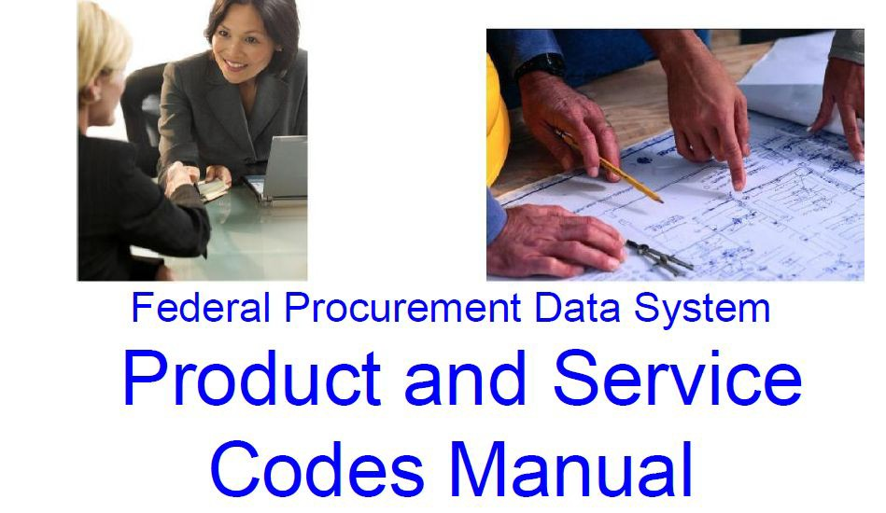


To Start: 3 Steps
Step 2 Register in beta.sam.gov
Step 1 Locate your PSC
Step 3 Conduct your research

Slide 18
Live Demonstration

Slide 19
Where to find help:
Help Desk
– Phone: 866-606-8220
– Website: www.fsd.gov
19

Slide 20
Poll Question #4
Was this information useful?

Slide 21
THANK YOU

