Slide 1

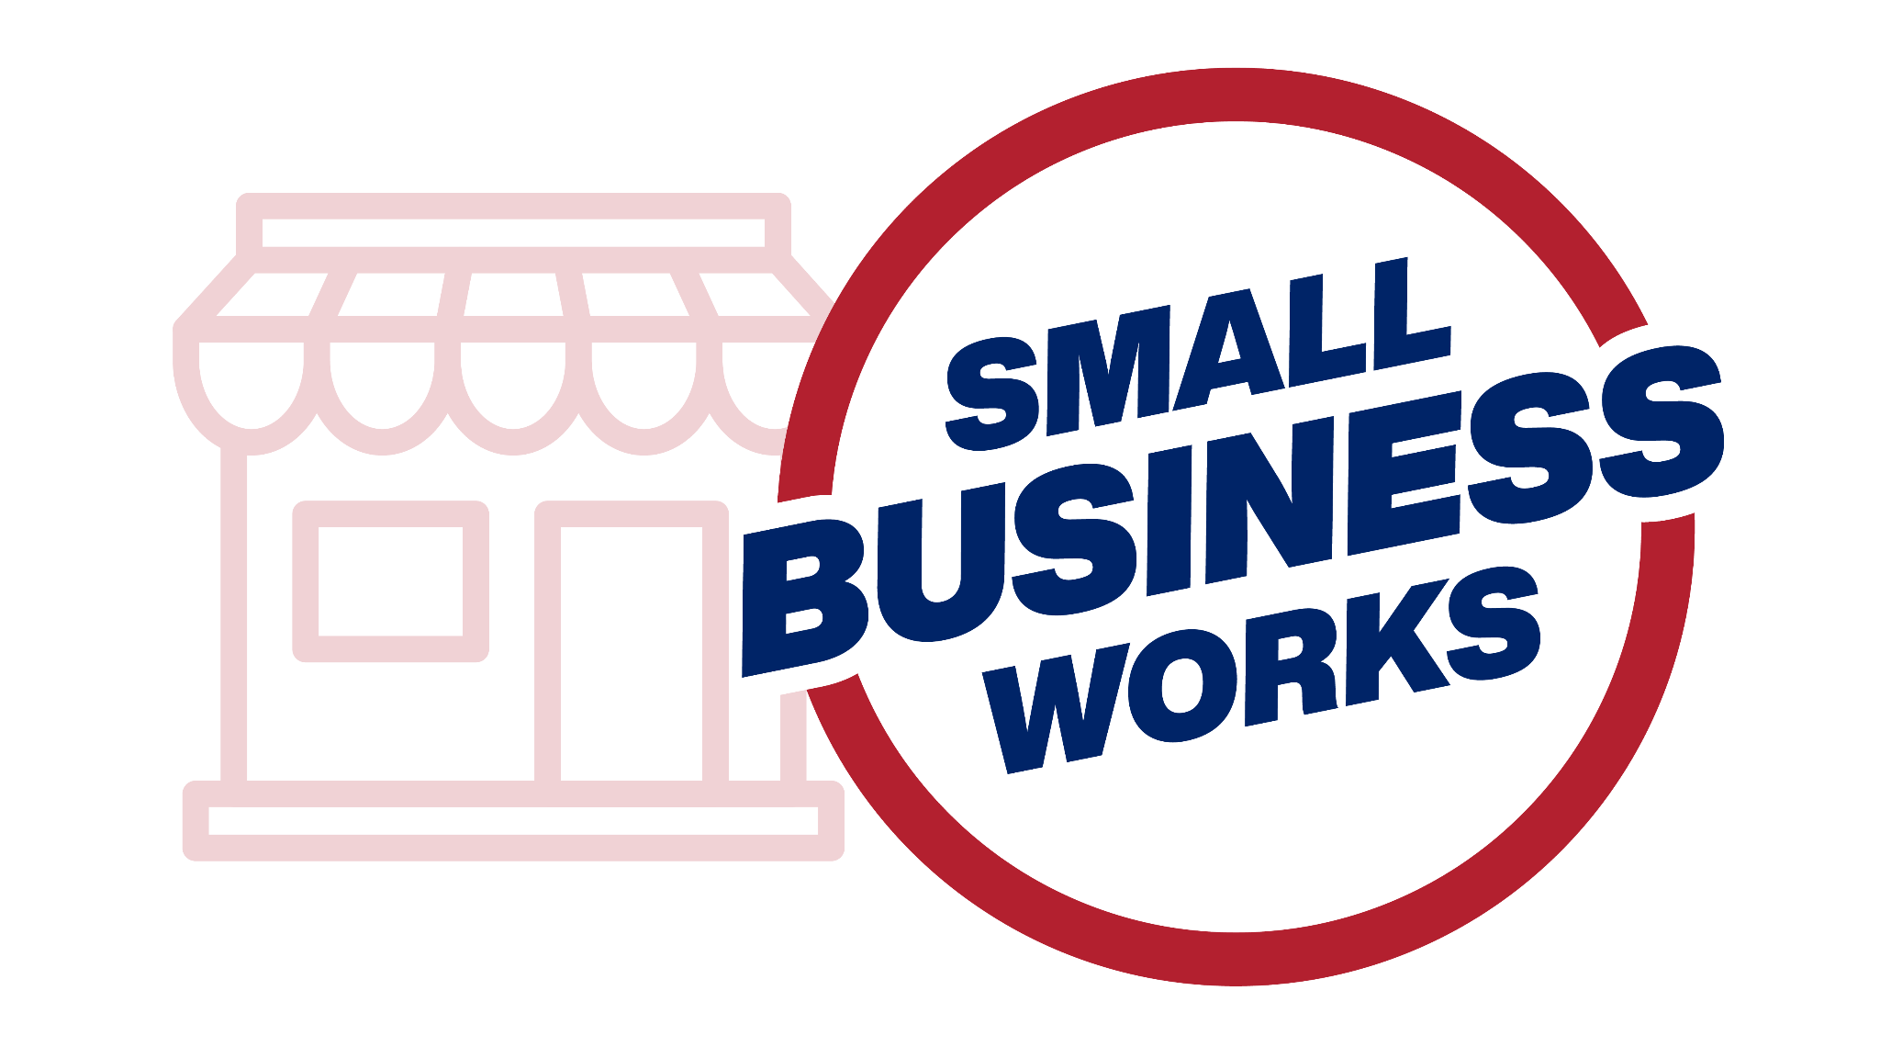
Small Business Works 2024
GSA OSDBU A.C.T.S on Maximizing Small Business Opportunities
U.S. General Services Administration

Slide 2
Surety Bond Guarantee Program for Small Businesses
sba.gov/osg

Slide 3
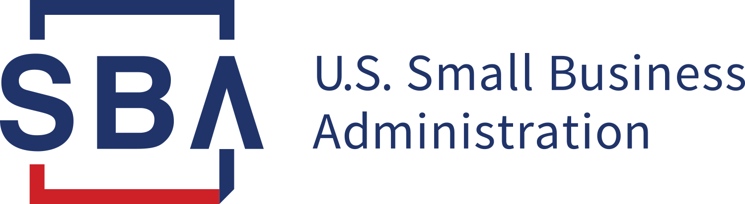
The SBA Has Your Back
All SBA products and services are extended to the
public on a nondiscriminatory basis.
sba.gov/osg

Slide 4

We help small businesses facing barriers to success by creating access and opportunity for them to qualify for contract bonding, increase bonding capacity, and grow their business.

Slide 5

Providing access and creating stability
You gain access to bid, performance,
payment, and ancillary bonds.
Our guarantee allows small businesses to qualify for more bonding.

Slide 6
SBA’s Surety Bond Guarantee Program
Enables surety companies to support small businesses having difficulty obtaining bonding.
sba.gov/osg

Slide 7



How you benefit
Grow your business
Increase
opportunity
Flexible requirements

Slide 8



Evaluation based on capacity, capital, and character
Capacity (your ability to complete the work) is based on experience in your field, key personnel experience, and day-to-day business management practices.
Character means the small business owner’s personal credit history and business reputation.
Capital is based on your company’s profitability and the quality of your financial statements.

Slide 9
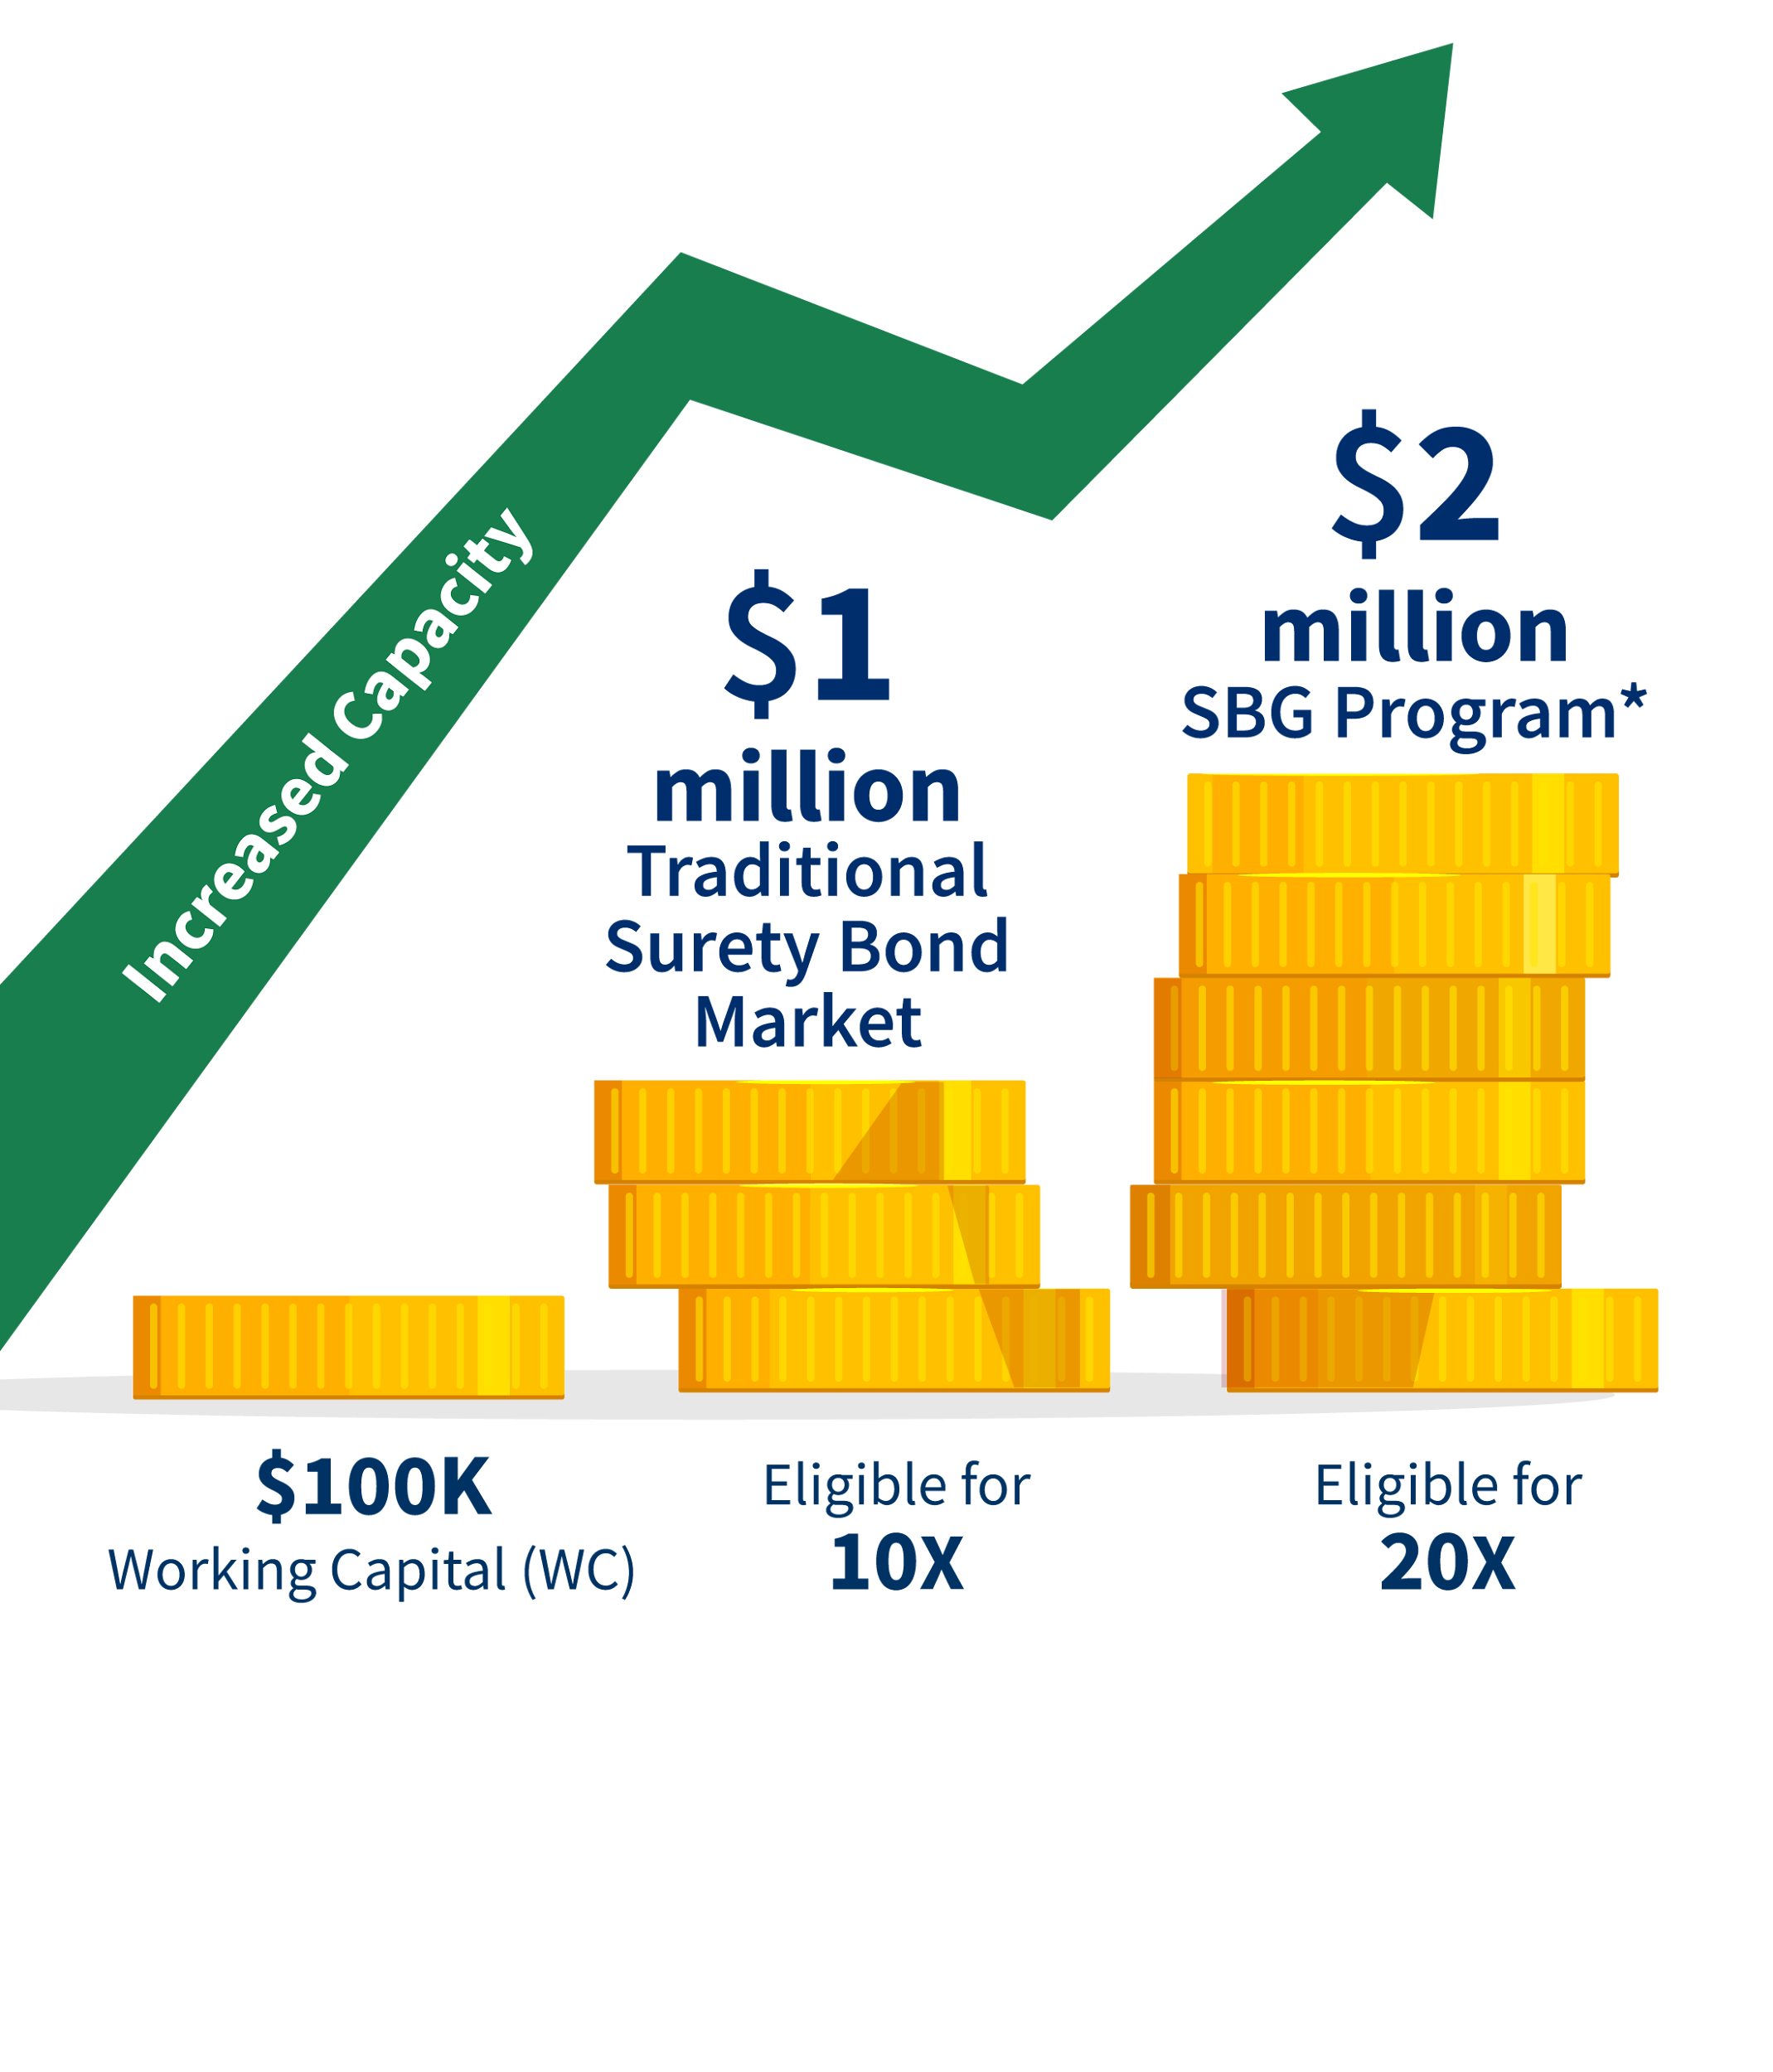
Benefits of SBA guaranteed bonds
  Working capital requirement is about half what is normally required for contract surety bonds.
  We count the unused portion of bank lines of credit (BLOC) as working capital.

Slide 10

Other program benefits
Lower working capital requirements allow small
businesses to qualify for
up to twice as much
bonding capacity.
Available balance on bank lines of credit (BLOC) counted towards working capital requirements.
Bond guarantees may
be available on larger projects with internal financial statements.

Slide 11

Vera Hall, Small Business Owner
“The ability to get this type of bonding through the SBA’s Surety Bond Guarantee program allows you as a small business owner to realistically compete with larger corporations for contracts that you want and need to grow your business.”
Let the SBG Program help your business grow.

Slide 12

A fast and user-friendly program
• Up-to-date technology • Experienced and professional staff • Online application process

Slide 13
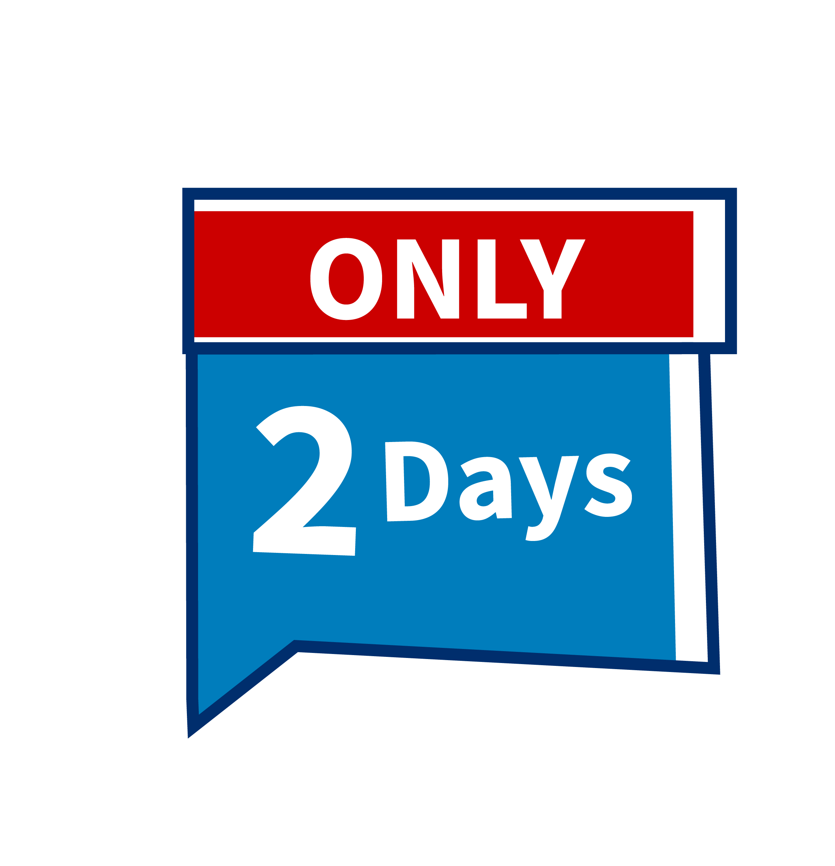
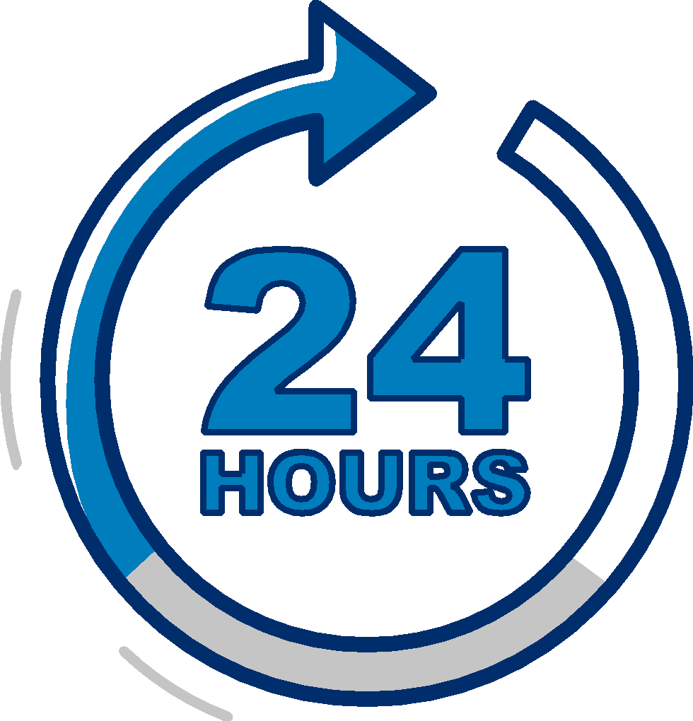
Prior Approval Program and QuickApp =
Fast decisions to meet your needs
Prior approval program delivers underwriting decisions in 2 days.
QuickApp decisions within 24 hours on bonds of $500,000 or less.

Slide 14

Bonds the SBA guarantees
A variety of bond types and amounts:
1
Bid
2
Performance
3
Payment
4
Maintenance
For each government and private sector
contract up to $9 million.
For each direct federal contract,
the limit is $14 million.

Slide 15

Program qualifications for small businesses
Categorized as a small business based on:
Average annual revenues
for construction, service
and supply firms
Average number of employees for manufacturers
Other requirements
Be current on public debts, taxes and repayment agreements
Pass underwriting standards

Slide 16

To qualify, small businesses must:
Possess good character
Need a bond that
business is unable to
obtain elsewhere
Be a U.S.-based, for-
profit business with legal resident owners
Be eligible to do business
with the federal government
Not be involved in
a current bankruptcy proceeding

Slide 17

Typical surety bond fees
Bid bond guarantee fees
are never charged by the SBA.
Contractor’s fee
0.6% of the contract amount paid to SBA for the guarantee.
Surety premium
is a charge paid to the surety company for the bond.

Slide 18





















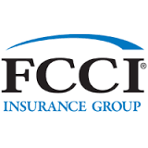


SBG Program Surety Partners
UC&S

Slide 19


Find an SBA-authorized surety agent
Visit
sba.gov/osg

Slide 20
Thank you!
Any questions?

