Slide 1

Sievo Informational Presentation for GSA Acquisition Policy Federal Advisory Committee.
One path to simplification with Sievo

Slide 2





Introduction of Sievo
Ossi Karali
VP, Sales
Ilona Kivimäki
Sustainability Sales Executive, Global
Presenter

Slide 3








Accolades
360+
Employees
150+
Customers
25+
Carbon Analytics Customers
$44M
Capital raised in 2022
Sustained Revenue growth (M€)
World Procurement Awards
Procurement Technology
(2023 Overall Winner)
turn procurement data into $ and ESG impact
NPS > 96% ; Beat 10/ 10 spend analytics benchmarks
Ranked #1 in Carbon analytics
the leading procurement analytics solution
Procurement Providers to Know (2017 – 2022)​
software, services & content
Bootstrapped growth
Kearny Top 100
ProcureTech (2021-22)

Slide 4




















Sievo has proven delivery capabilities for 150+ large global clients

Slide 5



THE URGENCY OF MEETING SUSTAINABILITY TARGETS
1
Time Perspective
Imminent Deadlines
Regulatory Pressure
Every 5 weeks represents 1% of the decade, underscoring the urgency of our actions*
2025 & 2030 sustainability targets are rapidly approaching, demanding immediate action
Increasing global regulation on sustainability heightens the need for compliance and proactivity
*Science Based Targets Initiative, 2023
Confidential © Sievo

Slide 6
"Procurement teams face the daunting task of balancing traditional responsibilities, sustainability targets, and regulatory compliance, using existing resources."
– Head of group procurement
Confidential © Sievo

Slide 7

Journey to Net Zero
Parallel Streams
Improved Scope 3 Measurement
Alignment with suppliers
Collaboration and Innovation with suppliers to reduce emissions

Slide 8




















Combining data from any source the customers need.
INTERNAL DATA SOURCES
3RD PARTY DATA PROVIDERS
Ability to focus on actions that matter.
Unified calculations
& vizualization
Monthly automated data gathering
Upstream activity data
CO2 emission & sustainability data
Automated mappings
Holistic view into emissions
Supplier specific or custom data
Full data transparency and ownership
Emission insights to take action.

Slide 9






Engaging cross-functional collaboration to speed up progress
Case study
A multinational pharmaceutical company headquartered in London, UK
with 2,5+ billion USD revenue.
Operates 32 manufacturing facilities in 10 countries, and 8 800+ employees wordwide.
“We wanted one solution that would be updated automatically, ensuring efforts would be focused on driving sustainable change rather than on data mapping processes.”
“Having our GHG emission data accessible at our fingertips is a key differentiator and will accelerate our objective to reduce our impact on the environment.”
– Francois Rousselot
Group Head of Procurement
C-level executives check key KPIs and keep track of real progress over time
Category managers have the information to negotiate with suppliers
Sustainability personnel
use verified numbers directly for reporting
Confidential © Sievo
Read full case study here.

Slide 10
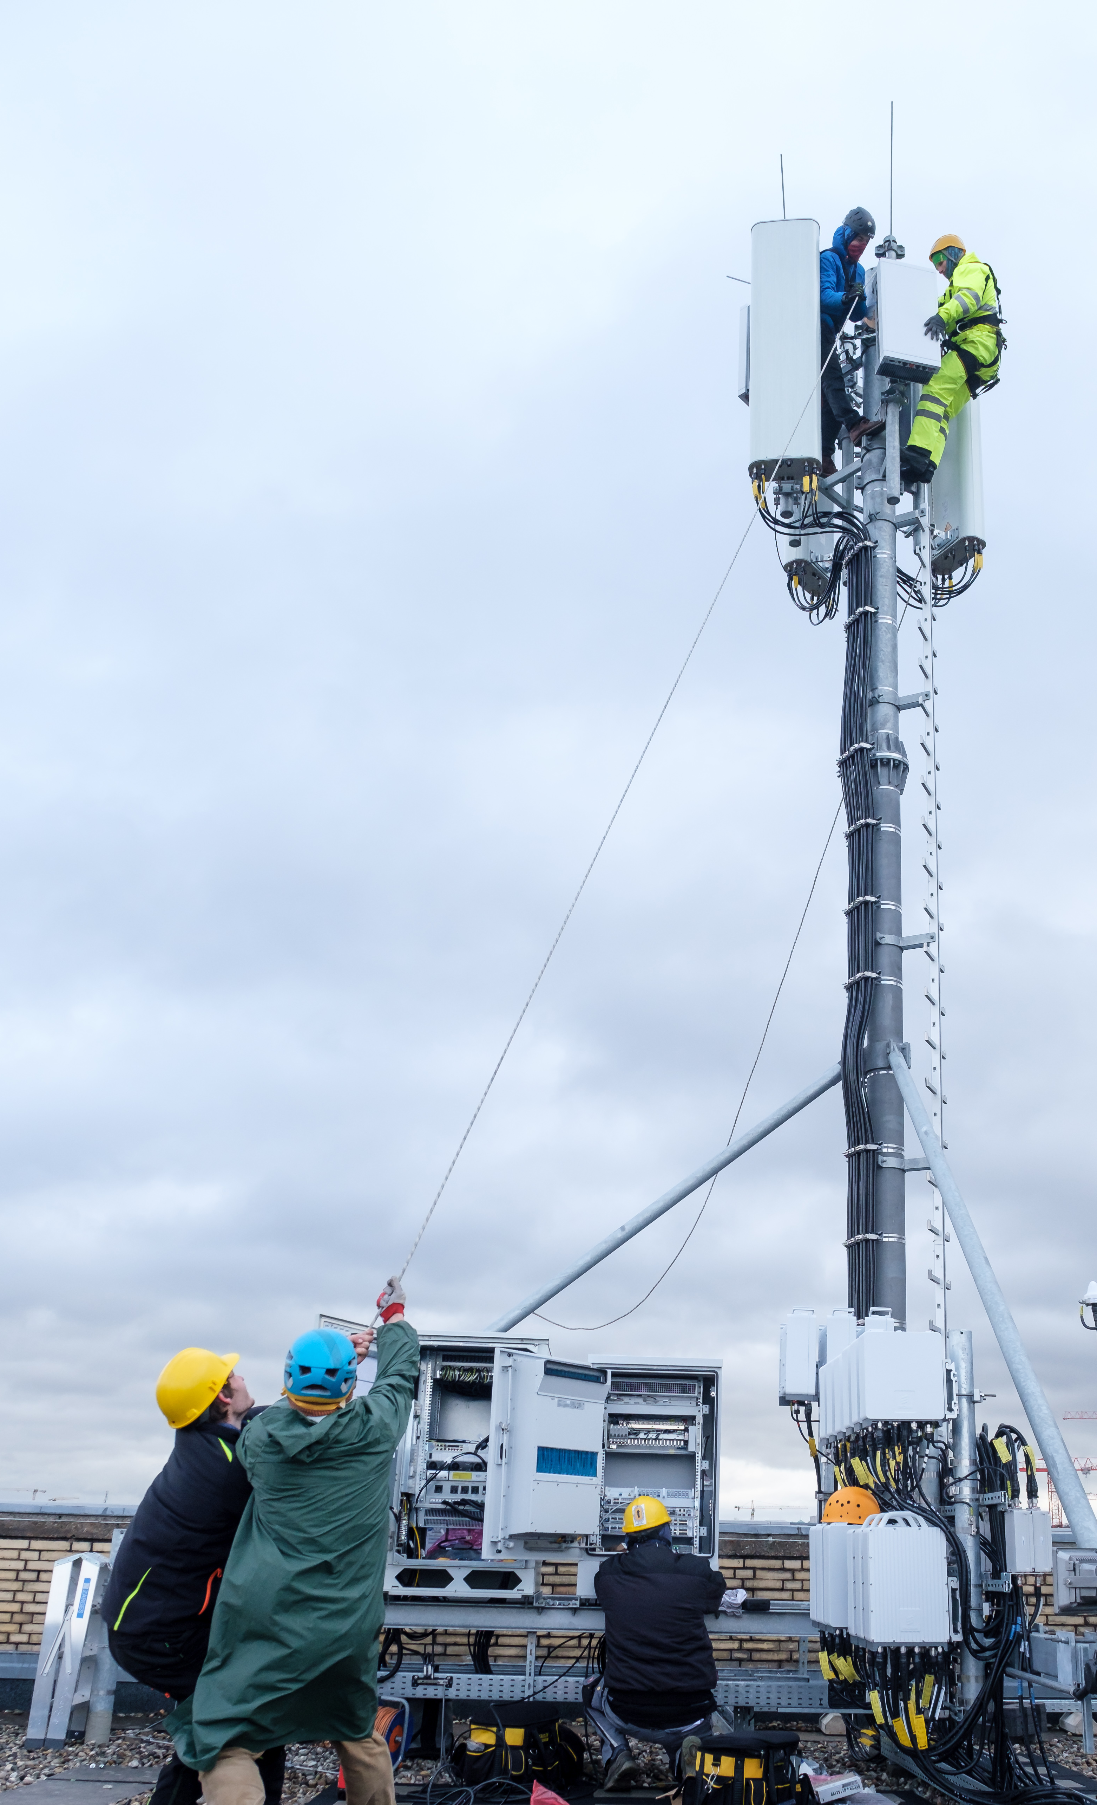


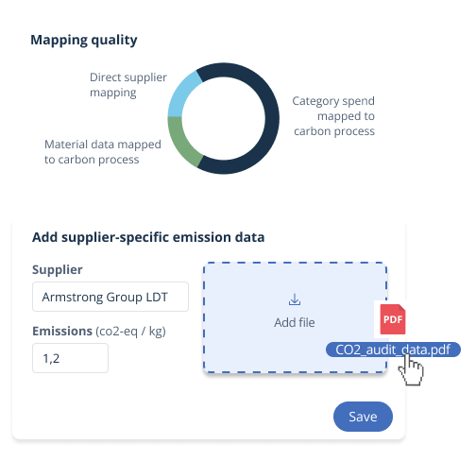

Prioritizing supplier-specific data to follow emission reductions
Case study
Global telco organization headquartered in Bonn, Germany with 108+ billion EUR revenue.
Present in 50+ countries, 240+ million customers and 200 000+ employees worldwide.
Deutsche Telekom
Track suppliers’ CDP responses
Prioritizing CDP figures over average emission factors
Follow suppliers’ net zero targets
To give high emission intensity companies a chance in negotiations if they have ambitious targets
Confidential © Sievo
Watch the solution presentation here.
Password: Jaxu

Slide 11
Results achieved:
Deutsche Telekom got one single source of Scope 3 emissions truth, with weekly automated data extraction, enrichment and emission mapping.
175B+ USD spend from 30+ data sources mapped to carbon data.
500+ users have direct access to the system & actionable data. Monthly, 2000+ loggins by their Procurement, Sustainability and Finance teams.
Holistic view into Scope 3 emissions with drill down ability to their 5-level taxonomy (total of 521 categories).
Automatically calculated carbon footprint of their supply chain via multiple different emission calculation methods, including spend-based calculations, primary supplier data and supplier information from CDP.
Carbon emissions became Deutsche Telekom’s second currency.
Confidential © Sievo

Slide 12
Ilona Kivimäki
Ilona.kivimaki@sievo.com
+358 44 0432 462

