Slide 1
We Know Government Contract Accounting

Slide 2

The Importance of Having Cost Accounting Systems in Federal Contracts

Slide 3
Who We Are

Slide 4
Our Practice Areas
Operational Support
Monthly Accounting Packages
Indirect Rate Calculations
Incurred Cost Proposals
Advisory Services
CFO & Controller Services
Audit Prep & Remediation
SF 1408 Gap Analysis
Software & Tools
Accounting Systems
Process Templates
Training
We provide no-cost and low-cost training opportunities, both in person and online.

Slide 5
Our Team

Slide 6
Learning Objectives
Recognize the need for an adequate or approved accounting system
List the criteria for an adequate accounting system
Describe the components of an accounting system
Explain some best practices for successfully passing the survey/audit

Slide 7
Poll Question 1
Which best describes your current accounting system?
  What’s an accounting system?
  We keep everything in excel.
  We’ve been looking at accounting systems and need help.
  We have an adequate accounting system in place.
Notes:
A. They are scalable

Slide 8

The Importance of Having Cost Accounting Systems in Federal Contracts

Slide 9
The Importance of
Having Cost Accounting Systems in Federal Contracts Part 1
Small Business Innovation Research/
Small Business Technology Transfer (SBIR/STTR) Phase II
Phase II usually awarded to a cost-type contract.
https://www.sbir.gov/tutorials/accounting-finance/

Slide 10
The Importance of
Having Cost Accounting Systems in Federal Contracts, Continued…
Cost-reimbursable contracts*
These include:
Cost-Plus Fixed Fee (CPFF)
Cost-Plus Award Fee (CPAF)
Cost-Plus Incentive Fee (CPIF)
Cost-Sharing Contracts
https://www.acquisition.gov/far/16.104

Slide 11
The Importance of
Having Cost Accounting Systems in Federal Contracts, Continued… Part 2
Cost-reimbursable contracts*, continued…
Time and Material (T&M) Contracts* (if the contract has any “M”)
Fixed-Price with Progress Payments
  https://www.acquisition.gov/far/part-52#FAR_52_232_16
  Fixed-Price with Prospective or Retroactive Price Redetermination
  https://www.acquisition.gov/far/part-16#FAR_16_205_3
  *These can be at the prime or subcontractor level.

Slide 12
The Importance of
Having Cost Accounting Systems in Federal Contracts, Continued…Part 3
Cost-reimbursable contracts*, continued…
Fixed-Price Incentive (Firm Target)
https://www.acquisition.gov/far/16.403-1
Multiple Award Contract (MAC) or Government-Wide Acquisition Contract (GWAC) where cost-type awards are contemplated or expected, even if you never receive a cost-type award.
https://georgewbush-whitehouse.archives.gov/omb/procurement/interagency_acq/best_practices_multiple_award_task_contracting.html

Slide 13
Poll Question 2
Cost-reimbursable contracts include all the following except?
A. Cost-Plus Fixed Fee (CPFF)
B. Cost-Plus Award Fee (CPAF)
C. Labor Hour (LH)
D. Cost-Plus Incentive Fee (CPIF)
Notes:
A. They are scalable

Slide 14

List the Criteria for an Adequate System

Slide 15

1. Is the accounting system in accord with GAAP?
Government contractors must comply with GAAP. Includes accrual-based accounting as evidenced by items such as Accounts Receivable and Accounts Payable.

Slide 16
2. Does the accounting system provide for: Part a
Proper segregation of direct and indirect costs?
  Direct – costs attributable to a final cost objective (e.g. contract)
  Indirect – costs attributable to more than one final cost objective (overhead) or to the business as a whole (G&A).
  Must consider CAS 402.

Slide 17

2. Does the accounting system provide for: Part b
Identification and accumulation of direct costs by contract?
  Costs incurred for a specific contract must be assigned to the contract.

Slide 18
2. Does the accounting system provide for: Part c
A logical and consistent method for the allocation of indirect costs to intermediate and final cost objectives?
  A logical “causal-beneficial” relationship such as Fringe costs allocated over all W-2 labor.

Slide 19

2. Does the accounting system provide for: Part d
Accumulation of costs under general ledger control?
  General ledger control means subledgers that tie to the general ledger and include appropriate internal controls.

Slide 20
2. Does the accounting system provide for: Part e
A timekeeping system that identifies employees’ labor by intermediate or final cost objective?
  Labor is the number one expense of most companies and the biggest expense to the Government, so they want to make sure you get it right.
  We recommend a streamlined approach of jobs or projects for all timekeeping including paid absences.

Slide 21
Poll Question 3
The accounting system must be in compliance with GAAP?
  True
  False
Notes:
A. They are scalable

Slide 22
2. Does the accounting system provide for: Part f
A labor distribution system that charges direct and indirect labor to the appropriate cost objective?
    This means allocating labor dollars throughout the G/L instead of into a single G/L account.
    And includes allocation of dollars across jobs, both direct and indirect.

Slide 23

2. Does the accounting system provide for: Part g
Interim (at least monthly) determination of costs charged to a contract through routine posting of books?
  Are you closing and reconciling books monthly?

Slide 24
2. Does the accounting system provide for: Part h
Exclusion from costs charged to government contracts of amounts which are not allowable in terms of FAR 31, Contract Cost Principles and Procedures, or other contract provisions?
  Written policies & procedures for unallowable costs including-
  Timekeeping
  Expense reporting
  Purchasing
G/L account
Proper rate calculations
Must consider CAS 405.

Slide 25
2. Does the accounting system provide for: Part i
Identification of costs by contract line item (CLIN/SLIN) and by units (as if each unit or line item were a separate contract) if required by the proposed contract?
  Take job costing to the next level: costing at the task level.

Slide 26
Poll Question 4
Written policies for unallowable costs include:
  Timekeeping
  Expense Reporting
  Purchasing
  All of the above
Notes:
A. They are scalable

Slide 27

2. Does the accounting system provide for: Part j
Segregation of preproduction costs from production costs?
  Preproduction costs are often specifically excluded from a contract, usually by way of the period of performance (POP).

Slide 28
3. Does the accounting system provide financial information:
Required by contract clauses concerning limitation of cost (FAR 52.232-20), limitation of funds (FAR 52.232-22), or limitation of payments (FAR 52.216-26).
  Do any of your contracts include any of these clauses?
  https://www.acquisition.gov/far/52.232-20
  https://www.acquisition.gov/far/52.232-22
  https://www.acquisition.gov/far/52.216-26

Slide 29

3. Does the accounting system provide financial information:
Required to support request for progress payments.
  https://www.acquisition.gov/far/52.232-16

Slide 30

4. Is the accounting system, and are the records maintained in such a manner that adequate, reliable data are developed for use in pricing follow-on acquisitions?
The Government wants to know you have the appropriate data to bid additional contracts.

Slide 31

5. Is the accounting system currently in full operation?
If not, explain why and when the items will be in full operation.

Slide 32
Poll Question 5
How often should books be closed and reconciled?
  Weekly
  Monthly
  Quarterly
  Annually
Notes:
A. They are scalable

Slide 33
Describe the Components of an Adequate
Accounting System

Slide 34
Components of Accounting System
Software (including apps, tools, files, worksheets, etc.)
  General Ledger
  Timekeeping
  Expense Reporting
  Payroll
  Indirect Rate Calculator
Policies and Procedures

Slide 35
Myths
DCAA approves accounting systems.
FALSE
DCAA (or any CPA or auditor) provides a report to the contracting officer who makes the final determination.

Slide 36
Myths
I can only use DCAA approved software.
FALSE
DCAA does not approve any software. No vendor can claim guaranteed DCAA compliance, acceptance, or approval. Each contractor's system evaluated on its own.

Slide 37

Facts
No software is guaranteed to be DCAA-compliant
Any software can be DCAA-compliant
It’s all in the P&P, configuration and operation of the software/system

Slide 38
Poll Question 6
Which of the following statements is true?
A. No software is guaranteed to be DCAA-compliant
B. Any software can be DCAA-compliant
C. DCAA approves accounting systems
D. Both A & B
Notes:
A. They are scalable

Slide 39
Explain Best Practices for Passing the Survey/Audit

Slide 40

Three Steps
1. Say What You Do
2. Do What You Say
3. Have Evidence to Prove It

Slide 41

Say What You Do
Written policies and procedures (P&P)
Reviewed and updated at least annually

Slide 42
Do What You Say
Work/desktop instructions
Software
Apps
Tools or Files
An auditor will observe certain processes to ensure you follow the P&P.

Slide 43
Have Evidence to Prove It
Records, reports, receipts
While not a formal audit, they will look at some transactional history to validate proper execution of P&P
Start early – even before you need an “approved” system
Even if you’re new to government contracts, you can lay the foundation and build on it as you grow
Complete the checklist – and gather all your supporting documentation
Hire an outsider – to help you prepare and perform a mock audit
Find someone who knows the process

Slide 44
Poll Question 7
Mock audits should be performed by?
A. Internal accounting department
B. Internal finance department
C. An outsider
D. The government
Notes:
A. They are scalable

Slide 45

Obtaining an Adequate (“Approved”)
Accounting System
An adequate (aka “approved”) accounting system meets the 15 requirements outlined in SF1408. An adequate accounting system is more than a Federal Acquisition Regulation (FAR) requirement for certain contract types, it helps you understand your costs and positions you for financial success.

Slide 46
CONNECT WITH US

Slide 47
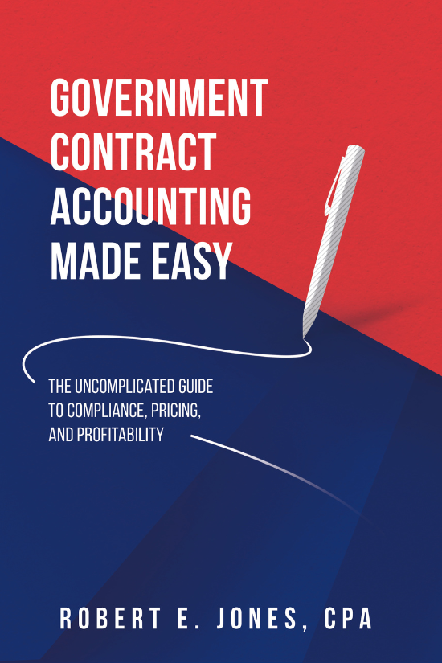
Upcoming Book Launch – October 4th at 9 am PDT
No need to struggle with government contract accounting.
Get step-by-step guidance with
"Government Contract Accounting Made Easy.”
Learn how to stay compliant and efficient.
Available October 4th at 9:00 AM PDT.
https://www.leftbrainpro.com/publications/

Slide 48
Discussion and Q&A slide

