Slide 1
U.S. Department of Transportation
Office of Small and Disadvantaged Business Utilization (OSDBU)
GSA & USDOT OSDBU Navigating Bonding
October 24, 2024

Slide 2
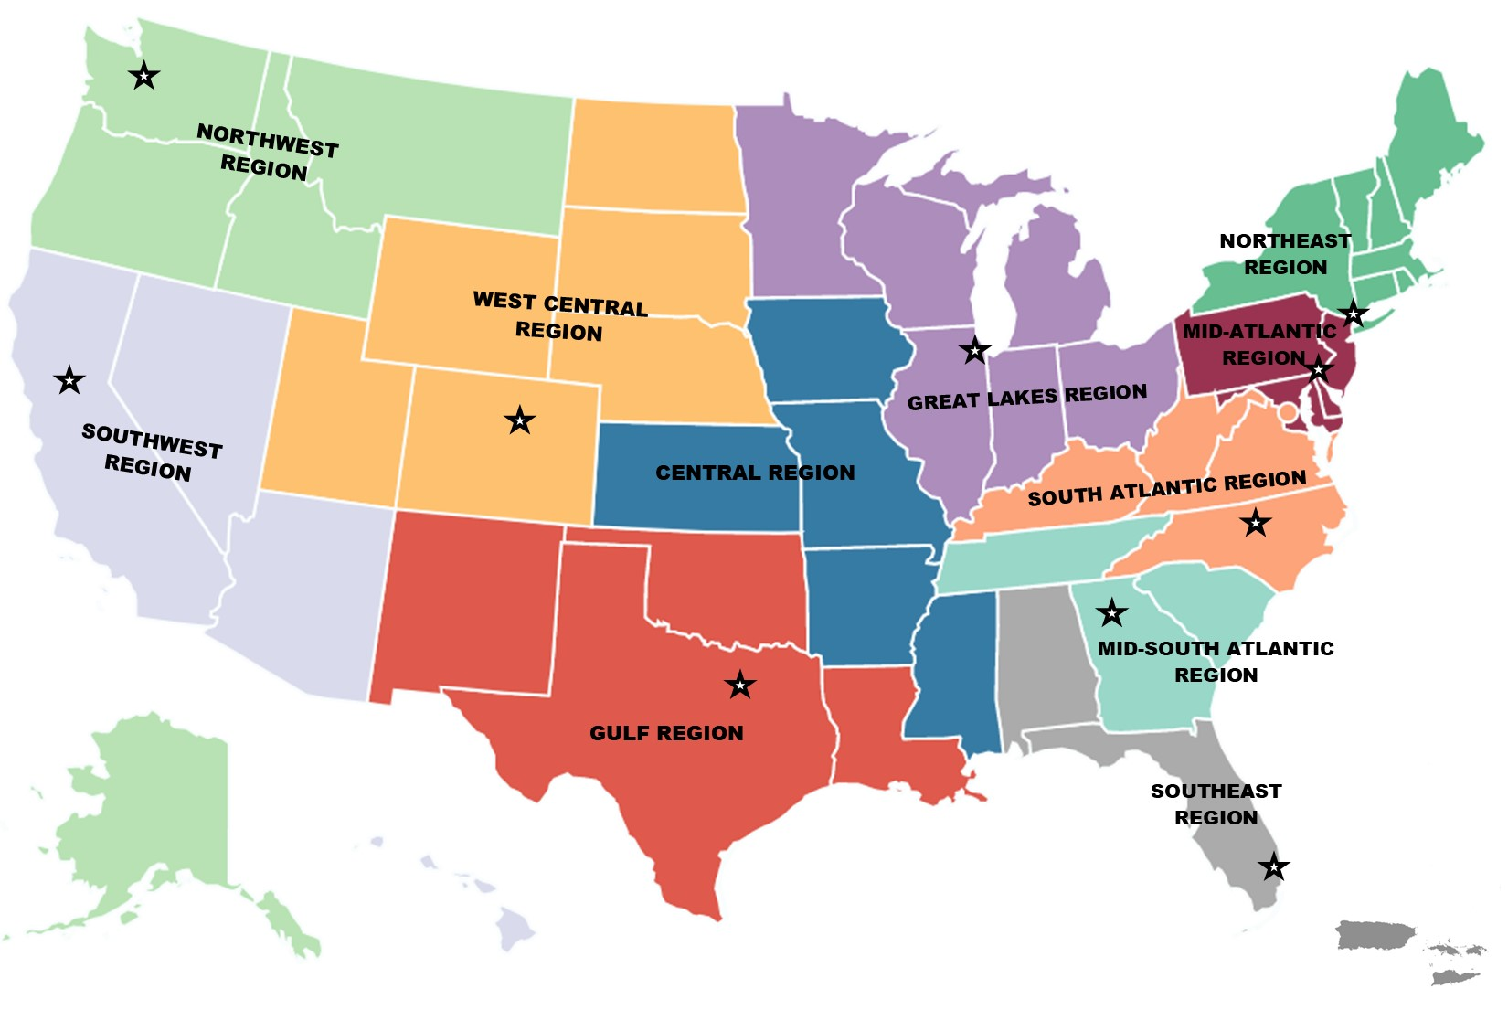
Small Business Transportation Resource Centers (SBTRCs)
Free business counseling and technical assistance
Provide U.S. DOT programming
Foster key regional relationships
11 regional centers

Slide 3
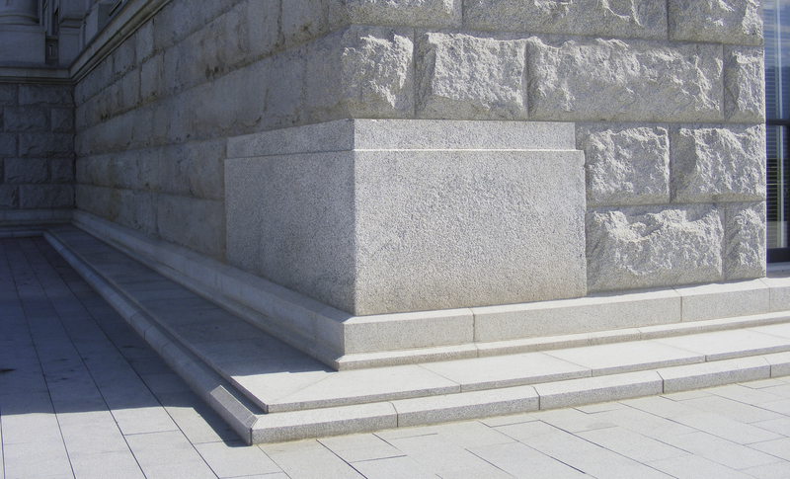
A Cornerstone of SBTRC Technical Services
The Bonding Education Program is often the entry point to our regional centers.
Bonding is a challenge for small and disadvantaged businesses.
Bonding can also help determine the trajectory of small business success in the transportation industry.

Slide 4

Slide title
U.S. DOT Bonding Education Program (BEP) Mission
To increase small businesses’ economic competitiveness to maximize opportunities by becoming surety bonded and compete for transportation-related contracts through education and resources to understand risk management, safety, workforce development and company capabilities.

Slide 5
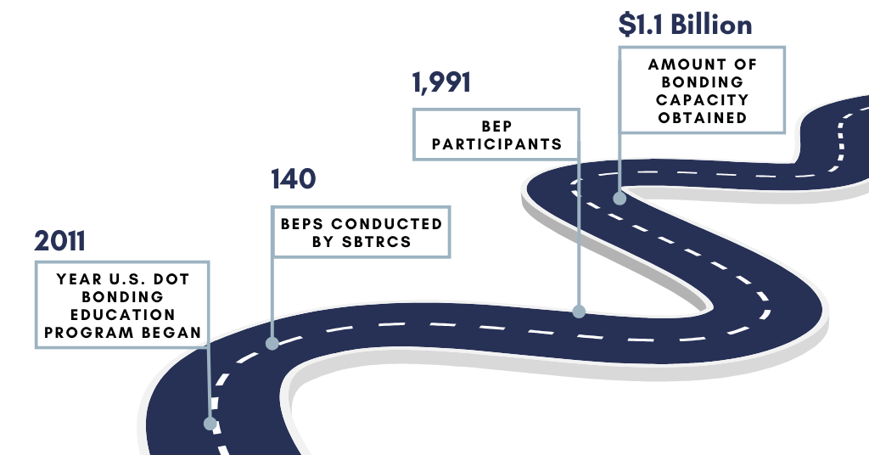
BEP Through the Years

Slide 6

Bonding Education Program (BEP)
Educational Workshops
Bond Readiness
Follow-Up Technical Assistance
Regional Projects and Stakeholders

Slide 7
BEP Eligibility Requirements
Have one of the following certifications/designations:
  Small Businesses
  DBE
  HUBZone
  SDB
  Service-Disabled Veteran Owned Business
  Veteran Owned Small Business
  Women Owned Small Business
  8(a)
  *Consultants, developers and engineering firms are not eligible for the program

Slide 8
BEP Eligibility Requirements
Existing business for at least 2 consecutive years
Revenue of at least $200,000 annually
Have a minimum of (2) full time employees (including owner)
Past performance in construction industry
Pursuing transportation-related contracts
Interested in satisfying credit, capacity, and character evaluations in consultation with surety reps

Slide 9
Example Previous BEPs
REGION PROJECT
Central Missouri/I-70 & Lambert Airport
Gulf Houston, TX
Great Lakes Michigan/Gordie Howe International Bridge Project
Mid Atlantic Philadelphia/30th Street Amtrak Train Station
Mid-South Atlantic Nashville/Metropolitan Nashville Airport
Northeast John F. Kennedy International Airport
Northwest Alaska
South Atlantic Hampton Roads Bridge Tunnel
Southeast Tampa Interchange
Southwest Osage County Transportation
West Central Salt Lake City International Airport Reconstruction Project

Slide 10
Find Your State Infrastructure Projects
White House Releases Updated State Fact Sheets Highlighting the Impact of the Infrastructure Investment and Jobs Act Nationwide
Bipartisan Infrastructure Law Funding Opportunities | US Department of Transportation

Slide 11

Resources
Find your regional SBTRC: Small Business Transportation Resource Centers | US Department of Transportation
Learn more about the Bonding Education Program: Bonding Education Program | US Department of Transportation
OSDBU Homepage: www.transportation.gov/osdbu

Slide 12
fffffffff
Thank You!
Magen Elenz
Bonding Education Program Manager
Magen.Elenz@dot.gov
www.transportation.gov/osdbu

