Slide 1
Veterans Small Business Certification Program
“VetCert”
John Perkins
Director

Slide 2
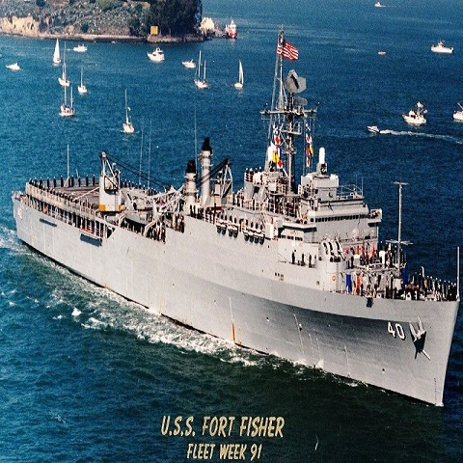
Another Sea Story

Slide 3
VetCert 2024 Legislative Updates
The National Defense Authorization Act of 2024 now requires that by December 22, 2024 all firms for subcontracting and for goaling purposes, must also be certified by SBA VetCert Program.
  Grace Period: Self certification for subcontracting and goaling purposes still allowed until December 22, 2024.
  Firms that apply before grace period ends will continue to have eligibility until VetCert makes a determination.
NDAA 2024 also increased federal wide set aside goal from 3% to 5% for Service-Disabled Veteran Owned Small Businesses
  2023 SDVOSB set aside Federal wide total was 31B. Up from 22B in FY 2022.
Notes:
MySBA
The SBA is developing a platform that will bring all certification, lending, and available resources under one integrated portal.

Slide 4
Application Paused (August 1st) and National Defense Authorization Act 2024
Question: How will the application pause during the upgrade period affect the NDAA 2024 mandate?
The National Defense Authorization Act (NDAA) 2024 requires self-certified SDVOSB and VOSB firms to be VetCert-qualified by December 22, 2024 to be eligible for Federal goaling and/or subcontracting credit.
Self-certified firms that apply through the SBA before December 22, 2024 can receive credit for federal goaling or subcontracting credit until SBA makes a final determination.
SBA’s certification upgrade period should not limit SDVOSB and VOSB firms from claiming federal goaling or subcontracting credit.
SDVOSB or VOSB must have submitted an application before December 22, 2024 to claim this credit.

Slide 5

Eligibility
To apply for certification as a VOSB or SDVOSB, a firm must meet the following requirements:
Owners identified by Veteran Affairs as a veteran and or service-disabled veteran
  Designation by Veteran Affairs Veteran Benefits Admin
  Guard and Reserve personnel without AD not eligible
Be considered a small business as defined by the size standard corresponding to any NAICS code listed in the business’s SAM profile (SAM registration required).
No less than 51 percent of the business owned and controlled by one or more veterans.
For certification as a SDVOSB, no less than 51 percent owned and controlled by one or more service-disabled veterans. For those veterans who are permanently and totally disabled and unable to manage the daily business operations, the spouse or permanent caregiver qualifies.

Slide 6
Veteran Qualifying Status: The Law.
Veteran Status means Active Duty as defined by the Veteran Affairs- Veteran Benefits Administration (VA VBA). Law states:
38 U.S.C. § 101(21) provides:
The term “active duty” means—
(A) full-time duty in the Armed Forces, other than active duty for training;
(B) full-time duty (other than for training purposes) as a commissioned officer of the Regular or Reserve Corps of the Public Health Service (i) on or after July 29, 1945, or (ii) before that date under circumstances affording entitlement to “full military benefits” or (iii) at any time, for the purposes of chapter 13 of this title;
Means Military time that has only training and or Guard and Reserve component time without Active duty time does not qualify for this program.

Slide 7

How Does a Business Prepare for Application?
Step 1: Determine eligibility.
The business owner must be a veteran or a service-disabled veteran as established in Title 38 CFR Part 74 or 13 CFR Part 128.
Be considered a small business as defined by the size standard corresponding to at least one NAICS code listed in the business’s SAM.gov profile.
No less than 51 percent of the business must be owned and controlled by one or more veterans.
For certification as a SDVOSB, no less than 51 percent of the business must be owned and controlled by one or more veterans rated as service-disabled by VA.
For those veterans who are permanently and totally disabled and unable to manage the daily business operations of their business, their business may still qualify for certification as an SDVOSB if their spouse or appointed permanent caregiver is assisting in that management.
Step 2: Ensure registration in SAM.gov. The business MUST be registered in SAM.gov to move forward.
Step 3: Gather required documentation before beginning the application.
Notes:
A list of required documentation is available on sba.gov/vetcert: Preparing for SBA Veteran Small Business Certification

Slide 8
Documents by Business Type
LLC
  Copy of filed Articles of Organization, or equivalent, including all amendments
  Copy of Certificate, or equivalent, showing filing
  Operating Agreement, including all amendments
  Minutes demonstrating or establishing the current operating practices. When signed and dated, these legally serve as evidence of important actions such as:
    Election or appointments of officers
    Adoption/implementation of bylaws or operating agreements
    Business decisions
    Voting
Corporation
  Copy of filed Articles of Incorporation, or equivalent, including all amendments
  By-laws: All corporate by-laws and all amendments, signed and dated as of their effective date
  Certificate, or equivalent, showing corporation’s creation
  Shareholders Agreements, including all amendments
  Minutes demonstrating or establishing the current operating practices. When signed and dated, these legally serve as evidence of important actions such as:
    Election or appointments of officers
    Adoption/implementation of bylaws or operating agreements
    Business decisions
    Voting
  Copy of the most recent Stock Ledger adopted in the minutes or by resolution.

Slide 9
Ownership – Additional Details
Dividends & Distributions (13 CFR 128.202(g))– Qualifying veteran must be entitled to receive:
  51%+ of annual distribution of profits and the qualifying veteran *ability* to share in the profits of the concern must be commensurate with the extent of his/her ownership interest
  100 percent of the value of each share of stock if interest is sold
  51%+ of the retained earnings of the company and 100 percent of the unencumbered value of each share of stock/interest in the event of dissolution
Community property (13 CFR 128.202(h)) – calculated without regard to community property
Surviving spouse (13 CFR 128.202(i)) - qualifies if he/she acquires interest of the deceased service-disabled veteran
  Terminates if surviving spouse remarries or relinquishes ownership
  Terminates after 10 years if death was due to service-connected disability
  Terminates after 3 years if death was not resultant of service-connected disability

Slide 10
Ownership – Business Types
Partnership (13 CFR 128.202(c))
  51% of aggregate voting interest must be unconditionally owned by qualifying veteran
LLC (13 CFR 128.202(d))
  51% of each class of member interest must be unconditionally owned by qualifying veteran
Corporation (13 CFR 128.202(e))
  51% of aggregate of all stock outstanding and 51% of each class of voting stock must be held by qualifying veteran
  For publicly-owned business, there’s an exception about ESOP ownership

Slide 11
Control
General (128.203(a))
  Management & daily operations
  Long-term decision-making and day-to-day operations
Managerial position and experience (128.203(b))
  Highest Officer position as defined in business governing docs
  Managerial experience of the “extent and complexity needed to control the concern”
  *Not* technical expertise or directly holding professional licensing – must have ultimate managerial and supervisory control over those who do, though
Control over a Partnership (128.203(c))
  Veteran must have role as general partner(s)
Control over an LLC (128.203(d))
  Veteran must have role as managing member(s)

Slide 12
Control – Corporations (128.203(e))
Must control Board of Directors – examples:
  100% of all voting stock held by veteran & veteran is on BOD
  51% of voting stock held by a veteran & veteran is on BOD – no supermajority which cannot be overcome by veteran owner
  Two or more veterans together own 51% or more; each is on BOD, and the qualifying veteran(s) have enforceable agreements to permit one of the qualifying veterans to vote as a block without a shareholder meeting
    If a supermajority requirement, the percentage must exceed that threshold
If none of the above are the case, veterans must control the BOD through actual numbers of voting directors or through weighted voting
  Quorum requirements cannot yield circumstance of negative control where non-veteran owners can prevent corporate action by not showing up
  Executive committees with action authority must be controlled by veterans
  Nonvoting or advisory directors do not impact control

Slide 13
Non-Veteran Control
Elements that Lead to Potential Non-Compliance
A non-qualifying-Veteran may not:
  Exercise actual control or have the power to control the business
  Have a business relationship with the qualifying Veteran that causes undue influence or limits the Veteran’s ability to independently run the business
  Control the business through loan arrangements
  Provide critical financial support or a critical license that allows the non-qualifying-Veteran to influence business decisions
The following scenarios require the Veteran to provide additional explanation and may lead to a finding of non-Veteran control:
  Non-Veteran is a former or current employer of the qualifying Veteran
  Non-Veteran receives higher compensation that the qualifying Veteran
Examples of red flags for the above:
  Shared resources (equipment, personnel, etc.)
  Co-location
  Non-Veteran provides bonding or critical license
  Non-Veteran has all of the industry-related experience, education, and expertise
  Evidence of exclusive “pass-through” arrangements beyond allowable standards
Note: VetCert certifies regulatory compliance; we do not investigate fraud
VA cemetery contract example….

Slide 14
Control
Outside obligations (128.203(i))
  Highest officer may not have outside obligations that prevent veteran from devoting time and attention to the concern to control its daily operations and management
  Generally must devote full-time during business’s normal hours of operations, but as long as veteran has ultimate managerial and supervisory control over day to day management and long term decision making this can be deemed as control Provided:
  If fewer hours are given to the concern, SBA assumes lack of control but veteran can provide information demonstrating control
Exception for extraordinary circumstances (128.203(j))
  No finding of lack of control if unanimous consent is required to:
    Add new equity stakeholder
    Dissolve the company
    Sell the company or all the assets of the company
    Merge the company with another
    Declare bankruptcy
Exception for Active Duty (128.203(k))
  If reservist is called to duty, other individual must be appointed & docs provided to SBA

Slide 15

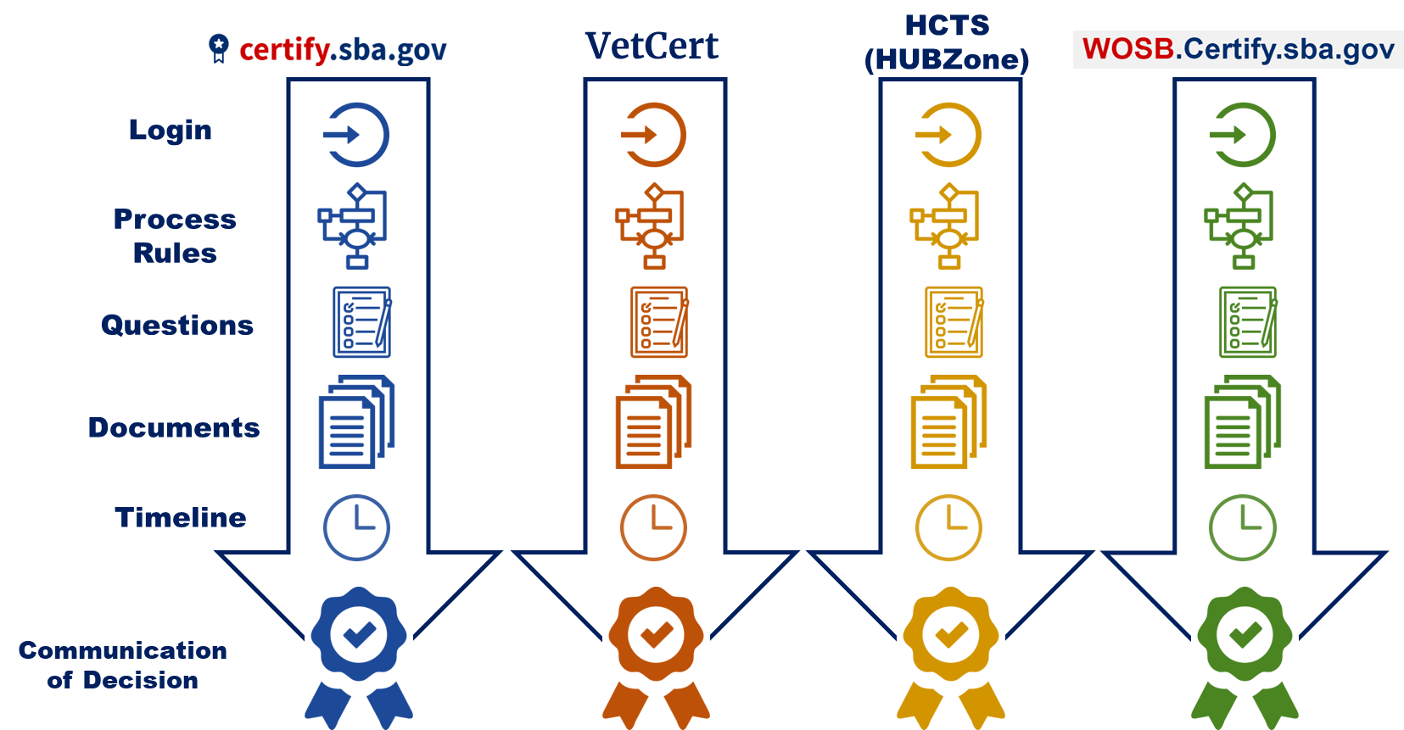
SBA Set-Aside Certifications Yesterday
OLD Customer Experience
Four different systems
Four different logins
Four processes with varying rules
Four sets of the same questions
Four sets of the same documents to upload
Four different processes and approval cycle times
Four different notification methods
Four different leadership teams for reviews/decisions
….and this is just for first application, it doesn’t address re-certification or changes to the business

Slide 16
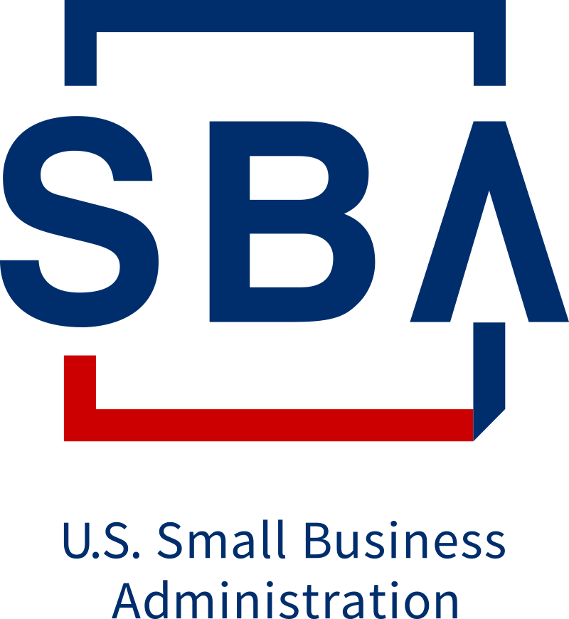

Future of SBA Certification
Vision
Eligible small businesses will more effectively compete in the federal marketplace by quickly accessing multiple set-aside program certifications through a simple unified system
SBA Certification Customer Experience
One log-in
One common application
One document repository
Common terminology
Common processing business rules
Common decision timeline
Streamlined, timely review process
Single portal customer service support
Same team processing all 4 certifications

Slide 17



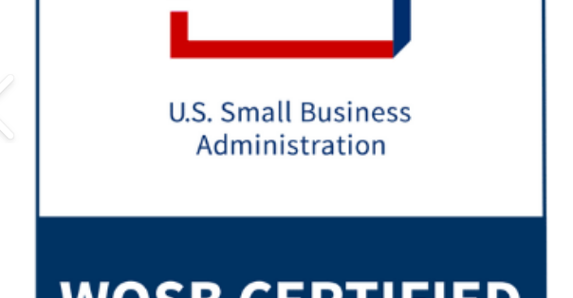
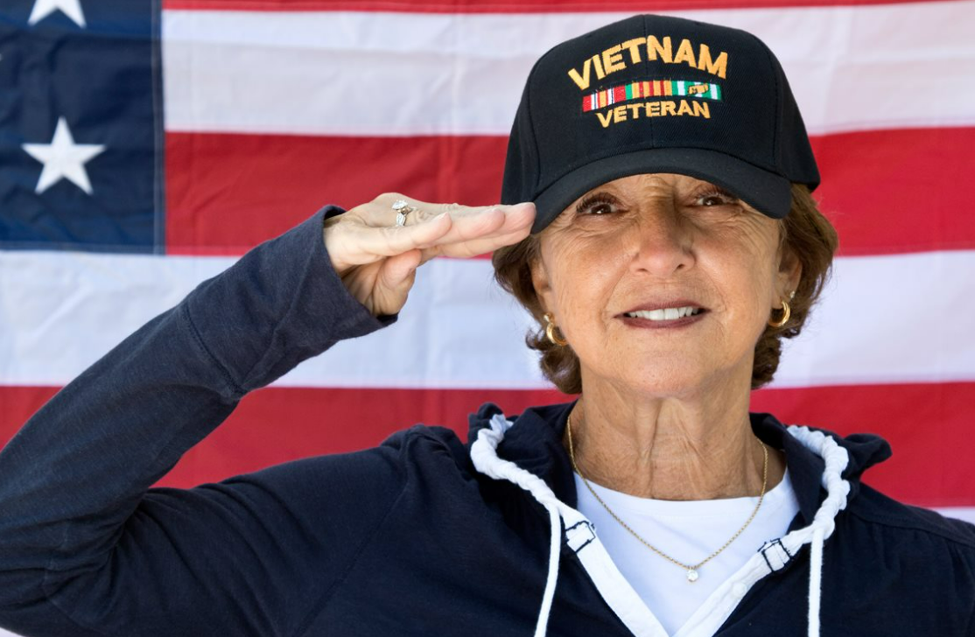

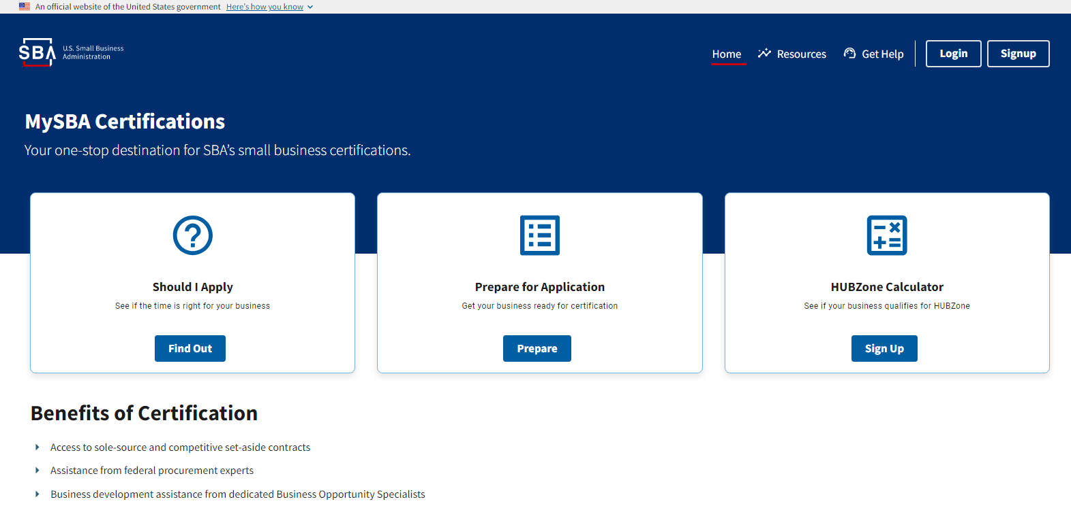
MySBA Certifications
https://certifications.sba.gov

Slide 18
Prepare Now for a Complete Application Submission
Ensure SAM.gov information is updated and accurate
The Qualified Owner initiates the application, add’l delegates and contributors can be added
Visit https://certifications.sba.gov and establish a login account
Complete the Application Questionnaire and upload supporting documents
Review the Prepare for Application link which provides a list of required documents
Review and submit!!

Slide 19
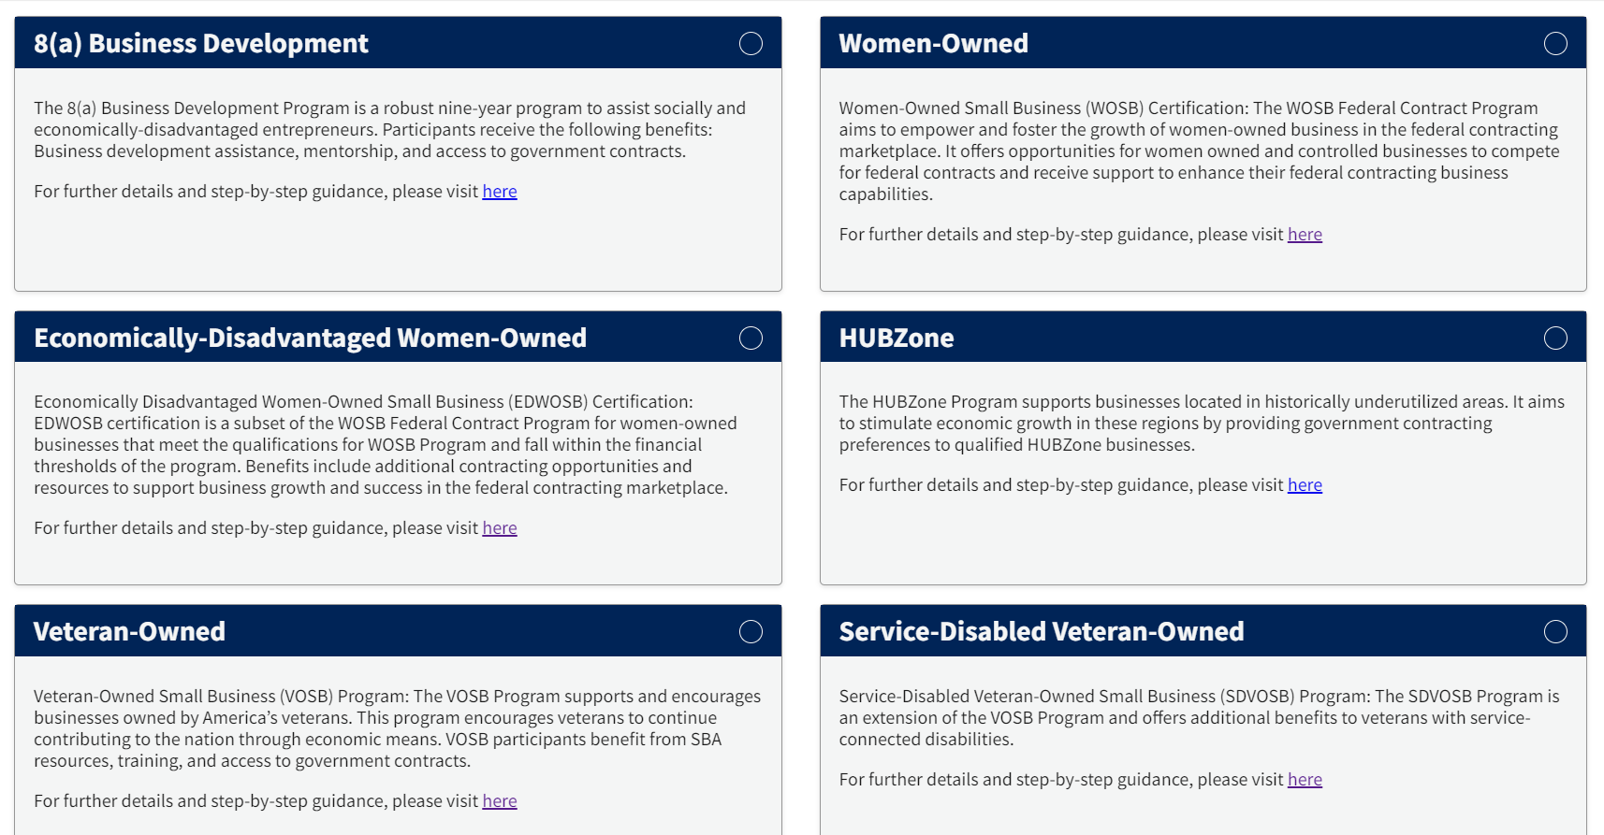
Eligible Program Selection
FIRM USER
NOTE: This page displays a list of programs the user is eligible for based on their answers in Ownership/Control Tables.

Slide 20
SBA Basic Certification Process Flow
Application Submission
Screening
Analysis
Decision
Applicant creates application and uploads required business documents
Owners upload required personal documents and sign required attestations
Screener validates basic eligibility requirements
Screener requests sent to applicants any documents that need to be sent prior to application phase
Analyst Confirms receipt of all required documents; requests clarifying information as needed
reviews entire application to assess regulatory compliance
Analyst reviews complex case fact patterns
initiates deficiency process as needed
All Analysts submit recommendation to approve, deny, or remove application
Federal Reviewer or Approver reviews’ final case documents.
Federal Reviewer or Approver makes final recommendation to approve or deny the application. Reviews and signs the final determination letter
Less documentation required then previous process
New software easy to navigate
Allows for reciprocal qualification with other SBA qualifying set aside programs.

Slide 21
SBA Verification Support Contacts
MySBA points of contact:
  1-866-443-4110
  email: certifications@sba.gov
  FAQ: FAQ - MySBA Certifications Knowledge Base - Confluence
  Certification Site: https://certifications.sba.gov/
  mailto:certifications@sba.gov
  Market Research: SBA - Dynamic Small Business Search

